Slide 1


12-13 mins
On the Structure of Address in Multi-Party Dialogue:
From Discrete Labels to Continuous Levels
5th August 2026
SIGDIAL 2026 in Atlanta, USA
Taiga Mori, Koji Inoue, Divesh Lala, Tatsuya Kawahara
Graduate School of Informatics, Kyoto University, Japan
Notes:
Good morning. My name is Taiga Mori, from Kyoto University.
The title of my talk is: On the Structure of Address in Multi-Party Dialogue: From Discrete Labels to Continuous Levels.
I am sorry, my English is not very good, so I put the key points on every slide. Please read them together with me.
Let us begin.
おはようございます。京都大学の森大我です。
発表タイトルは「On the Structure of Address in Multi-Party Dialogue: From Discrete Labels to Continuous Levels」です。
英語が得意ではないため、各スライドに要点を書いてあります。あわせてご覧ください。
では始めます。

Slide 2
Addressee Detection: The Standard Formulation
Prior work assumes address is DISCRETE: one label per utterance
Human–human–computer: binary — system, or another human?
Baba+ 2011; Shriberg+ 2012; Tsai+ 2015
Multi-party human dialogue: pick ONE label — A / B / C, or “group”
Jovanovic+ 2006; Ouchi & Tsuboi 2016; Gu+ 2021
Predicted after the turn ends — post-hoc, utterance level
Mainly an auxiliary task for turn-taking / response selection
1 / 14
Notes:
Most previous work treats addressee detection as a classification task.
In human-agent settings, the question is binary: is this utterance for the system, or for another human?
In multi-party human dialogue, the model picks one label: participant A, B, C, or the group.
Prediction is usually made after the turn is finished.
And addressee detection is usually only a sub-task for turn-taking.
従来研究のほとんどは、宛先推定を分類タスクとして扱ってきました。
人–人–システムの場面では、「システム宛てか、他の人間宛てか」の2値分類です。
多人数の人間対話では、A・B・C、または「全体」のうち一つのラベルを選びます。
予測は通常、ターンが終わった後に行われます。
そして宛先推定は、多くの場合 turn-taking の補助タスクでしかありません。

Slide 3
But Is Address Really Discrete?
RQ: Is address graded, and does it relate to listener behavior?
One utterance can address several listeners to different degrees
Under a single-label scheme, disagreement is discarded as noise
Address is modeled in isolation, apart from listener behavior
Prediction happens only after the turn is complete
2 / 14
Notes:
But is this assumption right?
Real dialogue is not always so simple. One utterance can address several listeners, with different strength.
Under a single-label scheme, when annotators disagree, we just call it noise and throw it away.
Also, address is usually studied alone. Its relation to listener behavior is rarely examined.
So our research question is: is address graded? And is it related to listener behavior?
しかしこの前提は正しいでしょうか。
実際の対話はそこまで単純ではなく、1つの発話が複数の聴者に異なる強さで向けられることがあります。
単一ラベルの枠組みでは、アノテータ間の不一致は単なる誤りとして捨てられます。
また宛先は単独でモデル化され、聴者行動との関係はほとんど検証されていません。
そこで本研究の問いは、宛先は段階的か、そして聴者行動と関係するか、です。

Slide 4
This Work: Three Contributions
Discrete label → continuous, per-listener address level
1. Evidence that address has graded structure
→ estimate it continuously, do not classify it
2. An operationalization: the address level
→ a latent value per listener, from categorical labels
3. It relates to turn-taking, gaze and backchannels
→ evidence for its validity
3 / 14
Notes:
This work makes three contributions.
First, we give empirical evidence that address has graded structure, so it should be estimated continuously, not classified.
Second, we propose an operationalization called address level: a latent continuous value for each listener, inferred from categorical annotations.
Third, we show that address level is related to turn-taking, listener gaze, and backchannels.
In short: from a discrete label to a continuous address level.
本研究の貢献は3つです。
第1に、宛先が段階的な構造を持つという経験的根拠を示し、分類でなく連続量の推定問題として再定式化します。
第2に、address level という操作化を提案します。カテゴリカルなアノテーションから、聴者ごとの潜在連続値を推定します。
第3に、address level が turn-taking・聴者の視線・あいづちと関連することを示します。
つまり、離散ラベルから連続的な address level へ、という話です。

Slide 5
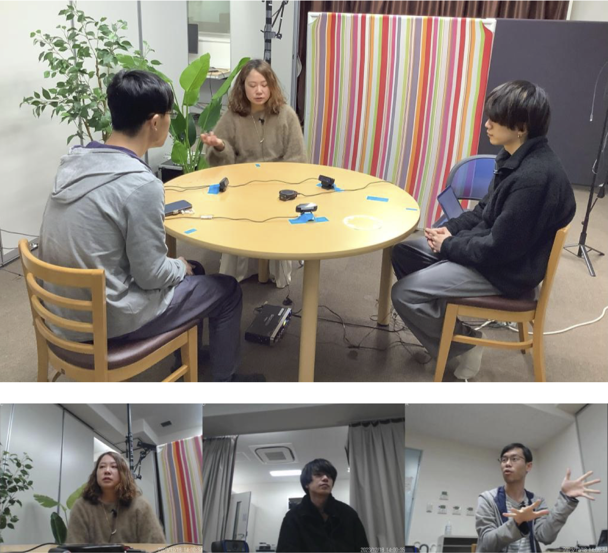
Dataset: Teidan Corpus
Teidan corpus: 36 Japanese triadic dialogues, 3,121 turns
12 groups × 3 topics
Total 3 h 38 min
86.7 turns per dialogue
Annotated: turns, backchannels, gaze
4 / 14
Notes:
We used the Teidan corpus from Inoue and colleagues, 2025.
It contains casual discussions in Japanese among groups of three lab members.
Twelve groups talked about three topics, so we have 36 dialogues, about three hours and forty minutes in total.
There are 3,121 turns. Turns, backchannels, and gaze are annotated by hand.
The three participants are called A, B, and C.
データは Inoue ら 2025 の対談コーパスを使いました。
同じ研究室の3名による日本語の雑談的な議詖です。
12グループ×3トピックで36対話、合計3時間38分ます。
ターン数は3,121。ターン、あいづち、視線が手作業で付与されています。
3名の参加者を A、B、C と呼びます。

Slide 6
Addressee Annotation
3 annotators, 8 labels — agreement is only moderate (κ = 0.52)
Label set from Kadota+ 2024
3,078 turns, 3 annotators each
Multimodal cues allowed
No information after the turn
Label | Meaning | Count
A | participant A | 1,932
B | participant B | 1,390
C | participant C | 1,751
E | everyone | 3,529
W | whoever | 334
N | none (monologue) | 247
O | other (outside) | 3
U | unknown | 48
5 / 14
Notes:
Each turn was given one of eight addressee labels, following Kadota and colleagues, 2024.
A, B, C mean one specific participant. E means everyone. W means whoever. N means nobody, so monologue. O means someone outside. U means unknown.
Three annotators labeled 3,078 turns independently. They could use multimodal cues, but not information after the turn.
On the right you see the counts. E is the most frequent label, more than 3,500.
Agreement was Fleiss kappa 0.52, which is moderate. So the annotation is consistent, but ambiguity clearly remains.
各ターンに、Kadota ら 2024 に基づく8種の宛先ラベルを付与しました。
A・B・C は特定の1名、E は全員、W は誰でも、N は誰でもない（独語）、O は参加者外、U は不明です。
3名のアノテータが3,078ターンを独立に付与しました。マルチモーダルな手がかりは使って良いが、当該ターンより後の情報は使わないよう指示しました。
右がラベルの頻度です。E が最も多く3,500以上です。
一致度は Fleissのκ = 0.52 で中程度。一定の一貫性はあるが、あいまいさも残っています。

Slide 7
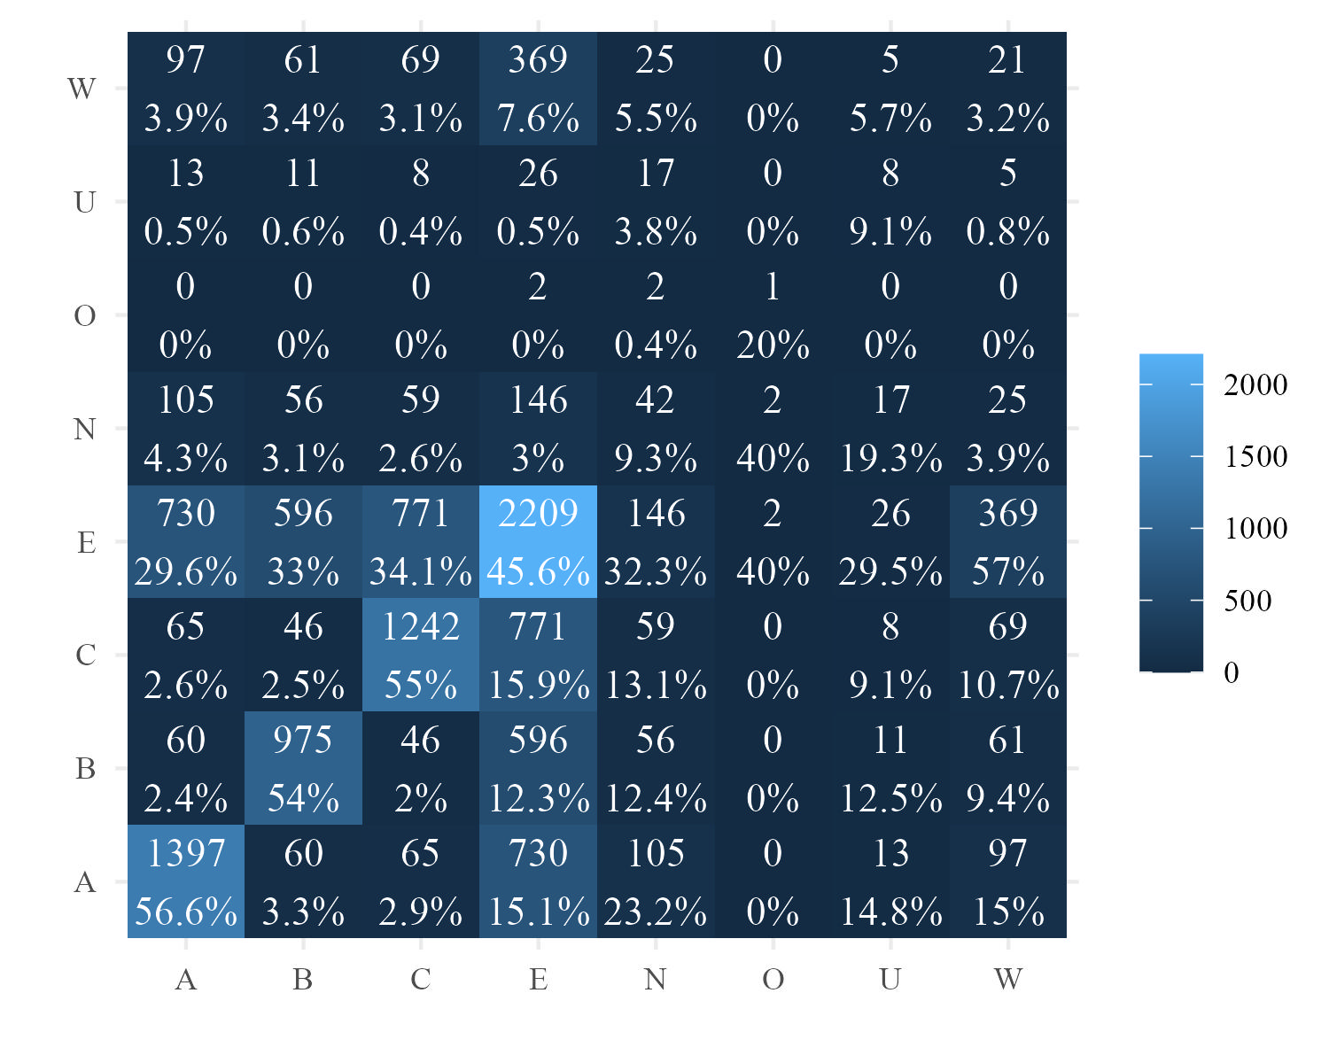
Annotators Disagree — Systematically
Individual vs. group is not a clean line: labels leak into E
A / B / C agree with themselves > 50%
2nd partner is always E (~30%)
E with itself 45.6%; A/B/C ~15%
W co-occurs with E, not with itself
6 / 14
Notes:
Next, which labels are ambiguous? This heatmap shows how often two labels co-occur on the same turn.
For A, B, and C, the most frequent partner is the same label, over 50 percent. So individual judgments are fairly stable.
But the second most frequent partner is always E, everyone, around 30 percent.
And for E, agreement with itself is 45.6 percent, while co-occurrence with A, B, or C is about 15 percent each.
W, whoever, co-occurs with E much more often than with itself.
So the boundary between addressing one person and addressing the group is not clean.
次に、どのラベルがあいまいかを見ます。このヒートマップは同じターンでラベル対が共起した回数です。
A・B・C は自己共起が50％以上で最も多く、個人宛ての判定は比較的安定しています。
しかし第2位は常に E（全員）で、約30％です。
E の自己共起は45.6％で、A・B・C との共起もそれぞれ約15％あります。
W（誰でも）は自己共起より E との共起がはるかに多いです。
つまり「個人宛て」と「全体宛て」の境界は明確ではありません。

Slide 8
Two Representations of Addressivity
The label gives 0 or 1; the level gives anything in between
Address LABEL — 0 or 1
Address LEVEL — 0 to 1
Merge W into E; drop U
Majority vote per turn
Listener or E → addressed; otherwise → not addressed
Latent θ ∈ (0, 1) per listener
Ideal points: L1 (1,0), L2 (0,1), E (1,1), N (0,0)
Pr = softmax( α − λ ‖θ − v‖² )
7 / 14
Notes:
We built two representations of addressivity.
On the left, the address label. This is the conventional discrete view. We merge W into E, drop U, and take a majority vote for each turn.
Then for each of the two listeners, if the majority label matches that listener, or is E, the listener is addressed. Otherwise not addressed. So the value is zero or one.
On the right, the address level. This is our proposal. For each listener in each turn we assume a latent value theta between zero and one.
Each label has an ideal point in this two-dimensional space. Listener one is one-zero, listener two is zero-one, everyone is one-one, and nobody is zero-zero.
The probability of an observed label is a softmax of minus the squared distance to the ideal point, plus an annotator bias term.
Note that E is one-one, not point-five point-five. We treat addressivity as directedness to each listener, not as a resource to divide.
We estimate the model with Bayesian sampling in Stan, and use the posterior median as the address level.
addressivity の表現を2通り作りました。
左は address label、従来の離散的な見方です。W を E に統合し、U を除外し、ターンごとに多数決を取ります。
2名の聴者のそれぞれについて、多数ラベルがその人か E なら addressed、それ以外なら not addressed。つまり0か1です。
右が提案する address level です。ターンと聴者の組み合わせごとに、0から1の潜在値 θ を仮定します。
各ラベルには2次元空間上の理想点を割り当てます。聴者1は(1,0)、聴者2は(0,1)、全員は(1,1)、誰でもないは(0,0)です。
観測ラベルの確率は、理想点との二乗距離にマイナスを付け、アノテータバイアスを加えた softmax です。
E を(0.5,0.5)でなく(1,1)としている点が重要です。addressivity を分配する資源でなく、聴者ごとの向けられとして扱うためです。
Stan でベイズ推定を行い、事後中央値を address level として使います。

Slide 9
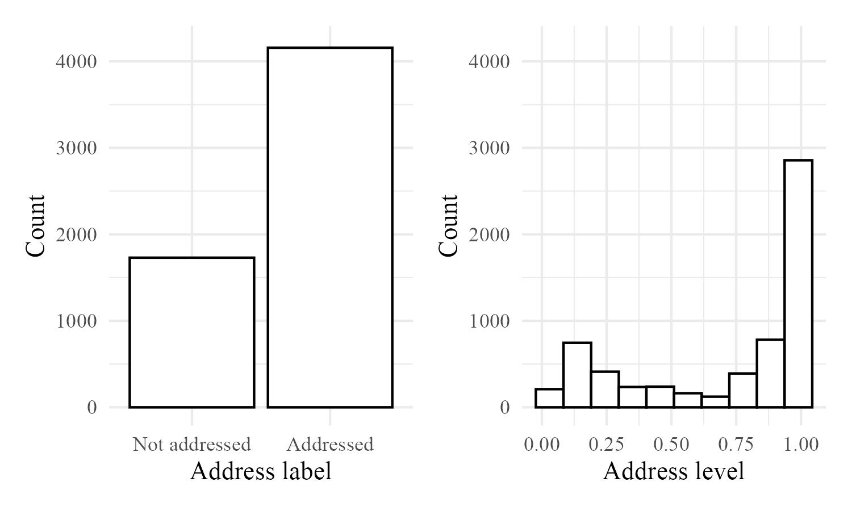
Distributions of Label and Level
Partially addressed states exist — not only 0 or 1
Label: addressed ≈ 2× not addressed
Level: mass at 0 and at 1 …
… but the middle is not empty
8 / 14
Notes:
This figure shows the two distributions.
On the left, the binary address label. Addressed is about twice as frequent as not addressed. This follows the original label counts, where E was the most frequent.
On the right, the address level. Many values are near zero or near one, as you expect.
But importantly, the middle of the scale is not empty. There are partially addressed states.
This is the first piece of evidence that address is graded.
この図は2つの分布です。
左が二値の address label。addressed は not addressed の約2倍で、E が最頙だった元のラベル分布と整合します。
右が address level。0付近と1付近に集中します。
しかし重要なのは、中間の値も空ではないことです。部分的に宛てられている状態が存在します。
これが、宛先が段階的であることの最初の証拠です。

Slide 10
Statistical Models
Label vs. level: same data, compared by predictive fit (ELPD)
Bayesian GLMM (brms); fixed effect: address label OR level
Random intercepts: turn, session, speaker, listener
Compared by leave-one-out cross-validation
Outcome (per listener, per turn) | Model | Observations
Became the next speaker | Bernoulli (logit) | 5,820
Gaze at the current speaker | Beta (proportion) | 5,744
Number of backchannels | Poisson + log(duration) | 4,920
9 / 14
Notes:
Now the models. We used Bayesian generalized linear mixed models with the brms package.
The fixed effect is either the address label, or the address level. Everything else is the same.
Random intercepts are included for turn, dialogue session, speaker, and listener.
We compare the two models by ELPD, that is expected log predictive density, using leave-one-out cross-validation. Larger is better.
We modeled three listener outcomes, shown in the table. Whether the listener became the next speaker, a Bernoulli model. The proportion of time the listener gazed at the speaker, a Beta model. And the number of backchannels, a Poisson model with turn duration as an offset.
The number of observations is about five to six thousand for each model.
モデルの説明です。brms を用いたベイズ一般化線形混合モデルを使いました。
固定効果は address label または address level。他の条件は共通です。
ランダム切片は、ターン・セッション・話者・聴者に入れています。
モデル比較は leave-one-out による ELPD（期待対数予測密度）で行い、大きい方が良いです。
対象は聴者行動3つ。次話者になったか（ベルヌーイ）、話者を見ていた時間割合（ベータ）、あいづちの回数（ポワソン、ターン長をオフセット）です。
観測数は各モデル5千〜6千程度です。

Slide 11
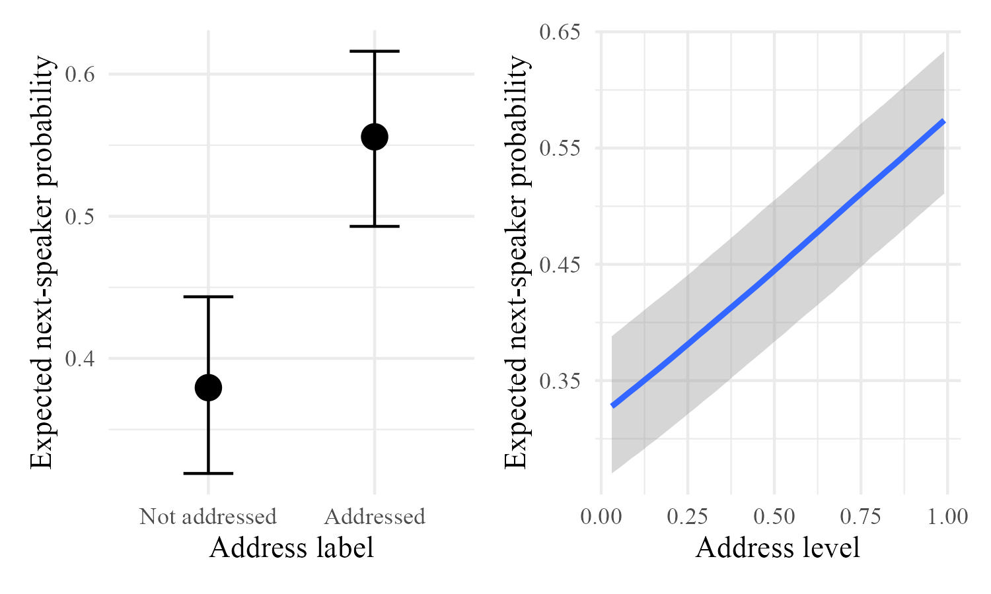
Result 1: Next Speaker
Higher addressivity → next speaker; the level fits better
left: label / right: level
Address label
β = 0.72 [0.59, 0.84]
Address level
β = 1.06 [0.89, 1.23]
ELPD: +14.4 (SE 4.9)
10 / 14
Notes:
First result: next-speaker selection.
In both plots, higher addressivity means a higher probability of becoming the next speaker. The left panel uses the address label, the right panel uses the address level.
For the label, the coefficient is 0.72. For the level, it is 1.06. Both credible intervals exclude zero.
Importantly, the ELPD comparison favors the address level, by 14.4 with a standard error of 4.9. So the continuous representation predicts better.
In other words, a listener labeled not addressed can still take the next turn, and a listener labeled addressed does not always take it.
最初の結果は次話者選択です。
どちらの図でも、addressivity が高いほど次話者になりやすい。左が address label、右が address level です。
係数は label で0.72、level で1.06。いずれも 95％信用区間が0を含まない。
重要なのは ELPD 比較で、address level が 14.4（SE 4.9）優れています。連続表現の方が予測が良いということです。
すなわち、not addressed と分類された聴者でも次話者になることがあり、addressed でも常にそうなるわけではないということです。

Slide 12
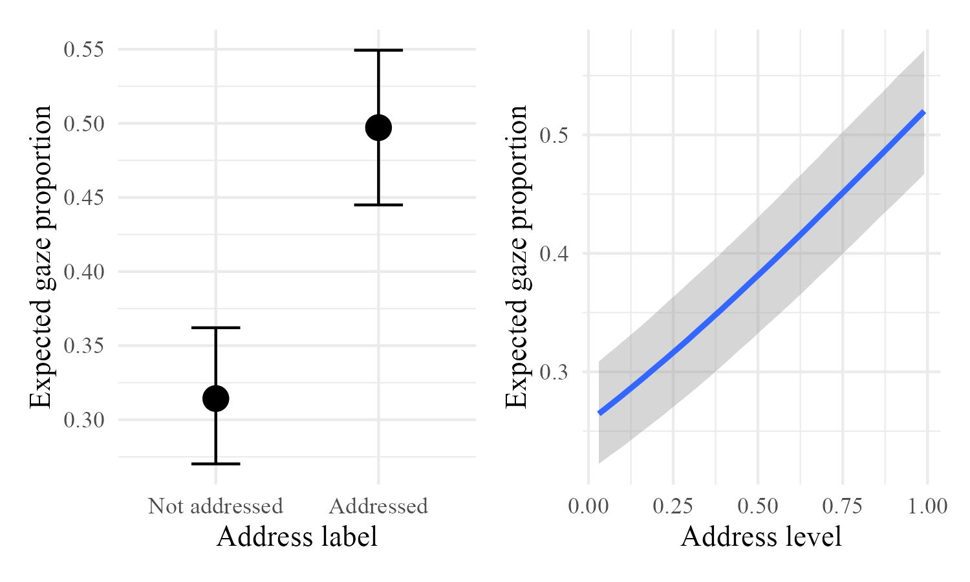
Result 2: Listener Gaze
Higher addressivity → longer gaze; the largest gain of the three
left: label / right: level
Address label
β = 0.77 [0.69, 0.85]
Address level
β = 1.15 [1.04, 1.26]
ELPD: +39.2 (SE 7.9)
11 / 14
Notes:
Second result: listener gaze.
Here the outcome is the proportion of the turn during which the listener looked at the current speaker.
Again, higher addressivity means more gaze. The coefficient is 0.77 for the label and 1.15 for the level.
The ELPD difference is 39.2, with a standard error of 7.9. This is the largest improvement among the three behaviors.
So gaze varies in a graded way with the strength of address. It is not fully explained by a binary distinction.
2つ目の結果は聴者の視線です。
従属変数は、ターン中に聴者が現話者を見ていた時間の割合です。
ここでも addressivity が高いほど視線が長い。係数は label で0.77、level で1.15です。
ELPD 差は39.2（SE 7.9）。3つの行動の中で最も大きな改善です。
つまり視線は宛てられ方の強さに応じて段階的に変化し、二値の区別では説明し尽せません。

Slide 13
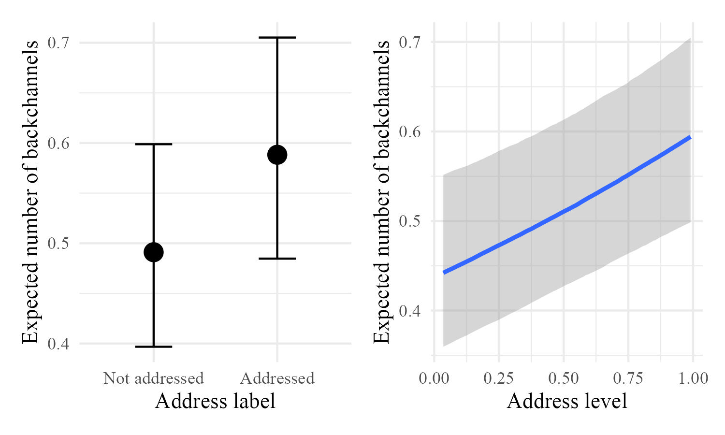
Result 3: Backchannels
Higher addressivity → more backchannels, but other factors too
left: label / right: level
Address label
β = 0.18 [0.08, 0.28]
Address level
β = 0.31 [0.17, 0.45]
ELPD: +3.5 (SE 1.6) — smallest
12 / 14
Notes:
Third result: backchannels.
The outcome is the number of backchannels the listener produced during the turn, with turn duration as an offset.
Listeners with higher addressivity produce more backchannels. The coefficient is 0.18 for the label and 0.31 for the level.
The address level is again better, but the ELPD difference is only 3.5. This is the smallest gain of the three.
So backchanneling is influenced by addressivity, but clearly also by other factors.
3つ目の結果はあいづちです。
従属変数はターン中のあいづち回数で、ターン長をオフセットにしています。
addressivity が高い聴者はあいづちが多い。係数は label で0.18、level で0.31です。
address level の方が良いですが、ELPD 差は3.5と10分の1以下の規模。3つの中で最も小さい改善です。
あいづちは addressivity に影響される一方で、他の要因も大きいと考えられます。

Slide 14
Qualitative Example: Double Address
One answer serves two questions: primary C, weaker B
01 C: What were we to do in Tokyo?
gazing at B
03 answers B in sequence, but C in content
2 annotators: C, C, E
So C is primary, B is weaker
02 B: Was there something to do?
gazing at A
03 A: Shopping.
gazing at C
13 / 14
Notes:
Here is a short example. The participants discuss a club trip to Tokyo.
In line 01, C asks what they were supposed to do in Tokyo, while gazing at B. So B is strongly addressed, and indeed B speaks next.
In line 02, B does not answer. Instead, gazing at A, B questions the presupposition: was there something we were supposed to do at all?
In line 03, A answers shopping. Sequentially this answers B. But A gazes at C, and in content it answers C’s question.
Two annotators labeled this turn C, and one labeled it E.
We think both are right. The primary address is C, but there is also a weaker address toward B, because answering C also answers B.
A single discrete label cannot express this. A continuous, per-listener level can.
短い例を見ます。部の旅行で東京に行く話をしています。
01行目で C は B を見ながら、東京で何をする予定だったかと尋ねます。B が強く宛てられており、実際に次に話すのは B です。
02行目で B は答えず、A を見ながら「そもそも何かする予定はあったのか」と前提を問い直します。
03行目で A は「買い物」と答えます。連鎖的には B への応答ですが、A は C を見ていて、内容上は C の質問に答えています。
このターンに対し、2名のアノテータは C、1名は E を付けました。
どちらも正しいと考えます。主な宛先は C ですが、C に答えることが B にも答えることになるため、B への弱い宛ても存在します。
単一の離散ラベルではこれを表現できません。聴者ごとの連続値なら表現できます。

Slide 15
Conclusions & Future Work
Estimate address continuously and online, with listener behavior
Per-listener levels keep what majority votes discard
Scalable: independent of the number of participants
Future: online joint modeling of gaze, backchannels, turn-taking
Limits: Japanese triads; 3 annotations per turn
14 / 14
Notes:
To conclude.
Aggregating annotations into one label discards information about the phenomenon. A continuous, per-listener representation keeps it.
This is also practical. Inside a group-addressed turn, a continuous representation can still tell participants apart. And because levels are estimated per listener, the framework does not depend on the number of participants.
Second, address is related to listener behavior during the turn. So it should be estimated online, while the utterance is still going on, not only after the turn ends.
In future work we want to test other languages, domains and group sizes, and to model addressivity, gaze, backchannels and turn-taking jointly in real time.
Our limitations: the data are Japanese triadic discussions, each turn has only three annotations, and we used posterior medians.
Thank you for listening. I am happy to take questions, and please feel free to email me.
まとめです。
アノテーションを1つのラベルに集約すると情報が失われます。聴者ごとの連続表現なら保持できます。
実用上の利点もあります。全体宛てのターンの中でも参加者間の違いを表せますし、聴者ごとに推定するので参加者数に依存しません。
第2に、宛先はターン中の聴者行動と関係します。つまりターン終了後だけでなく、発話途中にオンラインで推定すべきです。
今後は他言語・他ドメイン・他の人数での検証と、addressivity・視線・あいづち・turn-taking の同時モデル化に取り組みます。
限界として、データは日本語3者対話のみ、1ターンあたり3人のアノテーションだけ、事後中央値を使っている点があります。
ご清聴ありがとうございました。ご質問をお願いします。メールでもお気軽に。

Slide 16
Thank you!
Contact: mori@sap.ist.i.kyoto-u.ac.jp
Notes:
To conclude.
Aggregating annotations into one label discards information about the phenomenon. A continuous, per-listener representation keeps it.
This is also practical. Inside a group-addressed turn, a continuous representation can still tell participants apart. And because levels are estimated per listener, the framework does not depend on the number of participants.
Second, address is related to listener behavior during the turn. So it should be estimated online, while the utterance is still going on, not only after the turn ends.
In future work we want to test other languages, domains and group sizes, and to model addressivity, gaze, backchannels and turn-taking jointly in real time.
Our limitations: the data are Japanese triadic discussions, each turn has only three annotations, and we used posterior medians.
Thank you for listening. I am happy to take questions, and please feel free to email me.
まとめです。
アノテーションを1つのラベルに集約すると情報が失われます。聴者ごとの連続表現なら保持できます。
実用上の利点もあります。全体宛てのターンの中でも参加者間の違いを表せますし、聴者ごとに推定するので参加者数に依存しません。
第2に、宛先はターン中の聴者行動と関係します。つまりターン終了後だけでなく、発話途中にオンラインで推定すべきです。
今後は他言語・他ドメイン・他の人数での検証と、addressivity・視線・あいづち・turn-taking の同時モデル化に取り組みます。
限界として、データは日本語3者対話のみ、1ターンあたり3人のアノテーションだけ、事後中央値を使っている点があります。
ご清聴ありがとうございました。ご質問をお願いします。メールでもお気軽に。

Slide 17
Backup: Q&A (1 / 4)
Q. Isn’t address level just annotator disagreement?
A. Not error — it is latent, and it predicts behavior better.
Q. Why is E (everyone) = (1,1), not (0.5, 0.5)?
A. Addressivity is directedness to each listener, not a share.
Q. Annotators saw gaze — is the gaze result circular?
A. They used speaker gaze; we analyze listener gaze.
Q. The backchannel gain is only 3.5. Is it meaningful?
A. Smallest of the three. Backchannels have other causes too.

Slide 18
Backup: Q&A (2 / 4)
Q. Only 3 annotations per turn — is θ identifiable?
A. Weakly. Discrimination is shared across annotators.
Q. You used posterior medians, not full uncertainty.
A. Yes, a limitation. The direction of effects should hold.
Q. You excluded 134 turns with no majority label.
A. To fit both models to the same data. It does not help us.

Slide 19
Backup: Q&A (3 / 4)
Q. You merged W into E and dropped U — removing ambiguity?
A. W behaves like E; U has no direction. Key ambiguity is kept.
Q. How would a system estimate the level online?
A. Regress it from multimodal input, incrementally. Next step.
Q. Why not use a classifier’s softmax probability?
A. That is confidence in one label. Ours is per listener.

Slide 20
Backup: Q&A (4 / 4)
Q. Japanese triads only — does it generalize?
A. Unknown. Norms differ by culture. But it is size-independent.
Q. How does a system act on a continuous value?
A. Weight timing or gaze. Threshold only if a decision is needed.
Q. Why turn-level, if you argue for online estimation?
A. This paper is the motivation. Time-resolved work is next.

