Slide 1
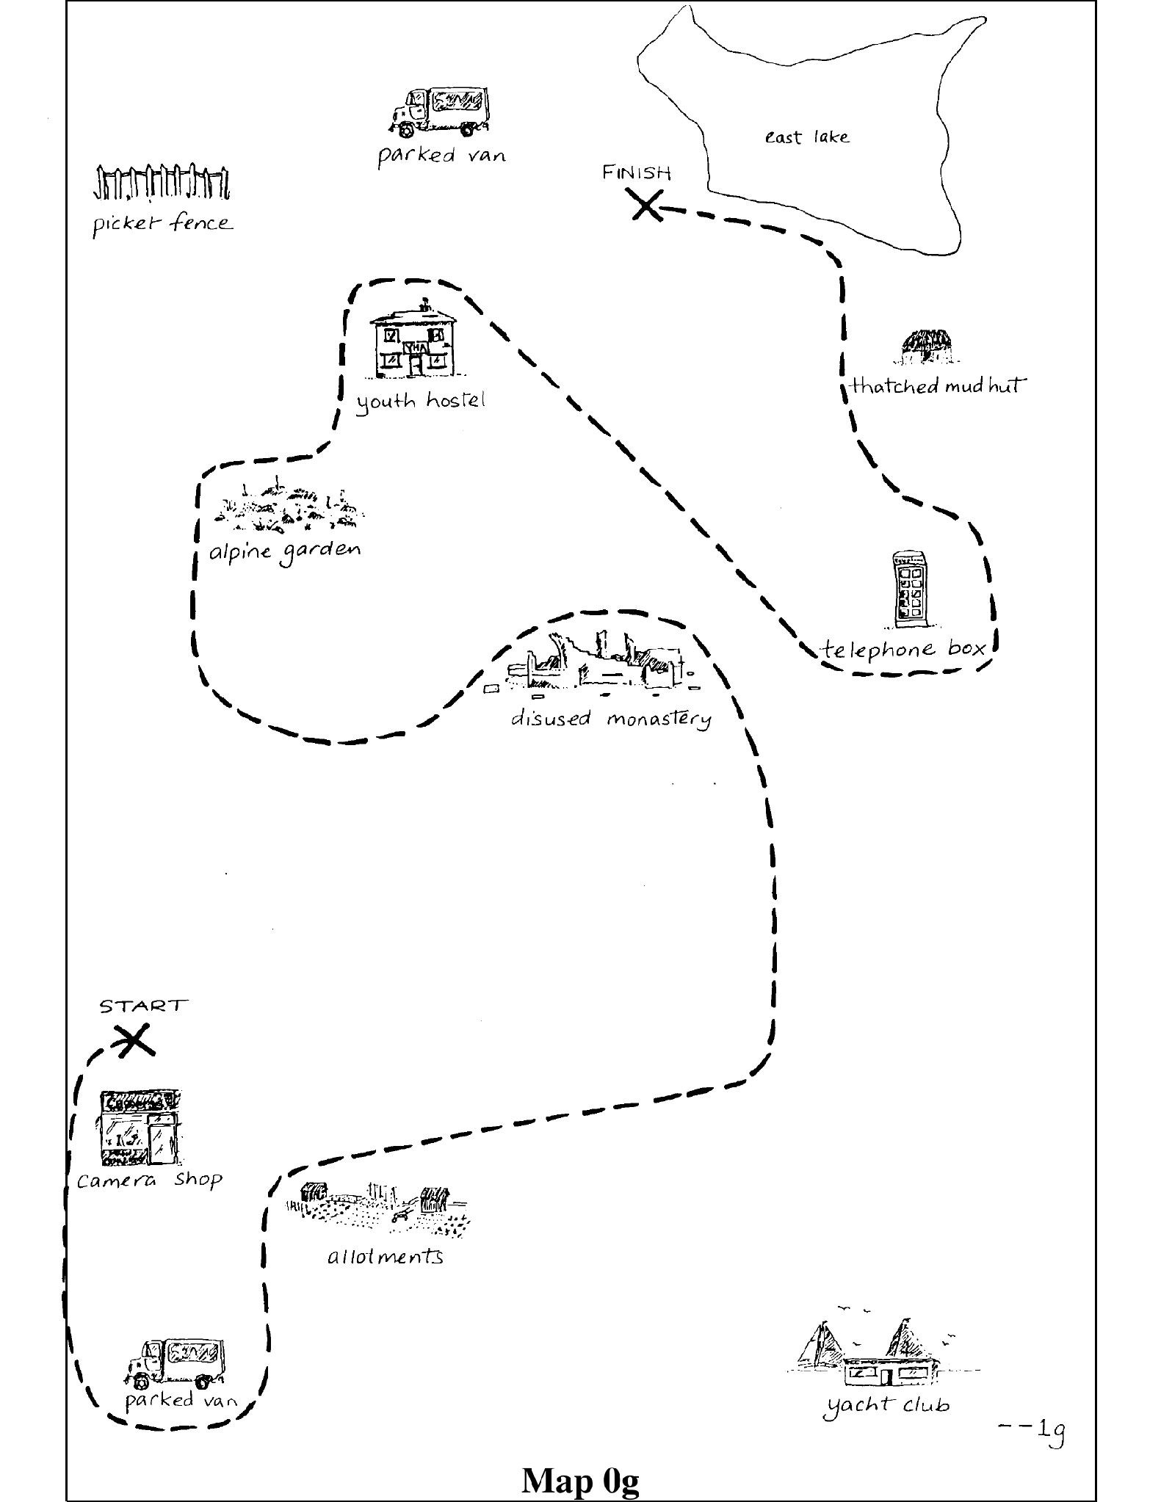
SIGDIAL 2026 · ORAL PRESENTATION
Seeing Is Not Sharing
Some Vision-Language Models Overestimate Common Ground in Asymmetric Dialogue
Nan Li · Albert Gatt · Massimo Poesio
Utrecht University
What could be shared ≠ what has been shared
Notes:
Good morning. I'm Nan Li from Utrecht University; this is joint work with Albert Gatt and Massimo Poesio. The title is the talk in four words: two people can look at the same thing and still mean different things. We show that some vision-language models miss that distinction — show them what the participants can see, and they start assuming the participants agree.
[Cue: pause after the title; do not read the subtitle twice.]

Slide 2
MOTIVATION
Shared perception is not shared interpretation
POTENTIAL COMMON GROUND
Both participants could have access to the same kind of landmark.
Co-presence in the scene.
ESTABLISHED COMMON GROUND
Built incrementally: the speaker refers, the addressee recognises or accommodates, both confirm or repair.
Clark & Wilkes-Gibbs 1986; Clark & Brennan 1991
A MODEL IS AN OVERHEARER
It sees the words, and sometimes the maps. It cannot ask a clarification question and it cannot repair.
Overhearers overestimate their own understanding (Schober & Clark 1989).
≠
Can a vision-language model tell what could be shared from what has actually become shared?
This is the question the paper operationalises — and asymmetric dialogue is where the two come apart most cleanly.
2
Notes:
In dialogue, a referring expression does not become common ground just because it was uttered. It becomes common ground once the addressee recognises it and the two confirm it — the incremental grounding process from Clark and colleagues. Until then a referent is only potential common ground. This matters most in asymmetric dialogue, where the participants hold different private information by design and neither can see the other's. A conversation can sound perfectly smooth while the two are talking about different things. And a model reading a transcript is structurally an overhearer: it observes every word, but it cannot ask and it cannot repair. [cut] Schober and Clark showed that human overhearers systematically overestimate their own understanding. Our question is whether the model inherits that illusion.
[Cue: stress the contrast between *could* and *has actually become*.]

Slide 3
TESTBED
MapTask: two private maps that differ by design
Lexical variant — the same landmark is named differently — “white water” vs. “rapids”
Existence — a landmark is on one participant's map only
Multiplicity — two parked vans on one map, one on the other
Perspectivist annotation (Li et al., LREC 2026): for every reference expression we know the giver's landmark and the follower's landmark, separately.
GOLD UNDERSTANDING STATE
Aligned 72.1% n = 9,435
Pending 26.0% n = 3,403
Misunderstood 1.8% n = 239
13,077 reference expressions · 128 dialogues · 16 map pairs. HCRC MapTask (Anderson et al., 1991); GMMT annotation, Li et al., LREC 2026.
3
Notes:
Our testbed is the HCRC MapTask. A giver guides a follower along a route, but their maps differ by design: landmarks are named differently, missing on one side, or duplicated on one map and not the other. What makes the study possible is a perspectivist annotation layer that we published at LREC earlier this year. It records, for every reference expression, the giver's landmark and the follower's landmark separately. That is 13,077 expressions across 128 dialogues. From those paired interpretations we derive a gold state. 72% aligned, 26% pending — not yet grounded — and that thin sliver is the genuinely misunderstood cases, where both sides believe they agree but grounded to different landmarks. 239 instances. Keep that sliver in mind.
[Cue: name the three discrepancy types while pointing at the map, then run your hand along the bar and stop on the purple sliver.]

Slide 4
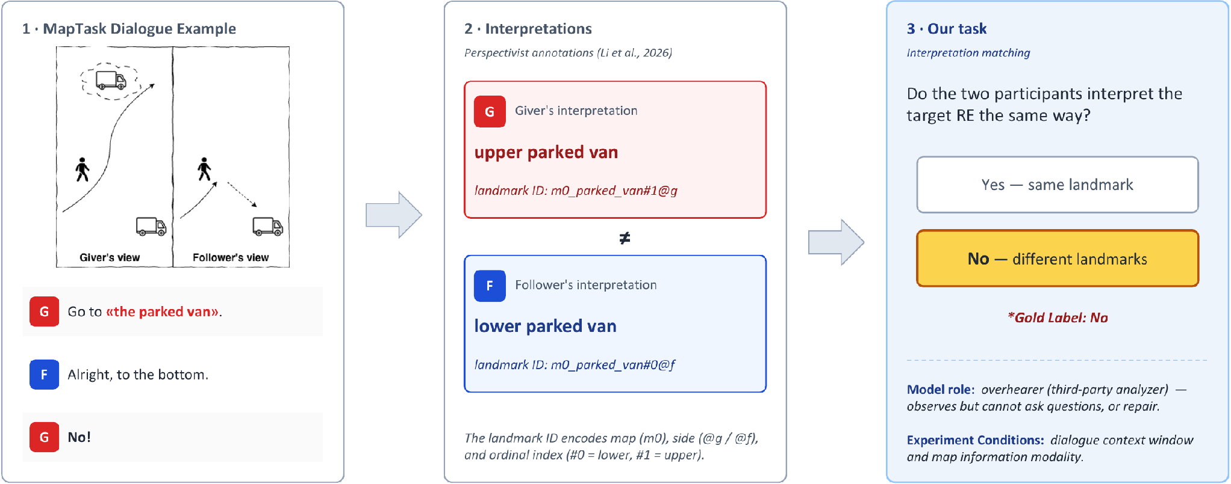
THE TASK
Interpretation matching: do both participants mean the same landmark?
The model is an overhearer: it observes the evidence but cannot ask or repair. Gold label here is NO — and NO covers two cases: grounding is still pending, or it happened but to different landmarks.
4
Notes:
Here is the task on a real misalignment. The giver says "Go to the parked van." The giver's map has two parked vans; the follower's has one, elsewhere. The follower says "Alright, to the bottom" — and the giver says "No." That repair is what tells us the fluency was not agreement. The annotations tell us the giver grounded the phrase to the upper van, the follower to the lower one. Same words, different entities — which is why one corpus-level gold referent is not enough. So our task, interpretation matching: given the expression, the dialogue, and some map information, do the two participants currently share the same interpretation? Here, No. And note the model's position — it observes, but it cannot ask, and it cannot repair.
[Cue: move left to right; pause on the ≠ sign.]

Slide 5
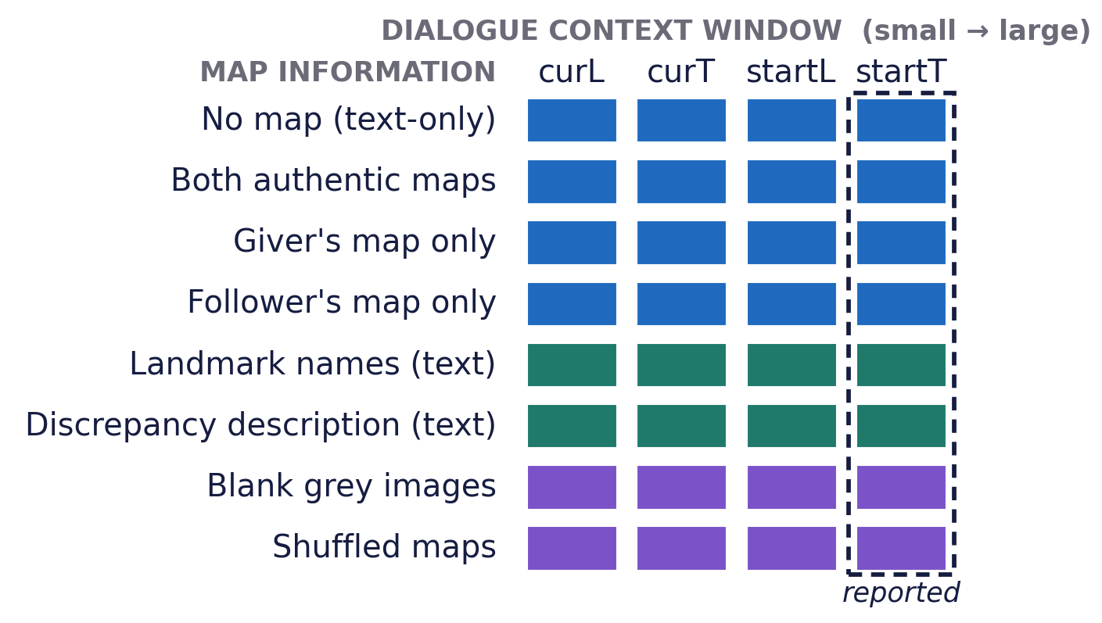
DESIGN
Two independent variables, fully crossed, zero-shot
1 · DIALOGUE CONTEXT
Four windows, from the current transaction up to the target line (curL) to the whole dialogue through the end of that transaction (startT).
Later turns carry confirmation and repair.
2 · MAP INFORMATION
Authentic maps (both / giver / follower); the same content delivered as text (landmark names, discrepancy descriptions); two content-free visual controls (blank grey, shuffled maps).
The controls are what separate content from channel.
Five open VLMs: Qwen3-VL 2B / 4B / 8B and Gemma-3 4B / 12B. Qwen3-VL-8B runs the full grid; the other four run the four baseline map conditions, also across all four windows.
Decoding is constrained to a single YES / NO token — so the token probability is directly the model's confidence.
5
Notes:
So how do we test this systematically? We control two things — what dialogue the model sees, and what map information it gets — fully crossed, all zero-shot. I will report the widest dialogue window unless I say otherwise.
First, dialogue context: the model can see as little as the current exchange or as much as the full dialogue — including later turns that carry confirmation and repair. That tells us whether grounding history helps.
Second, map access: the model gets no map, both authentic maps, or just one side's map. We also deliver the same map content as plain text — landmark names, or explicit discrepancy descriptions. And two content-free controls: blank grey images, and shuffled maps from an unrelated pair. If the effect were a generic "there is an image" artefact, the controls should reproduce it. Five models. Qwen3-VL-8B runs everything I show. Decoding is one YES or NO token, which gives us clean confidence.
[Cue: the dashed column is what the paper reports — say "all four windows, reporting the widest".]

Slide 6
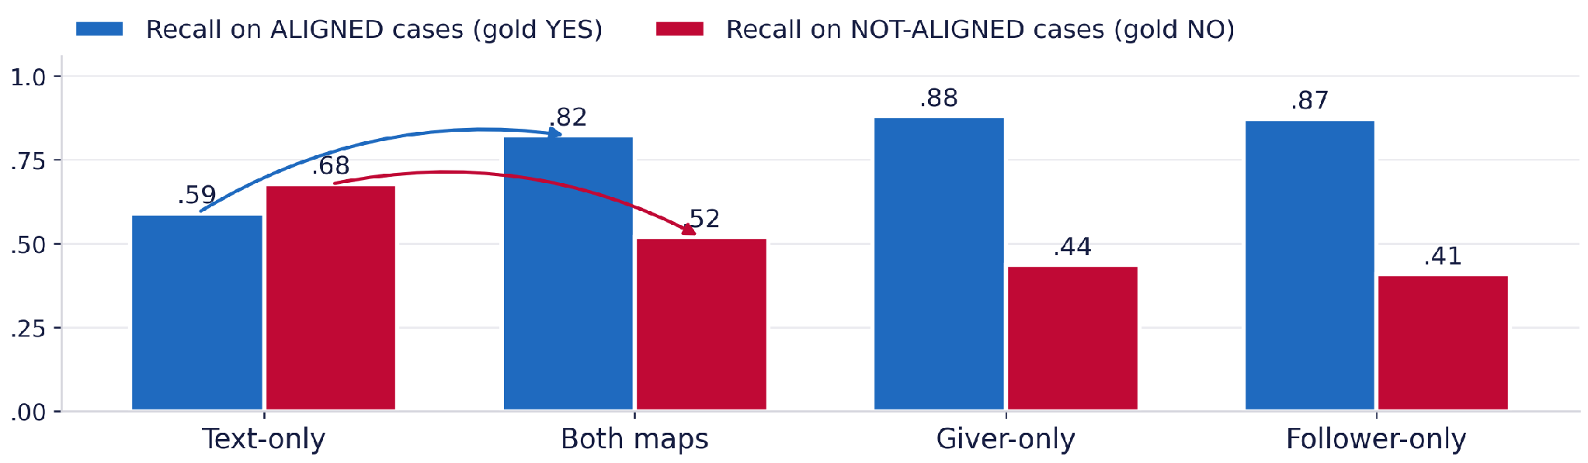
FINDING 1
Maps help — by pushing the model toward YES
MACRO-F1
RECALL · ALIGNED
RECALL · NOT ALIGNED
YES-RATE
.591 → .671
.590 → .822
.677 → .518
.515 → .727
Qwen3-VL-8B at startT. The gold aligned rate is .721 — the yes-rate alone is not the test; the direction of the recall trade-off is.
Either single map triggers it more strongly; both maps moderate it, via cross-map discrepancy evidence.
6
Notes:
So what happens when the model gets the maps? At first glance, good news: macro-F1 goes up about eight points.
But look at how. Recall on aligned cases jumps by more than 20 points. Recall on not-aligned cases drops. And the yes-rate climbs to match the base rate of aligned expressions.
Let me be precise. The yes-rate roughly matches the gold base rate — so by itself it is not evidence of bias. A classifier can match the base rate and still distribute its errors very differently. The evidence is the direction of the trade-off: in every authentic-map condition, aligned recall goes up and not-aligned recall goes down. Single maps make this more extreme; both maps is the mildest, because cross-map discrepancies give the model something corrective.
So the improvement is real, and it is bought by systematically over-predicting alignment.
[Cue: read the four cards left to right, then say the prevalence caveat out loud — do not skip it.]

Slide 7
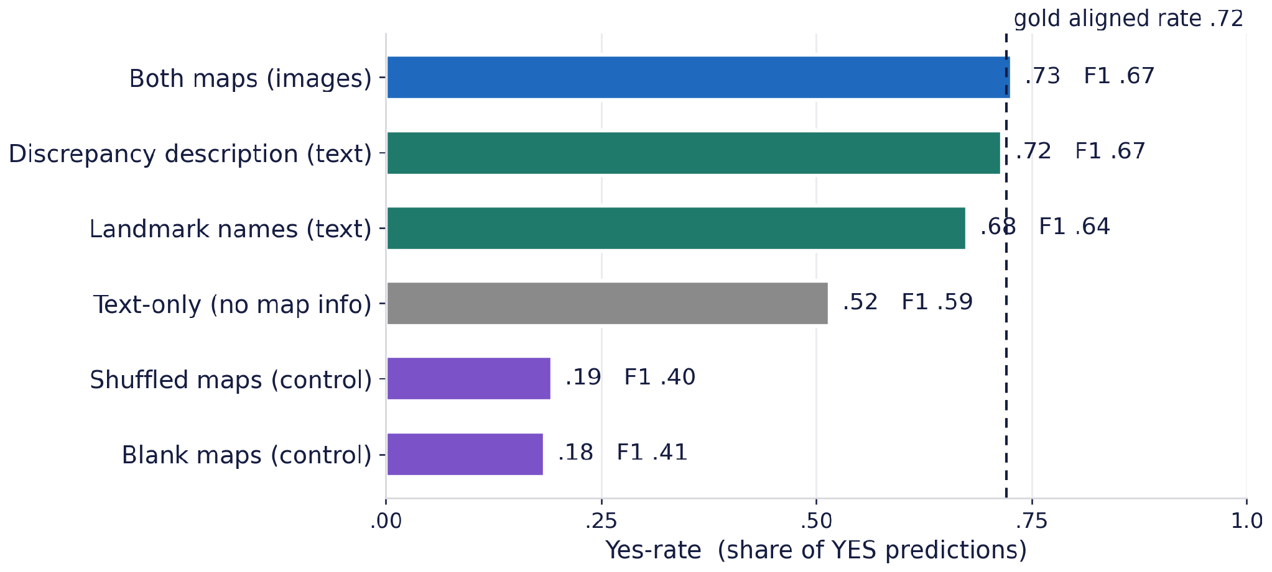
FINDING 2
The bias travels with content, not with the channel
SAME CONTENT, NO IMAGE
Landmark names .675 and discrepancy text .716, against .727 for real maps.
IMAGES WITHOUT CONTENT
Blank .184, shuffled .193 — below even text-only (.515). The model turns hyper-conservative.
SO THE CUE IS MAP CONTENT
in pixels or in words.
All conditions: Qwen3-VL-8B at startT. Caveat: the textual conditions do not reconstruct the full spatial layout, and authentic images add a small further shift — so this bounds, but does not eliminate, a role for vision.
7
Notes:
Is this a visual artefact — something about feeding images to a VLM? That is what the modality conditions are for.
Take the same map information and deliver it as plain text. The yes-rates land in the mid-sixties to low-seventies — almost the same as real maps at .727. Describing the maps in words reproduces almost the full effect of showing them.
Now the controls. Blank grey images and shuffled maps both drop to around .19 — far below the text-only baseline — the opposite direction. When the model gets an image it cannot extract content from, it turns hyper-conservative.
So the conditions split cleanly: task-relevant map content pushes toward yes, as pixels or as words; inputs without it do not. I would not say vision plays no role — the textual conditions omit spatial layout, and real images add a small further shift. But the dominant effect follows content.
[Cue: group the top three bars with your hand, then contrast with the bottom two.]

Slide 8
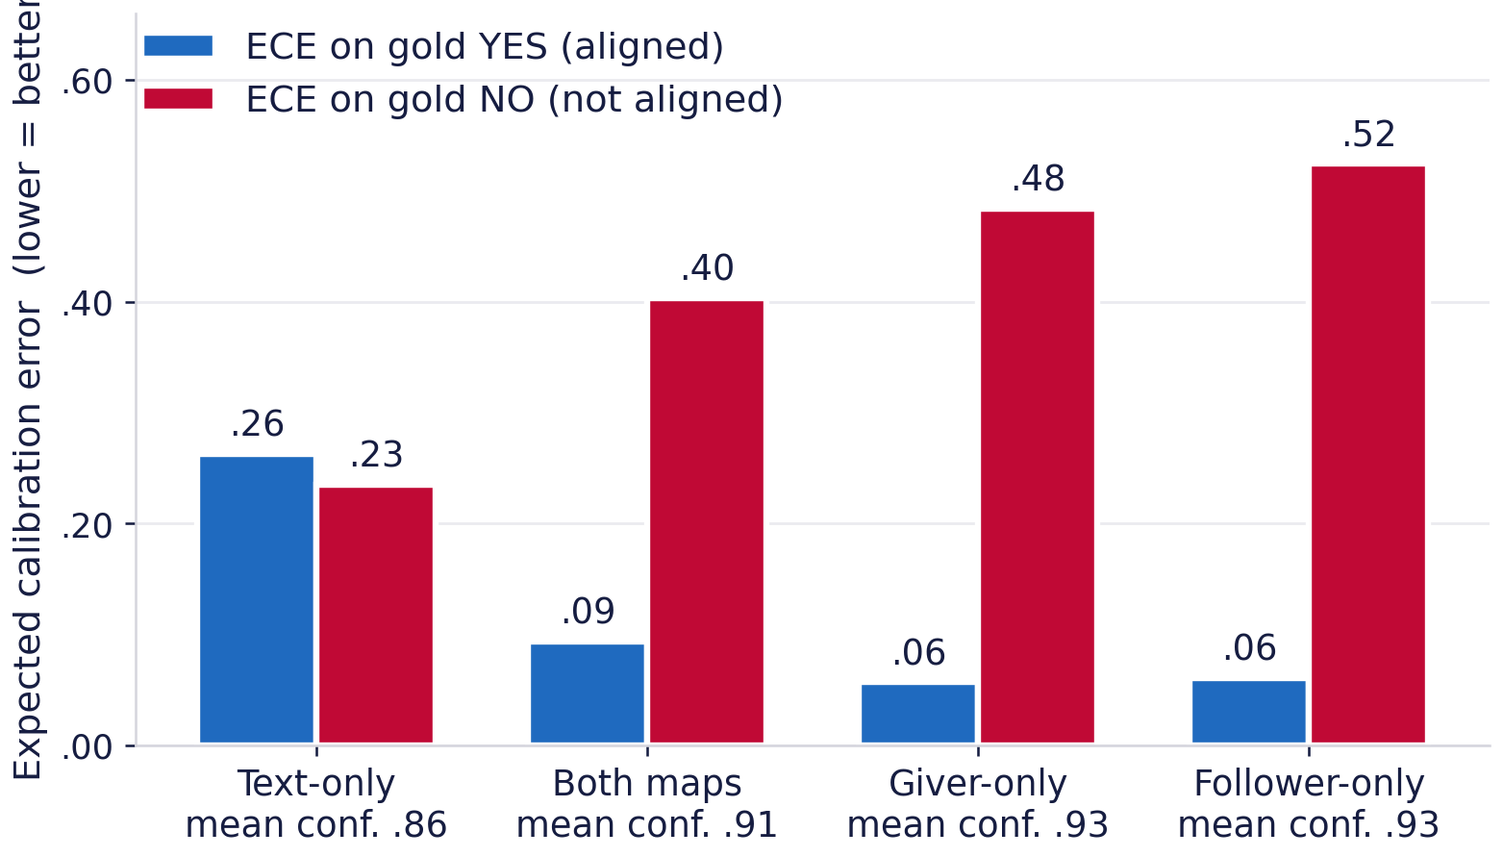
MECHANISM
On non-aligned cases, map access produces confident errors
CONFIDENT AND RIGHT ON GOLD YES
ECE .263 → .094 with both maps.
CONFIDENT AND WRONG ON GOLD NO
ECE .235 → .403, and .524 with the follower's map alone.
MORE THAN A THRESHOLD SHIFT
The gap between classes widens from .028 to .463.
Constrained single-token decoding, so confidence = exp(logprob). n = 13,077, Qwen3-VL-8B at startT. Lower ECE is better.
8
Notes:
Is this just a shifted decision threshold? Partly — the yes-rate does move. But calibration shows it is more than that. Because the output is one token, we get confidence for free, and we compute expected calibration error separately by gold label. Lower is better. Text-only is mediocre but symmetric, about .25 on both classes. Add maps and it splits. On gold-YES the model becomes very well calibrated: .094. On gold-NO it deteriorates to .403 — even worse with a single map. Mean confidence goes up too.
So when the model gets a non-aligned case wrong under map access, it is not hesitating. It is confidently wrong. For anything downstream — a system deciding whether to ask a clarification question — that is the worst kind of error.
[Cue: say "lower is better" once, explicitly. Point at gold-YES first, then gold-NO.]

Slide 9
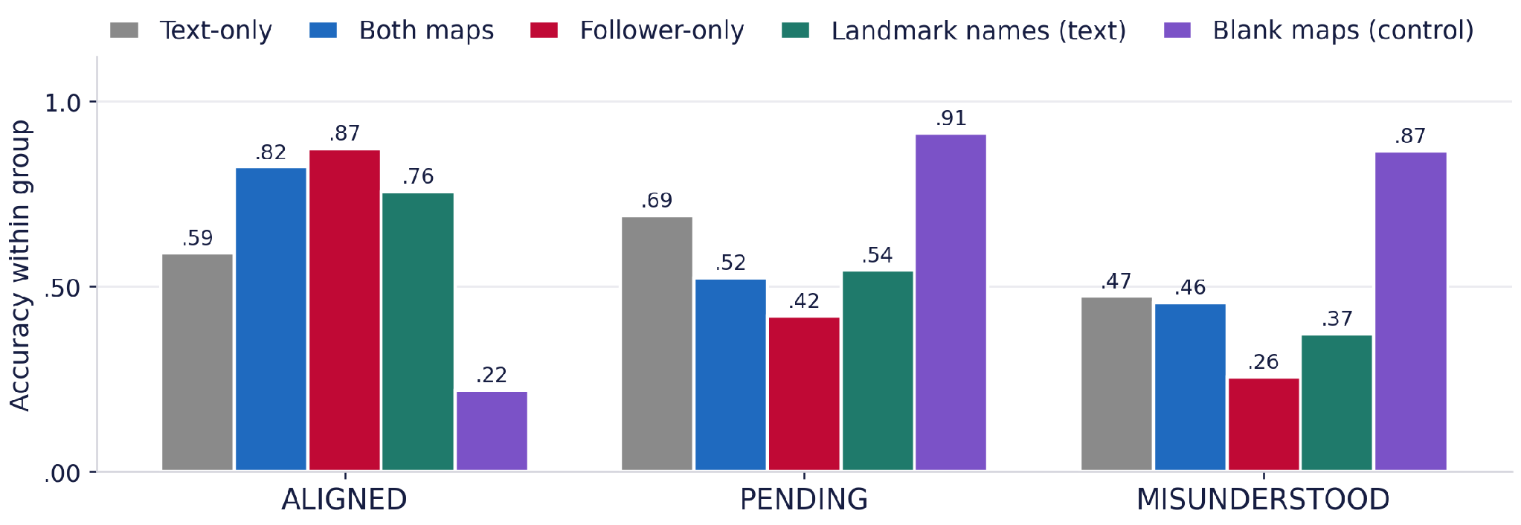
WHERE IT COSTS
The aggregate gain is paid for by pending cases
n = 9,435
+23.2 pp .590 → .822
n = 3,403
−16.8 pp p < 10⁻⁶
n = 239
−1.7 pp n.s. p = .724
Text-only → both maps. Blank maps look strong on pending and misunderstood only because they answer NO to almost everything.
9
Notes:
Where do the gains and losses land? Here we decompose accuracy by gold grounding status. On aligned expressions, maps add 23 points, .590 to .822. On pending expressions, where grounding has not happened yet, accuracy drops 17 points, and that drop is significant under every authentic-map condition. On the genuinely misunderstood cases, I want to be careful. The both-maps change is not significant — p is .724, on only 239 instances.
The single-map declines are significant; follower-only falls to .255. So the robust harm is on pending cases. Two more things. Landmark names as text, in teal, follow the same profile as real maps. And blank maps look excellent on pending and misunderstood — only because they answer NO to nearly everything. No condition gets better at detecting non-alignment for the right reasons.
[Cue: walk the three chips left to right. Say "not significant" out loud; do not let the printed chip do that work alone.]

Slide 10
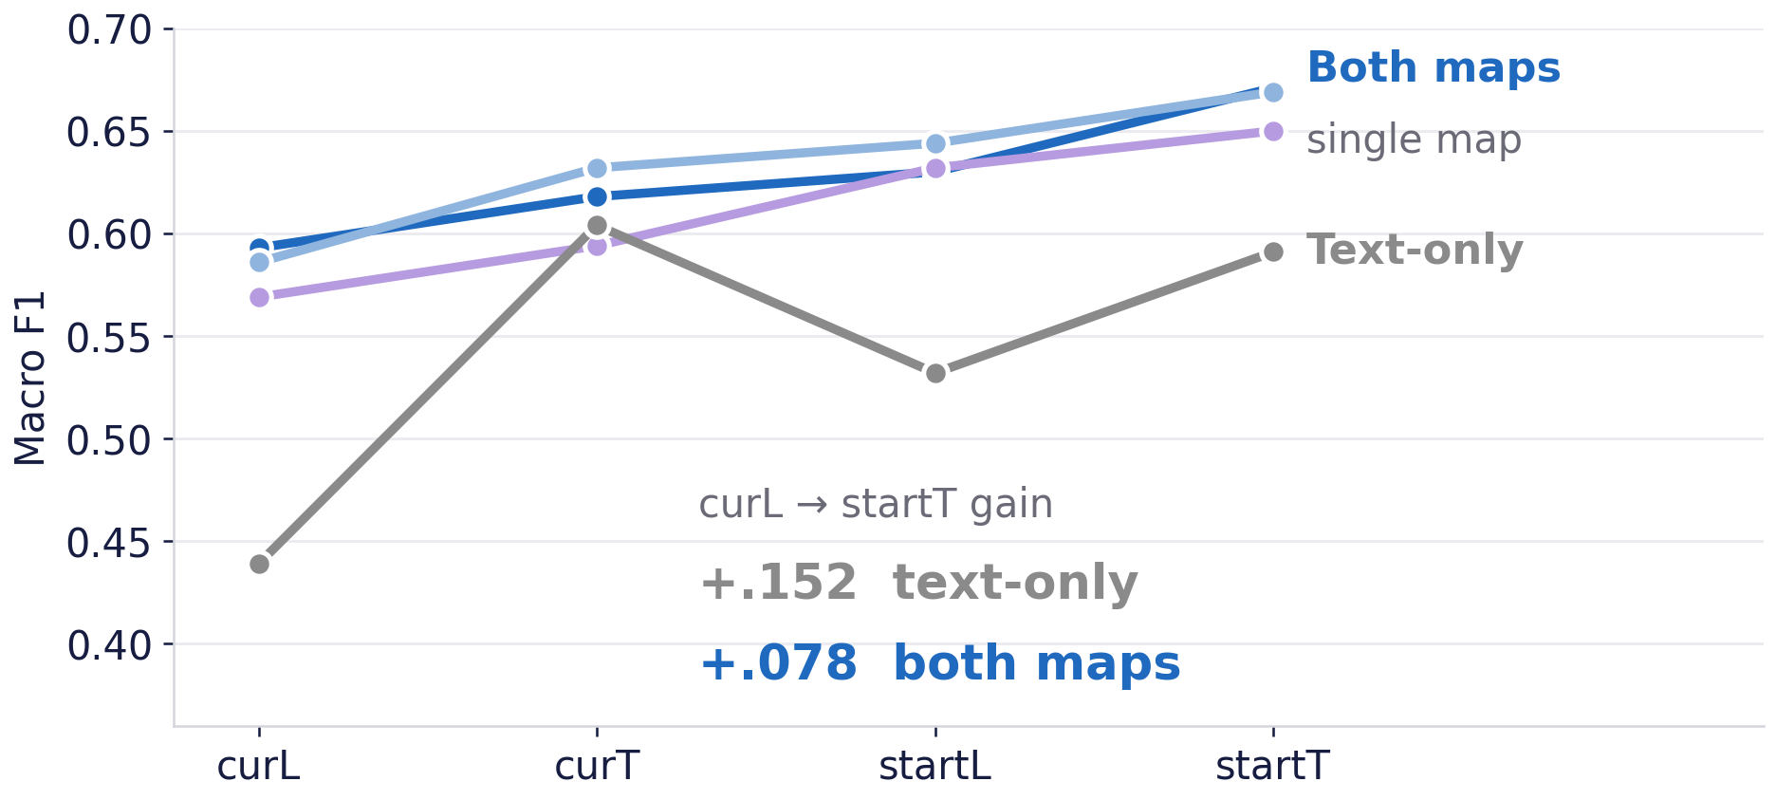
DYNAMICS
Dialogue evidence carries less weight once maps are in
Qwen3-VL-8B macro-F1 across the four context windows. Later turns always help — they carry repair and confirmation — but the gain halves once maps are available.
The reference-chain analysis is on backup slide B4, where the per-bucket gold aligned rate can be shown alongside it.
10
Notes:
One more view: how much does dialogue evidence actually buy? More context always helps, including the future turns that carry repair and confirmation. But look at the slopes. Without maps, going from the smallest window to the largest gains .152 in macro-F1. With both maps, the same expansion gains only .078. Once the model has static map cues, it leans on them and benefits much less from the interactional evidence — which is precisely the evidence that says what has actually been grounded.
[Cue: trace the grey line, then the blue one. This is the whole slide; do not add the chain analysis, it is in B4.]

Slide 11
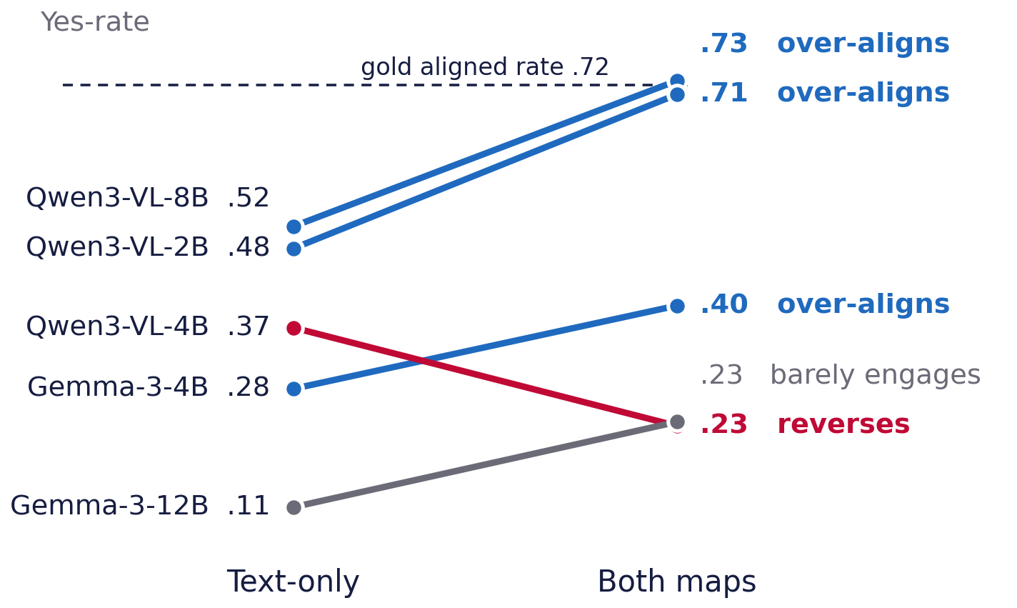
GENERALITY
Model-dependent — and scale does not fix it
“SOME” IS DOING REAL WORK
Four of five shift upward, but only three land near the base rate. Gemma-3-12B stays extremely conservative; Qwen3-VL-4B reverses.
LARGER ≠ MORE DISCERNING
2B beats 4B (F1 .566 vs .411); Gemma-3-4B beats 12B (.510 vs .416).
ONE LIKELY CONTRIBUTOR
A model that cannot read the maps cannot show a content-driven bias.
Baseline grid at startT, n = 13,077. Gemma's SigLIP encoder pools every image to 256 tokens; in a map-reading check Gemma scored 81–82 F1 on landmark names against 88–90 for Qwen3-VL.
11
Notes:
Is this universal? No — and the word "some" in our title is doing real work. Four of the five models shift upward when maps are added. But only three land anywhere near the base rate. Gemma-3-12B shifts upward but stays extremely conservative — its yes-rate never comes close to the base rate. And Qwen3-VL-4B moves the opposite way — maps make it more conservative. Scale does not save you either. 2B beats 4B, and Gemma-3-4B beats 12B. Larger is not more discerning. For Gemma we have a plausible contributor: its encoder pools every image to 256 tokens, and in a map-reading check it reads landmark names noticeably worse. A model that cannot read the maps cannot show a content-driven bias. That is a contributor, not a full account.
[Cue: trace the red Qwen3-VL-4B line and say "some" out loud. Do not say "larger models are more confident" — that holds for Qwen but reverses in Gemma.]

Slide 12
INTERPRETATION
What the failure tells us about VLM grounding
SCENE EVIDENCE
what COULD be shared — landmarks co-present on both maps
co-presence ⇒ alignment
THE MODEL'S JUDGEMENT
“ALIGNED” — because the landmark is on both maps.
Potential common ground is read as established common ground: the computational form of the overhearer's illusion.
DIALOGUE EVIDENCE
what HAS been grounded — recognition, confirmation, repair
under-weighted
Evaluation should separate visual reference recognition from interactional common-ground tracking.
12
Notes:
The model has two sources of evidence. The scene tells it what could be shared: which landmarks are co-present. The dialogue tells it what has been shared: recognition, confirmation, repair. It over-weights the first and under-weights the second, and the result is a confident "aligned" whenever the landmark appears on both maps. That is the computational form of the overhearer's illusion: rich referential context, no access to the process that establishes mutual understanding. The implication is on the bottom line: an evaluation reporting one aggregate number cannot tell these apart. They need to be measured separately.
[Cue: trace the thick red arrow, then the pale one.]

Slide 13
SCOPE
What this establishes — and what it does not
WHAT WE SHOW
· An interpretation-matching evaluation built on perspectivist annotations, over 13,077 reference expressions.
· Task-relevant map content shifts judgements toward YES — as pixels or as words.
· The cost concentrates on pending cases, and the errors there are confident.
· The pattern is model-dependent, and scale does not remove it.
WHAT WE DO NOT CLAIM
· Not an interactive test — the model can never ask or repair.
· The full condition grid is one model; the other four get the baseline comparison only.
· One corpus, MapTask-specific discrepancies, strong imbalance, and a rare misunderstood class (n = 239).
· Textual conditions omit full spatial layout; greedy binary decoding may mask softer uncertainty.
Next: interactive evaluation, further perspectivist corpora, and protocols that let a model express uncertainty and revise its judgement as the dialogue unfolds.
13
Notes:
The claim is deliberately scoped. What we show: an interpretation-matching evaluation over 13,077 expressions; map content shifting judgements toward yes, as pixels or as words; the cost concentrating on pending cases with confident errors; a pattern that is model-dependent. What we do not claim: this is an overhearer task, not a test of interactive clarification. The full grid is one model. One corpus, with a rare misunderstood class. And greedy binary decoding may hide softer uncertainty.
[Cue: brisk. This slide is what protects the final claim.]

Slide 14



CONCLUSION
Seeing is not sharing
1
Maps improve macro-F1 by reading potential referential overlap as established common ground.
2
The bias travels with content, not channel — text reproduces it, content-free images reverse it.
3
The cost lands where grounding matters — confident errors on pending cases.
These models infer what the interlocutors could be talking about — not what they have established together.
Paper
aclanthology.org/2026.sigdial-1.49
Code + prompts
github.com/chnln/seeing-is-not-sharing
SINS dataset
huggingface.co/datasets/chnln/…
Thank you — questions welcome. Funded by NWO, AiNed Fellowship NGF.1607.22.002 — Dealing with Meaning Variation in NLP.
14
Notes:
Three things to take away. One: seeing is not sharing. Map access improves F1 by reading potential referential overlap as established common ground. Two: the bias travels with content, not channel — text reproduces it, content-free images reverse it. Three: the cost lands where grounding matters, as confident errors on cases that are still pending. In one sentence: these models can infer what the interlocutors could be talking about, but not what they have actually established. Paper, code, and the dataset are behind those QR codes. Funded by the NWO AiNed Fellowship. Thank you.
[Cue: finish on the conceptual sentence, then gesture at the QR codes and stop talking so people can scan. Do not read the URLs or the grant number aloud.]

Slide 15
BACKUP
Baseline and modality results (Qwen3-VL-8B, startT)
Map information | F1-macro | R-pos | R-neg | Yes-rate
Text-only | .591 | .590 | .677 | .515
Both maps | .671 | .822 | .518 | .727
Giver-only | .669 | .879 | .436 | .791
Follower-only | .650 | .872 | .408 | .794
Landmark names (text) | .636 | .756 | .533 | .675
Discrepancy description (text) | .668 | .810 | .528 | .716
Blank maps | .407 | .220 | .910 | .184
Shuffled maps | .402 | .222 | .884 | .193
READING THE TABLE
R-pos = recall on aligned; R-neg = recall on not-aligned.
Gold aligned rate: .721.
n = 13,077 for every row.
Tables 1 and 2 of the paper. Single-map conditions amplify the bias; both maps moderate it slightly via cross-map discrepancy evidence.
B1
Notes:
Q1 "isn't the yes-rate just the base rate?" · Q4 "are the models bad at reading maps?"
Point at the two textual rows: .675 and .716 against .727 for real maps. That is
the answer to "is this a vision artefact" — no vision required, the bias
reproduces. Then the two control rows, .184 and .193, below the .515 text-only
baseline.
Gold aligned rate is .721. Say out loud that the yes-rate alone is not the test;
the recall trade-off is. R-pos = recall on aligned, R-neg = recall on not-aligned.
n = 13,077 for every row.

Slide 16
BACKUP
Accuracy by gold grounding status, with significance
Condition | Aligned | Pending | Misund.
Text-only | .590 | .691 | .473
Both maps | .822 | .523 | .456
Giver-only | .879 | .441 | .372
Follower-only | .872 | .419 | .255
Landmark names (text) | .756 | .544 | .372
Discrepancy desc. (text) | .810 | .540 | .368
Blank maps | .220 | .913 | .866
Shuffled maps | .222 | .886 | .858
MCNEMAR TESTS
Pending: p < 10⁻⁶ for every authentic-map condition.
Misunderstood — both maps: p = .724 (n.s.).
Misunderstood — giver-only: p = 8 × 10⁻³; follower-only: p = 3 × 10⁻⁹.
Table 4. n = 9,435 / 3,403 / 239. Blank maps score high on pending and misunderstood only because they answer NO to almost everything (yes-rate .184).
B2
Notes:
Q5 "239 misunderstood cases is very few — can you conclude anything?"
The honest answer is on the right. Pending: p < 10 to the minus 6 for every
authentic-map condition, on n = 3,403 — that is the claim we lean on.
Misunderstood under both maps: p = .724, not significant, and we say so in the
paper. Single maps do decline significantly: giver-only p = 8e-3,
follower-only p = 3e-9, down to .255.
If pushed: we phrase the misunderstood conclusions per condition, never in
aggregate.

Slide 17
BACKUP
Calibration by gold label
Condition | ECE | ECE-yes | ECE-no | Mean conf.
Text-only | .249 | .263 | .235 | .863
Both maps | .174 | .094 | .403 | .912
Giver-only | .172 | .057 | .484 | .927
Follower-only | .185 | .061 | .524 | .929
WHY THIS MATTERS
The class gap widens from .028 to .463 — spurious certainty on top of the threshold shift, not instead of it.
CROSS-MODEL CALIBRATION
Qwen3-VL-2B has the best ECE (.144) because it is the least confident (mean .789); Gemma-3-12B the worst (.531) at the second-highest confidence (.948).
Confidence rises with size in Qwen (.789 / .907 / .912) but falls in Gemma (.973 → .948). What holds in both families is that larger is not more discerning.
Table 3, n = 13,077, Qwen3-VL-8B at startT. conf := exp(logprob) of the single generated YES/NO token.
B3
Notes:
Q1 follow-up "why is this over-prediction rather than a threshold shift?"
This table is the strongest single answer. Text-only is symmetric, .263 against
.235. Under both maps the classes split: .094 on gold-YES, .403 on gold-NO. The
gap widens from .028 to .463. A threshold shift would move both classes together.
The lower card is for "does scale help?" — 2B has the best ECE because it is the
least confident; 12B the worst at the second-highest confidence.

Slide 18
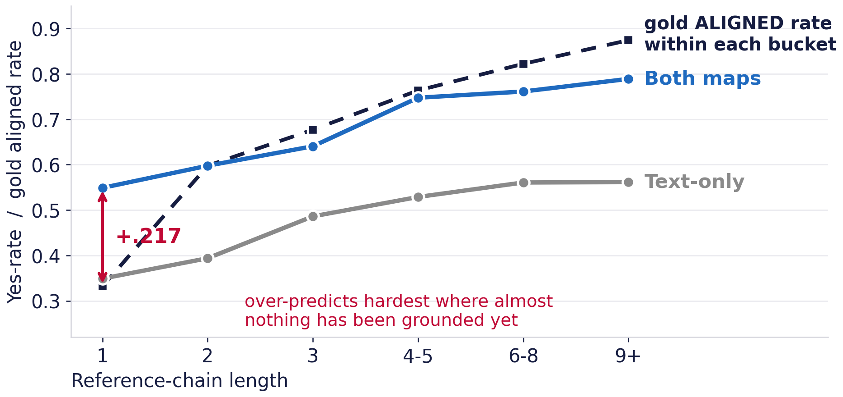
BACKUP
Reference chains, against the right baseline
WHY NOT COMPARE TO .721
The chain subset is not the whole dataset: all 9,435 aligned REs sit in chains, but only 1,799 of 3,403 pending ones do.
And prevalence climbs within it, .33 → .87.
WHAT THE DATA SAYS
At one mention the model answers YES .55 of the time where only .33 are aligned — a 22-point over-prediction.
By 9+ mentions it sits slightly below the local rate.
1,665 chains covering 11,473 of the 13,077 REs. Suggestive, not causal: chain length is not randomly assigned. The full three-panel figure from the paper is Figure 2.
B4
Notes:
For a question about repeated mention or temporal grounding.
This is the slide to go to, and it is deliberately not in the main deck: the
honest version needs the gold prevalence curve next to the yes-rate curve, and
that does not fit in a talk minute.
The dashed navy line is the gold aligned rate within each bucket. It climbs from
.33 to .87 because post-grounding mentions accumulate. Against that local
baseline the over-prediction sits at the LEFT end, not the right: at a single
mention the model says yes .55 of the time where only .33 are aligned.
If someone quotes the global .721 back at you, that is the wrong reference for
this subset - say so, and point at the dashed line.

Slide 19
BACKUP
Why the models diverge
VISION ENCODING
Qwen3-VL: native dynamic-resolution encoder, hundreds of tokens for a 791×1024 map, 2D-RoPE spatial encoding.
Gemma-3: SigLIP, resized to 896×896 and average-pooled to 256 tokens per image regardless of complexity.
MAP-READING SANITY CHECK
All five models were asked to list landmark names and positions on all 32 maps.
Qwen3-VL 88–90 F1 · Gemma-3 81–82 F1, with character-level naming errors and spatial mislocations.
WHAT THIS DOES AND DOES NOT EXPLAIN
A model that cannot reliably extract map content cannot show a content-driven bias — so weak map reading plausibly explains Gemma's conservatism.
It does not explain Qwen3-VL-4B, which reads maps well and still reverses. We report the heterogeneity; a mechanistic account is future work.
Appendix E. The over-alignment bias is not a universal property of vision-language architectures.
B5
Notes:
Q3 "why does Qwen3-VL-4B reverse?" · Q4 "could the models just be bad at reading maps?"
Left card answers the mechanism question for Gemma: SigLIP pools every image to
256 tokens regardless of resolution, and the sanity check shows it: 81-82 F1
against 88-90 for Qwen.
The bottom card is the honest limit. Weak map reading explains Gemma. It does
not explain Qwen3-VL-4B, which reads maps fine and still reverses. Say that
plainly — we report the heterogeneity and do not have a mechanistic account.

Slide 20
BACKUP
Design choices and positioning
WHY ZERO-SHOT, GREEDY, BINARY?
To characterise default judgement behaviour, and because constrained single-token decoding makes the token probability a clean confidence signal.
Few-shot, CoT and thinking models are natural follow-ups.
IS THE TEXT/VISION COMPARISON FAIR?
The textual conditions convey landmark lists and discrepancies, not the full spatial layout — acknowledged in Limitations.
The direction of the argument is unaffected: text already reproduces the bulk of the bias.
RELATION TO WANG ET AL. (2025)
They measure the overall overhearer gap on referential dialogue.
We use perspectivist annotations to split that gap into potential vs. established common ground, and use modality controls to locate its source.
HUMAN BASELINE?
Gold labels come from the perspectivist annotation, not from a human-overhearer baseline.
A matched human-overhearer baseline is future work.
Paper: aclanthology.org/2026.sigdial-1.49 (arXiv:2606.31719) · Code and prompts: github.com/chnln/seeing-is-not-sharing · SINS dataset: huggingface.co/datasets/chnln/seeing-is-not-sharing
B6
Notes:
Q2 "is the text/vision comparison fair?" · Q6 "few-shot / CoT?" · Q7 "human baseline?" · Q8 "vs Wang et al. 2025?"
Four separate answers on one slide; take only the one asked.
Zero-shot and greedy is deliberate: constrained single-token decoding is what
makes the token probability a clean confidence signal for the calibration
analysis. The text conditions genuinely omit spatial layout — acknowledged in
Limitations — but text alone already reproduces the bulk of the bias, which is
the part the argument needs.

Slide 21
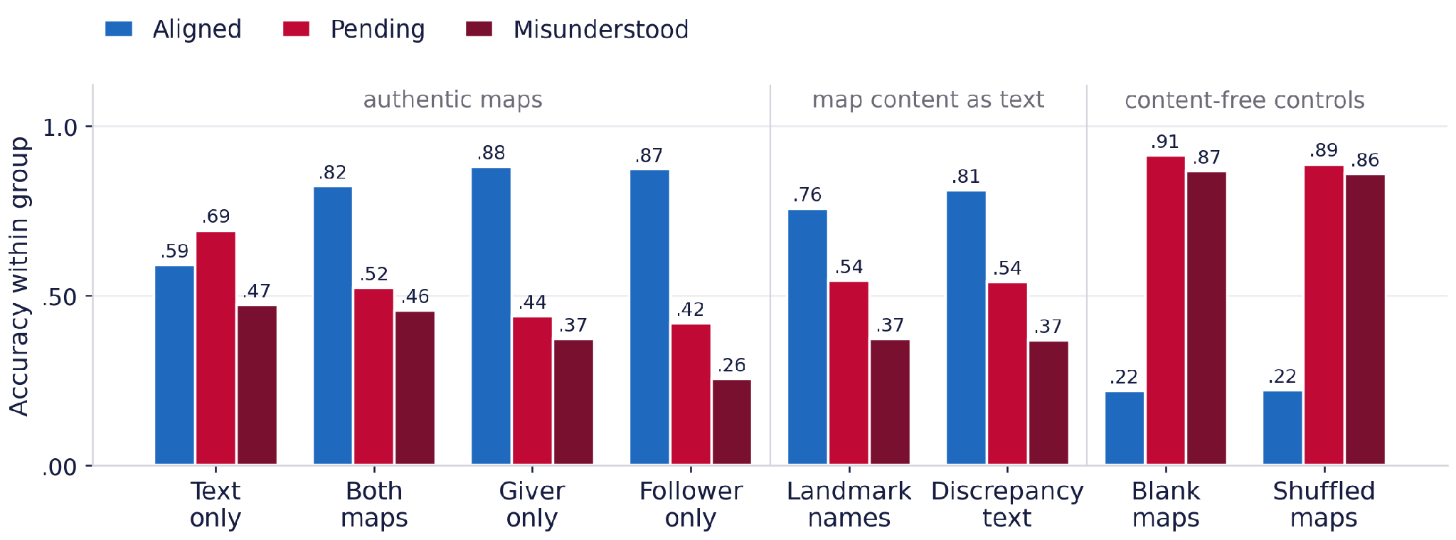
BACKUP
The same trade-off, grouped by condition
Table 4, all eight conditions. Anything carrying task-relevant map content — images or text — raises aligned accuracy and lowers pending and misunderstood accuracy.
The content-free controls invert the profile, for the wrong reason: they answer NO to almost everything.
B7
Notes:
Q3b "what about giver-only, or the discrepancy-text condition?"
One chart, all eight conditions, grouped so each condition's profile reads
vertically. The three bands are labelled: authentic maps, map content as text,
content-free controls.
The first two bands share a profile — aligned high, pending and misunderstood
low. The third band inverts it. That is the two-group story in one picture, and
it is why we say content rather than channel.

