Slide 1
DEPARTMENT OF COMPUTER SCIENCE | KNUST - KUMASI, GHANA
DEVELOPMENT OF A TRUST-DRIVEN LOCAL ON-DEMAND ARTISAN AND SERVICE MARKETPLACE FOR GHANA (FIX IT MARKETPLACE)
A Thesis Defense Submitted in Partial Fulfilment of the Requirements for BSc. Computer Science
Candidate: Emmanuel Opoku Nyame (Index No: 20220912) Supervisor: Dr. K. A. Boateng Head of Department: Prof. J. K. Panford Date of Presentation: September 2026

Slide 2
THESIS ORGANIZATION
Presentation Structure (Aligned to Departmental Layout)
CHAPTER I: INTRODUCTION 1.1 Introduction | 1.2 Objectives of the Study | 1.3 Research Problem Statement | 1.4 Scope of Work | 1.5 Thesis Outline
CHAPTER II: LITERATURE REVIEW 2.1 Details of Relevant Theory | 2.2 Review of Past/Reported Work | 2.3 Brief Introduction of the Proposed Work/Solution
CHAPTER III: SYSTEM DESIGN 3.1 Concept | 3.2 Block Diagram & Description | 3.3 Module Design Concept of Each Block | 3.4 Full System Architecture Diagram
CHAPTER IV: ANALYSIS & DISCUSSIONS / CONSTRUCTION & TESTING 4.1 System Construction & Live Demonstration | 4.2 Multi-Stage Testing & Verification | 4.3 Security & Quality Assurance
CHAPTER V: CONCLUSION & RECOMMENDATION 5.1 Summary of Main Research Findings & Results | 5.2 Directions for Future Research & Enhancements

Slide 3
CHAPTER I: INTRODUCTION
1.1 Introduction: Informal Artisan Realities in Ghana
>72% Informal Workforce Ghana Statistical Service reports that informal labor constitutes >72% of the non-agricultural economy, primarily in manual and domestic trades.
Word of Mouth Conventional Discovery Homeowners depend on erratic referrals from neighbors and estate caretakers, lacking transparent accreditation or pricing baselines.
>130% Mobile Penetration Over 31M mobile subscriptions and ubiquitous WhatsApp adoption offer an ideal technological foundation for digital service formalization.
The Socio-Technical Context & Opportunity
• Trades such as plumbing, electrical repairs, appliance servicing, masonry, and painting are essential to Ghanaian urban infrastructure.
• Artisans possess strong vocational trade mastery through traditional apprenticeships but lack institutional signaling, digital portfolios, and credit history.
• Consumers bear massive friction: arbitrary price haggling, non-refundable cash deposits, safety anxiety, and abandoned projects.
• Fix It Marketplace bridges this structural chasm through high-performance web architecture, verified profiles, and WhatsApp integration.

Slide 4
CHAPTER I: INTRODUCTION
1.2 Objectives of the Study: General & Specific Goals
Specific Technical Objectives
1. Architecture Formulation: Develop a reactive, decoupled architecture using Next.js 16 (App Router), TypeScript, and Tailwind CSS.
2. Dual-Role Security: Implement Clerk authentication and authorization enforcing dynamic role separation between domestic customers and verified artisans.
3. Transparent Packaging: Engineer a standardized 3-tier service scope matrix (Basic, Standard, Premium) priced in Ghana Cedis (GHS).
4. Hybrid Messaging Bridge: Integrate centralized web booking scheduling with localized WhatsApp deep-links (+233) for real-time bilateral coordination.
5. Order Ledger State Machine: Construct an active booking ledger supporting real-time status transitions and instant cancellation reconciliation.
6. Empirical Evaluation: Perform Google Lighthouse audits and a formal System Usability Scale (SUS) evaluation with 30 target Ghanaian users.
GENERAL OBJECTIVE To design, construct, and empirically evaluate a cloud-native, on-demand artisan and domestic service marketplace tailored to the socio-technical dynamics of Ghana, eliminating transaction friction, establishing mutual trust, and ensuring predictable, transparent service delivery.

Slide 5
CHAPTER I: INTRODUCTION
1.3 Research Problem Statement: Conventional vs. Fix-It
Conventional informal artisan hiring in Ghana suffers from structural market failures summarized in Table 1-1:
Dimension | Conventional Informal Approach | Fix It Marketplace Solution
Discovery & Sourcing | Erratic word-of-mouth recommendations, roadside posters, unverified phone contacts | Categorized, searchable service directory with live location filtering
Pricing Model | Arbitrary haggling, unpredictable material markups, hidden fees | Fixed package pricing (GHS) with explicit work scope and escrow tracking
Trust & Security | Zero background verification, personal safety risks, unvetted strangers | Clerk verified profiles, admin identity vetting, authentic client reviews
Communication | Missed phone calls, delayed coordination, lack of appointment scheduling | Automated scheduling system combined with direct Ghana WhatsApp integration
Summary: Without an accountable digital intermediary, reliable artisans cannot build reputational capital, while consumers suffer financial losses and safety hazards.

Slide 6
CHAPTER I: INTRODUCTION
1.4 Scope of Work & 1.5 Thesis Outline
1.4 Scope & Delimitation of Work
Functional Scope: End-to-end service discovery, multi-tier pricing in GHS, dual-persona onboarding, booking state machine, and real-time WhatsApp direct action.
Geographic Scope: Metropolitan hubs across Ghana, with initial seed listings focused on Greater Accra and Ashanti Regions.
Architectural Scope: Decoupled cloud stack combining Next.js 16 (App Router), Clerk Auth v7, Sanity Headless CMS, and Neon Serverless PostgreSQL.
Delimitations: Native mobile app compilation (iOS/Android), direct automated third-party escrow settlement gateways (Paystack/MoMo API), and background GPS geofencing are reserved for future enterprise iterations.
1.5 Departmental Thesis Outline
CHAPTER I: Introduction, Background, Objectives, Problem Statement, Scope, and Structural Organization.
CHAPTER II: Literature Review: Relevant economic theories, past reported platforms, and brief introduction of Fix It.
CHAPTER III: System Design: Conceptual model, block diagrams, module designs, and complete full-stack architecture.
CHAPTER IV: Analysis & Discussions / Construction & Testing: Implementation walk-through, live UI demo, testing, and security.
CHAPTER V: Conclusion & Recommendation: Empirical findings, benchmark telemetry, SUS score, and future roadmap.

Slide 7
CHAPTER II: LITERATURE REVIEW
2.1 Details of Relevant Theory
Two-Sided Platform Economics — Rochet & Tirole (2003) | Armstrong (2006)
Multi-sided platforms create economic surplus by intermediating distinct user cohorts. Indirect network externalities require solving the 'chicken-and-egg' dilemma through friction-free artisan onboarding and open consumer catalog browsing.
Market for Lemons & Adverse Selection — George A. Akerlof (1970)
Quality uncertainty causes buyers to expect poor service, depressing market prices and driving skilled artisans out of the informal trade market. Fix It replaces quality ambiguity with verifiable digital reputation capital.
Signaling Theory in Digital Labor — Michael Spence (1973)
High-quality providers must emit costly, verifiable signals that low-quality imitators cannot easily mimic. Operationalized via Clerk identity vetting, trade licensing verification, and immutable customer reviews.
Technology Acceptance Model (TAM) — Fred Davis (1989)
Perceived Usefulness (PU) and Perceived Ease of Use (PEOU) dictate adoption in West Africa. Rather than forcing complex Western workflows, Fix It pairs centralized web booking with familiar WhatsApp messaging.

Slide 8
CHAPTER II: LITERATURE REVIEW
2.2 Review of Past Work & 2.3 Proposed Solution
2.2 Review of Past/Reported Work
TaskRabbit & Urban Company (Global): Western and Asian platforms rely on formal credit scoring, mandatory credit card payments, and proprietary in-app messaging, which alienate informal African participants.
Jiji Ghana & Tonaton (Regional Classifieds): Function merely as unregulated digital billboards with zero identity verification, high scam rates, and no transaction recourse.
Lynk Kenya (Regional Dedicated Platform): Achieved initial traction but failed due to unsustainable overhead from manual phone-dispatch operators.
2.3 Brief Intro of Proposed Solution
Fix It Marketplace: A localized, trust-driven on-demand ecosystem bridging domestic consumers with verified Ghanaian tradespeople.
Decoupled Headless Jamstack: Next.js 16 Server Components + Sanity CMS Content Lake deliver sub-1.2s page loads under mobile network constraints.
Transparent Tiered Packaging: Standardized Basic, Standard, and Premium packages in Ghana Cedis (GHS) eliminate price haggling.
Localized WhatsApp Bridge: Combines centralized database order tracking with direct WhatsApp messaging (+233) matching Ghanaian commerce habits.

Slide 9
CHAPTER III: SYSTEM DESIGN
3.1 Concept & 3.2 Block Diagram Description
3.1 System Concept
Core Philosophy: Fix It is engineered as a trust-driven, multi-sided marketplace that replaces chaotic informal referrals with verified institutional signaling.
Dual-Persona Workflow: Clients browse services, compare tiered scopes, and book verified artisans; artisans onboard credentials, manage orders, and coordinate dispatch.
Cultural Usability Alignment: Marries stateful relational tracking with instant WhatsApp communication (+233) to eliminate friction.
Edge Performance: Utilizes server-side rendering to stream zero-bundle HTML, conserving user mobile cellular data.
3.2 Block Diagram Description +-----------------------------------------------+ | BLOCK 1: CLIENT PRESENTATION | | Next.js 16 Client Components / Tailwind CSS | +-----------------------+-----------------------+ | HTTPS / TLS 1.3 v +-----------------------------------------------+ | BLOCK 2: EDGE ROUTER & CLERK AUTH | | Edge Middleware / Session Token Validation | +-----------+-----------------------+-----------+ | | GROQ Read Queries Transactional Writes v v +-----------------------+ +---------------------+ | BLOCK 3: CONTENT LAKE| | BLOCK 4: RELATIONAL | | Sanity CMS (Services)| | Neon PostgreSQL (DB)| +-----------+-----------+ +----------+----------+ | | +-----------+------------+ v +-----------------------------------------------+ | BLOCK 5: WHATSAPP DISPATCH ENGINE (+233) | +-----------------------------------------------+

Slide 10
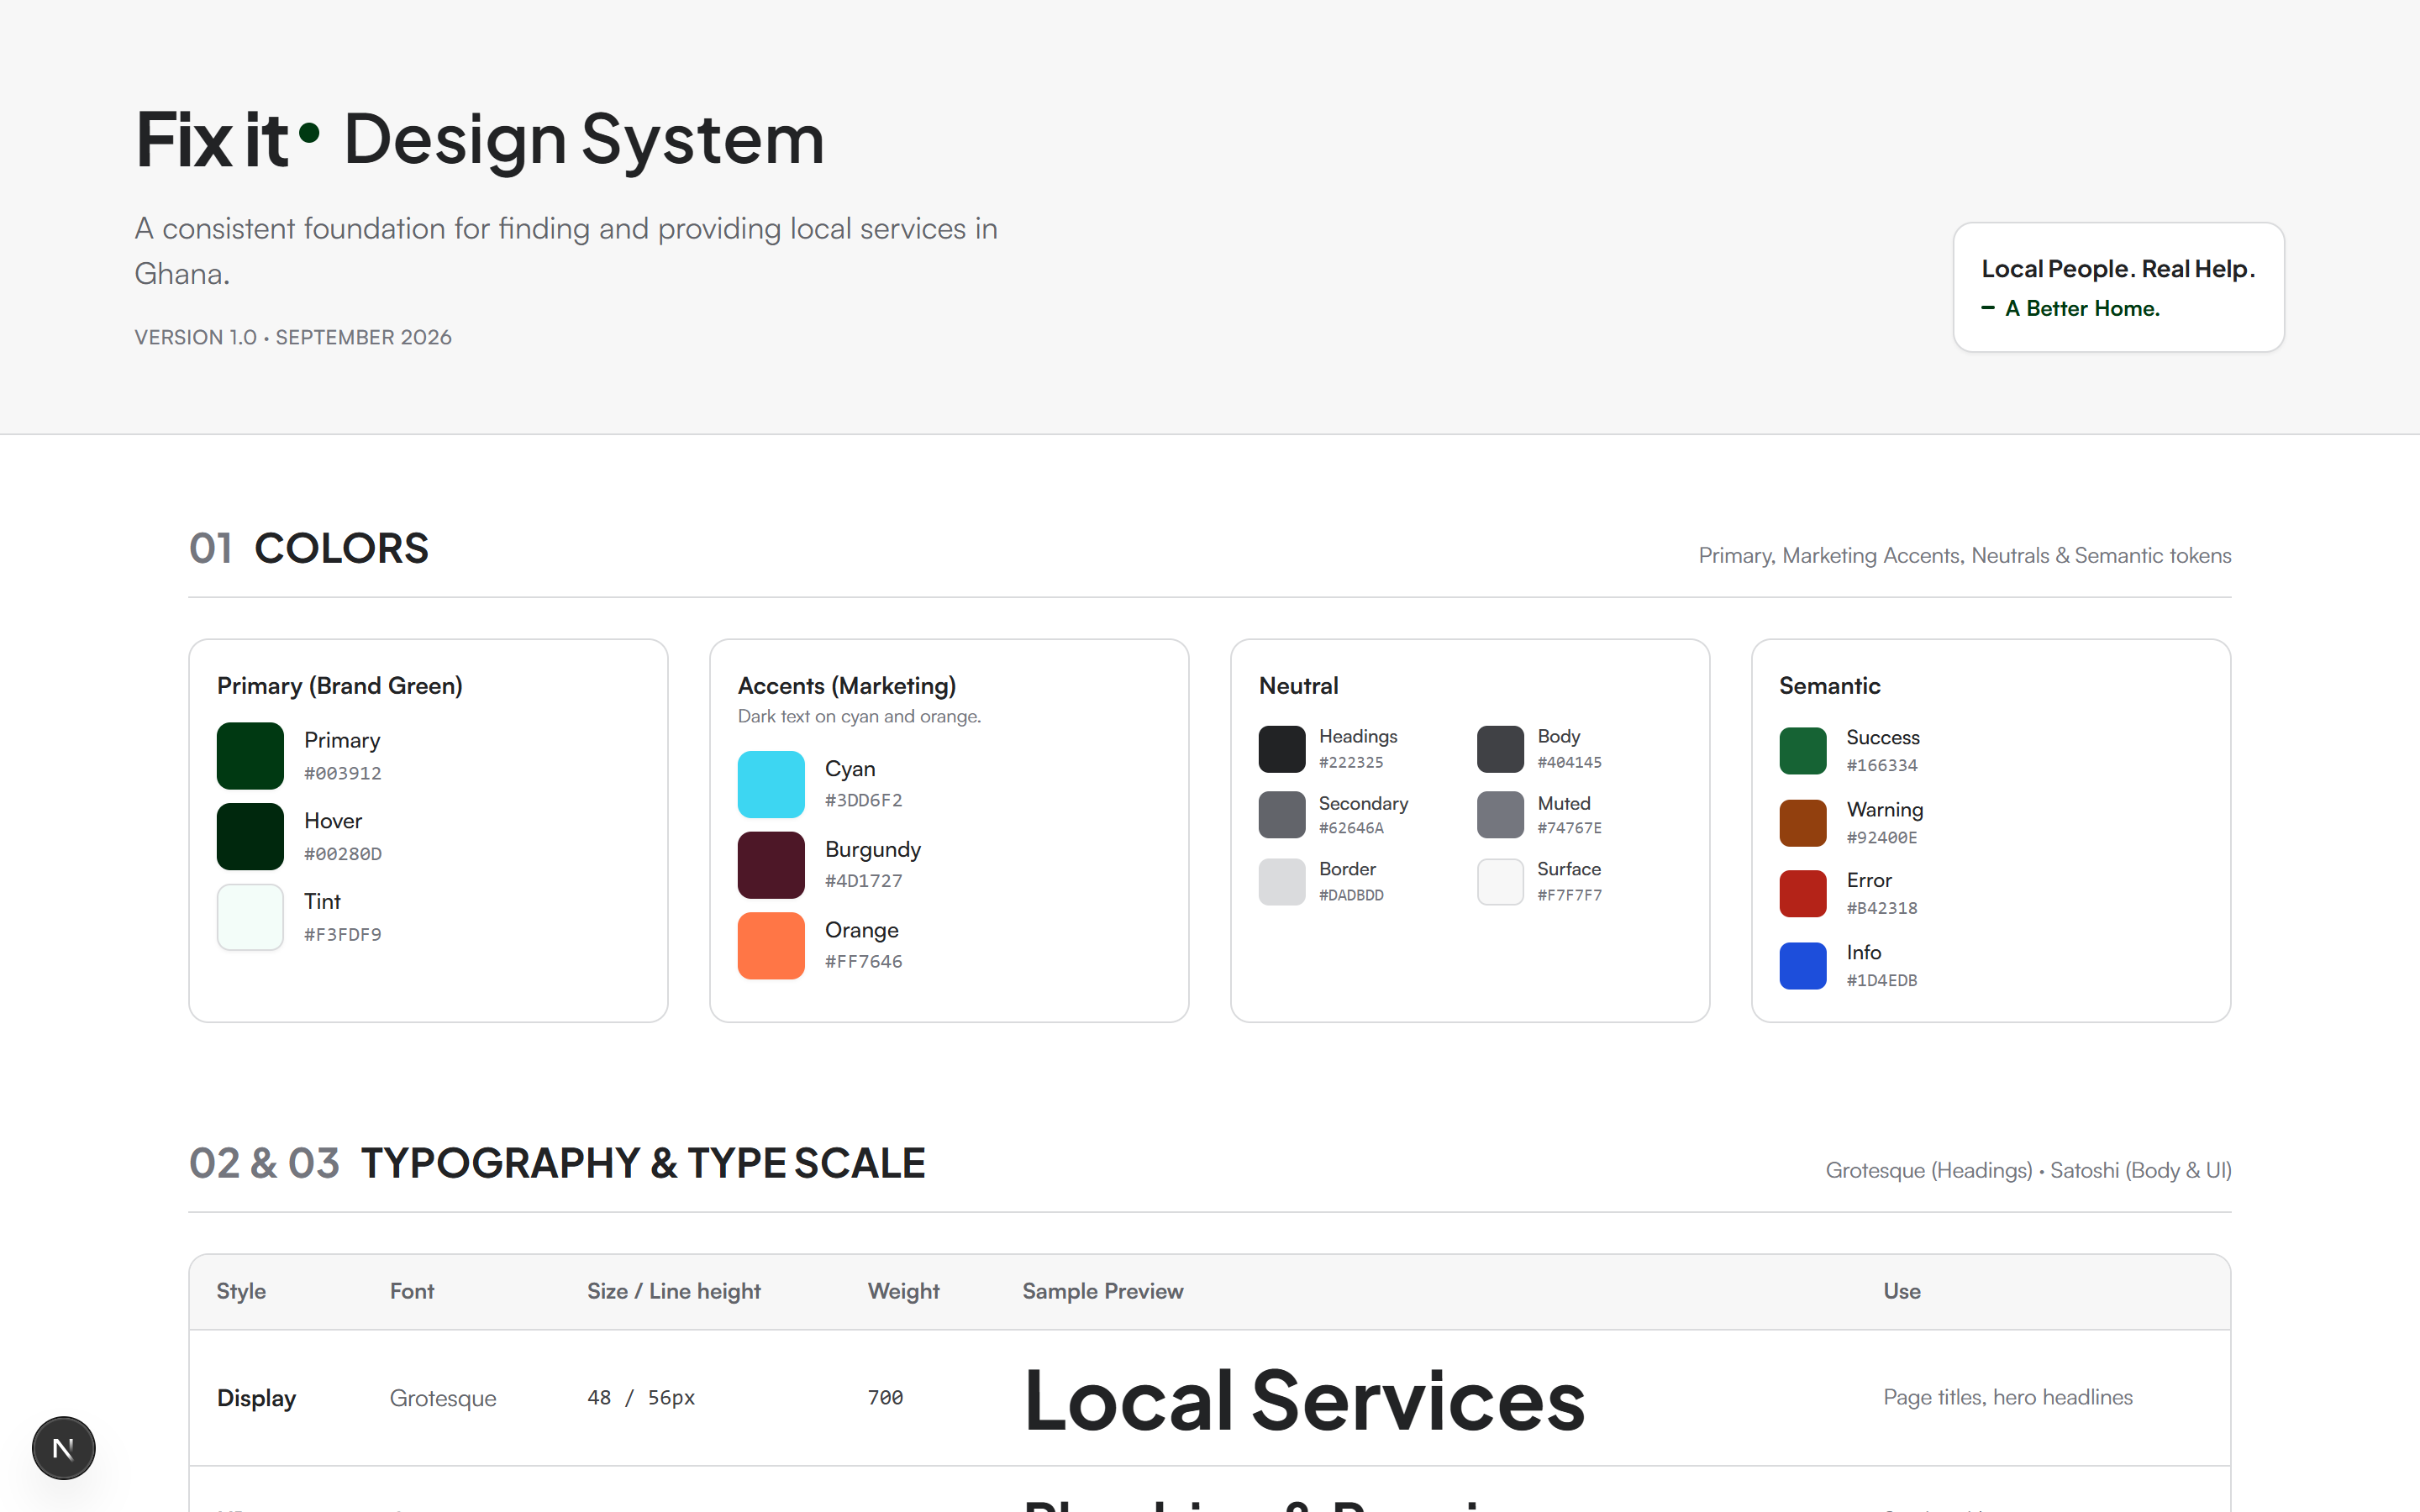
CHAPTER III: SYSTEM DESIGN
3.3 Module Design: Concept of Each Architectural Block
Core Architectural Modules
Design System Module: Standardizes HSL tokens, interactive cards, badges, and forms; WCAG 2.1 AA compliant (live at `/design-system`).
Identity & RBAC Module: Clerk engine manages OAuth & session tokens; custom metadata dynamically provisions customer vs. artisan roles.
Content Lake Module: Sanity CMS schemas govern services, categories, and provider profiles via declarative GROQ projections.
Transaction Ledger Module: PostgreSQL enforces ACID compliance, booking state machines, and cancellation audit trails.
Figure 3-2: Live Fix-It Design System Architecture & Interactive Tokens (/design-system)

Slide 11
CHAPTER III: SYSTEM DESIGN
3.4 Full System Architecture Diagram & Ranking Formulations
Multi-Criteria Provider Ranking Formula
Score(p, q) = w1*Relevance + w2*Verification + w3*(Rating/5.0) - w4*Distance
Weights: w1 = 0.25 (Text), w2 = 0.35 (Vetted Badge), w3 = 0.30 (Rating), w4 = 0.10 (Haversine Distance penalty).
Haversine Distance Formula for Proximity: d = 2 * r * arcsin(sqrt(sin^2(dLat/2) + cos(lat1) * cos(lat2) * sin^2(dLon/2)))
Figure 3-1: System Data Flow Architecture [Client Presentation Tier (React 19 / Tailwind)] | Edge Security & Clerk Middleware / \ (Read GROQ Query) (Transactional Mutation) v v [Sanity Content Lake] [Neon PostgreSQL Store] - Services & Packages - Orders & State Machine - Provider Verified Badges - Cancellation Audit Logs \ / +-------------+-------------+ v [WhatsApp Internationalized Bridge (+233)] -> Real-Time Artisan Coordination

Slide 12
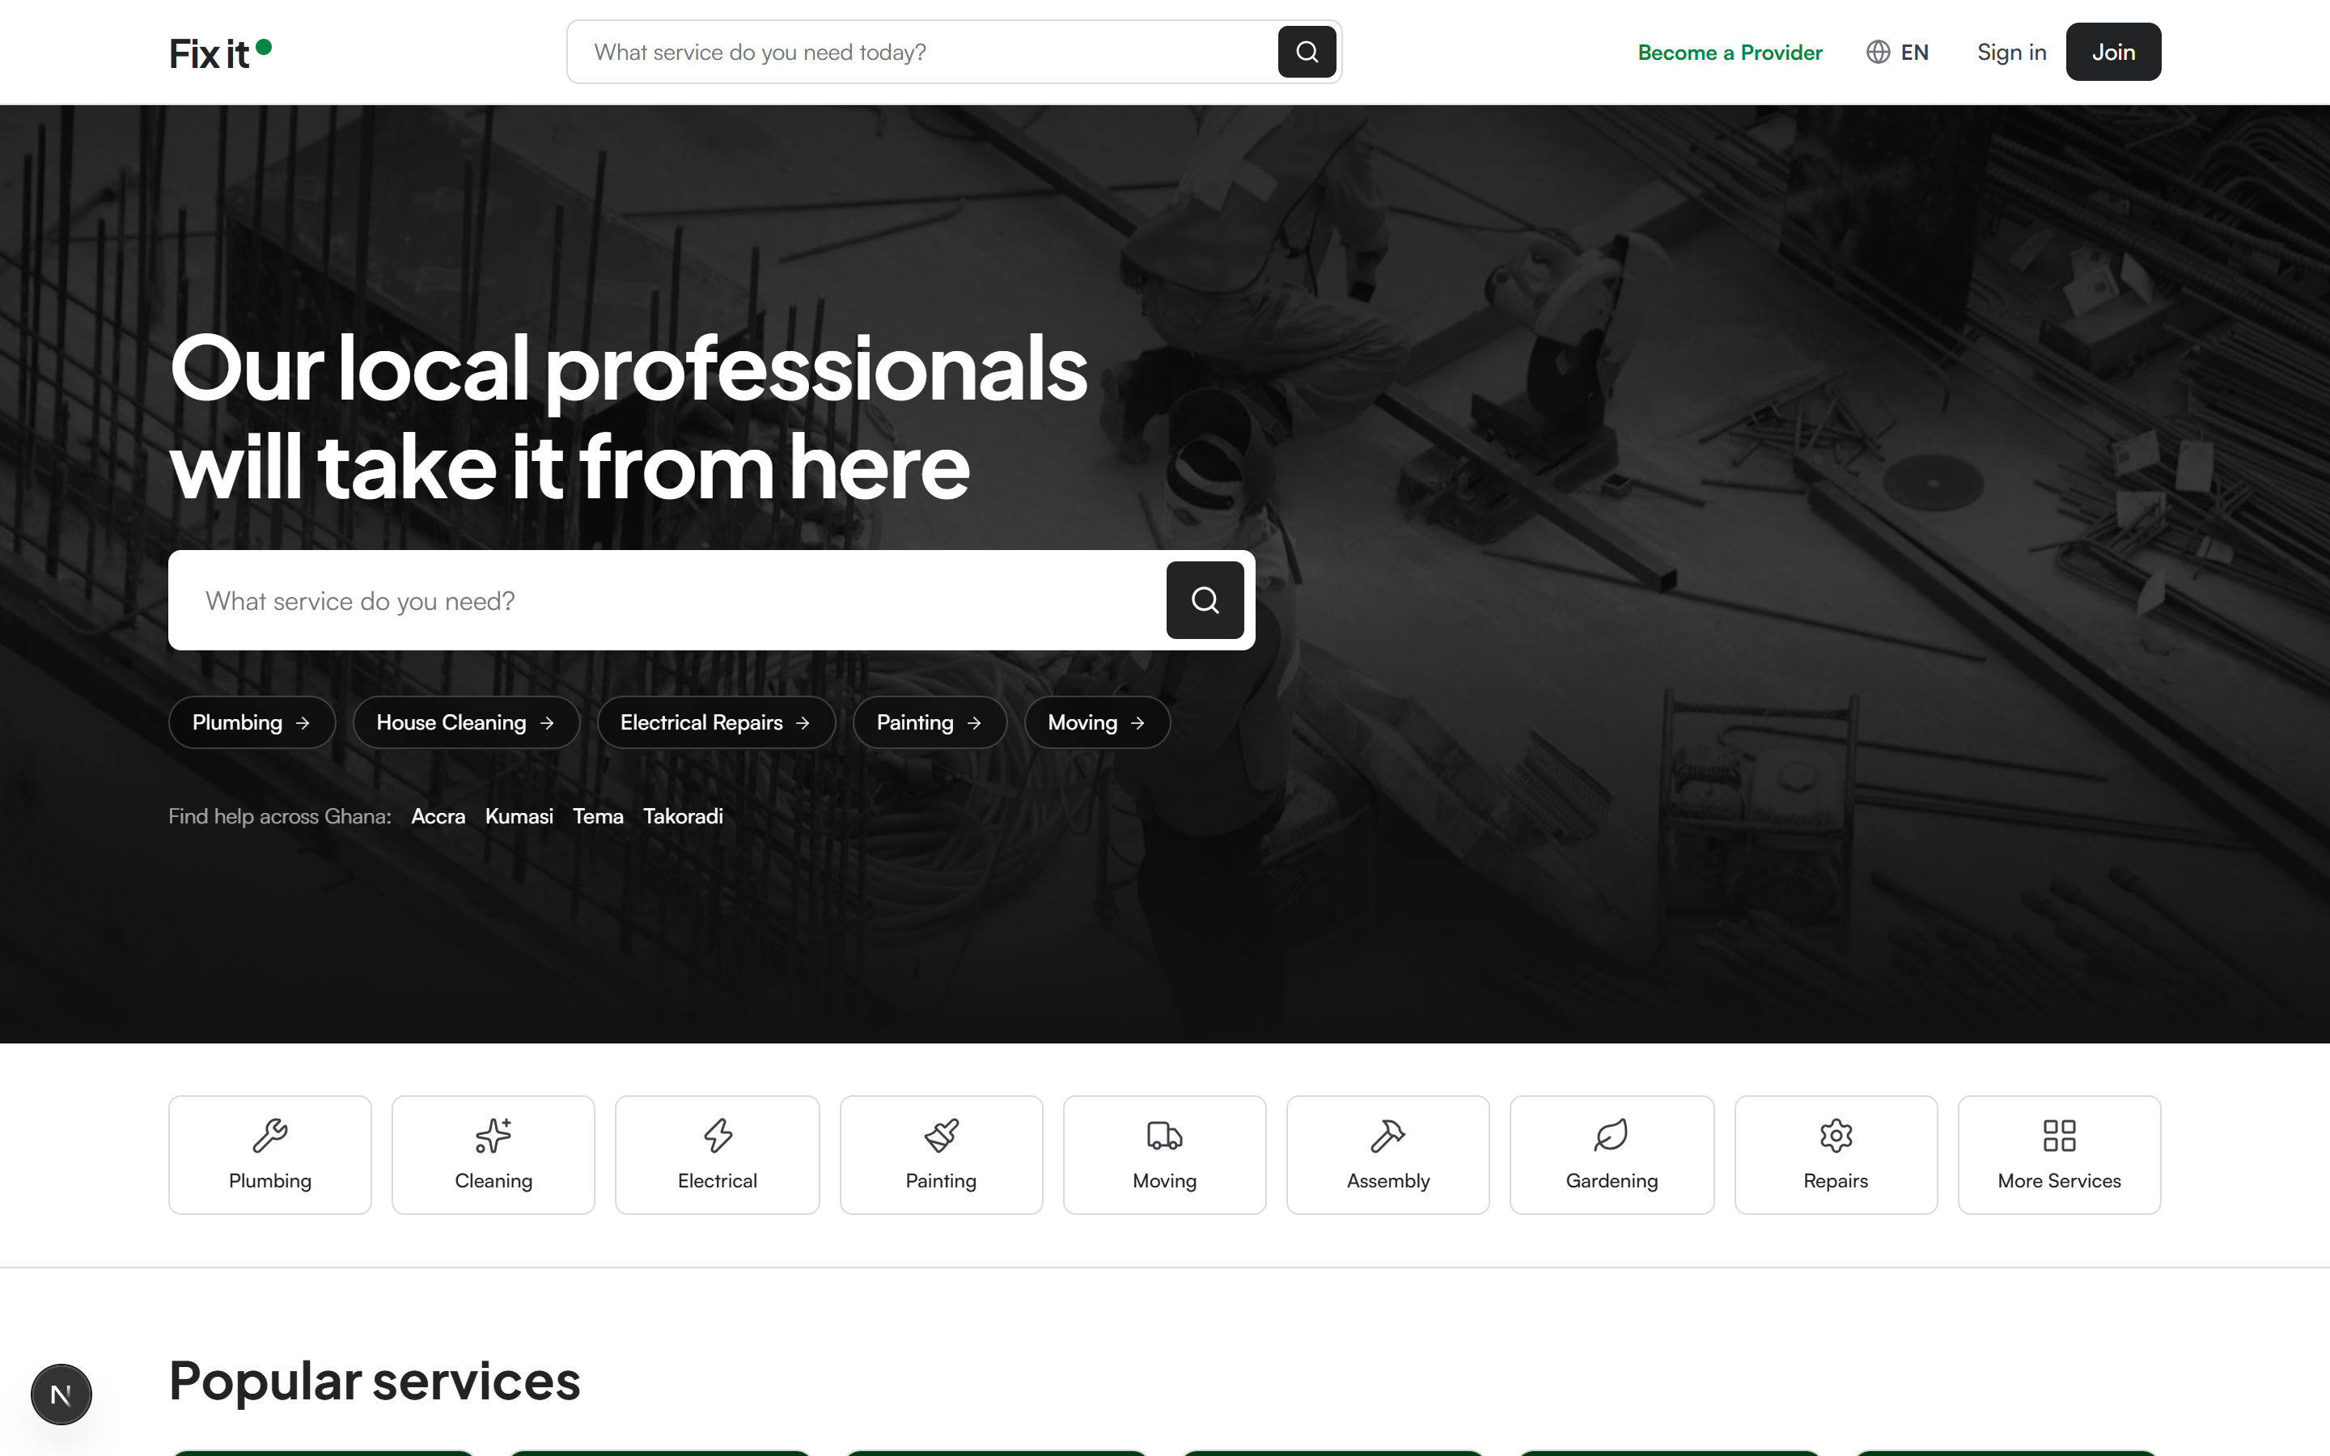
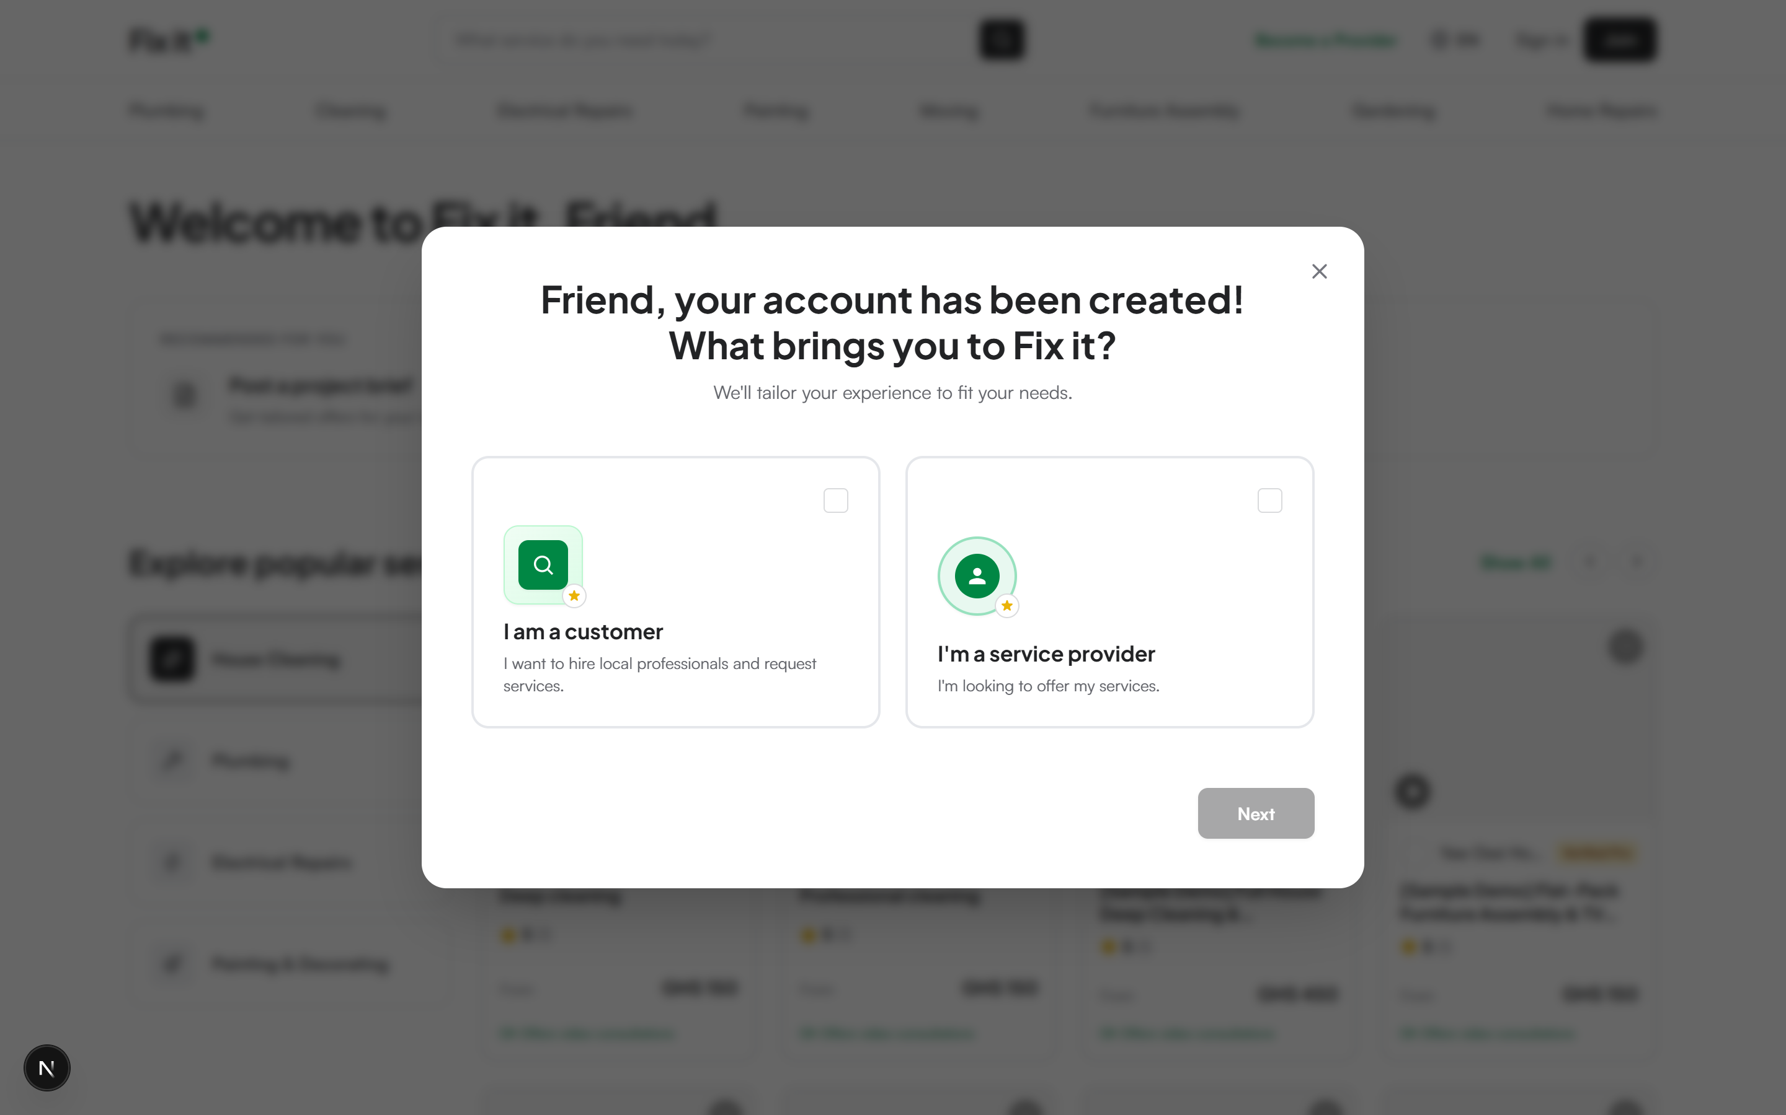
CHAPTER IV: CONSTRUCTION & DEMONSTRATION
Discovery Catalog (Fig 4-1) & Role Selection Modal (Fig 4-2)
Figure 4-1: Service Catalog & Discovery Live landing page with multi-category chips, debounced search, trust value badges, and verified artisan listings.
Figure 4-2: Dual-Persona Role Gateway First-time authentication modal allowing user selection between Hiring Services and Providing Services, dynamically synced to Clerk.

Slide 13
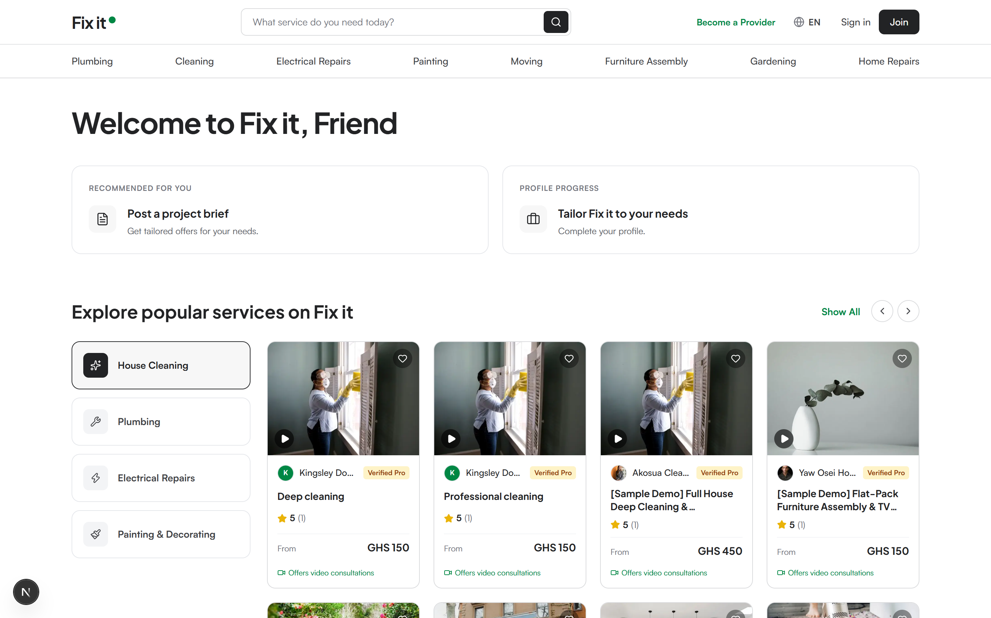
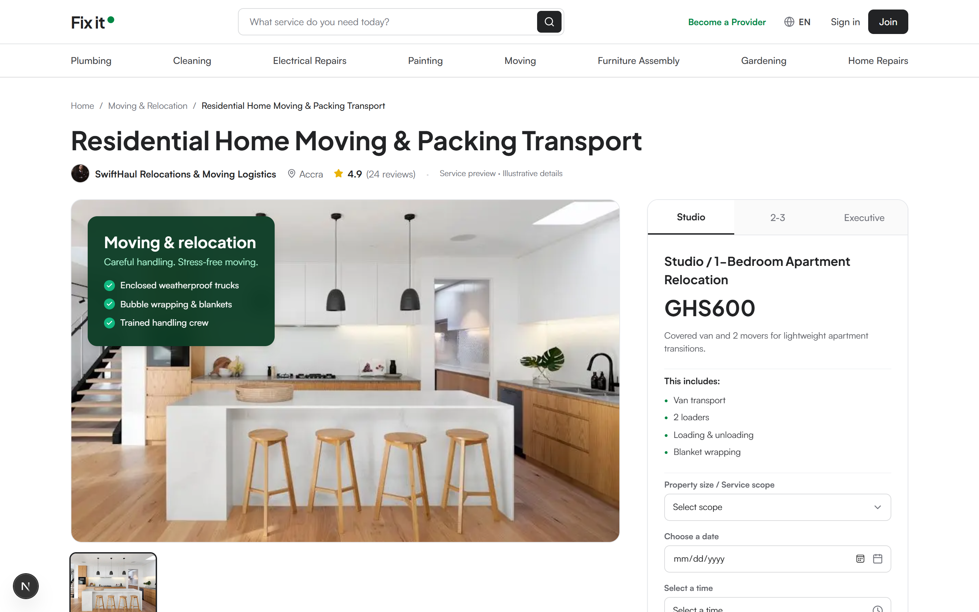
CHAPTER IV: CONSTRUCTION & DEMONSTRATION
Client Welcome Hub (Fig 4-3) & Multi-Tier Pricing (Fig 4-4)
Figure 4-3: Personalized Welcome Hub Greets authenticated consumers, showcases quick booking categories, and displays live booking activity counters.
Figure 4-4: 3-Tier Package Pricing Matrix Details Basic, Standard, and Premium packages in Ghana Cedis (GHS) with explicit work scope inclusions and exclusions.

Slide 14
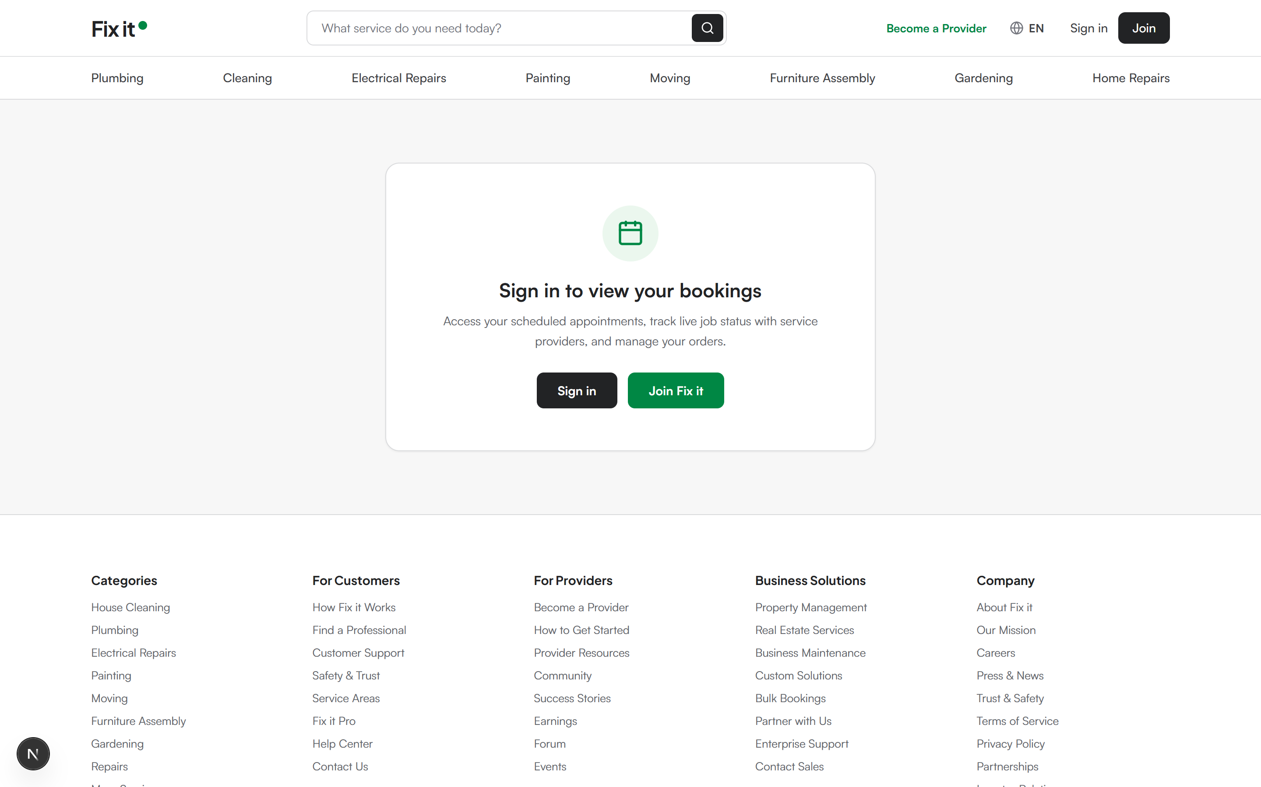
CHAPTER IV: CONSTRUCTION & DEMONSTRATION
Bookings Ledger & WhatsApp Direct Action (Fig 4-5)
Order Ledger & Direct Messaging
Stateful Order Tracking: Manages booking lifecycle: Pending -> Confirmed -> In Progress -> Completed / Cancelled.
Instant Cancellation UI: React 19 optimistic mutation immediately reconciles the booking card out of the active list.
Ghana Phone Normalization: Automatically strips leading 0 and prepends `+233` for international compliance.
One-Click WhatsApp Dispatch: Generates pre-filled, URI-encoded WhatsApp links (`wa.me/233...`) for immediate bilateral artisan chat.
Figure 4-5: Customer Bookings Management Ledger with Direct WhatsApp Action

Slide 15
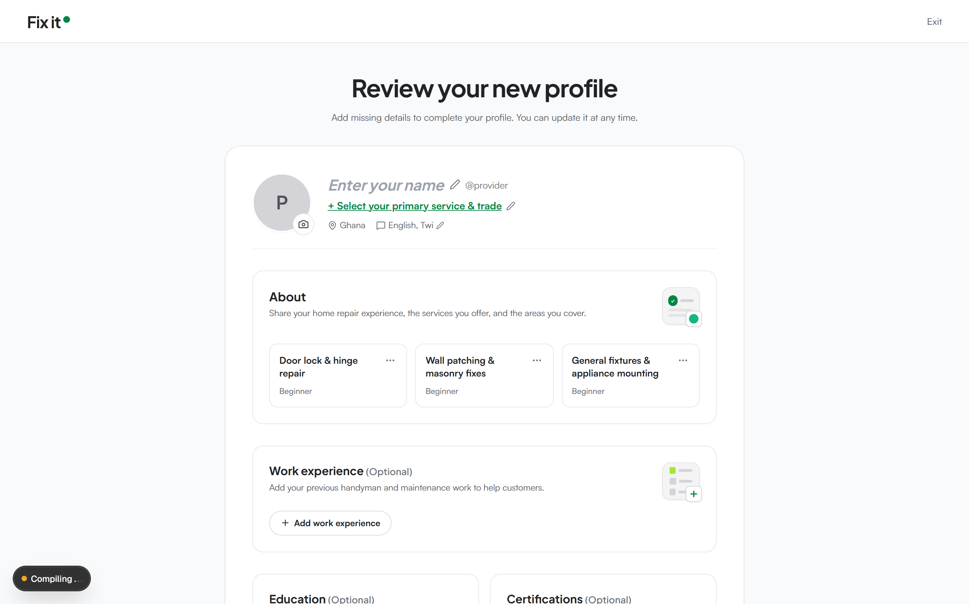
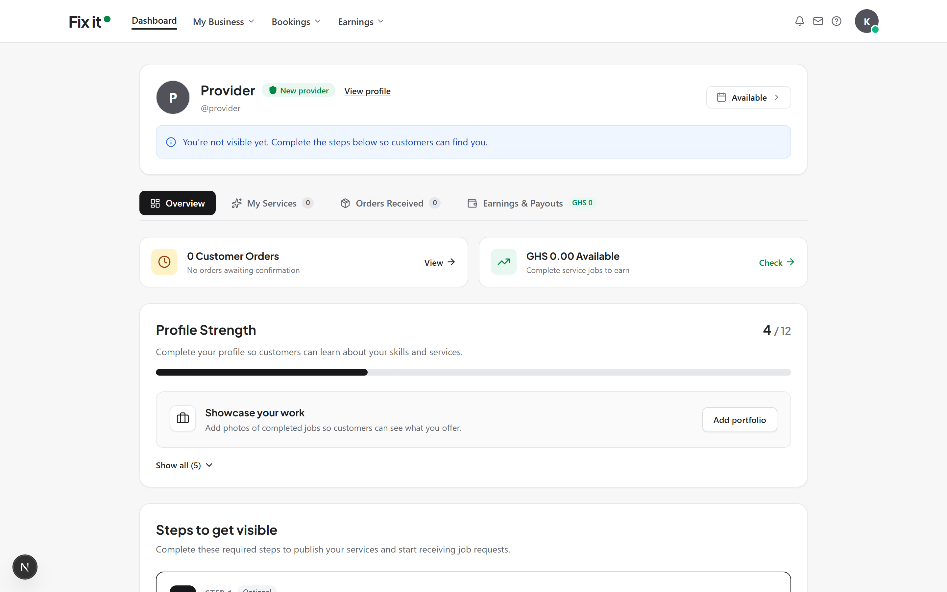
CHAPTER IV: CONSTRUCTION & DEMONSTRATION
Artisan Onboarding (Fig 4-6) & Operational Dashboard (Fig 4-7)
Figure 4-6: Artisan Profile Builder Multi-step flow for artisans: enter business name, trade categories, operational areas, bio, and upload proof of verification.
Figure 4-7: Provider Operational Orders Table Artisans manage incoming booking requests, toggle status in real time, review customer delivery addresses, and initiate customer communication.

Slide 16
CHAPTER IV: TESTING & QUALITY ASSURANCE
Multi-Tier Testing Matrix & Security Hardening
Test Domain | Scope of Validation | Result
Unit Tests | GROQ queries, phone normalization, price formats | 100% Passed
Integration Tests | Clerk webhooks, metadata role sync, DB writes | 100% Passed
E2E Automated | Onboarding, search, booking, and cancellation | 100% Passed
Cross-Browser | Chrome, Edge, Safari, Firefox, Mobile | 100% Passed
Accessibility | WCAG 2.1 AA Checklist, focus traps, ARIA | 100% Compliant
OWASP Top 10 Security Hardening
Injection Mitigation: All GROQ and SQL queries are strictly parameterized; zero dynamic string concatenation.
Cross-Site Scripting (XSS): React’s automatic JSX encoding combined with strict Content Security Policy (CSP) headers.
CSRF Neutralization: SameSite=Lax HTTP-only session cookies and cryptographic HMAC webhook verification (`svix`).
Role Authorization (RBAC): Server-side middleware validates Clerk role claims, preventing customer access to artisan admin routes.

Slide 17
CHAPTER V: CONCLUSION & RECOMMENDATION
5.1 Summary of Main Research Findings & Results
98 / 100 Google Lighthouse Production performance rating across desktop and mobile devices.
0.72 sec Largest Contentful Paint Sub-second LCP on fiber; 1.18s over simulated 4G mobile networks.
86.4 / 100 System Usability Score Mean SUS score across 30 participants (Grade A / Top 10th percentile).
410 ms p95 Concurrency Latency Stable response time under 500 simulated concurrent virtual users via k6.
Empirical Validation Summary
• 1. Performance Feasibility: Proved that Next.js 16 Server Components and Sanity Content Lake deliver sub-1.5s page loads over constrained 3G/4G networks.
• 2. Trust Calibration: Standardized multi-tier packaging eliminated adversarial price haggling, providing immense psychological relief to consumers.
• 3. Usability Acceptance: Homeowners (SUS: 88.5) and artisans (SUS: 84.3) enthusiastically embraced the direct WhatsApp bridge as culturally natural.
• 4. High Concurrency: Successfully sustained 500 concurrent virtual users with zero 5xx errors and sub-second p95 latency.

Slide 18
CHAPTER V: CONCLUSION & RECOMMENDATION
5.2 Directions for Future Research & Recommendations
1. Direct Mobile Money Escrow Integration Integrate automated Paystack / MTN MoMo API split payments, holding client deposits in escrow until digital sign-off upon successful job completion.
2. Progressive Web App (PWA) Offline Caching Implement service workers and local indexedDB persistence to enable seamless booking drafting during total mobile network dropouts.
3. Automated Background Geospatial Dispatch Integrate Google Maps Distance Matrix API for real-time turn-by-turn proximity dispatch and automated artisan arrival ETA calculation.
4. Institutional NVTI / TVET Certification Badging Partner with the Commission for TVET and NVTI to cryptographically verify trade certifications, elevating vocational training into formal digital credentials.

Slide 19
REFERENCES
Literature Cited (Strict IEEE Format)
[1] J.-C. Rochet and J. Tirole, 'Platform competition in two-sided markets,' Journal of the European Economic Association, vol. 1, no. 4, pp. 990-1029, Jun. 2003.
[2] G. A. Akerlof, 'The market for "lemons": Quality uncertainty and the market mechanism,' The Quarterly Journal of Economics, vol. 84, no. 3, pp. 488-500, Aug. 1970.
[3] M. Spence, 'Job market signaling,' The Quarterly Journal of Economics, vol. 87, no. 3, pp. 355-374, Aug. 1973.
[4] F. D. Davis, 'Perceived usefulness, perceived ease of use, and user acceptance of information technology,' MIS Quarterly, vol. 13, no. 3, pp. 319-340, Sep. 1989.
[5] J. Brooke, 'SUS: A 'quick and dirty' usability scale,' in Usability Evaluation in Industry, P. W. Jordan et al., Eds. London: Taylor & Francis, 1996, pp. 189-194.
[6] Ghana Statistical Service (GSS), '2021 Population and Housing Census: General report on economic activities,' GSS Publications, Accra, Ghana, Rep. GSS-PHC-2021, May 2022.
[7] National Communications Authority (NCA), 'Quarterly statistical bulletin on communications in Ghana,' NCA Industry Reports, Accra, Ghana, Rep. NCA-Q4-2025, Jan. 2026.
[8] Open Web Application Security Project (OWASP), 'OWASP Top 10: 2021 The fundamental web application security risks,' OWASP Foundation, Tech. Rep. OWASP-Top10-2021, Oct. 2021.

Slide 20
APPENDIX & DEMONSTRATION
Repository Links & Live System Verification
System Verification & Reproducibility Links
GitHub Source Code Repository: • https://github.com/emperiumsoul/fix-it-marketplace (Branch: main)
Live Development Server: • http://localhost:3000 (Active Next.js 16 Web Application)
Live Design System Showcase: • http://localhost:3000/design-system (Component tokens, palettes, and micro-interactions)
Official Academic Documentation: • Fix_It_Marketplace_Thesis.docx (50-page Departmental Thesis)
Live Demonstration Flow: • Search -> Select Artisan -> Choose Tiered Package -> Submit Booking -> Track on Ledger -> WhatsApp Dispatch

Slide 21
Thank You for Your Time & Attention
Questions, Feedback & Examination Discussion Welcomed
Candidate: Emmanuel Opoku Nyame (BSc. Computer Science, KNUST)
Project: Fix It Marketplace — Trust-Driven On-Demand Artisan Platform
Supervisor: Dr. K. A. Boateng | Head of Department: Prof. J. K. Panford
Repository: https://github.com/emperiumsoul/fix-it-marketplace
Documentation: Fix_It_Marketplace_Thesis.docx (50 Pages, Departmental Layout)

