Slide 1

Optimizing Sensing Arrays for High-Resolution Microwave Imaging
Kunwei Sun

Slide 2
Pipeline of reconstruction model
CSV files
(antenna locations, frequency, channel names, etc.)
Reconstruction
K-means segmentation
Result
SNR calculate
DB calculate
Distance calculate

Slide 3

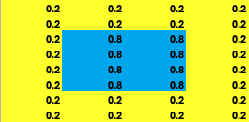
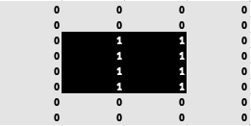
What is K-mean segmentation
K-means segmentation aims to group similar pixels together
How the K-means works:
1. Choose the Number of Clusters (K)
2. Initialize Centroids
3. Assign Pixels to Nearest Centroid
4. Update Centroids
5. Reassign Pixels
6. Result
An example of K-mean segmentation

Slide 4
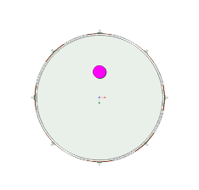
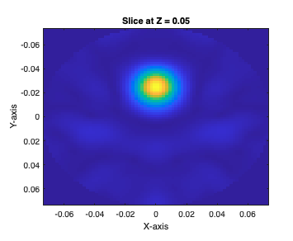
loc1

Slide 5
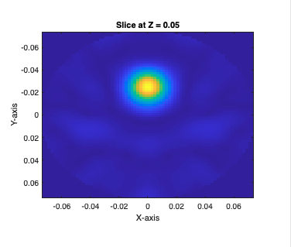
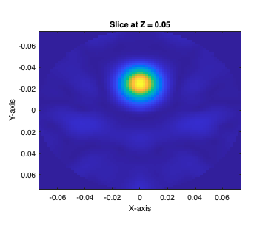
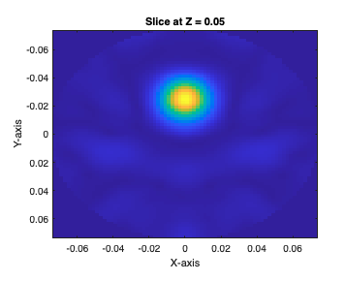
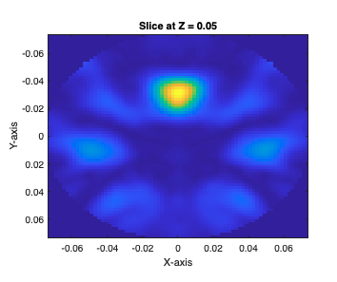
Reconstruction result
Freq1
1-5GHz
Freq2
1-2GHz
Freq3
1-3GHz
Freq4
2-4GHz

Slide 6
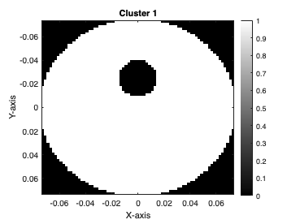
Segmentation Result-freq1

Slide 7
Segmentation Result-freq2

Slide 8
Segmentation Result-freq3

Slide 9
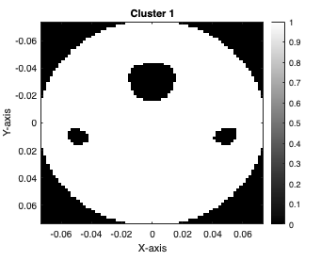
Segmentation Result-freq4

Slide 10
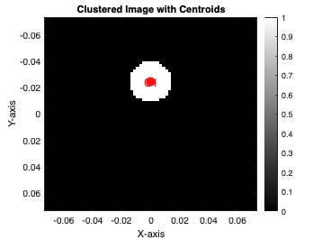
Result of centroid

Slide 11

Centroid and distance and compare with real
Centroid of simulate: (0,24.7)(mm)
Centroid of real: (0,30)(mm)
$∆$Distance: 5.3mm

Slide 12
Frequency 1-4 compare
Freq | 1 | 2 | 3 | 4
db | 25.9837 | 25.981 | 25.9815 | 19.3141
SNR_var | 14.2649 | 14.2775 | 14.2676 | 10.2131
SNR_mean | 13.2476 | 13.2508 | 13.2501 | 8.2899

Slide 13
loc2(problem)
Unfortunately we couldn’t distinguish between close targets

Slide 14
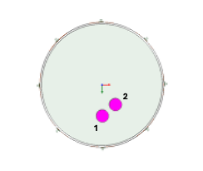
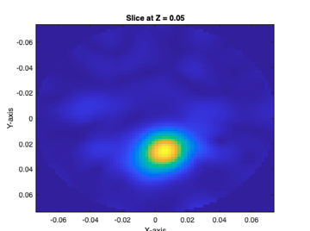
Real vs Reconstruction

Slide 15
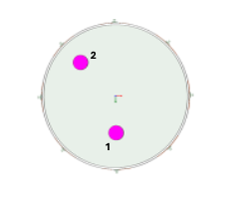
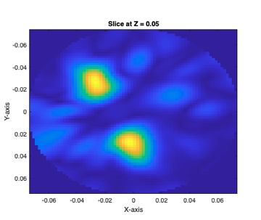
loc3

Slide 16
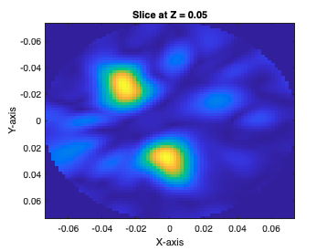
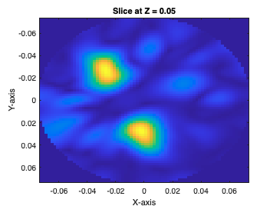
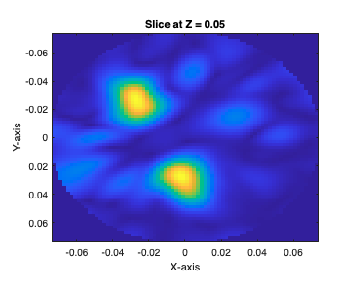
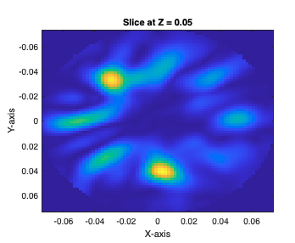
Reconstruction result
Freq1
1-5GHz
Freq2
1-2GHz
Freq3
1-3GHz
Freq4
2-4GHz

Slide 17
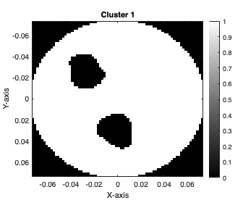
Segmentation result-freq1

Slide 18
Segmentation result-freq2

Slide 19
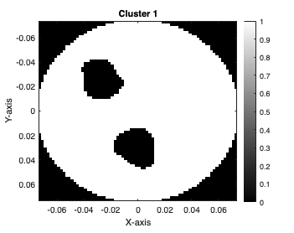
Segmentation result-freq3

Slide 20
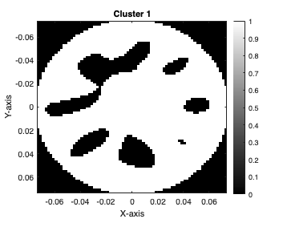
Segmentation result-freq4

Slide 21
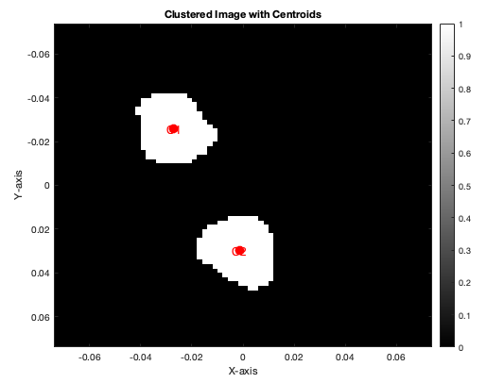
Result of centroids

Slide 22

Centroid and distance and compare with real
Centroid 1 of simulate: (-27.1,-25.7)(mm)
Centroid 2 of simulate: (-1.4,29.9)(mm)
Distance between 1 and 2: 61.3mm
Centroid 1 of real: (0,37.5)(mm)
Centroid 2 of real: (-35,-35)(mm)
Distance between 1 and 2: 80.51mm
$∆$ Distance: 19.21mm

Slide 23
Frequency 1-4 compare
Freq | 1 | 2 | 3 | 4
db | 30.3133 | 30.319 | 30.3133 | 24.2637
SNR_var | 7.2694 | 7.2742 | 7.2698 | 7.7724
SNR_mean | 8.6606 | 8.6611 | 8.6605 | 7.5442

Slide 24
Conclusion
Frequency 4 (Freq.4) result is not good (lowest DB, SNR).
Frequency 2. (Freq.2) have the best performance in all the tumor conditions (highest DB, SNR).
Compare the result between the real centroid and reconstruction centroid, it still have MSE which we need to improve the reconstruction module.
Our K-means segmentation module works well.

Slide 25
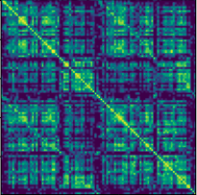
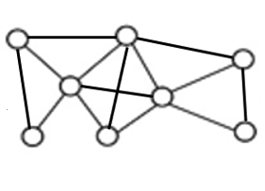
What can we do next
1. Improve the segmentation model, maybe we can add some manual modules to improve the segmentation performance.
2. Try to apply GNN (graph neural network to find out the relationship between parameters in the microwave (antenna locations, antenna numbers, channels…) and the result (image quality, DB, SNR…)), but this needs more data (more than 100) for training.

Slide 26

Q&A

