Slide 1
Ocular Checkpoint 4
Integrated application and measured CP4 evidence
Draft for team and instructor review
12 November 2026
Previously presented as GAZE. Head movements support instructor review.
01
Notes:
Draft for Checkpoint 4 review, 12 November 2026. Sources: https://github.com/emperuna/gaze-cv/blob/d60038d3f256f7d2bcc60e6c769018f8c47c2d3c/README.md
https://github.com/emperuna/gaze-cv/blob/d60038d3f256f7d2bcc60e6c769018f8c47c2d3c/docs/checkpoints/cp4-checklist.md

Slide 2
Problem and scope
Instructors need source-time context when reviewing visible head movements.
The required workflow uses saved video from one fixed camera and fixed seats.
Ocular organizes forward, left, right, down and unknown observations.
Human interpretation remains central. The project does not determine misconduct.
02
Notes:
Draft for Checkpoint 4 review, 12 November 2026. Sources: https://github.com/emperuna/gaze-cv/blob/d60038d3f256f7d2bcc60e6c769018f8c47c2d3c/PRD.md
https://github.com/emperuna/gaze-cv/blob/d60038d3f256f7d2bcc60e6c769018f8c47c2d3c/ARCHITECTURE.md

Slide 3
Data and separation
Dataset | Purpose | Count | Boundary
Pointing04 | Validation | 240 images | Subjects 1 to 10
Pointing04 | CP4 held-out test | 120 images | Subjects 11 to 15
CP3 stress set | Historical test | 63 images | 3 people, correlated variants
Video and fixtures | Integration | Separate records | No held-out accuracy claim
CP3 labels still need human cross-check. No local training is performed.
03
Notes:
Draft for Checkpoint 4 review, 12 November 2026. Sources: https://github.com/emperuna/gaze-cv/blob/d60038d3f256f7d2bcc60e6c769018f8c47c2d3c/docs/evaluation/data-card.md
https://github.com/emperuna/gaze-cv/blob/d60038d3f256f7d2bcc60e6c769018f8c47c2d3c/docs/checkpoints/cp3-hand-in/data-card.md

Slide 4
Application integration
Input path | Interface | Python processing | Outputs
Image or video | Upload and settings | Automatic runner | Annotations and JSON
Seat review | Confirm fixed regions | Shared seat and event logic | Playback, histories, events
Optional camera | Start and Stop | Persistent frame worker | Direction-only preview
Saved sessions reopen without repeating inference. Missing observations reset continuity.
04
Notes:
Draft for Checkpoint 4 review, 12 November 2026. Sources: https://github.com/emperuna/gaze-cv/blob/d60038d3f256f7d2bcc60e6c769018f8c47c2d3c/ARCHITECTURE.md
https://github.com/emperuna/gaze-cv/blob/d60038d3f256f7d2bcc60e6c769018f8c47c2d3c/docs/checkpoints/cp4-before-after.md

Slide 5
Baseline and main methods
Geometric baseline
Learned head model
MediaPipe facial landmarks
Eye–nose–chin geometry
Requires usable facial observations
Gold-YOLO head detection
6DRepNet360 rotation estimates
Quality gates preserve unknowns
Web directions are camera-relative. A fixed seat region does not establish desk-relative calibration.
05
Notes:
Draft for Checkpoint 4 review, 12 November 2026. Sources: https://github.com/emperuna/gaze-cv/blob/d60038d3f256f7d2bcc60e6c769018f8c47c2d3c/src/gaze/pipeline.py
https://github.com/emperuna/gaze-cv/blob/d60038d3f256f7d2bcc60e6c769018f8c47c2d3c/src/gaze/head_image.py
https://github.com/emperuna/gaze-cv/blob/d60038d3f256f7d2bcc60e6c769018f8c47c2d3c/docs/evaluation/hidden-faces.md

Slide 6
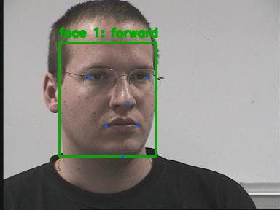
Interface demonstration
1 Upload an authorized saved clip
2 Review and confirm seat regions
3 Process and inspect movement records
4 Seek to events and reopen the session
Historical annotation example from Pointing04. This is not a screenshot of the current interface.
06
Notes:
Draft for Checkpoint 4 review, 12 November 2026. Sources: https://github.com/emperuna/gaze-cv/blob/d60038d3f256f7d2bcc60e6c769018f8c47c2d3c/frontend/README.md
https://github.com/emperuna/gaze-cv/blob/d60038d3f256f7d2bcc60e6c769018f8c47c2d3c/docs/superpowers/specs/2026-10-29-saved-review-verification.md
https://github.com/emperuna/gaze-cv/blob/d60038d3f256f7d2bcc60e6c769018f8c47c2d3c/docs/evaluation/data-card.md
Image attribution: N. Gourier, D. Hall and J. L. Crowley, Pointing04. See the data card. The workflow descriptions come from the recorded saved-review integration.

Slide 7
Recorded CP3 results
Method | Accuracy | Macro F1 | Coverage
Baseline | 46.03% | 0.4875 | 52.38%
Head model | 20.63% | 0.3071 | 38.10%
63-image historical stress set. The main method did not improve aggregate accuracy.
Apple M5 MacBook Air image workload: 7.66 ms/image baseline and 83.48 ms/image head model. These are not integrated video FPS.
07
Notes:
Draft for Checkpoint 4 review, 12 November 2026. Sources: https://github.com/emperuna/gaze-cv/blob/d60038d3f256f7d2bcc60e6c769018f8c47c2d3c/outputs/evidence/cp3-core/comparison.json
https://github.com/emperuna/gaze-cv/blob/d60038d3f256f7d2bcc60e6c769018f8c47c2d3c/docs/checkpoints/cp3-hand-in/README.md

Slide 8
CP4 held-out and laptop results
120 held-out Pointing04 images: baseline 82.50% accuracy, macro F1 0.8519.
Head model: 76.67% accuracy, macro F1 0.7807. Both methods: 94.17% coverage.
src/evaluate.py froze input, code, model and settings hashes before test inference.
Four-seat demo-laptop median: baseline 3.44 FPS, head 0.95 FPS. The 10 FPS target was not met.
CP3 and CP4 use different datasets and hardware. Larger CP4 scores do not establish algorithm improvement.
08
Notes:
Sources: https://github.com/emperuna/gaze-cv/blob/cp4-80/outputs/evidence/cp4/held-out-results.json
https://github.com/emperuna/gaze-cv/blob/cp4-80/outputs/evidence/cp4/frozen-protocol.json
https://github.com/emperuna/gaze-cv/blob/cp4-80/outputs/evidence/cp4/benchmark-baseline.json
https://github.com/emperuna/gaze-cv/blob/cp4-80/outputs/evidence/cp4/benchmark-head.json
ASUS Vivobook Go E1504FA, AMD Ryzen 5 7520U, Balanced on battery. Three runs per method, four seats, 120 frames at 1280x720. Full-session FPS includes preflight through final exports; excludes initialization, upload, browser and manual setup. Unknowns stay in classification denominators. CP3 was a different stress set on an Apple M5; numerical differences are not causal improvement estimates.

Slide 9
Technical test cases
16 fresh cases, including more than three hard or edge conditions
Cases | Condition | Recorded outcome
CP4-01 to 07 | Protocol, leakage, integrity and overwrite guards | Pass on technical expectations
CP4-08 to 10 | Gaps, ambiguity and invalid configuration | Pass on technical expectations
CP4-11 to 16 | Real models, four-seat review, seeking and reopening | Pass on technical expectations
Executed 12 November 2026. Technical passes do not establish classroom event accuracy.
09
Notes:
Source: https://github.com/emperuna/gaze-cv/blob/cp4-80/docs/checkpoints/cp4-hand-in/05-test-cases.md
164 application tests, 26 frontend tests and 16 repository automation tests passed. Real browser image/video processing, 120 frames and four seats were checked on the demo laptop. The older 20-case October record is preserved separately. Synthetic protocol/rule tests do not establish real classroom event precision or recall.

Slide 10
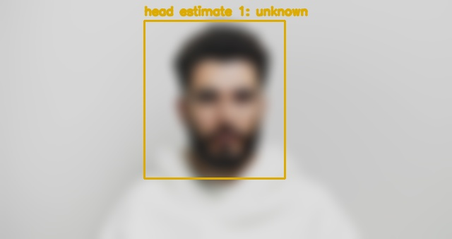
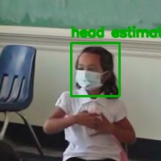
Recorded CP3 failure examples
Blurred input
Reference forward, predicted unknown
Recorded reason: head_blurry
Masked classroom crop
Reference right, predicted forward
Usable output can still be wrong
Seat suggestions also returned five regions for four proxy participants, requiring manual correction.
10
Notes:
Draft for Checkpoint 4 review, 12 November 2026. Sources: https://github.com/emperuna/gaze-cv/blob/d60038d3f256f7d2bcc60e6c769018f8c47c2d3c/outputs/evidence/cp3-core/README.md
https://github.com/emperuna/gaze-cv/blob/d60038d3f256f7d2bcc60e6c769018f8c47c2d3c/docs/checkpoints/cp3-hand-in/data-card.md
https://github.com/emperuna/gaze-cv/blob/d60038d3f256f7d2bcc60e6c769018f8c47c2d3c/docs/superpowers/specs/2026-10-29-saved-review-verification.md
Photos: cottonbro studio, Pexels 5474326; RDNE Stock project, Pexels 8363848. These records describe head pose only. Conditions are not proven causal diagnoses.

Slide 11
Operating limitations
Review bounds: 64 MB, five minutes, 18,000 frames, 1920 by 1080 pixels and 20 seats.
The supported setup uses fixed cameras, stable seat positions and compatible source timestamps.
Blur, dim lighting, small heads, occlusion and mixed poses can produce unknown or wrong directions.
Real event precision, recall, writing false alerts and classroom generalization remain unvalidated.
11
Notes:
Draft for Checkpoint 4 review, 12 November 2026. Sources: https://github.com/emperuna/gaze-cv/blob/d60038d3f256f7d2bcc60e6c769018f8c47c2d3c/docs/checkpoints/cp4-checklist.md
https://github.com/emperuna/gaze-cv/blob/d60038d3f256f7d2bcc60e6c769018f8c47c2d3c/docs/evaluation/seats.md
https://github.com/emperuna/gaze-cv/blob/d60038d3f256f7d2bcc60e6c769018f8c47c2d3c/docs/superpowers/specs/2026-10-29-saved-review-verification.md

Slide 12
Remaining submission evidence
Review the held-out scores, laptop benchmark and the saved-video fallback.
Verify classroom labels and another member’s independent reproduction.
Review the report, draft slides and effort-weighted completion calculation.
Verify the captioned backup recording and the actual hand-in revision.
A hand-in tag identifies source and files. It does not certify 80% accepted effort or instructor acceptance.
12
Notes:
CP4 package sources: https://github.com/emperuna/gaze-cv/tree/cp4-80/docs/checkpoints/cp4-hand-in
The required app paths are integrated. Independent classroom seat/event/writing validation, human reproduction, team effort-weight review and portal submission remain separate. Preserve limitations and do not mark blocked Issues Done.

