Slide 1
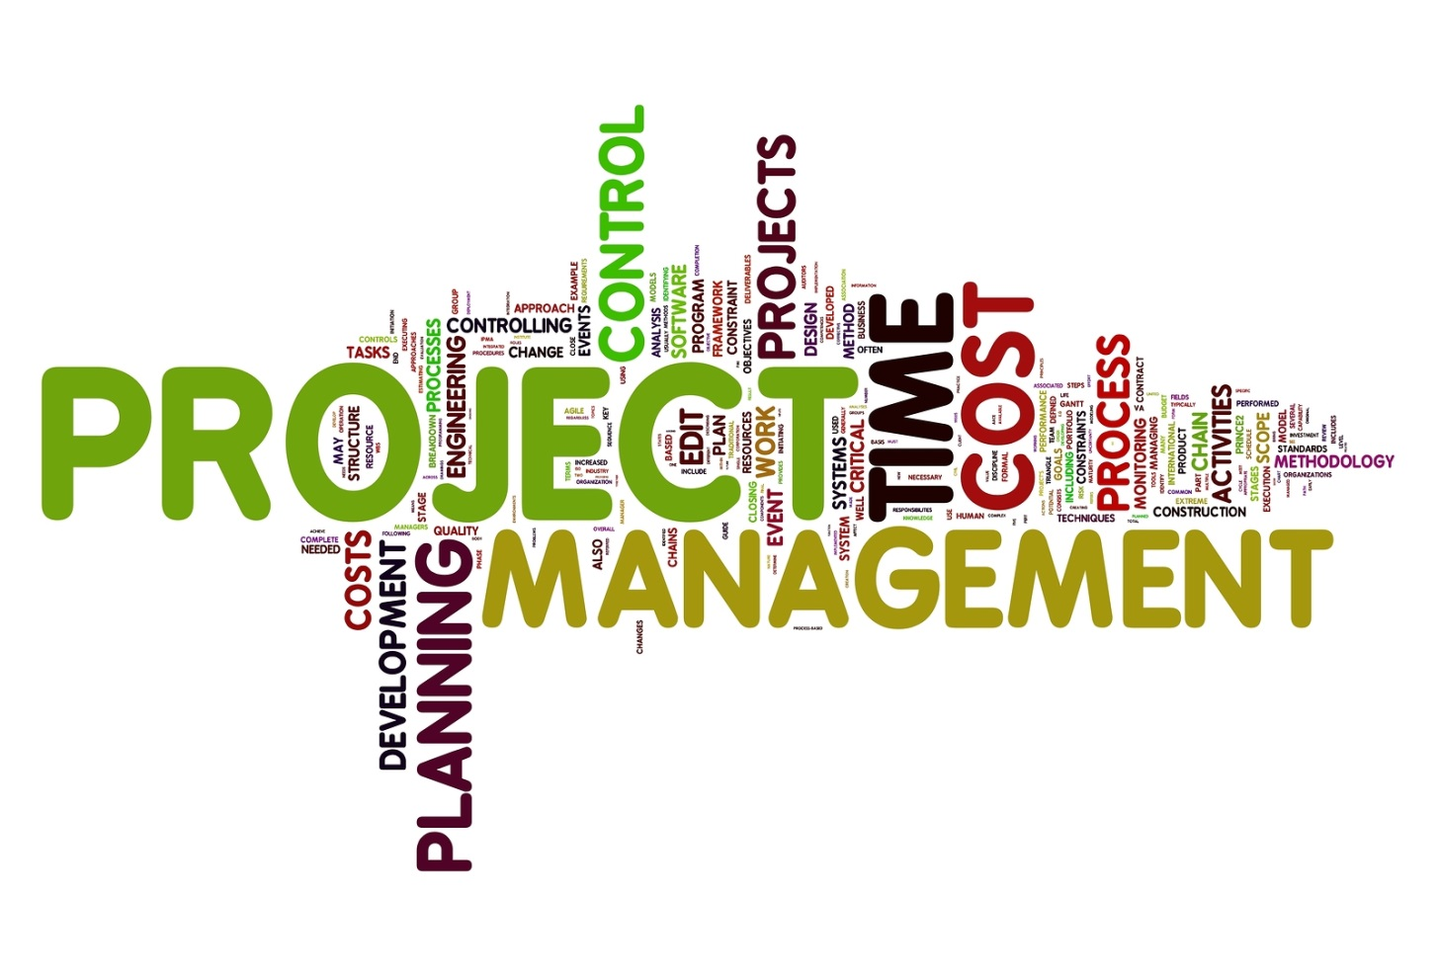
PROJECT MANAGEMENT
Alliance Software Inc
April 21, 2014

Slide 2
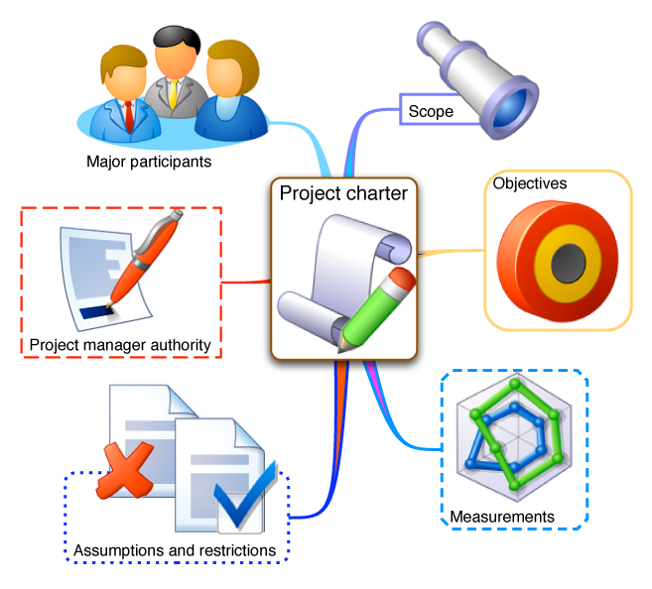
PROJECT PLANNING

Slide 3

Identify your STAKEHOLDERS
Who will be affected by the project?
Who can exert influence on the project?
Who are interested in the project?

Slide 4
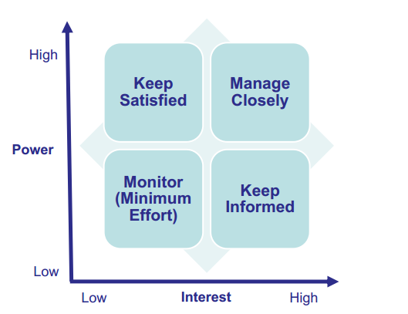
Prioritize your STAKEHOLDERS

Slide 5
Understand your KEY STAKEHOLDERS
What financial or emotional interest do they have in the outcome of your work? Is it positive or negative?
What motivates them most of all?
What information do they want from you?
How do they want to receive information from you? What is the best way of communicating your message to them?

Slide 6
Example 1: Identify & Prioritize Stakeholders
Alliance Set-up

Slide 7
Example 2: Identify & Prioritize Stakeholders
With thousands of members in the Happy Valley Area, PMI Smile Chapter is a very large chapter . This year, they have allocated $25K in the technology portfolio to redesign their outdated website.

Slide 8
Example 2: Identify & Prioritize Stakeholders
Twelve board members set the strategic directions of the chapter:
Herman (President), Michael (Past President), Lynn (Governance), Murray (Finance), Felix (Professional Development), Andres (External Relations), Marcelo (Membership), John (Technology), George (Communities), Steve (Volunteers), Natalie (Marketing) and Debra (Corporate Champions).
Shari, Executive Director, runs the chapter office. Her staff, Anthony (technical support), Shirley, Krystina and Greg, administer the websites and manage the chapter events (event registration, monthly meetings, etc.)

Slide 9
Example 2: Identify & Prioritize Stakeholders
There are several communities (special interest groups)within the chapter such as information systems, health, project management office (PMO), government, military and students. Volunteers, sponsors, local PMI registered education providers (REPs) and nearby PMI chapters may be impacted by the project as well.

Slide 10
Exercise: Identify & Prioritize Stakeholders
1. G5 asked your company to create a mobile game application similar to Clash of Clans.
Your company: Owner/CEO, project manager, developers
G5: Executive board, Liaison, Test department
2. OJT Project

Slide 11
What is a PROJECT PLAN?
according to the Project Management Body of Knowledge, is: "...a formal, approved document used to guide both project execution and project control.
to document planning assumptions and decisions, facilitate communication among stakeholders, and document approved scope, cost, and schedule baselines.

Slide 12
Contents of a PROJECT PLAN
Processes to be used
The life cycle for each phase of the project
Methods for executing the work of the project
Change management methods
Configuration management plan
Performance baseline validation
Stakeholder communication
Management reviews of content, issues, and pending decisions

Slide 13
Sample Files
Project Plan
Project Schedule
Test Strategy

Slide 14
Example
OJT Project

