Slide 1



Table of Penalty/Offenses
Types of Penalty/Offenses
Company Standards
Code of Conduct & Discipline
Restroom Etiquette
Proper Decorum/Dress Code
Management
Who Am I Working With?
Core Values
Vision and Mission
Culture
Who We Are
TO OUR TEAM!
www.empireoneglobalsolutions.com

Slide 2
EmpireOne BPO Solutions Inc.
is an Innovative BPO Company that aims to provide the best outsourcing solutions to both small and medium businesses.
Table of Penalty/Offenses
Types of Penalty/Offenses
Company Standards
Code of Conduct & Discipline
Restroom Etiquette
Proper Decorum/Dress Code
Management
Who Am I Working With?
Core Values
Vision and Mission
Culture
Who We Are

Slide 3
Initiated as EmpireOne Group, consists of six different businesses:
EmpireOne Travel
2008
specializes in travel to and from the Philippines, most frequently through packages for groups between 10-15.
EmpireOne Credit Solutions
2008
assists individuals and corporations in need of assistance through credit counseling, consumer proposals, and bankruptcy help.
Table of Penalty/Offenses
Types of Penalty/Offenses
Company Standards
Code of Conduct & Discipline
Restroom Etiquette
Proper Decorum/Dress Code
Management
Who Am I Working With?
Core Values
Vision and Mission
Culture
Who We Are
Florida Properties Managed, LLC
2008
is a real estate portfolio comprised of single-family homes, multi-unit buildings, and triplexes in Central Florida.
2011
Buffett Investments Corp.
is a real estate holding company.
Influence Communications
2014
is an ad agency that takes marketing campaigns from conception to production.
EmpireOne Global Solutions Inc.
2017
is an innovative Business Process Outsourcing Company that offers internal and external business solutions.

Slide 4
Our Culture is Our Brand
At EmpireOne, we are redefining what it means to be a business outsourcing company because we strive to be the best. We know that being average just won’t cut it, so we foster exceptional performances and careers.
Table of Penalty/Offenses
Types of Penalty/Offenses
Company Standards
Code of Conduct & Discipline
Restroom Etiquette
Proper Decorum/Dress Code
Management
Who Am I Working With?
Core Values
Vision and Mission
Culture
Who We Are

Slide 5

VISION
MISSION
We exist to be a premium quality service provider by ensuring our client that we will help to grow their business by providing them smart and flexible business solutions at all times.
Table of Penalty/Offenses
To be the ultimate choice of companies across the globe in all their outsourcing and offshoring solutions needs.
Types of Penalty/Offenses
Company Standards
Code of Conduct & Discipline
Restroom Etiquette
Proper Decorum/Dress Code
Management
Who Am I Working With?
Core Values
Vision and Mission
Culture
Who We Are

Slide 6






Table of Penalty/Offenses
INNOVATION
PASSION
EXCELLENCE
Types of Penalty/Offenses
Company Standards
Code of Conduct & Discipline
Restroom Etiquette
Proper Decorum/Dress Code
Management
Who Am I Working With?
Core Values
Vision and Mission
Culture
Who We Are
HONESTY
INTEGRITY
TEAMWORK

Slide 7
At EmpireOne, you will be surrounded by intelligent, innovative people who genuinely care about you and your career path. While you may want to work with us because the opportunity sounds appealing, you will no doubt learn to love the experience for the people.
Table of Penalty/Offenses
Types of Penalty/Offenses
Company Standards
Code of Conduct & Discipline
Restroom Etiquette
Proper Decorum/Dress Code
Management
Who Am I Working With?
Core Values
Vision and Mission
Culture
Who We Are

Slide 8
We do practice open-door policy
but this follows a certain parameters:
Managers, supervisors and other company officers have hectic time to do a small talks with you, so find the perfect time. When you got the chance, be professional with your words.
It is right to consult your immediate supervisor first before going directly to the managers, CEO and etc. Following the hierarchy is the best step to take!
It is also best to identify and resolve the issue on your own first. Practice your problem-solving skills.
Table of Penalty/Offenses
Types of Penalty/Offenses
Company Standards
Code of Conduct & Discipline
Restroom Etiquette
Proper Decorum/Dress Code
Management
Who Am I Working With?
Core Values
Vision and Mission
Culture
Who We Are

Slide 9


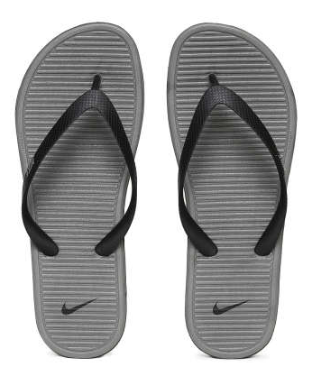


For Women, NO WEARING OF:
Slippers
Short shorts
Sleeveless, Tube, Sando and Spaghetti strap
Table of Penalty/Offenses
Types of Penalty/Offenses
Company Standards
Code of Conduct & Discipline
Restroom Etiquette
Proper Decorum/Dress Code
Management
Who Am I Working With?
Core Values
Vision and Mission
Culture
Who We Are

Slide 10
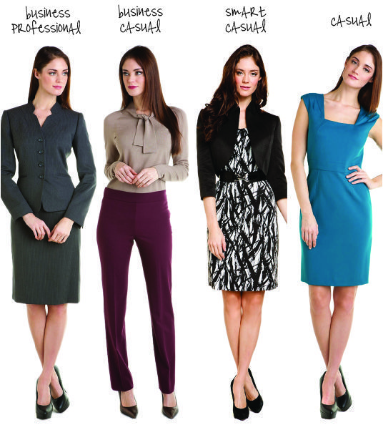
Acceptable Dress Codes
Table of Penalty/Offenses
Types of Penalty/Offenses
Company Standards
Code of Conduct & Discipline
Restroom Etiquette
Proper Decorum/Dress Code
Management
Who Am I Working With?
Core Values
Vision and Mission
Culture
Who We Are

Slide 11
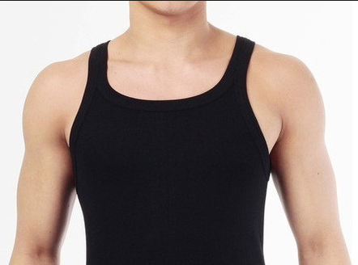


For MEN, NO WEARING OF:
Slippers
Short shorts
Sando and Racerback
Table of Penalty/Offenses
Types of Penalty/Offenses
Company Standards
Code of Conduct & Discipline
Restroom Etiquette
Proper Decorum/Dress Code
Management
Who Am I Working With?
Core Values
Vision and Mission
Culture
Who We Are

Slide 12

Acceptable Dress Codes
Table of Penalty/Offenses
Types of Penalty/Offenses
Company Standards
Code of Conduct & Discipline
Restroom Etiquette
Proper Decorum/Dress Code
Management
Who Am I Working With?
Core Values
Vision and Mission
Culture
Who We Are

Slide 13
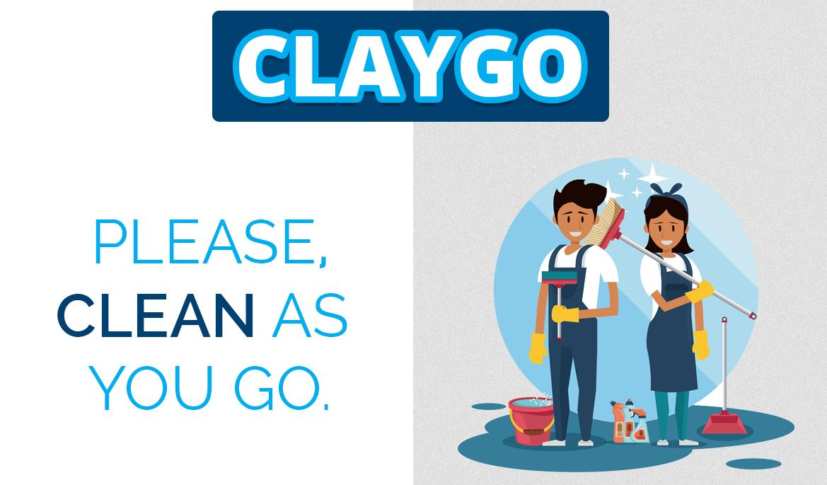
Table of Penalty/Offenses
Types of Penalty/Offenses
Company Standards
Code of Conduct & Discipline
Restroom Etiquette
Proper Decorum/Dress Code
Management
Who Am I Working With?
Core Values
Vision and Mission
Culture
Who We Are
A clean as you go policy is a cleaning strategy used to minimize risks to hygiene, health, and safety.
The clean as you go method involves taking opportunities to clean continually throughout the working day and making cleaning part of your daily routine to ensure that surfaces, equipment, waste, and the premises are clean, hygienic, and clutter free.

Slide 14
Never leave the restroom dirty. Smelly toilets are big turn offs.
Lock the door carefully when you are inside. If someone is inside, don’t peep under the doors or knock endlessly. Wait for the other person to come out.
Female employees should avoid carrying their handbags inside the washroom. Do not carry expensive items to the restroom.
Make sure you do not wet the toilet seat. Do not throw water on the floor as someone might slip and get hurt.
Table of Penalty/Offenses
Types of Penalty/Offenses
Company Standards
Code of Conduct & Discipline
Restroom Etiquette
Proper Decorum/Dress Code
Management
Who Am I Working With?
Core Values
Vision and Mission
Culture
Who We Are

Slide 15
Females should always sit on the toilet seat while peeing. Male employees should always stand a little close to the toilet seat to avoid dripping.
Never forget to use flush once you are done. Check the toilet seat for unwanted stains or substance. Do not hesitate to call the toilet attendant if the flush is not working.
Make it a point to wash your hand with an antiseptic soap or sanitizer every time you use the restroom. Use a tissue paper to wipe off hands.
Do not spit on walls. It is absolutely childish to write names or make designs on toilet walls.
Table of Penalty/Offenses
Types of Penalty/Offenses
Company Standards
Code of Conduct & Discipline
Restroom Etiquette
Proper Decorum/Dress Code
Management
Who Am I Working With?
Core Values
Vision and Mission
Culture
Who We Are

Slide 16
Don’t take much time inside the restroom. One should avoid taking hand phones inside the washroom.
Make sure you turn on the exhaust fan once you are inside the toilet. Do not forget to switch off the lights and exhaust fan when you leave the restroom.
Do not throw unwanted hair or soap wrappers in the washbasin. Keep the soap inside the soap case.
Ask the attendant to clean the toilet whenever it is dirty.
Table of Penalty/Offenses
Types of Penalty/Offenses
Company Standards
Code of Conduct & Discipline
Restroom Etiquette
Proper Decorum/Dress Code
Management
Who Am I Working With?
Core Values
Vision and Mission
Culture
Who We Are

Slide 17

To promote good and healthy working environment
Upholds professionalism
Table of Penalty/Offenses
Types of Penalty/Offenses
Company Standards
Code of Conduct & Discipline
Restroom Etiquette
Proper Decorum/Dress Code
Management
Who Am I Working With?
Core Values
Vision and Mission
Culture
Who We Are
Set standards on how our organization lives up to its objectives.

Slide 18

Proper Conduct and Etiquette
Company’s Productivity
Table of Penalty/Offenses
Types of Penalty/Offenses
Company Standards
Code of Conduct & Discipline
Restroom Etiquette
Proper Decorum/Dress Code
Management
Who Am I Working With?
Core Values
Vision and Mission
Culture
Who We Are
Provide Healthy and Secure Environment
Proper Use of Company’s Facilities and Property

Slide 19
LEVEL
1
Minor offense deal with transgression that is inconsequential in nature but if not corrected it will become a habit. No impact on the company’s business
Table of Penalty/Offenses
Minor offense deal with transgression that would cause delay in operations, pose any threats or harm on company’s property.
Types of Penalty/Offenses
Company Standards
Code of Conduct & Discipline
Restroom Etiquette
Proper Decorum/Dress Code
Management
Who Am I Working With?
Core Values
Vision and Mission
Culture
2
Who We Are
3
Serious and major offense deal with transgression that would impact the company’s image that might leads to loss of company’s clients or business. This also entails the security of our employees, clients and customers information’s. This may also be ground for termination.

Slide 20
Conduct and Etiquette
SECTION
DESCRIPTION OF OFFENSE
LEVEL
1st OFFENSE
2nd OFFENSE
3rd OFFENSE
4th OFFENSE
5th OFFENSE
1
Creating Unnecessary noise inside the office
1
Verbal Warning
Written Warning
Final Written Warning
Suspension/Adminis-trative Hearing
Termination
2
Sleeping during working hours
1
Verbal Warning
Written Warning
Final Written Warning
Suspension/Adminis-trative Hearing
Termination
Table of Penalty/Offenses
Types of Penalty/Offenses
Company Standards
Code of Conduct & Discipline
Restroom Etiquette
Proper Decorum/Dress Code
Management
Who Am I Working With?
Core Values
Vision and Mission
Culture
Who We Are
3
Failure to complete the pre-employment requirements
1
Verbal Warning
Written Warning
Final Written Warning
Suspension/Adminis-trative Hearing
Termination
Inappropriate conduct causes disorder or disrupt of work such as but not limited to:
Physical Violence amongst employees inside the working place.
Any forms of threats
3
Termination
4
5
Failure to maintain cleanliness and order in the assigned workstation
1
Verbal Warning
Written Warning
Final Written Warning
Suspension/Adminis-trative Hearing
Termination

Slide 21
SECTION
DESCRIPTION OF OFFENSE
LEVEL
1st OFFENSE
2nd OFFENSE
3rd OFFENSE
4th OFFENSE
5th OFFENSE
6
Being Disrespectful towards superior. Using foul language or act discourteous.
2
Written Warning
Final Written Warning
Suspension/Adminis-trative Hearing
Termination
7
Abandonment of Work
3
Final Written Warning
Suspension/Adminis-trative Hearing
Termination
8
Refusal to render overtime during business needs/critical days
2
Written Warning
Final Written Warning
Suspension/Administrativ Hearing
Termination
Table of Penalty/Offenses
Types of Penalty/Offenses
Company Standards
Code of Conduct & Discipline
Restroom Etiquette
Proper Decorum/Dress Code
Management
Who Am I Working With?
Core Values
Vision and Mission
Culture
Who We Are
9
Malingering
3
Termination
10
Rudeness to clients and customers which includes but not limited to co-employees
3
Termination
Any forms of stealing such as but not limited to:
Theft
Burglary
Filching
Pilferage
Termination
11
3

Slide 22
Company’s Productivity
SECTION
DESCRIPTION OF OFFENSE
LEVEL
1st OFFENSE
2nd OFFENSE
3rd OFFENSE
4th OFFENSE
5th OFFENSE
1
Simple Negligence of duties that causes an error with minimal business impact
1
Written Warning
Final Written Warning
Suspension/Adminis-trative Hearing
Termination
Insubordination by an employee to any order by his superior of authorized officer without any valid reason such as but not limited to the following:
Refusal to accept work schedule or shift assignment
Refusal to be assigned to another department or unit and reassigned to another position or role
2
Final Written Warning
Suspension/Adminis-trative Hearing
Termination
Table of Penalty/Offenses
Types of Penalty/Offenses
Company Standards
Code of Conduct & Discipline
Restroom Etiquette
Proper Decorum/Dress Code
Management
Who Am I Working With?
Core Values
Vision and Mission
Culture
Who We Are
2
Any work or call avoidance types which includes but not limited to:
Not answering to a critical call/lead or service call/lead
Termination
3
3

Slide 23
SECTION
DESCRIPTION OF OFFENSE
LEVEL
1st OFFENSE
2nd OFFENSE
3rd OFFENSE
4th OFFENSE
5th OFFENSE
Intentionally disconnecting a call or failure to answer lead request
Failure to respond to customer emails
Termination
3
3
Gross Negligence of duties that causes error with significant business impact
Huge company loss
Anything prejudicial to the image or reputation of the company to its customers and external parties
3
Termination
Table of Penalty/Offenses
Types of Penalty/Offenses
Company Standards
Code of Conduct & Discipline
Restroom Etiquette
Proper Decorum/Dress Code
Management
Who Am I Working With?
Core Values
Vision and Mission
Culture
Who We Are
4
Performing any act of that would result in hindering once productivity or attempt to violate company’s productivity
3
Termination
5

Slide 24
SECTION
DESCRIPTION OF OFFENSE
LEVEL
1st OFFENSE
2nd OFFENSE
3rd OFFENSE
4th OFFENSE
5th OFFENSE
Failure of the employee to improve and meet the job standard of its task and responsibilities after being coach and given a chance to improve his performance; Failing the company’s performance improvement plan or the likes
3
Termination
6
Table of Penalty/Offenses
Types of Penalty/Offenses
Company Standards
Code of Conduct & Discipline
Restroom Etiquette
Proper Decorum/Dress Code
Management
Who Am I Working With?
Core Values
Vision and Mission
Culture
Who We Are
Enticing and instigating any act that can cause any delay or hinder job output
3
Termination
7

Slide 25
Health and Security
SECTION
DESCRIPTION OF OFFENSE
LEVEL
1st OFFENSE
2nd OFFENSE
3rd OFFENSE
4th OFFENSE
5th OFFENSE
Non-Observance of proper housekeeping such as but not limited to:
Proper disposal of waste materials
Failure to observe CLAYGO (Clean As You Go)
1
Verbal Warning
Written Warning
Final Written Warning
Suspension/Adminis-trative Hearing
Termination
1
Table of Penalty/Offenses
Types of Penalty/Offenses
Company Standards
Code of Conduct & Discipline
Restroom Etiquette
Proper Decorum/Dress Code
Management
Who Am I Working With?
Core Values
Vision and Mission
Culture
Who We Are
Creating or doing unsanitary act inside the production floor such as but not limited to:
Eating inside the production floor
Failure to use spill proof mug
2
Written Warning
Final Written Warning
Suspension/Adminis-trative Hearing
Termination
2
Non-disclosure of contagious diseases which may endanger the lives of other employees
3
Termination
3

Slide 26
SECTION
DESCRIPTION OF OFFENSE
LEVEL
1st OFFENSE
2nd OFFENSE
3rd OFFENSE
4th OFFENSE
5th OFFENSE
Using or manufacturing and selling illegal drugs or drug paraphernalia while on duty or inside the company’s premises
3
Termination
4
Working while under the influence of illegal drugs or intoxicated
3
Termination
Table of Penalty/Offenses
Types of Penalty/Offenses
Company Standards
Code of Conduct & Discipline
Restroom Etiquette
Proper Decorum/Dress Code
Management
Who Am I Working With?
Core Values
Vision and Mission
Culture
Who We Are
5
Bringing in of alcoholic drinks or beverages
3
Termination
6
Unauthorized carrying and possession of any firearms, explosive and sharp objects inside the company
3
Termination
7
Any form of harassment including but not limited to sexual harassment
3
Termination
8
Gambling inside the company premises
3
Termination
9

Slide 27
Company’s Facilities & Properties
SECTION
DESCRIPTION OF OFFENSE
LEVEL
1st OFFENSE
2nd OFFENSE
3rd OFFENSE
4th OFFENSE
5th OFFENSE
Mishandling of company’s facilities or any unauthorized shifting and replacing of the furniture or any facilities
1
Verbal Warning
Written Warning
Final Written Warning
Suspension/Adminis-trative Hearing
Termination
1
Accessing websites or bringing provocative or pornographic materials
2
Written Warning
Final Written Warning
Suspension/Adminis-trative Hearing
Termination
Table of Penalty/Offenses
Types of Penalty/Offenses
Company Standards
Code of Conduct & Discipline
Restroom Etiquette
Proper Decorum/Dress Code
Management
Who Am I Working With?
Core Values
Vision and Mission
Culture
Who We Are
2
Divulging of confidential information of the company and its accounts to competitors and any unauthorized persons
3
Termination
3
Any fraudulent acts which includes but not limited to:
Use/Submission of fake or forged documents
Falsification of documents
Intentional deception to secure unfair or unlawful game
3
Termination
4

Slide 28

You matter to us!
“People are definitely a company’s greatest asset. It doesn’t make any difference whether the product is cars or cosmetics. A company is only as good as the people it keeps.” – Mary Kay Ash
Employees are the bread and butter of the company.
You matter, your numbers matter, your skills matter.
You are the real fuel of the company’s growth and success.
We aim to keep you delighted on your stay here!

Slide 29

Thank you!
and
WELCOME TO
www.empireoneglobalsolutions.com

