Slide 1
A Deontic Logic
Theorem Prover
For Codes Of
Ethics Applications

Slide 2
Motivation
Joint Honours Computer Science and Philosophy
Machine Ethics

Slide 3
What is Deontic Logic
Concepts
  Obligation (ought to)
  Prohibition (ought not to)
  Permission (neither ought to nor ought not to)
Types
  Standard
  Dyadic (Non-Monotonic)
  Predicate

Slide 4
Applications
Within Computer Science
More generally
  Codes of ethics

Slide 5
Existing Tools
KED: A Deontic Theorem Prover
NHS Health Research Authority Decision Tool

Slide 6
Design and Implementation
Semi-structured input
Brute force strategy prover
Command line output

Slide 7
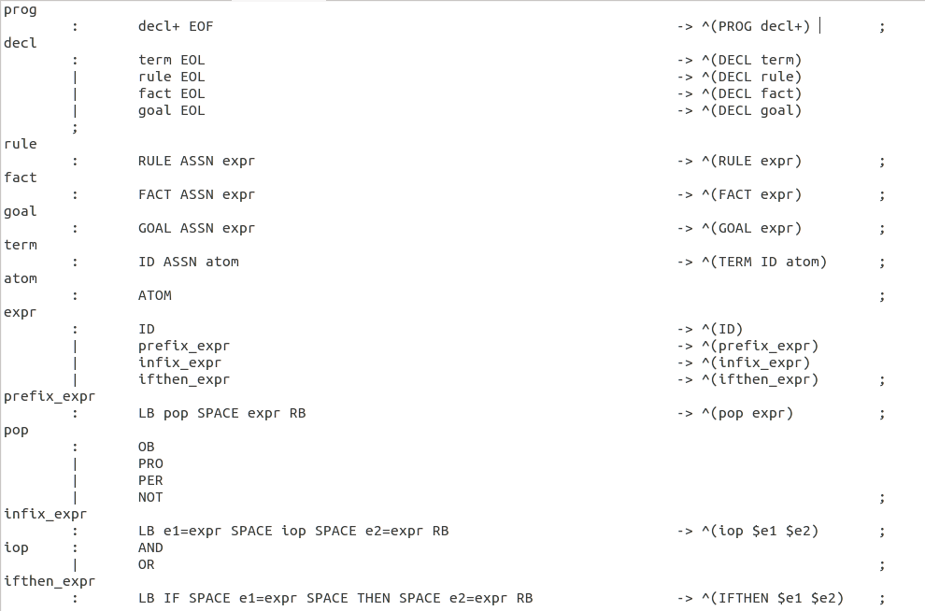
Semi Structured Input

Slide 8
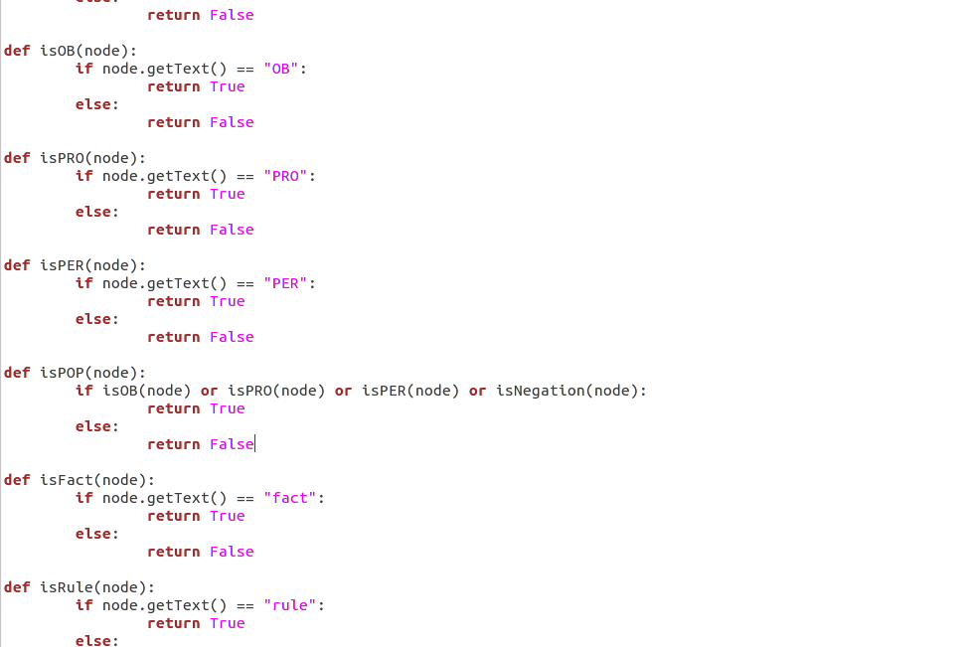
Brute Force Prover

Slide 9
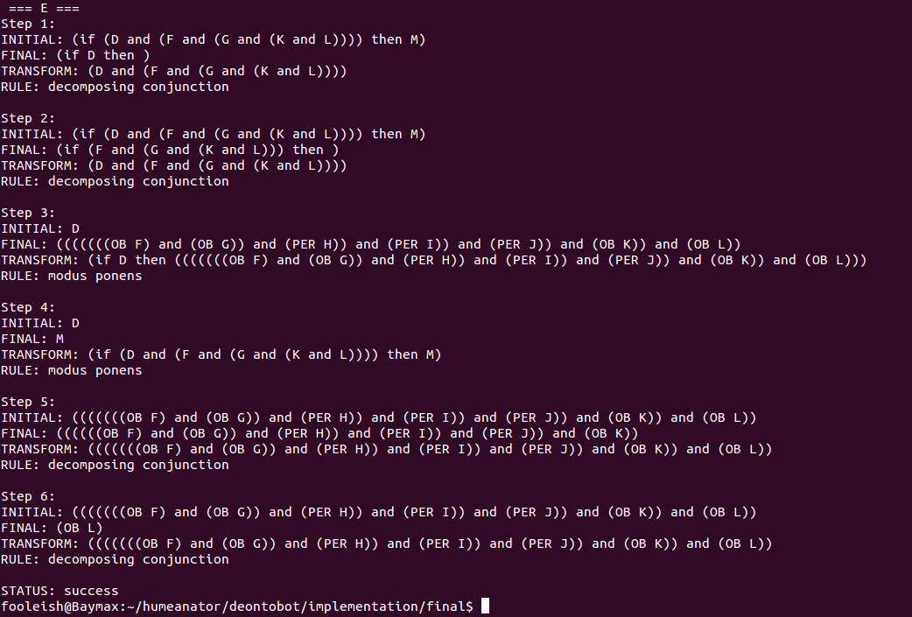
Command Line Output

Slide 10
Case Study
Ethics applications (Freedom of Information)
Climate and agriculture experiment

Slide 11
Tool Evaluation
Successful as tested
More complex case studies?
  British Psychology Code of Ethics and Conduct

Slide 12
Questions?

