Slide 1
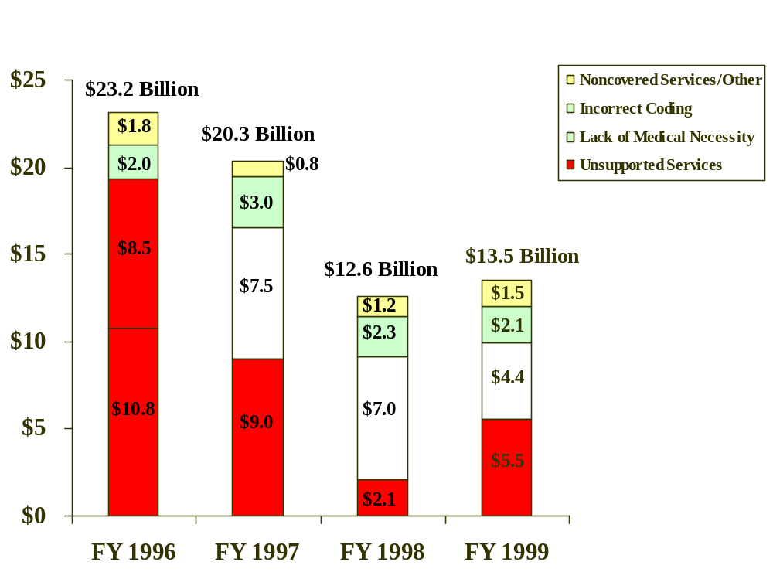
Estimated Improper Payments by Type of Error
(Dollars in Billions)

