Slide 1
Statistical Issues in Alzheimer’s Disease Study Design and Analysis – Why Do Nearly All AD Trials “Fail”?
June 29, 2017
Suzanne Hendrix, PhD
Pentara Corp
Disclosure: President and CEO of Pentara Corporation through which I am a
paid consultant for several public, private and non-profit organizations .

Slide 2
Introduction
Alzheimer’s disease is initially diverse and later homogeneous – everyone progresses similarly starting in mild disease
Disease modifying treatments may only work in the heterogeneous stages (early)
Effects are expected to slow disease not improve
Effects may differ within subgroups
Combined treatments may be needed

Slide 3
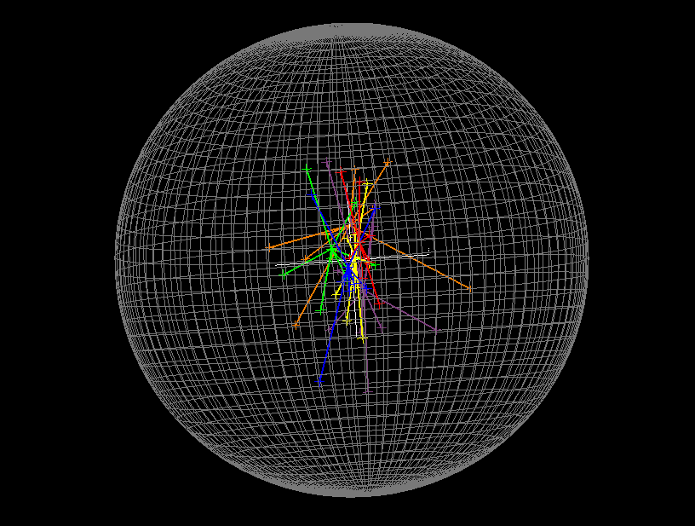

Slide 4
How Do We Increase the Chance of Success?
Reduce Variability in Data Collected
Select a homogeneous population
Ensure good site training
Use outcomes optimized for the population
Minimize dropout
Reduce Variability in Data Analyzed
Clean data quickly to identify site problems
Correct data issues but don’t “smooth out” treatment effects

Slide 5
How Do We Increase the Chance of Success?
Reduce Variability through Analyses
Make reasonable assumptions
Use covariates and covariate by treatment interactions
Model correctly
Run simulations ahead of time or in parallel to optimize analysis methods

Slide 6
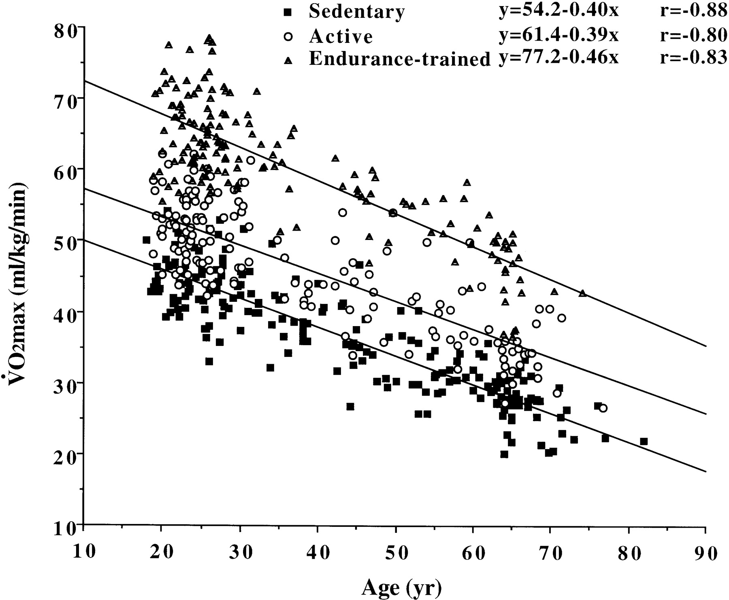
Adjustment for Covariate

Slide 7
Powering Early Phase Studies
Companies often can’t afford to power a study such that any meaningful difference will result in success
Most phase 2 studies measure efficacy but aren’t big enough to definitively fail (provide proof of no effect)
Combined evidence across multiple endpoints can substantiate efficacy claims
Need formal process for this
Combining p-values across endpoints

Slide 8
Understand Effect Sizes
Absolute difference (usually reported) – not comparable across outcomes
Standardized Effect Sizes
Cohen’s D (often used) – good for small proof of concept studies or short studies
% Placebo decline - need to have decline in placebo group - often used for longer studies of disease modifying treatments

Slide 9
Summary
Study Population – more homogeneous (or heterogeneous, but in known ways)
Reduce variability of study
Covariates can help – time by covariate interactions
Simulations helpful
Measuring “the disease” in all stages

