Slide 1
Regulatory Environment for Alzheimers Therapeutics (and Diagnostics)
Mark Ammann, Pharm.D. President, Catalyst Regulatory Services
September 12, 2017

Slide 2

Background/experience
Pharm.D. University of Michigan College of Pharmacy
27 years working in Industry
Novartis, Pharmacia, Pfizer (18 years)
Consultant (9 years)
Regulatory Affairs (Strategy)
Clinical/Medical
Non-clinical
Chemistry/
Manufacturing
Regulatory Affairs
Marketing/Sales
Pharmacovigilance

Slide 3
CNS-specific Experience
Novartis – Responsible for development of atypical antipsychotic (3 years)
Pharmacia – Therapeutic Area Head for CNS (Neurology and Psychiatry – 2 years)
Pfizer – Therapeutic Area Head for Psychiatry (2 years)
Consulting (UBC/Catalyst) – Consulting support for numerous CNS agents including 8 different projects targeting Alzheimer’s
Includes disease modifying and symptomatic treatment
NCEs as well as new formulations
Managed ~15 Meetings with Neurology Division to discuss Alzheimer’s development programs (Pre-IND and End-of-Phase 2)

Slide 4
Agenda
Regulatory “101” Overview
FDA Overview
FDA Meetings (focus on pre-IND)
IND Preparation and Submission
Special Considerations for Development of Drugs for Alzheimer’s

Slide 5
Regulatory Affairs Responsibilities
Submissions
Liaison
Document preparation & submission
Document management
Archiving
Bi-directional agency communication
Regulatory authority meeting strategy
Authorized agent services
Strategy
Critical program review
Analysis of the ext. environment
Alignment w/ product objectives
Health authority engagement strategy
Regulatory risk analysis
Notes:
We are a full service regulatory affairs group and cover the usual strategy submissions and liaison functions. For some clients were are their outsourced regulatory affairs team, providing all aspects of regulatory work.

Slide 6
Key Deliverable – Regulatory Strategy Document
Regulations and Guidelines Review
Alignment with Commercial Objectives
Key label claims
Critical differentiating factors
Comprehensive Review of Pertinent Precedents
Key Labeling Claims Language
Safety Database Size
Clinical Endpoints: primary/secondary
Key Development Issues
Post-Approval Requirements
Non-Clinical Program Requirements
Clinical Program Design
Core elements of pivotal registration program
Needs in special populations (renal/hepatic impairment, geriatrics)
Special safety studies (QT evaluation, abuse liability)
Options for expedited submission or approval
“Breakthrough Therapy”, “Fast Track”, “Subpart H”, Priority Review
Options for enhanced exclusivity
Orphan designation (7 years)
Pediatric exclusivity (6 months)
GAIN/QIPD (5 years for novel antibiotic)
Recommended Strategy for Regulatory Authority Interactions

Slide 7

Regulatory Strategy Publication
Applied Clinical Trials October 2008
http://www.appliedclinicaltrialsonline.com/developing-regulatory-strategy

Slide 8
FDA Organization
Biologics (i.e. tissue/cellular)
Drugs (incl. ther. biologics)
Devices (i.e. diagnostics)

Slide 9
FDA Neurology Division
Attendees from recent (Aug 2017) Alzheimer’s Meeting
Nicholas Kozauer, MD – Medical Team Leader, DNP
Kun Jin, PhD – Biometrics Team Lead

Slide 10
FDA Involvement in Development Lifecycle
Preclinical
Phase 1
Phase 2
Phase 3
Marketing
IND
NDA
Pre-IND
Meeting
EoP2 Meeting
Pre-NDA
Meeting
Advertising/ Promotion

Slide 11
Pre-IND Meetings Why have one?
Developing a new medicine takes an average of 10-15 years
Goal: de-risk program

Slide 12
Pre-IND Meetings Do I NEED one?
Pre-IND meetings are optional
Provides the opportunity to discuss critical development issues. Particularly useful if:
Developing novel compound or indication
Uncertainty about development program scope
Absence of guidance documents and/or precedents
Products with potential for accelerated development
Complex safety issues
Development of compound in class with some “baggage”
General objectives:
Get alignment on preclinical safety evaluation (↓risk of clinical hold)
Agree on design of initial clinical study
Seek early input on overall development program

Slide 13
Pre-IND Meetings When should I have one?
Discovery
Preclinical Development
Clinical Research
Marketing
IND
NDA
GLP Tox
“Early” Pre-IND Meetings
“Late” Pre-IND Meetings
Typically: To discuss overall approach to preclinical program
Seek agreement on GLP tox program design
Confirm program is sufficient to address risks
No material “data” to discuss
Early discussion of development program scope
More difficult to discuss features of initial clinical study (dose, safety monitoring)
Typically: To discuss data from preclinical program to confirm acceptance
Requires completion of key GLP tox studies
Best opportunity to discuss translation of preclinical results to clinical program
Able to discuss any “surprises” from GLP tox
Note: may be on “critical path” to IND (i.e. possible delay)
You are generally only going to get one… So pick wisely…

Slide 14
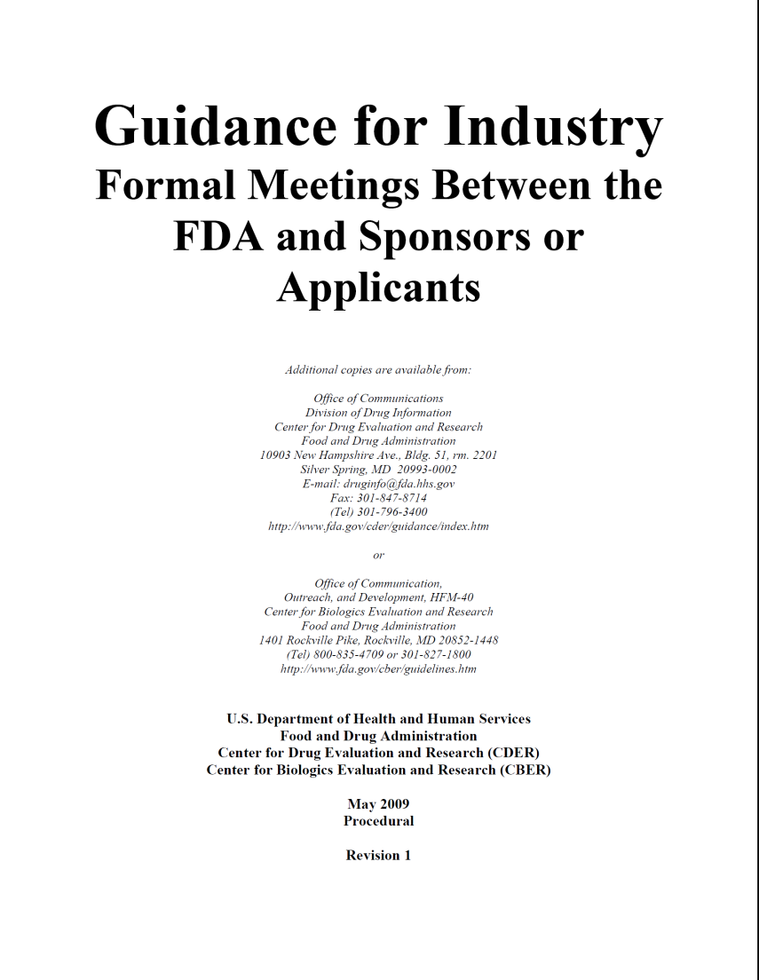
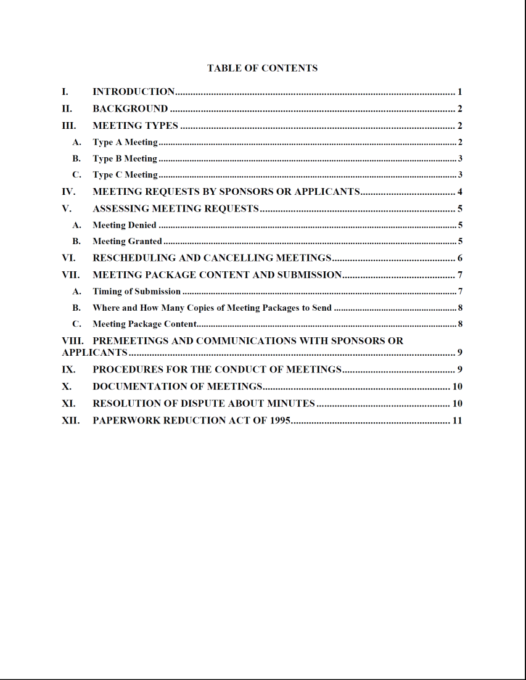
FDA Meeting Guidance
Formal Meetings Between the FDA and Sponsors or Applicants
http://www.fda.gov/downloads/Drugs/GuidanceComplianceRegulatoryInformation/Guidances/UCM153222.pdf

Slide 15
FDA Type B Meeting Timeline (60 day target)
Rehearsal #1
Goal: “brainstorm” potential questions/challenges from FDA and assign responsibilities
Rehearsal #2
Goal: Review/refine draft responses to “challenges” anticipated
Rehearsal #3
Goal: “Dress Rehearsal”, Mock FDA Meeting.
Rehearsal #4
Goal: “On-site” in Wash DC area. Typically have Preliminary responses from FDA for this final rehearsal
2
6
10
14
18
22
26
30
34
38
42
46
50
54
58
4
8
12
16
20
24
28
32
36
40
44
48
52
56
60
FDA Response: Meeting Granted (or not)
FDA Internal review Meeting
Generally ~1 week prior to meeting
Submit Meeting Request
Submit Briefing Book
Generally 1-2 days prior to meeting
Draft Responses
Within 3 weeks of request
Due 1 month prior to meeting
Note: the scenario presented assumes that a meeting is granted on day 60. FDA is not always able to adhere to the 60-day window to grant Type B meetings.
FDA Meeting

Slide 16
Issues to Address at a Pre-IND Meeting
Design of IND-enabling (GLP) toxicology studies or acceptability of data from preclinical program
Adequacy of quality (CMC) assessment (i.e. stability, analytical characterization, impurities)
Proposed clinical program
Starting dose
Dose escalation scheme
Patient population (HV vs. patients)
Safety monitoring
Study design (i.e. SAD vs. combined SAD/MAD)
Overall registration package (especially for novel products)
Endpoints, size of safety database, # clinical trials

Slide 17
Example Questions to ask…
Does the agency agree that toxicology testing is adequate to support the proposed clinical study?
For example, are the toxicities seen…
At a sufficient exposure multiple to anticipated human levels?
Monitorable and/or reversible
Not relevant to humans?
Does the agency agree that the proposed clinical study design is acceptable?
Dose selection
Visit frequency
Study procedures (safety monitoring)
Inclusion/exclusion criteria etc.
Primary endpoint(s)
For programs with existing clinical data…
Does clinical safety data to-date support proposed clinical design?

Slide 18
Keys to a Successful Meeting
You only get one chance
Preparation is crucial
Ensure alignment on approach
Anticipate challenges to allow best response
Need to start rehearsals early (cannot wait until written responses – often too late)
Success: no unanticipated questions
Time goes very fast
Need to keep discussion focused (no tangents)
Need to have someone watch clock

Slide 19
IND Overview

Slide 20
Investigational New Drug Application
Allows for a legal exemption from the federal law which states that an unapproved drug is prohibited from being shipped or transported for interstate commerce
Submits application to the FDA to obtain authorization to begin testing in humans in clinical trials
An IND will become effective in 30 days unless FDA finds fault with application

Slide 21
References
FDA Guideline: “Content and Format of Investigational New Drug Applications (INDs) for Phase 1 Studies of Drugs, Including Well-Characterized, Therapeutic, Biotechnology-derived products
http://www.fda.gov/downloads/Drugs/GuidanceComplianceRegulatoryInformation/Guidances/UCM071597.pdf
Title 21 Code of Federal Regulations, Section 312

Slide 22
FDA Objectives for IND Review
21 CFR 312.22 General Principles
“FDA’s primary objectives in reviewing an IND are, in all phases of the investigation, to assure the safety and rights of subjects
and, in Phase 2 and 3, to help assure that the quality of the scientific evaluation of drugs is adequate to permit an evaluation of the drug’s effectiveness and safety...”

Slide 23
Central Focus of IND
Background data necessary for FDA to make a safety assessment
Toxicology and Safety Pharmacology
Previous Human Experience
Protocol for proposed clinical study
General Investigational Plan
Investigator’s Brochure

Slide 24
IND Review Process at FDA
1
3
5
7
9
11
13
15
17
19
21
23
25
27
29
2
4
6
8
10
12
14
16
18
20
22
24
26
28
30
FDA Internal review Meeting
Submit IND
Possible Questions
Generally Day 28 to 30
“Clinical Hold” or “May Proceed”
Protocol revisions
Additional data
Requests for amendments
If no response received by day 30 IND is “Active” by default

Slide 25
FDA Review Team
Division Director
Clinical
Team Leader
Medical Reviewer
Pharm/Tox
Team Leader
Pharm/Tox Reviewer
Chemistry/Manufacturing
Team Leader
Chemist
Clinical Pharmacology
Biostatistics
Project Manager

Slide 26
Common Reasons for Clinical Hold
Unreasonable and significant risk
Prolonged human exposure
Unacceptably high doses relative to supportive non-clinical data, etc.
Unacceptable toxicity in animal studies and/or insufficient monitoring in the clinical study
Protocol clearly deficient
IND not sufficiently complete to assess risk
IB misleading, erroneous or materially incomplete
Use of unqualified investigators

Slide 27
Common Technical Document (CTD)
Historically IND broken up into 10 sections – See 1995 Guideline
It is important to note that the CTD was initially designed to provide structure for marketing applications
Module 1
Regional
Administrative
Information
1.0
Not Part of the CTD
(varies by region)
CTD format is defined in ICH M4 guidance
eCTD = electronic
CTD Table of Contents 2.1
CTD Introduction 2.2
Non-clinical Overview 2.4
Clinical
Overview
2.5
Module 2
Quality
Overall
Summary
2.3
CTD
(same across regions)
Non-clinical Written and Tabulated Summaries 2.6
Clinical Summary
2.7
Module 3
Quality
3.0
Module 4
Nonclinical
Study Reports
4.0
Module 5
Clinical Study Reports
5.0

Slide 28
IND Maintenance Activities
IND Amendments
Protocol amendments
New Protocol
New Investigator
Information amendments
Clinical
Pharmacology/Toxicology
Chemistry
IND Safety Reports
IND Annual Reports/DSUR
Within 60 days of anniversary of IND (or Intl. Birthdate)

Slide 29
Regulatory Environment for Alzheimer’s
Large number of historical development failures. Last approval in 2003.
FDA wants to be a partner to make new medications available
Huge unmet medical need
To facilitate development and broadly communicate their positions, FDA developed a guidance (Feb 2013) on development of drugs to treat early-stage patients:
https://www.fda.gov/downloads/drugs/guidancecomplianceregulatoryinformation/guidances/ucm338287.pdf
Endpoints for dementia-stage trials – co-primary (Cog + Funct or Cog + Global)
Early AD (i.e. MCI or prodromal AD) – a single composite endpoint (i.e. CDR-SB) may be acceptable
Disease modification – willing to consider approval based upon effect on biomarker (provided that there is widespread agreement that biomarker is predictive of clinical benefit)
Europe has also developed a guidance:
http://www.ema.europa.eu/docs/en_GB/document_library/Scientific_guideline/2016/02/WC500200830.pdf
Regulators are “Collaborative”
Recent example with 36 questions for FDA meeting

Slide 30
Other (misc) points to Consider
Phase 2 studies are often long and large – explore whether they can be adequate to serve as one pivotal study needed for registration
Diagnostics/biomarkers
If required for patient selection – qualification
If used to select subset of patients for treatment (i.e. ApoE4) need to explore potential impact on labeling
Generally need to show that subset you intend to exclude does not respond (or is unsafe).
Biomarkers – as measure of disease progression – require extensive validation
Eligibility for Fast Track and Breakthrough Designation
Exploration of novel approaches to meet requirements for replication of results
i.e. one study in Mild/Mod AD + one study in prodromal

