Slide 1


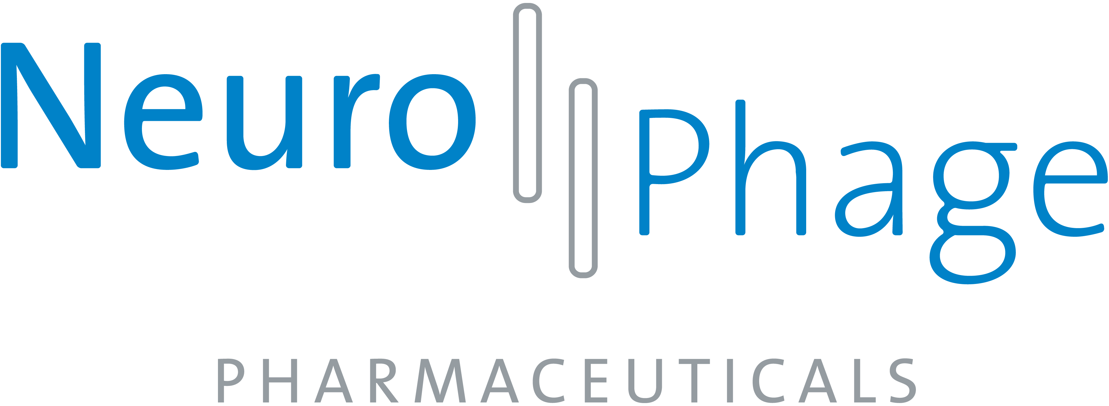

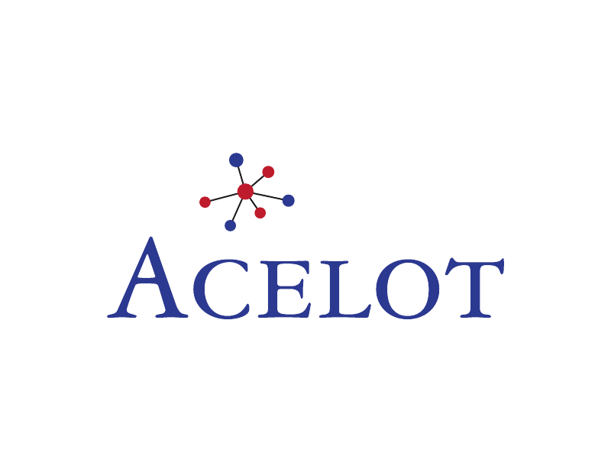




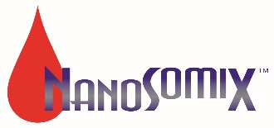
Maximizing the Potential of Small Companies in Alzheimer’s Disease Research: Challenges and Opportunities
Richard A Margolin¹, Joseph A Araujo², Kira Sheinerman³, Dennis Van Epps⁴, for the Alzheimer’s Association Small Company Consortium (AASCC)
¹CereSpir, Inc., New York, NY USA; ²InterVivo Solutions, Inc., Toronto, ON, Canada; ³ DiamiR, LLC, Princeton, NJ, USA; ⁴NanoSomiX, Inc., Aliso Viejo, CA, USA
Introduction
Desired Funding Sources
Information and Knowledge
Alzheimer’s disease (AD) will be a global public health catastrophe in coming decades unless effective treatments are developed. Numerous large pharmaceutical companies have deployed very substantial financial and human resources in a decades-long effort to achieve this goal, but this work has not yet produced a breakthrough, and their efforts wax and wane. Contemporary drug discovery increasingly involves advanced technologies such as pharmacogenomics and high throughput screening, and development utilizes novel animal models, PK/PD modeling, and translational strategies, especially those employing biomarkers. It also involves the pursuit of diagnostics for patient screening and stratification, disease progression and treatment monitoring. Besides large companies, small organizations are targeting AD and have some significant advantages, e.g., greater agility. Notably, a substantial and increasing percentage of innovative intellectual property is arising from small companies. Unfortunately these organizations are frequently highly resource-constrained, e.g., in accessing capital, information, and clinical samples, which impedes realization of their potential. To increase the effectiveness of small diagnostic, therapeutic, and service sector companies the Alzheimer’s Association has recently facilitated creation of the Alzheimer’s Association Small Company Consortium (AASCC). Here we report the consortium’s initial activities and goals.
Government grants and pharma partner funding were the most highly ranked targets by member companies over the next 12-18 months (Figure 3). Combining government and foundation grants, non-dilutive funding was the primary funding source target of the consortium companies and reflected a substantial difference from current funding strategies.
The companies were asked to indicate the type of information most important to the success of their mission and the type of information most difficult to obtain. Almost half of the member companies ranked scientific journals as the most important type of information for their success, with other categories (competitive intelligence, industry news, regulatory information (separately, for diagnostics, biomarkers and therapeutics) (Figure 4, left panel), and. Considering the challenge of obtaining information in the same categories, a majority of companies ranked competitive intelligence as the most difficult type of information to obtain (Figure 4, right panel).
Table 1. AASCC companies responding to the survey
The primary mission of these companies is the development of therapeutics (10 [55%]), diagnostics (5 [28%]), support services (2 [11%], and other (1 [6%]) (Figure 1). .Three companies espouse missions involving more than one category. Therapeutically focused companies represented a majority.
Figure 3. Current and desired funding
Figure 4. Most important (L) and most difficult information to obtain (R)
Collaboration and Business Partnerships
Additional Challenges, Opportunities, and Future Directions
Objectives
Only three companies currently participate in precompetitive collaborations/consortia other than the ASCCC, and only four currently collaborate with academic groups. Notably, however, all companies expressed willingness to collaborate with other AASCC member companies, if compatible with their mission.
Desired business partnership targets and the frequency with which they are sought by the companies are indicated in Table 2. Relationships with government agencies and pharma partners are most sought by AASCC companies, while connections with venture capital firms are least sought.
Member companies were invited to identify additional challenges and to suggest potential solutions for them. Some frequently mentioned problems and potential solutions, when identified, include the following:
Problem: Access to pre-vetted experts in various disciplines and subjects, eg, preclinical models, biomarkers, human trial design considerations. Solution: assemble a databank of relevant information
Problem: High price of key resources, eg, competitive intelligence, transgenic AD model mice, and reagents. Solution: organize a pooled buying model to obtain discounted pricing
Problem: Identify most convincing data/assays for successful out-licensing of lead compound. Solution: obtain expert input
Problem: Validated biomarkers. Solution: participate in precompetitive consortia developing them
To communicate the mission and type of activities being performed by member companies of the AASCC
To communicate the current and desired funding streams of such companies, and their perspective on partnering and collaboration
To indicate future directions for AASCC companies and the consortium
Figure 1. Distribution of Focus of Company Activities
Methods
Current Funding Sources
We tabulated the business and scientific characteristics of AASCC companies and surveyed their current and near-term needs and goals to determine key obstacles and steps to facilitate achievement of their mission. Topics queried included current funding and anticipated capital needs, current and desired academic and precompetitive collaborations, interest in large biotech and pharma partnerships, the importance of scientific and industry community visibility, and access to competitive intelligence and scientific information. The responses, perceived factors limiting progress and potential remediation strategies were analyzed. For questions soliciting ranking of multiple potential responses, rank sum information was calculated and normalized to the number of companies responding.
Angel investment represented the highest ranked current funding source for consortium companies (Figure 2). Pharma partners and venture capital firms were other prominent funding sources. Importantly, a significant number of consortium companies reported only one source of funding, with the number of funding sources ranging from zero (n=1) to three (n=4). The data also indicated that non-dilutive funding sources, such as government and foundation granting agencies are not significant sources of funding.
Type of Business /Partnership | Frequency Sought (%)
Pharma Partner | 29
Other Biotech | 21
Government Grants | 17
CRO | 12
Foundation Grants | 9
Angel | 7
VC | 5
Discussion and Conclusions
The major challenges for small AD-focused organizations were funding, visibility and access to information. Although the majority of AASCC companies are therapeutically focused, and thus, the interpretation of the survey data may be biased towards their challenges and opportunities, the main challenges and potential solutions for them were common to all or a majority of companies.
The data will help the AASCC facilitate companies’ ability to contribute effectively to the development of future treatments for AD.
Table 2. Collaboration and Partnership
Results
Visibility and Recognition
Company Profiles
Companies were queried about the importance of visibility and recognition to their development and the vehicles they used to achieve these goals. The companies were very productive with regard to publishing in the scientific literature, with a mean of approximately 2.5 publications per year per company. Conferences and press releases were found to be more commonly utilized than public relations firms.
Twenty companies have joined the AASCC to date, including organizations in the diagnostics, therapeutics, and services support sectors. Fifteen member companies responded to the survey or participated in its evaluation (Table 1).
Acknowledgements
Figure 2. Distribution of Current funding
The authors gratefully acknowledge the assistance of James Hendrix PhD, Director, Global Science Initiatives, Alzheimer’s Association.

