Slide 1


ADNI 3 plans for Biomarker Core
Leslie M Shaw & John Q Trojanowski
Magdalena Korecka
Michal Figurski
Teresa Waligorska
Magdalena Brylska
Leona Fields
Nirali Shah

Slide 2
Biomarker Core Aims for ADNI 3
Continue to collect, store, curate and track all biofluid samples collected from subjects in ADNI-1, ADNI-GO, ADNI-2 and ADNI-3 and continue regular reconciliation and reviews with the clinical core at UCSD. Provide blinded sample aliquots for studies approved by the NIA/ADNI/RARC.
Implement new test methods for CSF biomarkers:
Implement new automated immunoassay platform for CSF Aβ₁₋₄₂, t-tau and p-tau₁₈₁, following validation study and review of all possible systems in consultation with PPSB BBWG.
Implement our newly validated mrmMass Spec assay to measure Aβ₁₋₄₂, Aβ₁₋₄₀ and Aβ₁₋₃₈ in all ADNI CSFs.
Establish validated Mass Spectrometry-based assay to identify and measure t-tau and, possibly, tau isoforms in CSF
Implement other validated and promising new biomarker immunoassays such as those that measure other species of tau in CSF, including fragments of tau. We are following closely any promising lead for plasma biomarkers with predictive value and exosomes as a potentially valuable carrier of CNS biomarkers in the circulation. The results from these ongoing studies will determine the likelihood of incorporating these new analytes into ADNI-3.
Partner with the PPSB and other investigators who pursue additional approved Add-On studies of AD biomarkers in plasma and/or CSF in order to bring these assays on-line for use in ADNI 3.
Continue longitudinal studies of ADNI biomarkers that are most informative including CSF t-tau, p-tau₁₈₁ and Aβ₁₋₄₂. Neurogranin and Vilip 1 data recently uploaded and total α-syn and PS129-α-syn, YKL40 data will be available later this year. We propose to add the most promising of these as opportunities to improve on our CSF AD panel in order to chart the onset and progression of AD and determine earliest predictors of cognitive decline.
Collaborate in studies of best combinations of biomarkers for prediction of cognitive and functional decline, both within-biomarker core as well as with other cores and investigators such as the FNIH biomarker consortium.
Continue international collaboration (AA GBSC & IFCC CSF WG) to establish a certified reference material for Ab₁₋₄₂ that supports improved analytical platform to platform, lot-to-lot performance, and to promote harmonization across analytical methods for these widely used CSF biomarkers.

Slide 3
Selection of a new automated immunoassay platform for ADNI 3
Move from a manual RUO immunoassay to a fully automated immunoassay platform for ADNI 3: due diligence started Q4, 2014.
This follows extensive discussions over past few years with stakeholders
Need for preliminary validation data for ADNI 3 grant submission
Sought after features:
precision & accuracy based; dilutional linearity, parallelism
Excellent level of intra- and inter-lab performance
full automation;
commitment to the ADNI study;
on an IVD trajectory;
commitment to pre-competitive activities,
to contribute to CSF biomarker QC/standardization
Commitment to data sharing consistent with the ADNI study
Selection will be done in consultation with the ADNI PPSB/BBWG/DDWG, chaired by Johan Luthman.

Slide 4
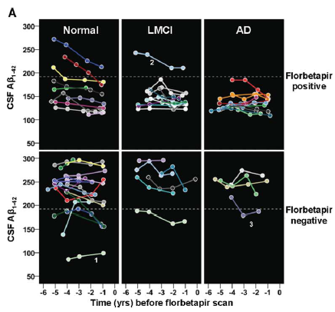
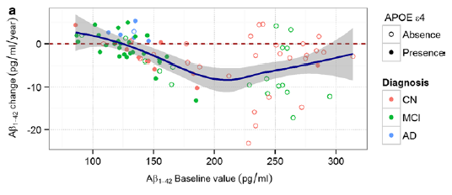
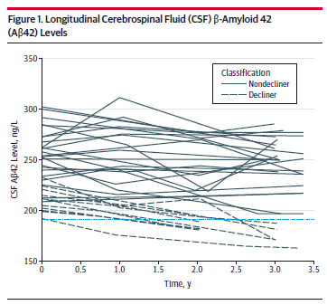
ADNI subjects with BASELINE normal CSF Aβ₁₋₄₂:
In some CSF Aβ₁₋₄₂ remains stable/normal & in some declines to abnormal
“stable”, non-decliners
B
“decliners”
Toledo, et al, 2013
20 stable,
-0.5pg/mL/yr
14 decliners,
-9.2 pg/mL/yr
C
Landau et al, 2013
* Subjects in the ADNI 1 add-on study, sponsored by an anonymous donor, included
a total of 141 subjects with 3 or more CSFs collected longitudinally between 2005 - 2014
Mattsson, et al, 2015

Slide 5
Support of standardization efforts
ADNI-longterm commitment to standardization of all methods
Open access to data generated following quality control
Has been in operation for 10 years
Benefits from lots of interaction, peer review, with the scientific community in academia, industry, governmental sectors
Alz Assn Global Biomarker Standardization Consortium
Analytical methods standardization--strong support for improved performance of existing and new immunoassays for CSF biomarkers, and automation
The Alz Assn-supported international CSF QC program provides continuing feedback on quality both short and long term
Support for mrm/tandem mass spectrometry for direct measurement of absolute Aβ₁₋₄₂ concentration
IFCC/IRMM project to develop reference Aβ₁₋₄₂ peptide material and using mrm/msms and large pools of CSF with accurately measured Aβ₁₋₄₂
Need same for t-tau
CAMD(Coalition Against Major Diseases) has made a substantial commitment to support FDA approval for the use of HV and CSF AD biomarkers in treatment trials
Hippocampal volume
CSF AD biomarkers

Slide 6
BIOMARKER CORE AIMS FOR THE ADNI-3 RENEWAL Leslie M. Shaw and John Q. Trojanowski
It is important to take into account the heterogeneity of AD in the ADNI-3 Biomarker Core in ADNI3. Many studies emphasize this including ADNI data showing that that a very small minority (4/22) of ADNI subjects with clinical AD/MCI only had AD plaque and tangle pathology at autopsy, while 82% had plaques and tangles in addition to TDP-43 and/or alpha-synuclein (α-syn) inclusions as well as hippocampal sclerosis in some cases (Toledo et al, ANP Commun, 1:65, 2013). These findings are echoed in a larger study of non-ADNI Penn subjects (Toledo et al, ANP, 124:23-35, 2012).
Further, we have used a CSF total α-syn assay in ADNI CSF samples that may enable detection of co-morbid LBs in MCI/AD subjects in ADNI 3 (Toledo et al, ANP, 126:683-697, 2013) and we also have access to a phospho-α-syn immunoassay that could be incorporated into ADNI-3 (Wang et al, Sci Trans Med, 4:121-20, 2/15/2012).
TDP-43 biomarkers are not yet available so we work with Hugo Vanderstichele at ADx and Andreas Jeromin at Quanterex on TDP-43 ELISA based assays, but it is not yet certain if a TDP-43 immunoassay will be ready for use in ADNI-3. We also need to address the issue of co-morbid cerebro-vascular disease (CVD), but information on CVD may come from imaging rather than chemical biomarker studies.

Slide 7
Alzheimer’s Disease: heterogeneity and biomarker timeline dynamics
Kang JH, et al, AlzDement, 2015

Slide 8
Biomarker Core Aims for ADNI 3
Continue to collect, store, curate and track all biofluid samples collected from subjects in ADNI-1, ADNI-GO, ADNI-2 and ADNI-3 and continue regular reconciliation and reviews with the clinical core at UCSD. Provide blinded sample aliquots for studies approved by the NIA/ADNI/RARC.
Implement new test methods for CSF biomarkers:
Implement new automated immunoassay platform for CSF Ab₁₋₄₂, t-tau and p-tau₁₈₁, following validation study and review of all possible systems in consultation with PPSB BBWG.
Implement our newly validated mrmMass Spec assay to measure Ab₁₋₄₂, Ab₁₋₄₀ and Ab₁₋₃₈ in all ADNI CSFs.
Establish validated Mass Spectrometry-based assay to identify and measure t-tau nd, possibly, tau isoforms in CSF
Implement other validated and promising new biomarker immunoassays such as those that measure other species of tau in CSF, including fragments of tau. We are following closely any promising lead for plasma biomarkers with predictive value and exosomes as a potentially valuable carrier of CNS biomarkers in the circulation. The results from these ongoing studies will determine the likelihood of incorporating these new analytes into ADNI-3.
Partner with the PPSB and other investigators who pursue additional approved Add-On studies of AD biomarkers in plasma and/or CSF in order to bring these assays on-line for use in ADNI 3.
Continue longitudinal studies of ADNI biomarkers that are most informative including CSF t-tau, p-tau₁₈₁ and Aβ₁₋₄₂. Neurogranin and Vilip 1 data recently uploaded and total a-syn and PS129-a-syn, YKL40 data will be available later this year. We propose to add the most promising of these as opportunities to improve on our CSF AD panel in order to chart the onset and progression of AD and determine earliest predictors of cognitive decline.
Collaborate in studies of best combinations of biomarkers for prediction of cognitive and functional decline, both within-biomarker core as well as with other cores and investigators such as the FNIH biomarker consortium.
Continue international collaboration (AA GBSC & IFCC CSF WG) to establish a certified reference material for Aβ₁₋₄₂ that supports improved analytical platform to platform, lot-to-lot performance, and to promote harmonization across analytical methods for these widely used CSF biomarkers.

Slide 9
New biomarkers in NIA/ADNI/RARC-approved studies
Biomarker | Fluid | # | ADNI study | Investigator
Proteome/RBM | plasma | 1,065 | BL & yr1; multiple publications | HSoares;Pfizer/PPSB/FNIH
Proteome/RBM | CSF | 317 | BL ADNI 1; multiple publications | WPotter,etal/PPSB/FNIH
BACE & sAPP | CSF | 402 | BL ADNI 1; recent publication | MSavage;merck/PPSB/FNIH
α-Synuclein;xMAP | CSF | 390 | BL ADNI 1; several publications | JZhang; University of Wash
Proteome/ MRM/tandem MSMS | CSF | 331 | BL ADNI 1; 567 tryptic peptides associated with 221 proteins; recent publication, another planned | ADNI PPSB/FNIH; LHonigsberg
Neurogranin; IA NFIL; IA | CSF | 416 | BL ADNI 1; manuscript accepted; manuscript submitted | KBlennow; Sahlgrenska UHosp
DDE; LC/msms | plasma | 211 | AD vs controls, ADNI 1 | ALevey; Emory University
Vilip 1; HS IA | CSF | 612 | ADNI 1, GO, 2 in longitudinal samples 2015 AAIC abstract, pub. planned | AFagan; Wash University
Phos-α-SYN;xMAP | CSF | 567 | Study in BL & longitudinal samples | JZhang; University of Wash
YKL40, SNAP25 & neurogranin | CSF | 612 | Studies in longitudinal samples data just uploaded | AFagan; Wash University
Metabolic networks | serum | 833 | Studies in BL samples | RKaddoura-Daouk; Duke Univ, Phenomenone
Aβ1-42/1-40;ELISA | plasma | 764 | ADNI 1, GO, 2 in BL & longitudinal | ISherriff; Araclon Biotech

