Slide 1
Update of China-ADNI
Kuncheng Li. M.D., Ph.D.
Dept. of Radiology, Xuanwu Hospital, Capital Medical University Beijing:100053
Emeil: cjr.likuncheng @vip.163.com
首都
Notes:
Honorable president Maria, professor Weiner, dear colleagues,goodmorning! I am Kuncheng Li, from Xuanwu Hospital, Capital Medical University, in Beijing. Today, I represent for the team of China-ADNI to give the report on the progression of China-ADNI over the past year.

Slide 2
Outline
General information of China-ADNI
Progress of the main cores
Notes:
The report have two parts. First to introduce general information of China-ADNI.

Slide 3
ADI-China
Scientist advisory board
Administration committee
PI: Prof. Kuncheng Li, CMU
CO-PI: Prof. Jun Wang, BJU
CO-PI: Prof. Hongzheng Wang, BUMC
Clinical core
Liyan Qiao
MRI core
Kuncheng Li
PET core
Fang Li
Patholoy core
Cuidi Wang
Biomarker and Genetics Core
Jun Wang/Yan Zhang
Biostatistics and Informatics core
Li Wang
DATA Post process
Yong Fang
Notes:
China-ADNI is haveng scientist advisory board, clinical, MRI, PET, pathology, biomarker and genetic, biostatistics and informatic, and data post process core. PI is me, kuncheng Li, and Jun Wang, Hongzhen Wang are co-PI.

Slide 4
Research plan：subjects
800-1000 subjects (80 sites)
Normal | Early MCI | Late MCI | Mild AD
200-250 | 200-250 | 200-250 | 200-250
Notes:
This is our initial plan of China-ADNI to collect 800-1000 subject that includes normal volunteer as
normal control, early MCI，late MCI and mild AD four groups and there are 200-250 in every group.

Slide 5
Research plan：examinations
Neuropsychological battery
Biomarkers:
Blood: Apo E polymorphism, Amyloid 40/42, tau
CSF: Amyloid 40/42, tau
MRI: Multi-modality
PET: FDG-PET and amyloid Imaging of PET
(later this year)
Notes:
The data of acquisition were included the neuropsychological test, multi-modality MRI, PET (18F FDG-PET,
18F-AV45-PET), and biomarkers. The latter are including APOE polymorphism, Amyloid 40 or 42, and tau of
blood and CSF.

Slide 6
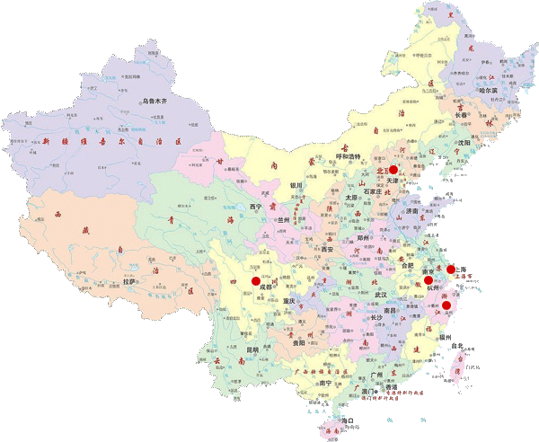
6 cities joined in this study,
distributed in the northern, eastern, central and southwestern area of china mainland.
Notes:
So far there are 6 cities joined in this study, distributed in the northern, eastern and southwestern area
（Beijing，Hangzhou, Nanjing, Chongqing, Chengdu and Wuhan).

Slide 7
Enrolled subjects
44 new subjects enrolled in the year past, now we have totally 85 cases collected.
Normal | Early MCI | Late MCI | Mild AD
11 | 27 | 17 | 30
Notes:
Up to last June, we have collected 11 normal volunteer, 27 early MCI, 17 late MCI, and 30 mild AD patients. 44 new subjects enrolled in the year past, now we have totally collected 85 cases.

Slide 8
Outline
General information of China-ADNI
Progress of the main cores
Notes:
The report have two parts. First to introduce general information of China-ADNI.

Slide 9
Neuropsychological battery
Screen: MMSE, LM-I, LM-II, GDS, CDR
Baseline: ADAs-Cog，ECOG，CWRT，MoCA, BNT, Rey AVLT(30’ Delay), Category Fluency(animal),Trial A& B,NPI, FAQ
6 month later: ADAs-Cog，ECOG , MMSE, CDR, MoCA, BNT, Rey AVLT(30’ Delay), Category Fluency(animal),Trial A& B,NPI, FAQ
12 month later: ADAs-Cog，ECOG , MMSE, LM-I, LM-II, GDS, CDR, MoCA , BNT, Rey AVLT(30’ Delay), Category Fluency(animal),Trial A& B,NPI, FAQ
24 month later: ADAs-Cog，ECOG , MMSE, LM-I, LM-II, GDS, CDR, MoCA , BNT, Rey AVLT(30’ Delay), Category Fluency(animal),Trial A& B,NPI, FAQ
36 month later: ADAs-Cog，ECOG , MMSE, LM-I, LM-II, GDS, CDR, MoCA , BNT, Rey AVLT(30’ Delay), Category Fluency(animal),Trial A& B,NPI, FAQ
Notes:
This is neuropsychological battery, all kinds of scale are in strict accordance with the requirements of WW-ADNI, including screening, baseline and 6 month, 12 month, 24 month and 36 month follow-up assess.

Slide 10
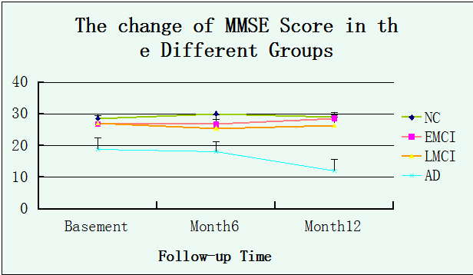
Changes of MMSE score in different groups
Notes:
I would like show you the preliminary follow-up results of clinical core. firs is the changes of MMSE score in different groups, only the score of mild AD patients was going down, however, the scores of other groups nearly no change at 6 and 12 month.

Slide 11
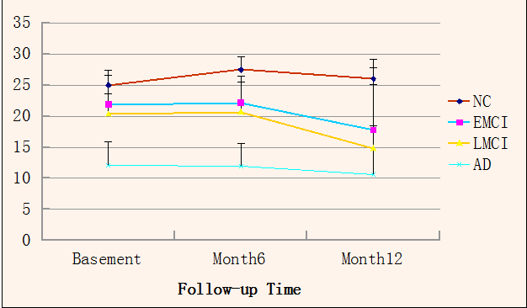
Changes of MoCA score in different groups
Notes:
The scores of MoCA going down at 12 month in early MCI, late MCI and mild AD groups, however, normal control is no significant change.

Slide 12
Biomarker study
Diagnosis | APOE type | Aβ42 (pg/ml) | Aβ40 (pg/ml)
NC | ε2/3 | 49 | /
NC | ε3/3 | 35 | /
NC | ε2/2 | 36 | /
NC | ε3/3
NC | ε2/3 | / | 118.57
NC | ε3/4 | / | 91.07
NC | ε3/3 | / | 110.27
NC | ε3/3 | / | 8.11
MCI | ε2/3 | 65 | /
MCI | ε3/3 | / | /
MCI | ε2/2 | / | /
MCI | ε3/3 | / | 137.12
MCI | ε4/4 | / | 101.58
EMCI | ε3/3 | / | 82.72
EMCI | ε2/3 | / | /
EMCI | ε3/3
Notes:
Now we move to biomarker study. Please look at the table. It is the preliminary result from a few samples.
We test the APOE indicated one possibility: a relatively lower percentage of ApoE ε4 in Chinese AD
patients. Because we have two site to test Aβ successively, Peking University and Beijing Jiaotong
University, and difference test box were used, perhaps this is the reason for this discrepancy.

Slide 13
Biomarker study
Diagnosis | APOE type | Aβ42 (pg/ml) | Aβ40 (pg/ml)
EMCI | ε3/3 | / | 110.19
EMCI | ε2/3 | / | 96.53
EMCI | ε3/3 | / | 38
EMCI | ε3/3 | / | 108
LMCI | ε3/3 | / | /
LMCI | ε4/4 | / | 137.34
LMCI | ε3/3 | 81 | /
AD | ε3/3 | 48 | /
AD | ε2/3 | 39 | /
AD | ε3/3 | 62 | /
AD | ε3/3 | / | 114.04
AD | ε3/3 | / | 91.21
/ | ε3/3 | / | 24
Notes:
Only The Lab of Beijing Jiaotong University to do the test in the future, so it should be no problem.

Slide 14
MRI Study
Standard protocol for MRI acquisition
Quality control among different sites
Improve the post-processing methods
Notes:
We have established a standard protocol for MRI acquisition according to the WW-ADNI guideline, and implement quality control among different sites, and improve the post-processing methods.

Slide 15
MRI Protocol
3D T1 volume
Diffusion tensor imaging
Resting state fMRI
Arterial spin labelling
Susceptibility weighted imaging
Notes:
The data of MRI is including 3D-T1 volume, DTI, rs-fMRI, ASL perfusion and SWI of brain.

Slide 16
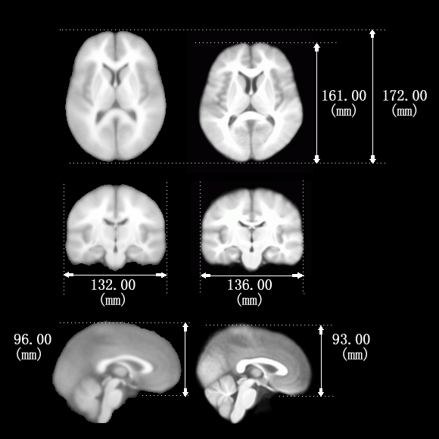
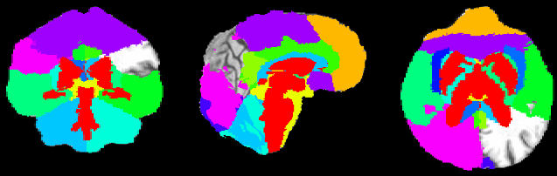
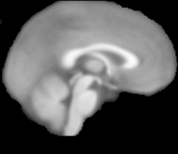
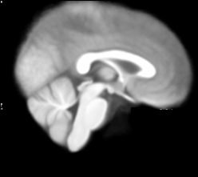
A individual-level inline morphometry analysis
Hippocampus and left temporal cortex are significant in distinguishing AD or AD+MCI from normal elderly, while the discrimination of MCI seems difficult
A new brain template based on 2020 normal Han people
Notes:
This is some preliminary result of MRI data, We have used a software made by Siemens, called “Individual-level Inline Morphometry Analysis”based of the 3D structural MRI data. It could automatically measured volume grey matter, white matter, and subcortical nucleus. And the volumes of each region were normalized to an index number of percentage using the volume of the whole brain.
The normal ranges of each area were determined based on the large population dataset and the index out of the bound will be marked as abnormal brain areas.
The volume of hippocampus, and left temporal cortex were significant decreased in mild AD group, comparing with normal elderly group, but could not discrimination of MCI. The method database is western people, not suitbal for Chinese people. Next we want to use a new Chinese brian template based on 2020 han nationality Chinese people by our team, and I believe it will be more accurate for the Chinese patients.

Slide 17
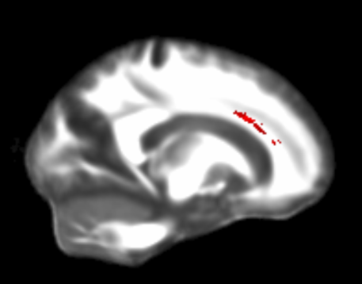
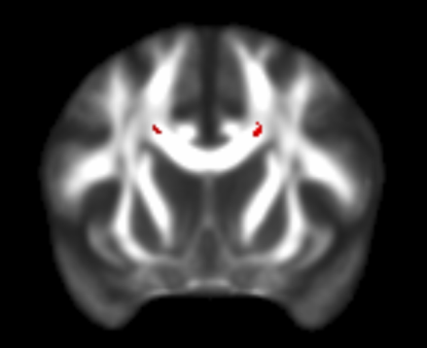
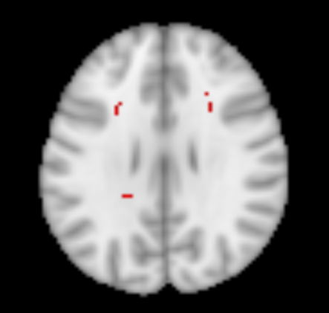
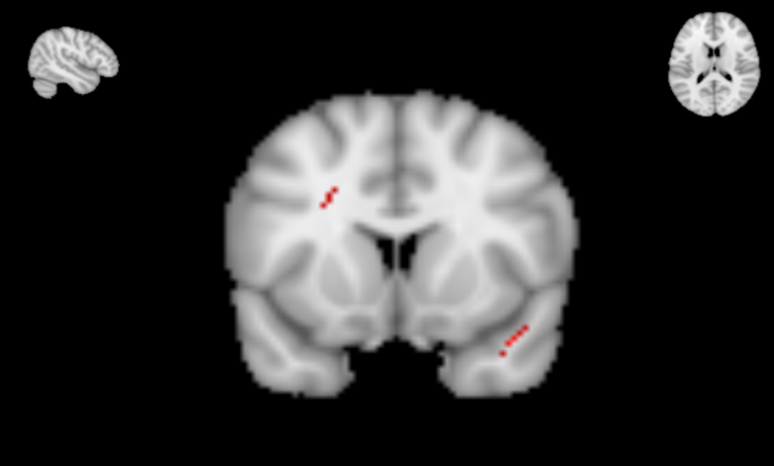
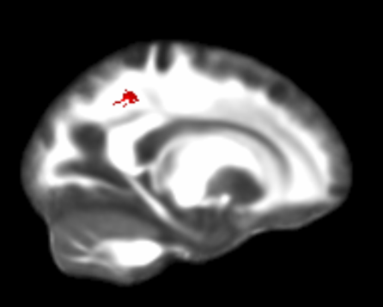
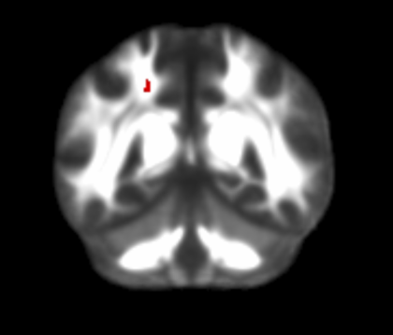
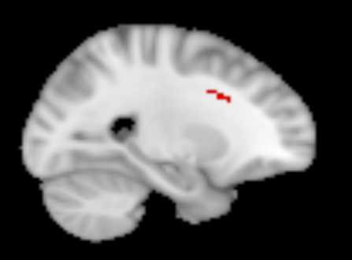
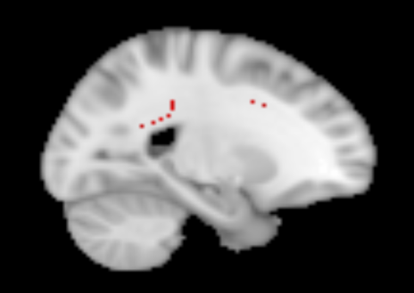
decreased FA value
Increased MD value
A TBSS (tract Based Statial Statistics) study demonstrated that MD value was increased and FA value was degreased, in mild AD, however, MD is more significant than FA value in detecting the mild AD
Notes:
With Tract Based Spatial Statistics method, a set of white matter showed decreased FA value, including the body of corpus collosum, corona radiate, and subcortical area in right parietal lobe. And some areas showed increased MD value, including splenium of corpus collosum, corona radiate, and subcortical area in left superior temporal lobe. Through the comparison of FA and MD, we found the MD value is more significant in detecting mild AD.

Slide 18
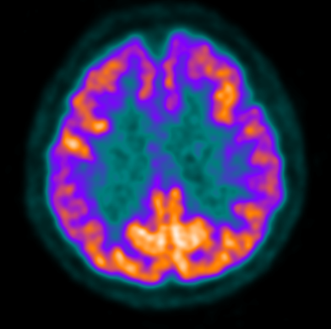
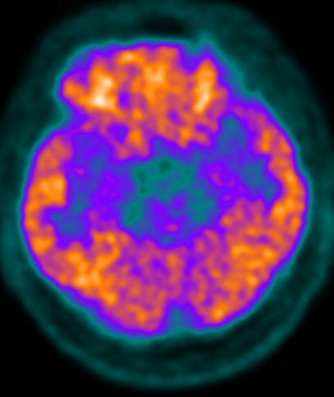
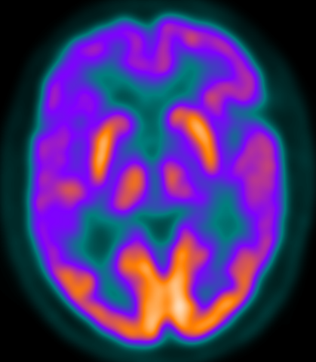
PET Study
¹⁸F FDG-PET baseline examination (34 cases)
Amyloid-PET-MRI will be performed later this year
AD
MCI
NC
Notes:
34 cases had undergone the baseline FDG-PET, abnormal metabolic changes could be observed in medial temporal lobe, PCC, temporal-parietal association cortex, and frontal lobe in mild AD patients.
medial temporal lobe, PCC, and temporal-parietal association cortex get involved in MCI.
Amyloid imaging with MRI-PET will be performed in August this year. I think it is a big step for the research progress of China-ADNI. We are looking forward to it. The MRI/PET should been installed in end July Xuanwu Hospital.

Slide 19
Many thanks to the support from WW-ADNI！
Notes:
Finally, I express gratitude to all the colleague of China-ADNI, and many thanks to the support from WW-ADNI. We have long way to go, however, we have taken the first step.

Slide 20
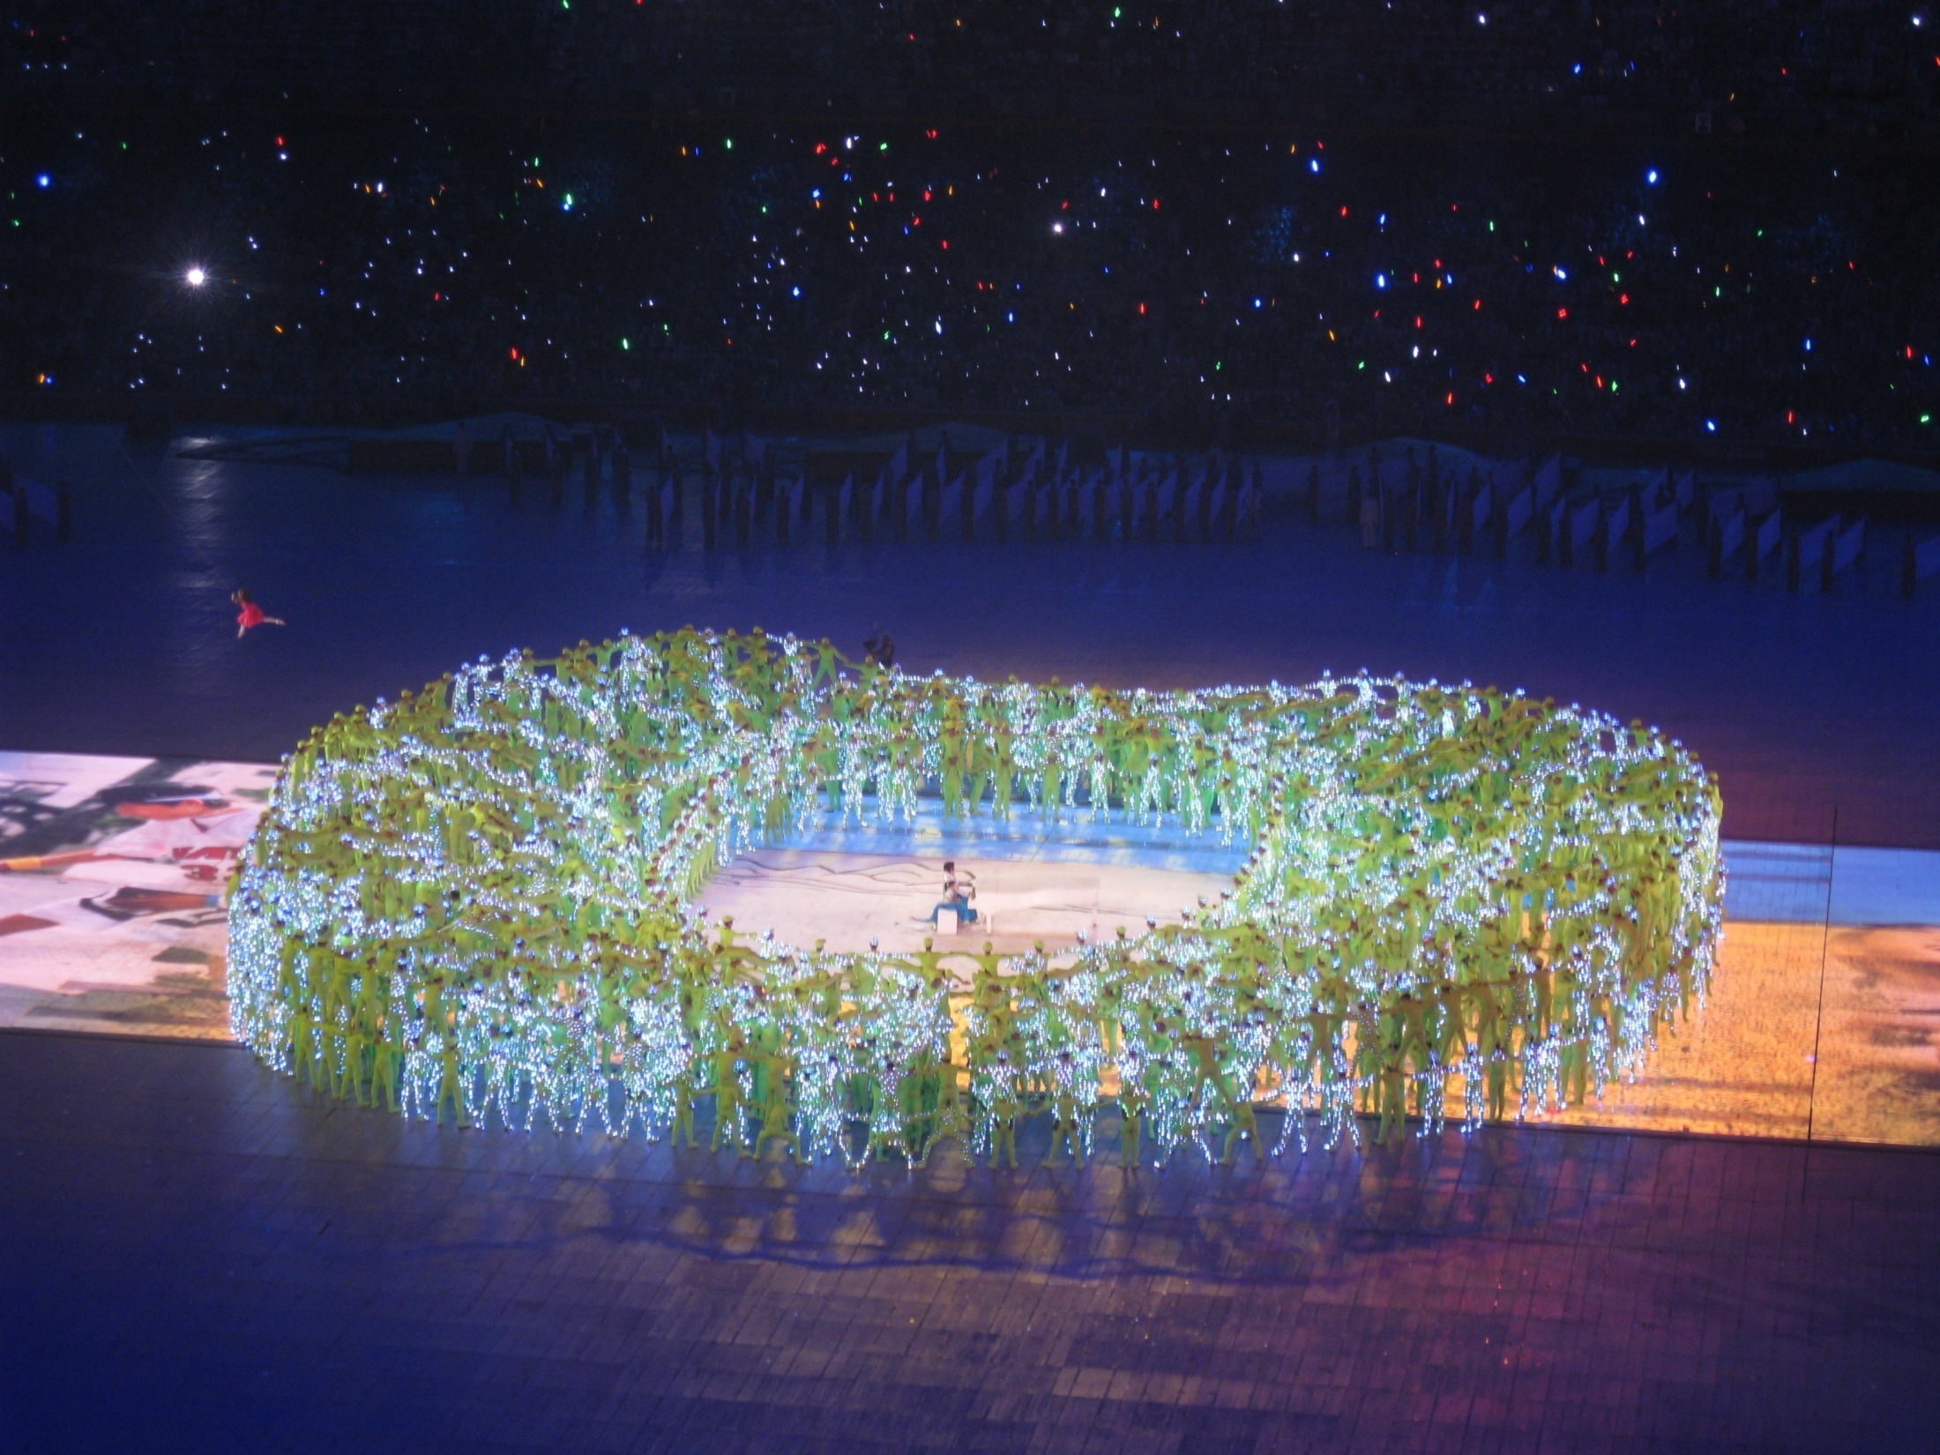
Thank you!
Notes:
Thank you very much for your attention!

