Slide 1
ADNI Clinical Core
Paul Aisen
Ron Petersen
Michael Donohue
Jennifer Salazar
WW ADNI
Washington, DC
July 17, 2015
©2012 MFMER | 3188678-<number>

Slide 2
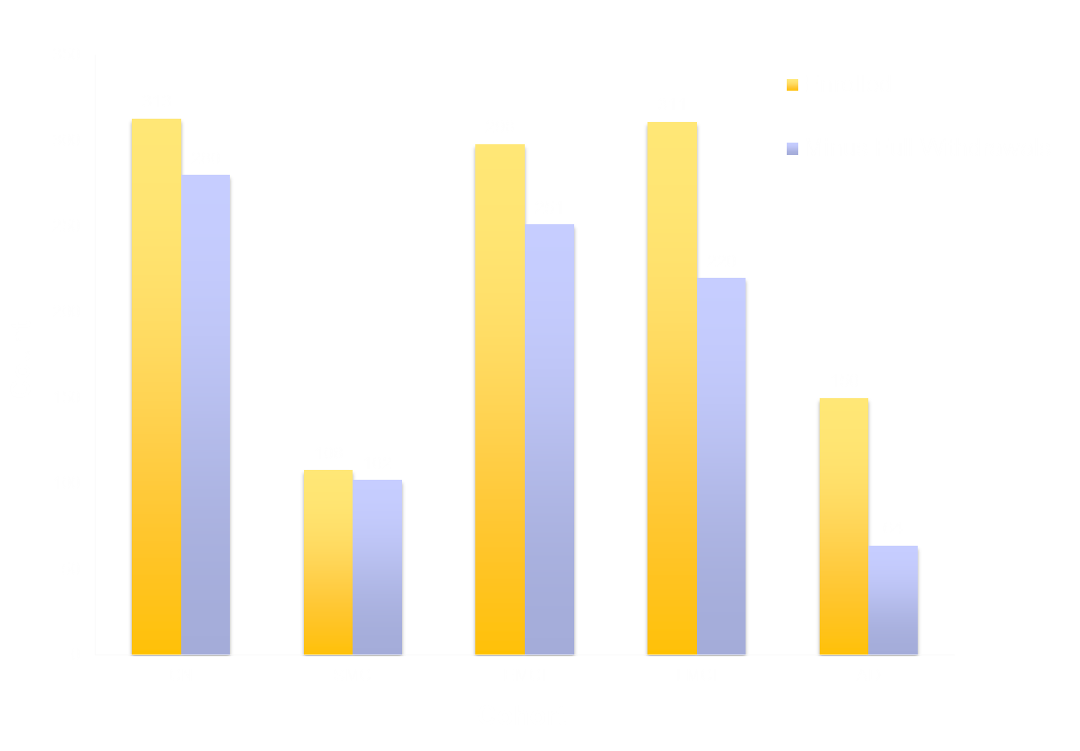
ADNI 2 Enrollment by Cohort
Total at initial entry (includes 276 ADNI 1 + 120 ADNI GO rollovers): 1180
Current total (minus reported withdrawals): 917
©2012 MFMER | 3188678-<number>
Notes:
Includes rollovers and does not include screen fails

Slide 3
ADNI GO + 2 Baseline
 | CN n=184 | SMC n=103 | EMCI n=301 | LMCI n=160 | AD n=145 | Combined n=893 | P
Age (yrs) | 73.4 (6.3) | 72.2 (5.6) | 71.3 (7.4) | 72.2 (7.5) | 74.6 (8.1) | 72.5 (7.3) | <0.001
Female | 94 (51%) | 61 (59%) | 132 (44%) | 74 (46%) | 59 (41%) | 420 (47%) | 0.027
Education | 16.5 (2.5) | 16.7 (2.6) | 16.0 (2.7) | 16.5 (2.6) | 15.8 (2.7) | 16.3 (2.6) | 0.009
CDR-SB | 0.0 (0.1) | 0.01 (0.2) | 1.3 (0.8) | 1.7 (1.0) | 4.5 (1.7) | 1.5 (1.7) | <0.001
ADAS 13 | 9.2 (4.5) | 8.9 (4.3) | 12.7 (5.4) | 18.7 ( 7.1) | 31.0 (8.4) | 15.5 (9.6) | <0.001
MMSE | 29.0 (1.3) | 29.0 (1.2) | 28.3 (1.6) | 27.6 (1.8) | 23.1 (2.1) | 27.6 (2.6) | <0.001
Part. ECog | 1.3 (0.3) | 1.6 (0.3) | 1.8 (0.5) | 1.8 (0.5) | 1.9 (0.6) | 1.7 (0.5) | <0.001
Study Part. Ecog | 1.2 (0.3) | 1.3 (0.3) | 1.6 (0.5) | 1.9 (0.7) | 2.7 (0.7) | 1.7 (0.7) | <0.001
©2012 MFMER | 3188678-<number>

Slide 4
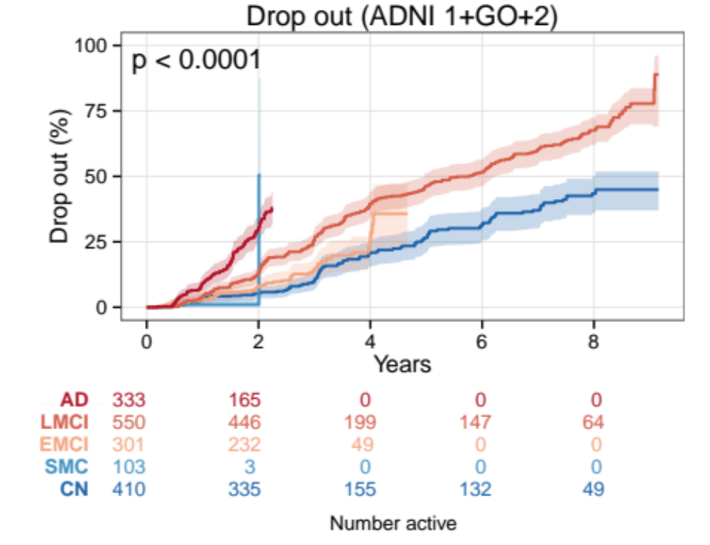
Dropout Rate
dropout = reported withdrawals
©2012 MFMER | 3188678-<number>
Notes:
1, GO, and 2

Slide 5
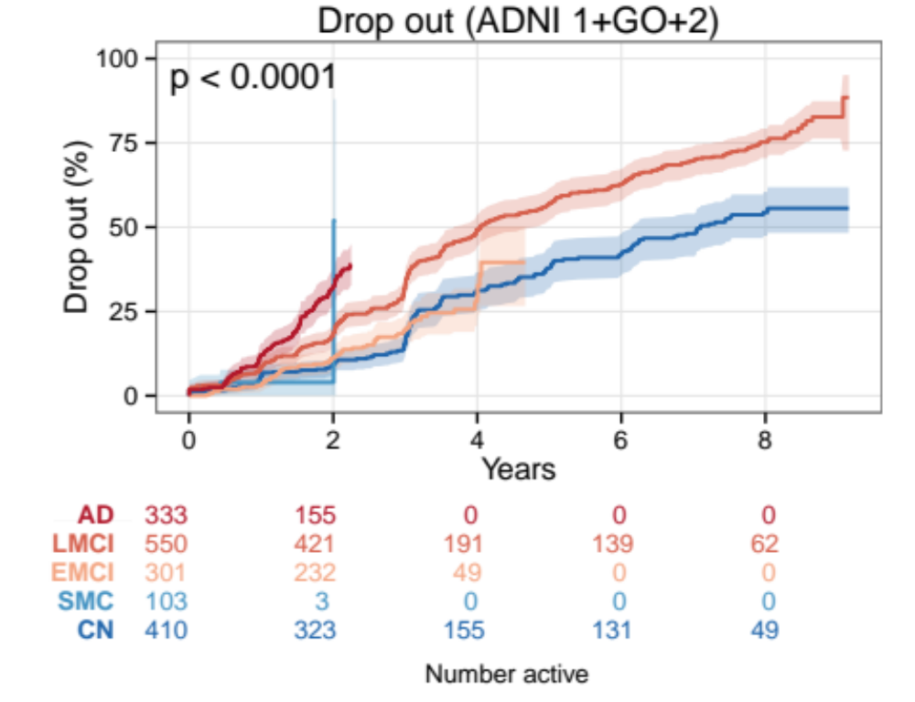
Dropout Rate
dropout = reported withdrawals or no new data in last 18 months
©2012 MFMER | 3188678-<number>
Notes:
1, GO, and 2

Slide 6
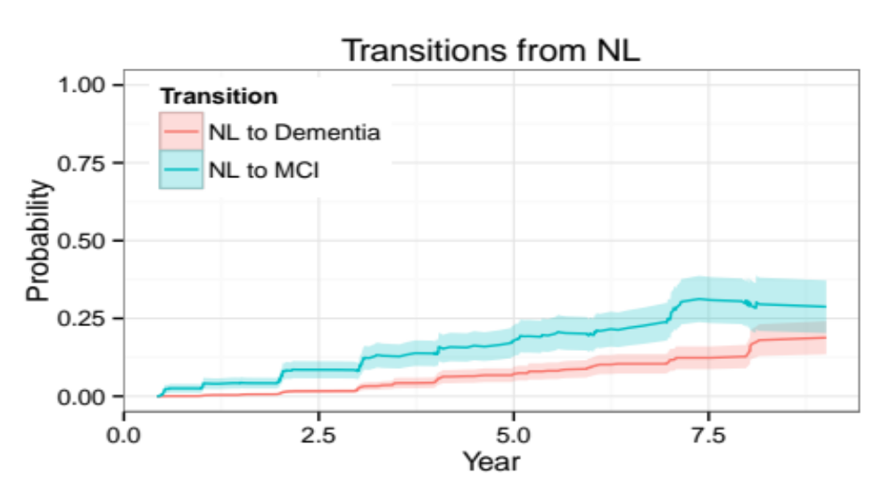
Transitions from NL
Notes:
The NL to MCI rate is fairly linear. Annual rates: 4.1%, 4.0%, 4.1%, 3.0%, 4.2%, 1.8%, 7.4% for years 1-7.

Slide 7
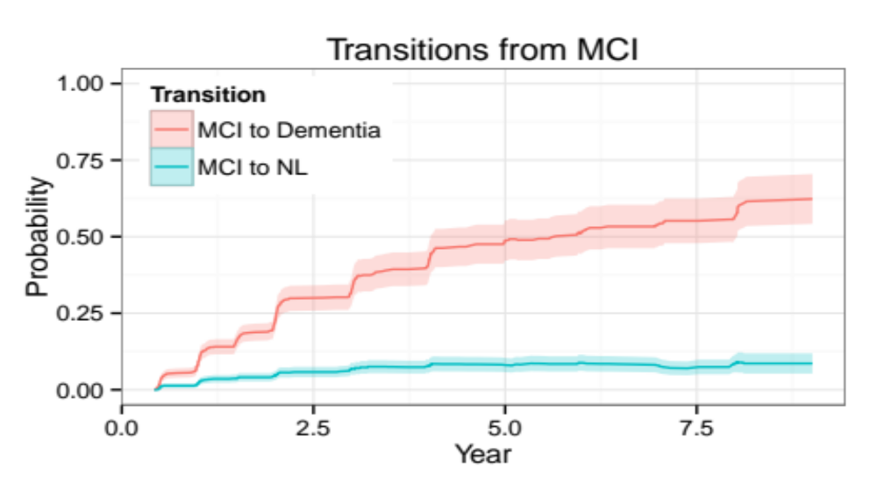
Transitions from MCI
Notes:
There appears to be some slowing of rate of MCI-to-Dem transitions. The annual rates are 13.1%, 15.8%, 8.8%, 8.9%, 2.9%, 3.3%, 2.8% for years 1-7.

Slide 8
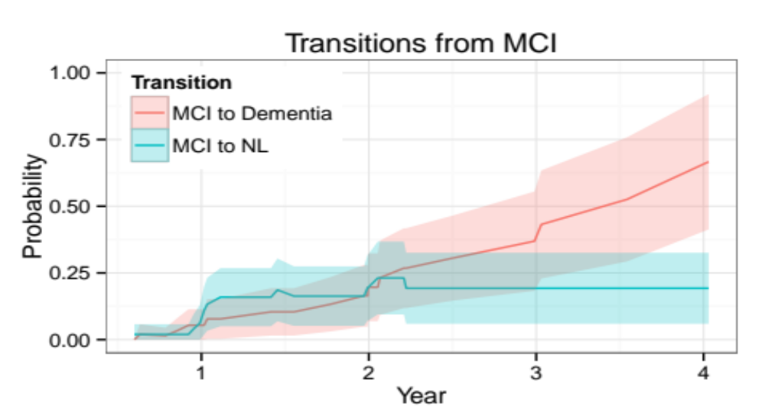
Transitions from “de novo” MCI
Notes:
Different time-scale here (only 4 years of followup). Progression to dementia might be a touch lower at year 2, say, but not a huge difference currently

Slide 9
ADNI 3 CLINICAL CORE PLANS
Paul Aisen
Ron Petersen
Mike Donohue
Mike Weiner

Slide 10
The aims of the ADNI3 Clinical Core will include:
Oversight of ADNI3 clinical activities, data management, tracking and quality control, recruitment and retention of participants, regulatory oversight and financial management.
Characterization of the cross-sectional features and longitudinal trajectories of cognitively normal older individuals and mild cognitive impairment.
Study of the relationships among clinical/demographic, cognitive, genetic, biochemical and neuroimaging features of AD from the preclinical through dementia stages.
Assessment of genetic, biomarker and clinical predictors of decline.
Refinement of clinical trial designs, including secondary prevention, slowing of progression in symptomatic disease, and cognitive/behavioral management.

Slide 11
Key hypotheses of ADNI3 Clinical Core
All or almost all normal participants with brain amyloidosis will show cognitive decline compared to those without amyloidosis, and will progress to MCI.
  Confirmation of this hypothesis is critical to early stage trial design and regulatory support.
MCI participants who are biomarker positive (amyloid and tau) will progress more rapidly than those who are negative

Slide 12
Other hypotheses
Amyloid-related cognitive decline involves episodic memory, executive function and orientation across the spectrum of AD
AD-related cognitive decline can be captured by unsupervised web-based testing
Early stage AD cognitive decline predicts later functional and clinical decline
Web-based registries will facilitate recruitment for ADNI (and therapeutic trials)

Slide 13
ADNI3 cohorts
ADNI3 will carry forward roughly 300 normals (w/wo subjective concerns) and 300 MCI (EMCI+LMCI)
ADNI3 will enroll modest numbers of new normal and MCI participants
ADNI3 will follow MCI participants who progress to AD dementia

Slide 14
Possible adjustments to assessments
Drop RAVLT, add FCSRT?
Drop Boston Naming?
Drop Clock Drawing?
Add web-based cognitive testing.
CFI instead of eCOG? Other PROs?
Decisions will be conservative: strong commitment to the enormous longitudinal ADNI database-> we will preserve most (possibly all) existing measures
Continued discussion with PPSB

Slide 15
Alzheimer’s Therapeutic Research Institute
Research institute in San Diego
Started June 21, 2015
Affiliated with USC
Generous administrative and academic support from USC
Admin, Clinical Operations, Informatics, Biostatistics cores
Projects: FYN inhibitor (Strittmatter, van Dyck), Intranasal insulin (Craft), A5/EARLY (Sperling, Janssen), GAP …

