Slide 1
EPAD update
José Luis Molinuevo
Worldwide-ADNI Update Meeting Friday, July 17, 2015 Washington, D.C.

Slide 2
EPAD Goal
The European Prevention of Alzheimer's Dementia (EPAD) project aims to develop an infrastructure that efficiently enables the undertaking of adaptive, multi-arm Proof of Concept studies for early and accurate decisions on the ongoing development of drug candidates or drug combinations for the prevention of AD dementia.

Slide 3

EPAD Consortium
Worldwide-ADNI Update Meeting Friday, July 17, 2015 Washington, D.C.
3
Notes:
Talking points:
EPAD is a community of 35 diverse partners, including patient organizations, academic institutes, Biotech and other SMEs, CROs and pharmaceutical companies. All are essential to make EPAD a success.

Slide 4
Our mission
To deliver a standing, double-blind, Alzheimer’s disease PoC adaptive trial which is sustainable beyond the 5 years of the IMI funding.
Part of the IMI-AD Platform (EMIF-AD, AETIONOMY, EPAD)
Consortium involving 8 work packages (WPs), 5 Scientific Advisory Groups (SAGs), National/Regional Leaders and a network of about 30 EPAD Trial Delivery Centres (TDC’s).
Worldwide-ADNI Update Meeting Friday, July 17, 2015 Washington, D.C.

Slide 5
EPAD clusters
The EPAD Delivery Cluster (WP1-4)
Preparation stage
Implementation execution stage
The EPAD Supportive Cluster (WP5-8)
Preparation stage
Supportive role
Worldwide-ADNI Update Meeting Friday, July 17, 2015 Washington, D.C.

Slide 6
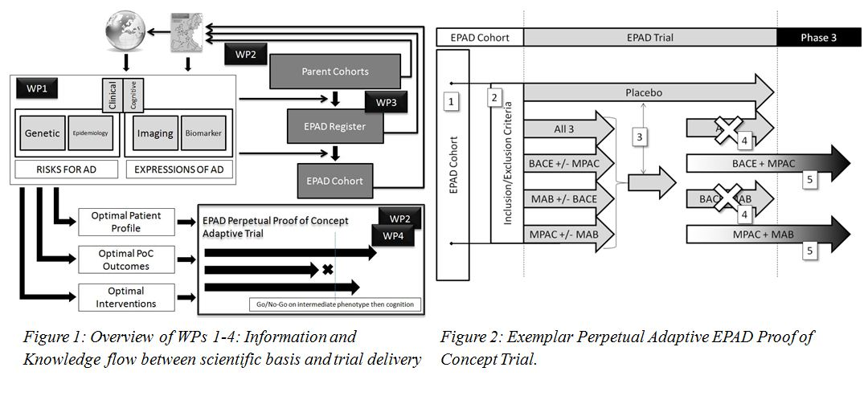
EPAD delivery cluster
Worldwide-ADNI Update Meeting Friday, July 17, 2015 Washington, D.C.

Slide 7
EPAD delivery cluster: Preparing the setting
WP1
Defining the risk spectrum: the population suitable for secondary prevention.
To define the evaluation criteria for inclusion of subjects into the EPAD Register, EPAD Cohort and EPAD Trial, and the relevant biomarker and clinical assessments and endpoints.
To assess and select potential trial mechanisms and compounds, through a Clinical Candidate Selection Committee.
WP2
To develop and optimise disease modelling and simulation software supporting trajectory risk modelling
To build the interventional adaptive trial design and needed methodology, providing updates to the design, analysis of new interventions and of existing compounds.
Worldwide-ADNI Update Meeting Friday, July 17, 2015 Washington, D.C.

Slide 8
Preparing the setting
WP3
Parent Cohort identification
Creation of EPAD register
WP4
To establish certified EPAD TDCs across Europe
To establish the EPAD Cohort and related data flows, databasing infrastructure, quality control/assurance and monitoring procedures (in close collaboration with WP7)
To sign off the EPAD Cohort Protocol
To sign off the EPAD Trial Master Protocol
To establish a Principal Investigators Network supporting EPAD Cohort and Trial activities (in close collaboration with WP7)
Worldwide-ADNI Update Meeting Friday, July 17, 2015 Washington, D.C.

Slide 9
EPAD supportive cluster
WP5: Project Management
WP6: Dissemination
WP7: Business Model and Sustainability
WP8: ELSI
Worldwide-ADNI Update Meeting Friday, July 17, 2015 Washington, D.C.

Slide 10
Implementing and executing the project

Slide 11
Patient Recruitment: How It Works
Your P2 Arm Flexible pool of subjects
EPAD accelerates patient access and trial enrollment by providing a pre-identified, trial-ready cohort of 6,000+ subjects for quick, targeted recruitment process
1,500 patients available
6,000 to join cohort
Evergreen registry of
24,000 at-risk people

Slide 12
From Register to the LCS

Slide 13
Aims of EPAD LCS
To be a readiness cohort for the EPAD PoC Trial
To provide biomarker, cognitive, clinical and risk factor data (including genetic data) for disease modeling work in a pre-dementia population.
To use disease models for risk stratification and thereafter subject selection for the EPAD PoC Trial.
To provide run in, pre-randomisation data for the EPAD-PoC analysis at an individual level to allow for more powerful analyses of change following intervention with various agents in the EPAD PoC trial
Worldwide-ADNI Update Meeting Friday, July 17, 2015 Washington, D.C.

Slide 14
Inclusion/exclusion criteria
In principle, the cohort will have pre-dementia subjects with limited exclusion criteria (mainly people with other overt causes of cognitive impairment).
It will include a trial ready population ranging from:
Normal cognitive people AD pathology biomarker negative (TBD)
Normal cognitive people AD pathology (biomarker) positive (TBD)
Prodromal AD/ MCI due to AD (TBD)
For disease modelling this will be treated like a spectrum of single process
It will take into account additional info (ApoE genotype, ..)

Slide 15
Inclusion/exclusion criteria
In principle, the cohort will have limited exclusion criteria. Basic inclusion criteria
Age 50 to 80
Subjects able to read and write, ≥ 7 years of education
Do not satisfy clinical criteria for any type of dementia
Do not carry a PS1, PS2 or APP mutation.
Do not suffer from any neurological, mental, medical condition associated with risk of cognitive impairment or limiting psychometric testing
Do not have any cancer or history of cancer in the preceding 5 years.
Are willing to participate in the EPAD PoC Trial subject to further informed consent.
Worldwide-ADNI Update Meeting Friday, July 17, 2015 Washington, D.C.

Slide 16
Baseline evaluation
The baseline assessments will characterise:
Biomarker (likely to include CSF Aβ42 and tau biomarkers)
Imaging (MRI)
Cognitive status (outcomes advised by WP1)
PET amyloid in connection with IMI-2 call?
There will be a dynamic review of the ‘spectrum’ in the LCS (between WP4 and WP2) in a fashion that Scott Berry referred to as ‘managed heterogeneity’.
We predict annual follow up assessments:
Cognitive follow

Slide 17
The EPAD Cohort
Loss to Follow Up
Enter Other Clinical Trial
Enter EPAD Trial
Draw through existing imaging (and other) data from Parent Cohort
?
Data
Data
Data
EPAD Cohort Baseline
Clinical
New biomarker
New imaging
1st Follow Up
2nd Follow Up
Replenishment from EPAD Register
Worldwide-ADNI Update Meeting Friday, July 17, 2015 Washington, D.C.
17

Slide 18
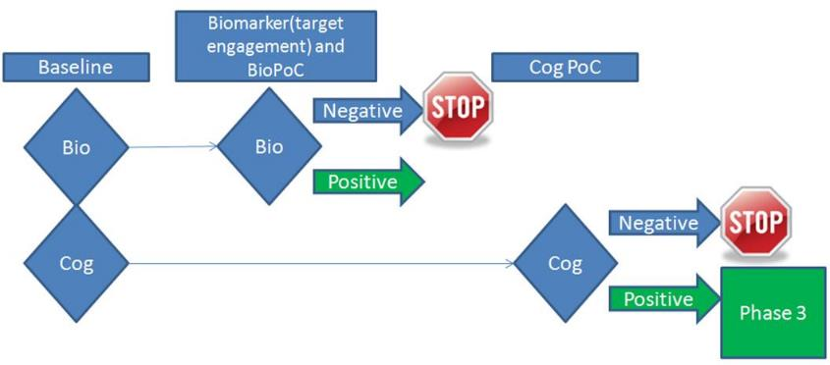
The EPAD PoC Trial
Allows early decisions on progression to longer term clinical outcomes by impact on pre-defined and target-specific intermediary phenotype.
EPAD PoC trial budget is not covered by IMI call
Worldwide-ADNI Update Meeting Friday, July 17, 2015 Washington, D.C.
18

Slide 19
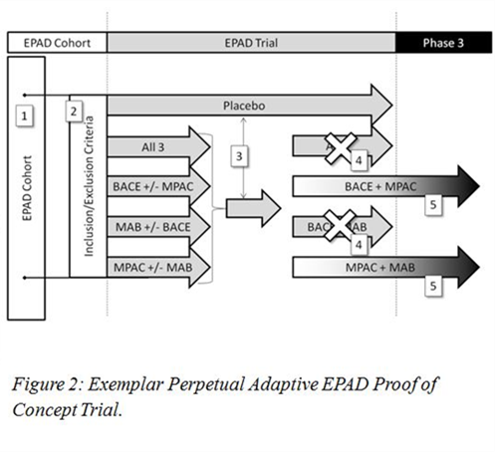
EPAD adaptive trial

Slide 20
The EPAD Centre Network
National leads will work closely with the WP4 leadership and EPAD Executive in the establishment of approximately 30 EPAD-TDCs across Europe.
EPAD-TDCs will be closely located to the EPAD Cohort’s Participants as identified in feasibility run on the EPAD Register.
They will have access to the necessary outcome infrastructure (e.g. PET scanners) and will be experienced in undertaking Phase 2 trials to the highest standards.
Worldwide-ADNI Update Meeting Friday, July 17, 2015 Washington, D.C.

Slide 21
The EPAD Centre Network
Each EPAD-TDC’s will be expected to recruit 200 participants to the EPAD Cohort and 50 of these people into the EPAD PoC Trial.
EPAD-trial delivery centres network will be providing best practice to deliver the EPAD Cohort and PoC Trial.
The development of the broader EPAD Community will assist with the ongoing motivation of staff and become a key element for sustainability beyond year 5 of the programme.
Worldwide-ADNI Update Meeting Friday, July 17, 2015 Washington, D.C.

Slide 22
Practicalities on EPAD TDC
The importance of EPAD TDC for sustainability: EPAD community
EPAD TDC will be certified and contracted
Cohort access
Trial delivery
Open in three waves across Europe
Funding model
The role of the national leads
Worldwide-ADNI Update Meeting Friday, July 17, 2015 Washington, D.C.

Slide 23
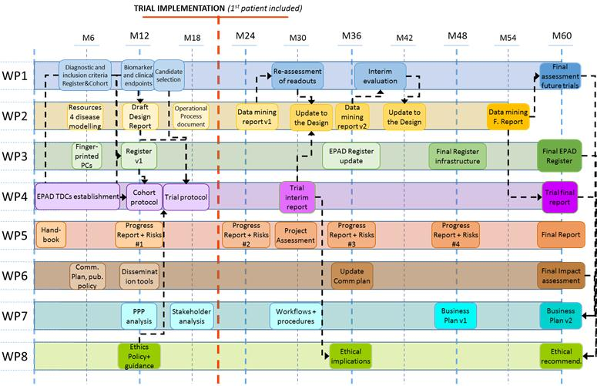

Slide 24
Summary
EPAD is a recently started IMI project aiming to deliver a standing, double-blind, AD prevention PoC adaptive trial which is sustainable beyond the 5 years of the IMI funding
Main milestones happening at the end of the first year are
EPAD Cohort Protocol signed off and regulatory/ethical approval obtained, cohort data infrastructure ready (M14)
Cohort First Patient In (M16)
EPAD Trial Protocol signed off (M 17)
EPAD Trial regulatory approvals obtained and establishment of trial Data Safety Monitoring Board. (M 20)
EPAD Trial First Patient In (M 21)

Slide 25



Acknowledgment
The research leading to these results has received support from the Innovative Medicines Initiative Joint Undertaking under grant agreement n° 115736, resources of which are composed of financial contribution from the European Union's Seventh Framework Programme (FP7/2007-2013) and EFPIA companies’ in kind contribution.

Slide 26
THANK YOU

