Slide 1


Genetics Core Update and ADNI-3 Plans
Andy Saykin, Indiana University
For the Genetics Core/Working Groups
WW-ADNI Meeting, Washington DC
July 17, 2015
asaykin@iupui.edu

Slide 2
Original ADNI-2 Specific Aims Progress Report & Impact
Aim 1: Blood sample processing, genotyping and dissemination
Aim 2: Genome-wide analysis of multidimensional phenotypic data collected on the ADNI cohort
Aim 3: Serve as a central resource, point of contact and planning group for genetics in ADNI
Genetics Core Report: Alzheimer’s & Dementia 11 (2015) 792-814

Slide 3
Aim 1: Blood sample processing, genotyping and dissemination
1707 participants have at least 1 lymphoblastoid cell line (LCL) DNA sample banked at NCRAD*
810 ADNI-1, 125 ADNI-GO, and 772 ADNI-2
1685 participants have at least 1 DNA sample from genomic blood extracted and banked*
777 ADNI-1, 127 ADNI-GO, and 781 ADNI-2
1198 participants have RNA samples*
RNA collection was initiated in ADNI-GO
ADNI-1 subjects who continued to ADNI-GO/2 have RNA samples; 290 ADNI-1, 128 ADNI-GO, and 780 ADNI-2 subjects have at least 1 RNA sample stored at NCRAD
* Data as of 3/24/2015
Core Report: Alzheimer’s & Dementia 11 (2015) 792-814

Slide 4
Aim 1: Blood sample processing, genotyping and dissemination – cont’d
Genotyping
All samples: APOE, DNA fingerprinting & GWAS (n=1724*)
Unique individuals with GWAS (n=1674) (8 more need QC repeat)
ADNI-1: TOMM40 PolyT (n=757)
Genome-wide association studies (GWAS)
ADNI-1 Illumina 610 Quad (n=818*)
ADNI-GO/2 Illumina OmniExpress (n=793)
Illumina Omni2.5M (n=817*) – completed with WGS
Whole exome sequencing (WES) – n=18 (extreme phenotype)
Whole genome sequencing (WGS) – n=808 (Broad VCF set)
RNA genome-wide expression profiling (Affymetrix array)
Pending QC: n~746 of 811 PaxGene blood RNA tubes (BMS)
* 1674/1724 GWAS available; local IRB related embargo: 61/818; 5/817; updated 4/2015
Core Report: Alzheimer’s & Dementia 11 (2015) 792-814

Slide 5
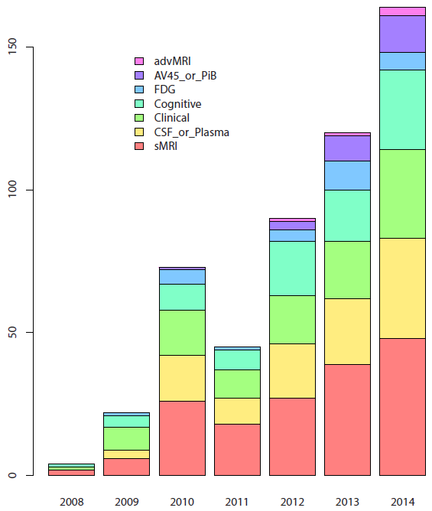
Publications
Aim 2: Genome-wide analysis of multidimensional phenotypic data collected on the ADNI cohort
ADNI Genetics Data Use and Reports (2008 to 2014)
As of 1/1/2015
Core Report: Alzheimer’s & Dementia 11 (2015) 792-814

Slide 6
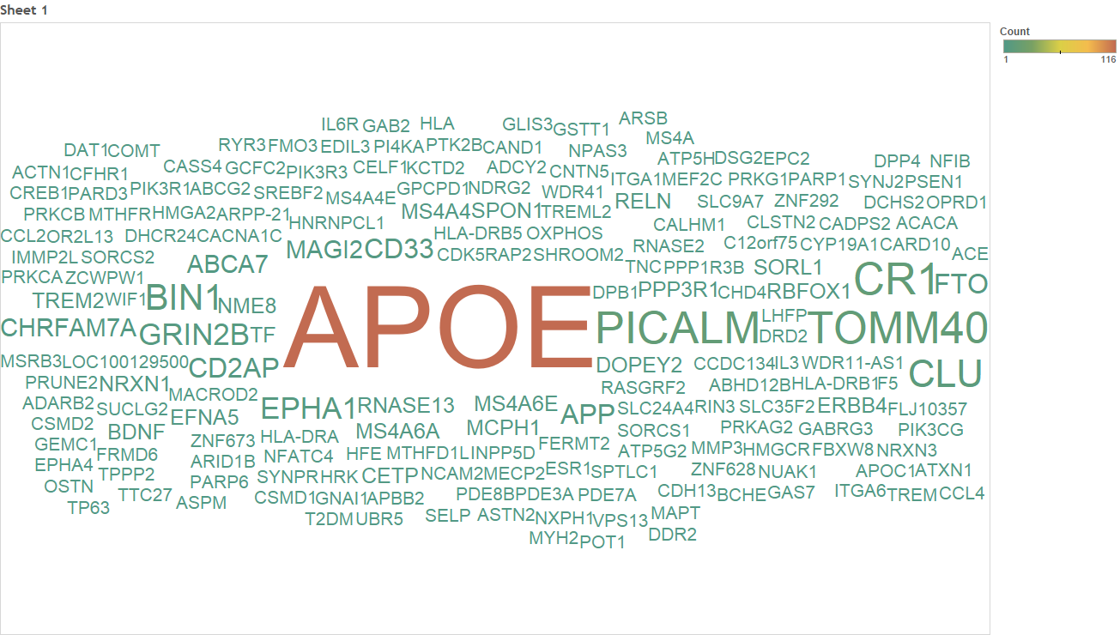
Gene Counts
ADNI Genetics Data Use and Reports (2008 to 2014)
As of 1/1/2015
Core Report: Alzheimer’s & Dementia 11 (2015) 792-814
Notes:
Gene counts(include APOE): https://public.tableausoftware.com/workbooks/Gene_count_08-14_v2?:showVizHome=no
Gene counts(exclude APOE): https://public.tableausoftware.com/workbooks/Gene_count_01?:showVizHome=no
Journal counts: https://public.tableausoftware.com/workbooks/Journal_count_08-14_v2?:showVizHome=no

Slide 7
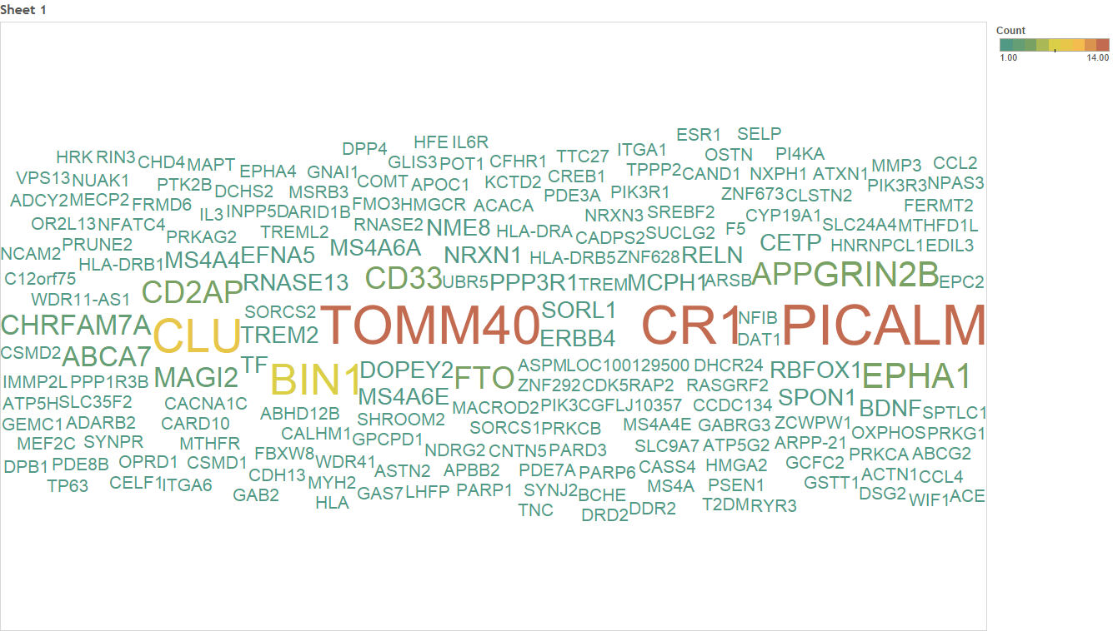
Gene Counts without APOE
ADNI Genetics Data Use and Reports (2008 to 2014)
As of 1/1/2015
Core Report: Alzheimer’s & Dementia 11 (2015) 792-814
Notes:
Gene counts(include APOE): https://public.tableausoftware.com/workbooks/Gene_count_08-14_v2?:showVizHome=no
Gene counts(exclude APOE): https://public.tableausoftware.com/workbooks/Gene_count_01?:showVizHome=no
Journal counts: https://public.tableausoftware.com/workbooks/Journal_count_08-14_v2?:showVizHome=no

Slide 8
Aim 2: Genome-wide analysis of multidimensional phenotypic data collected on the ADNI cohort
ADNI APOE data has been reported extensively regarding MCI and AD
ADNI GWAS data - Selected contributions highlighting impact
ADNI GWAS and related studies in MCI and AD:
2009: 1st GWAS of MRI hippocampal volume in AD
2010: 1st GWAS of CSF amyloid and tau markers
2010: 1st whole brain ROI-based GWAS & voxel-based GWAS
2010: 1st GWAS of longitudinal hippocampal MRI change
2010: Among 1st studies of mitochondrial DNA variations in AD
2011: Replication sample in very large-scale AD case-control GWAS
2011: Among the 1st reports of copy number variation (CNV) in AD/MCI
2012: Sample in two of the 1st large-scale genetic meta-analyses of MRI
2012: 1st gene pathway analysis of amyloid PET (PiB)
2012: Among the 1st gene pathway analyses of memory impairment

Slide 9
Aim 2: Genome wide analysis and impact of ADNI MCI and AD phenotypes – continued
2013: 1st GWAS of amyloid PET (florbetapir)
2013: 1st MRI study of recently discovered TREM2 variant
2013: 1st whole-exome sequencing study in MCI (1st extreme MRI phenotype in MCI)
2013: Demonstrated strong influence of genetic variation on plasma protein levels
2013: 1st large scale WGS data set released to scientific community – analyses begin
2013: 1st GWAS of the healthy human structural connectome discovers SPON1 gene
2014: Largest GWAS of memory at the time - FASTKD2 gene discovered and
associated with hippocampal structure on MRI
2014: Metabolomics collaboration launched (to include gene-metabolite studies)
2015: WES detects REST as novel neuroprotective target in MCI
2015: RNA baseline expression profiling and quality control nears completion
2015: Numerous discovery, replication & methods studies continue using ADNI data

Slide 10


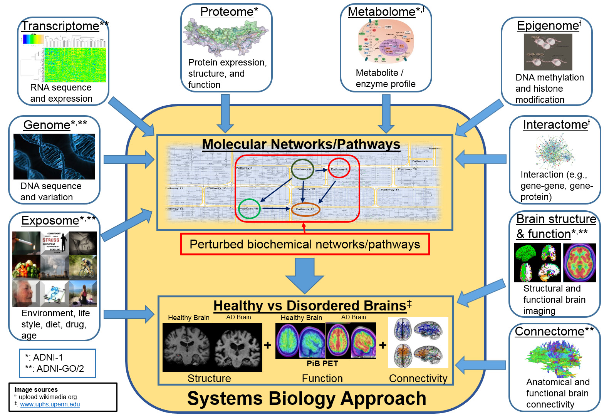

Converging –omics & Systems Biology
Core Report: Alzheimer’s & Dementia 11 (2015) 792-814
Notes:
Sources of Images:
Metabolome: http://upload.wikimedia.org/wikipedia/commons/c/c4/TumorMetabolome.jpg
Epigenome: http://upload.wikimedia.org/wikipedia/commons/a/a2/Epigenetics_of_adipose_development..jpg
Interactome: http://upload.wikimedia.org/wikipedia/commons/b/b4/The_protein_interaction_network_of_Treponema_pallidum.png
Healthy vs Disordered Brain: http://www.uphs.upenn.edu/news/News_Releases/2013/12/verma/verma_large.jpg

Slide 11
Systems Biology Working Group
Genetics Core (IU, UCI, USC)
PPSB Core Liaisons & other company experts
AbbVie, Biogen, Eisai, Lilly, Janssen, Pfizer, Piramal, et al
EAC Representatives
Metabolomics Network (Duke University)
Analytics Organizations
Sage Bionetworks, Orion Bionetwork, In-Silico Biosciences, GNS Healthcare
AMP-AD Investigators
Other academic labs (Emory, MSSM, Penn, Rush)
Spring 2015

Slide 12
Path from genetic signal to targeted therapeutics: key applications to drug discovery and development
Core Report: Alzheimer’s & Dementia 11 (2015) 792-814

Slide 13
Novel Target Discovery Examples
fas-activated serine/threonine kinase domains 2 (Chr 2q33.3)
Pharmacogenomics (2015) 16(5), 429–432

Slide 14
FASTKD2 & Memory
Cohorts: HRS, ADNI-1, ADNI GO/2, AddNeuroMed, IMAS, ROS/MAP
Notes:
Figure 2. Association and effect of rs7594645-G (FASTKD2) on immediate recall in the Health and Retirement Study discovery genome-wide
association study (GWAS). (a) All single-nucleotide polymorphisms (SNPs) within 500 kb of FASTKD2 are plotted based on their GWAS − log10
P-values, NCBI build 37 genomic position and recombination rates calculated from the 1000 Genomes Project reference data. The color scale
of r2 values is used to label SNPs based on their degree of linkage disequilibrium with rs7594645. Genes in the region are labeled with arrows
denoting 5’- to -3’ orientation. (b) Mean immediate recall scores (adjusted for clinical covariates and population structure) ±s.es. are displayed
based on rs7594645 genotype. Presence of the minor allele (G) of rs7594645 imparted a modest additive effect of improving memory
performance and accounted for 0.5% of the phenotypic variance.

Slide 15
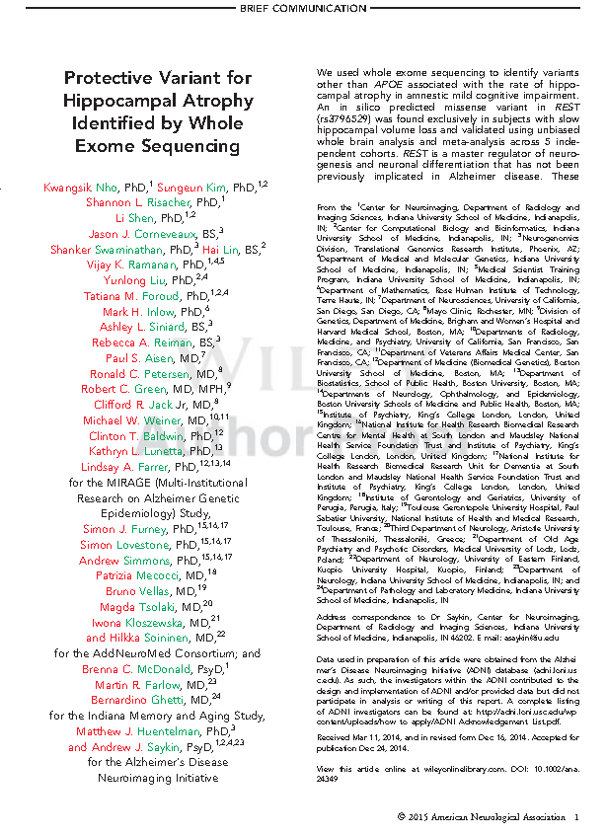
REST: Protective Variant
Repressor element 1-silencing transcription factor (4q12)
Expressed in cortex & hippocampus, Represses genes involved in cell fate, cell death & neurogenesis, Role in protection against oxidative stress & amyloid toxicity
Lu et al Nature (2014)
Nho et al Annals of Neurology 77(3); 2015

Slide 16
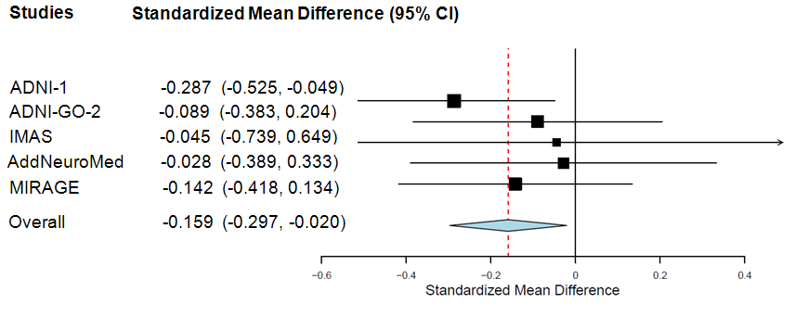
REST: Meta-Analysis 5 Independent Cohorts (N=923)
Quantitative Trait loci (QTL) Association Analysis using hippocampal volume as endophenotypes
rs3796529 (REST)
P = 0.02
Effect of rs3796529 on right hippocampal volume at baseline
Subjects with minor alleles of rs3796529 showed larger hippocampal volume
Nho et al. Annals of Neurology (2015)
Cohorts: ADNI-1, ADNI-GO/2, IMAS, AddNeuroMed, MIRAGE

Slide 17
GWAS of Longitudinal Amyloid PET: IL1RAP
IL1RAP (interleukin-1 receptor accessory protein)
rs12053868 (P=1.38x10⁻⁹)
Ramanan et al., AAIC 2015 and Ramanan et al., Brain 2015 (In Press)

Slide 18
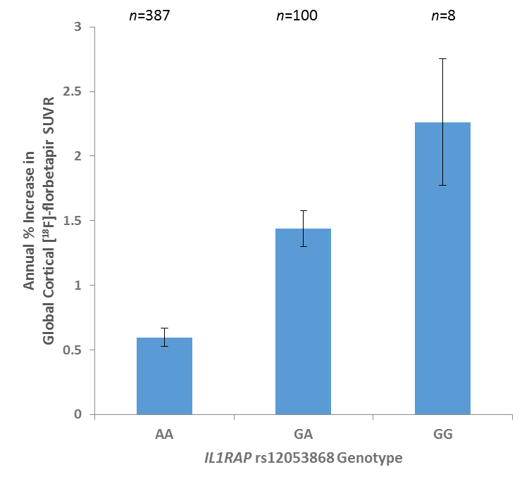
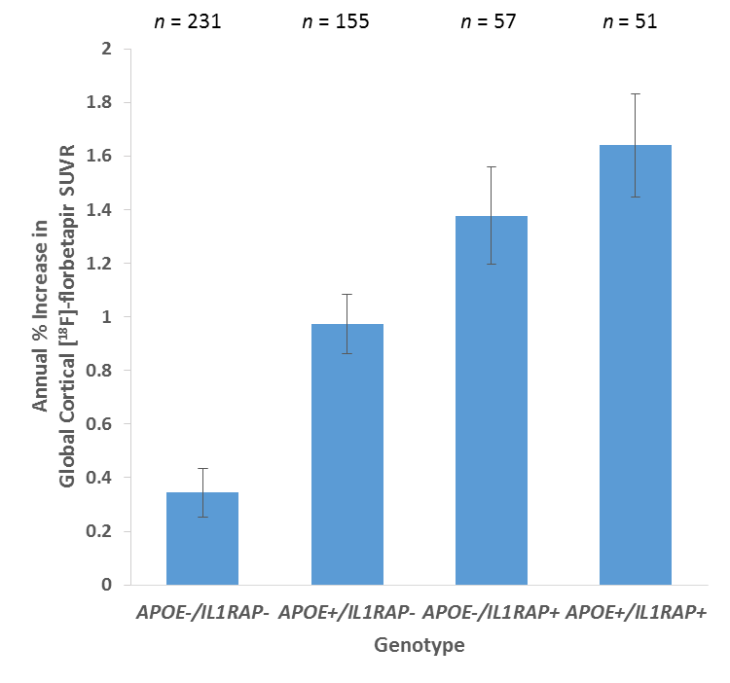
Effect of IL1RAP rs12053868
IL1RAP rs12053868-G is associated with higher rates of amyloid accumulation
IL1RAP rs12053868-G and APOE ε4 exert independent, additive effects
Cohen’s d=1.20
Equivalent OR=8.79
Cohen’s d=0.60
Equivalent OR=3.00
-IL1RAP (7.1%) + APOE ε4 (3.4%) explain 10.5% of the phenotypic variance (age and gender explain 0.9%)
-IL1RAP association remains genome-wide significant (P=5.80x10⁻⁹) with additional covariates of APOE ε4 status, baseline diagnosis, education, baseline amyloid burden and its square, and PCA eigenvectors
Ramanan et al., AAIC 2015 and Ramanan et al., Brain 2015 (In Press)

Slide 19
ADNI 3 – OVERALL SPECIFIC AIMS Genetics can contribute to each goal
Overall goal: validation of biomarkers for AD
Longitudinal change of cognition and biomarkers: measures that capture longitudinal change with highest statistical power
Prediction of cognitive decline:
Clinical trial design: Optimum outcome measures, predictors, and inclusion/exclusion criteria for clinical trials
Discovery: new markers, new targets

Slide 20
Scientific Rationale & Hypotheses
Genetics informs precision medicine and impacts trial design
Examples: A4, API Columbian kindred and APOE, DIAN-TU, TOMMORROW Study
Understand disease heterogeneity – phenotype profile, rate of progression
Analyses in current samples, eg, amyloid vs tau vs inflammatory subtypes –treatable subsets?
Role of gene pathways & networks in comorbidities – “diseasome”
Existing Pharma data sets have relatively little longitudinal follow-up and usually incomplete biomarker panels
Discovery, validation and prioritization of diagnostic and therapeutic targets
Current: APOE, TOMM40, BCHE (rivastigmine, now amyloid), TREM2 …. Promising nominations: FASKD2, REST, IL1RAP
Future: prescription by genotype with PGX screen to avoid adverse effects

Slide 21
Genetics Aims for ADNI-3 Overview
Aim 1: Data collection, sample banking, quality control and dissemination
Aim 2: Comprehensive and integrative genomics and bioinformatics analysis emphasizing systems biology
Aim 3: Determine the clinical and biological significance of identified variants
Aim 4: Continue to provide organization, collaboration and leadership for genomic studies of quantitative biomarker phenotypes

Slide 22
Genetics Core/Working Groups
Indiana University
Imaging Genomics Lab
Andrew Saykin (Leader)
Li Shen (co-Leader)
Sungeun Kim
Kwangsik Nho
Shannon Risacher
Vijay Ramanan
National Cell Repository for AD
Tatiana Foroud (co-Leader)
Kelley Faber
PPSB Working Group Members
Xiaolan Hu (BMS)
Enchi Liu (Janssen)
Leanne Munsie (Lilly) *
Qingqin Li (J&J)
Nadeem Sarwar (Eisai) *
Adam Schwarz (Lilly)
Holly Soares (BMS)
Dave Stone (Merck)
FNIH Team
* Genetics Core Liaisons
Core Collaborators/Consultants
Steven Potkin (UCI; co-Leader)
Lars Bertram (Max Planck)
Lindsay Farrer (BU)
Robert Green (BWH)
Matt Huentelman (TGen)
Jason Moore (U Penn)
Paul Thompson (USC)
Other Collaborators – RNA and NGS Projects:
Liana Apostolova (IU)
Nilufer Ertekin-Taner (Mayo Clinic)
Keoni Kauwe (BYU)
Yunlong Liu (IU)
Fabio Macciardi (UC Irvine)
2014

