Slide 1
MRI WWADNI 2015
Mayo
Cliff Jack
Bret Borowski
Matt Bernstein
Arvin Forghanian-Arani
Jeff Gunter
Dave Jones
Kejal Kantarci
Rob Reid
Denise Reyes
Matt Senjem
Kaely Thostenson
Prashanthi Vemuri
Chad Ward
Funded MRI Investigators
Charlie DeCarli – UCD
Nick Fox – UCL
Mike Weiner/Duygu Tosun – SFVA
Paul Thompson – USC
Danielle Harvey – biostats
MR Company collaborators
Dan Rettmann – GE Mayo
Pete Kollasch – Siemens, Mayo
Yansong Zhao - Philips, BU

Slide 2
ADNI 3 protocol – all sequences in all subjects
3D T1 volume
3D FLAIR
T2* GRE
ASL –3D, pCASL, background suppression
TF-fMRI – 2 tiered, use capability of advanced systems
Advanced - 10 minute, multi band, sub second TR
Basic – 10 minute, 3 sec TR
dMRI - 2 tiered, use capability of advanced systems
Advanced - 2 b-shells with 48/64 encoding directions
Basic – single shell b=1000
Coronal high res T2 – hippocampal subfields

Slide 3
ADNI 3 MRI protocol rationale 3D T1, FLAIR, T2*GRE
3D T1 (MPRAGE, IR-FSPGR)
most precise longitudinal measure (biomarker or clinical/psych) – core for multi modality comparisons
Associations with tau PET (and other measures)
FLAIR
Disease detection – safety standard, clinical reads
Associations of CVD with tau PET (and other measures)
Possible improved results with 3D
T2* GRE
MCB detection, all clinical trials

Slide 4
ADNI 3 MRI protocol rationale ASL, dMRI, TF-fMRI
Promising associations, but not strong enough to recommend including in trials using ADNI 2 methods
Significant developments since ADNI 2
in other fields, improved methods = better diagnostic performance
Opportunity to see if advanced methods cross the “value” threshold for use in clinical trials

Slide 5
ADNI 3 MRI protocol rationale ASL, dMRI, TF-fMRI
field continues to seek methods which can be used in Phase 2 which provide an early signal of treatment response
measures of brain function may detect neuronal response to therapeutic reduction in toxic molecular species (e.g. soluble Ab or tau)
2016 advanced is 2022 routine – do not want methods to be outmoded by end of ADNI 3 grant cycle
Grantsmanship – novelty

Slide 6
Approach to “experimental sequences ” from ADNI 2 – leveraging the best in class from other efforts
dMRI and TF-MRI – human connectome project (HCP)
ASL – ISMRM expert work group
Phantom – NIST/ISMRM QMRI committee

Slide 7
dMRI approach
advanced, HCP-like – 2 shells, b=1000 & 2000
Better ROI-based MD, FA measures
Enable adding ROI-based kurtosis measures
Basic – single shell, b=1000
Compatibility – equivalent of basic dMRI in every subject at no time penalty
extract b1000 shell from advanced acquisitions
Rooted in multi center real world trial environment

Slide 8
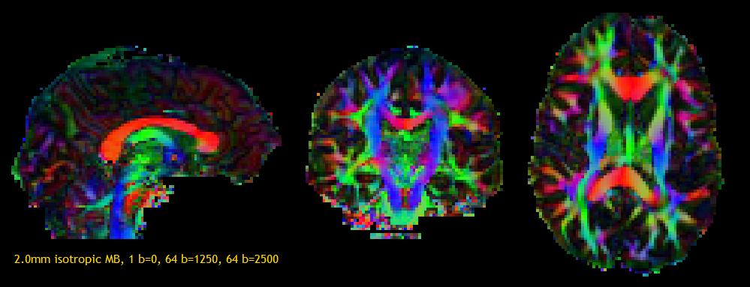
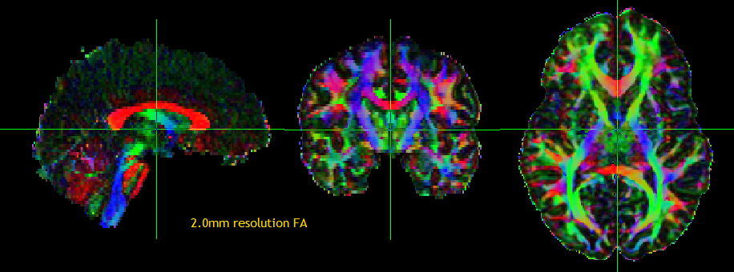
Advanced (Multiband, Multishell)
skyra
Basic
GE 750

Slide 9
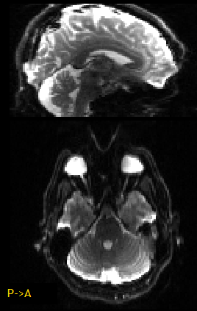
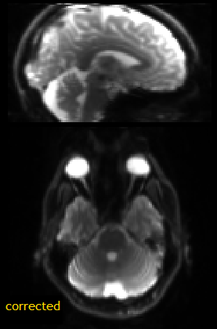
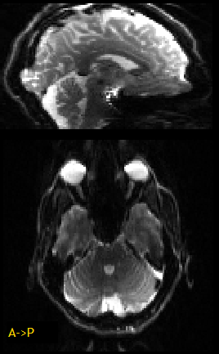
Correcting EPI Distortion By Acquiring b = 0 volumes with both P->A and A->P Phase Encoding Directions

Slide 10
Features of advanced dMRI sequence *note requires 32 (64) array coil **NH = now w vendor assist
feature | Siemens | GE | Philips
32 array coil | now | 2016 | now
multi band | d13 (WIP) | 2016 | WIP w 3/5
Multi b shells | d13 | WIP | now
Multi b0s | NH | now | 5.x
b0 spacing | NH | x | 5.x
Flip phase | NH | Use CV | NH
Grad dir contr | NH | NH | 5.x

Slide 11
TF-fMRI approach
advanced, HCP-like – 10 min, sub second TR, MB
More precise measure of time series (temporal resolution)
Less noisy node to node, ICA, graph theory measures
Directly measure physiological parameters
Time varying connectivity metrics
Basic – 10 minute, ~3 sec TR
Compatibly advanced and basic
down sample advanced time series to 1 volume/~3 sec

Slide 12
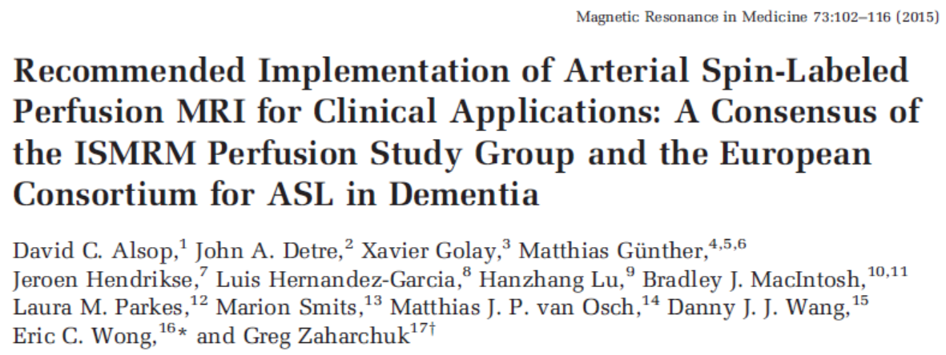
pseudo-continuous labeling with background suppression
segmented three-dimensional readout without vascular crushing gradients
and calculation and presentation of both label/control difference images and CBF maps
GE product now; Siemens d13; Philips 3D GraSE now testing

Slide 13
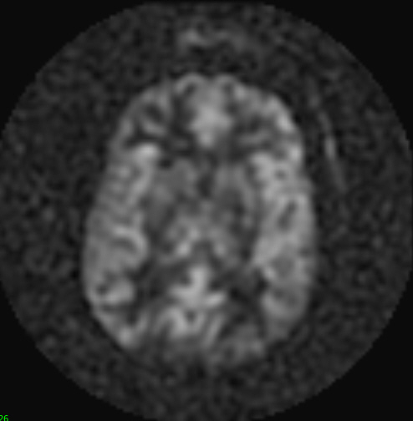
3D pCASL CBF map, volunteer, GE

Slide 14
MR Phantom: ADNI Experience
scanners are much more stable now vs 2005 –hence less need to correct for scan to scan geometry fluctuation
use phantom to track scanners through upgrade and maintenance cycles – qualification and re qualification
Phantoms are helpful for establishing comparability of new models of scanners as the come along

Slide 15
ADNI Phantom
Designed by ADNI MRI core along with Rich Mallozzi (GE), Josh Levy(Phantom Labs) in 2004/2005
produced at Phantom Labs in upstate NY – Josh Levy
Priced in the range of $6k per unit
Freely available analysis package distributed via ADNI website – Jeff Gunter (Mayo)
Commercial analysis available from ImageOwl (a Phantom Labs partner)

Slide 16
NIST-ISMRM System Phantom
ISMRM Standards and Quantitative MR committee has developed a quantitative MRI phantom design
Provides similar geometric fidelity measurements to ADNI phantom (that component strongly influenced by ADNI phantom experience)
WITH resolution and slice thickness assessments inspired by ACR-NEMA phantom
AND NIST validated T1, T2, PD arrays

Slide 17
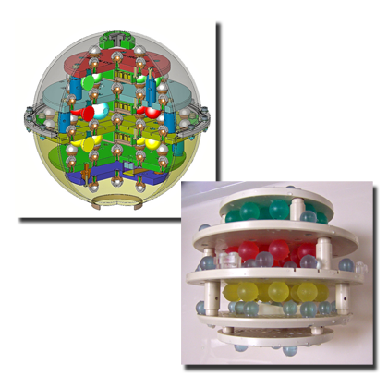
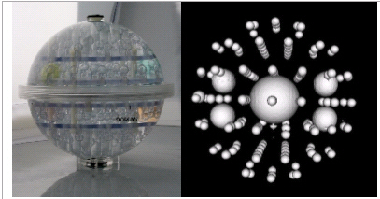
NIST-ISMRM System Phantom
ADNI phantom

Slide 18
NIST-ISMRM System Phantom
“Open Source” philosophy – anybody welcome to manufacture them
Currently only vendor has done it
more expensive than ADNI phantom – target price is lower if production can be increased
Analysis software is currently immature (work in progress) – will be open source

Slide 19
Plan for phantoms in ADNI 3
Use: to qualify and requalify scanners
But ADNI phantoms in field for 10yrs
Keep existing ADNI phantoms that are in the field until they age out of use and need repair/replacement
Previous pharma studies have some ADNI phantoms in storage at Mayo which could be folded into the ADNI fleet as replacements needed
When that supply is exhausted, roll in NIST/ISMRM phantom to replace ADNI phantoms?
Comparison testing this summer

Slide 20
MR measures - Maintain current set of funded MR investigators with roles adapted to ADNI 3
Structural MRI measures
BSI – UCL (Fox)
Freesurfer – SFVA (Tosun )
TBM – USC (Thompson)
TBM-Syn – Mayo (‘Jack’)
Cerebrovascuar disease – UC Davis (DeCarli)
AIRA H (CMB) – Mayo (‘Jack’)
ASL – SFVA (Tosun)
TF-fMRI – Mayo (‘Jack’)
dMRI - USC (Thompson)
Hipp subfields – U Penn (Yuskevich) SFVA (Mueller)

