Slide 1
ADNI Private Partner Scientific Board (PPSB) Update Susan De Santi, PhD 2015 Chairperson
WW ADNI Meeting July 17, 2015

Slide 2
PPSB: Leadership
Chair | Susan De Santi, Piramal Pharma, Inc.
Chair-elect | Gerald Novak, J&J
FNIH | Dorothy Jones-Davis, Scientific Project Manager* Rosa Canet-Aviles, Scientific Program Manager Renee Bullion, Partnership Development Officer# Julie Wolf-Rodda, Director of Development
Past PPSB Chairs | Jesse Cedarbaum, Biogen; Adam Schwarz, Eli Lilly; Johan Luthman, Eisai; Enchi Liu, Janssen AI; Mark Schmidt, J&J; Holly Soares, BMS; Patricia Cole, Takeda; Eric Siemers, Eli Lilly; Bill Potter; Pete Snyder
* Primary project manager
# Primary Partnership Development contact

Slide 3




























PPSB Partner Organizations

Slide 4
PPSB: 2015 Key Deliverables
Provide advice and input from a private partner perspective on the ADNI 3 grant proposal
In the pre-competitive space, evaluate needs/gaps and recommend projects or analyses that could accelerate drug development
PPSB working groups interface with ADNI cores on achieving working group goals and objectives
Articulate & communicate PPSB needs to the ADNI leadership (via PPSB Core Liaisons and the ADNI PPSB Chair)

Slide 5
PPSB Acomplishments of Cores and Working Groups

Slide 6
Clinical Endpoints Working Group
Co-Chairs | Veronika Logovinsky*, Eisai; Nandini Raghavan*, J&J
Clinical Endpoints Working Group Members *Due Diligence team | Alette Wessels, Lilly; Angshuman Sarkar, Novartis; Chang-Heok Soh, Roche; Enchi Liu, Janssen; Gerald Novak*, J&J; Jinping Wang, Eisai; Mike Ward, Genentech; Nuno Mendonca, AbbVie; Peng Yu*, Lilly; Peter Castelluccio, Lilly; Peter Quarg, Novartis; Richard Mohs, Lilly; Tobias Bittner, Roche; Xin Zhao, J&J; Ira Do*, Eisai; Julie Chandler, Merck; Adam Schwarz*, Lilly Kristin Kahle Wrobleski, Lilly; Michael Egan, Merck; Michael Ropacki*, Janssen; Annette Merdes*, Servier; Lyn Harper Mozley, Merck; Holly Posner*, Pfizer; Jesse Cedarbaum, Biogen; Susan De Santi*, Piramal; Bruce Albala*, Eisai; Davis Ryman, AbbVie; Holly Soares, BMS; Johan Luthman, Eisai; Mark Schmidt, J&J; Simen, Pfizer; Rick Margolin*, CereSpir; Robert Brashear*, Janssen; Lu Xu, Eisai; Michael Ryan*, Novartis;

Slide 7
Clinical Endpoints Working Group: Update on Current Activities
Workstream 1: pAD/MCI Endpoints and Methods (Lead: Nandini Raghavan, J&J)
Continue work on the formal comparison of pAD/MCI composite endpoints and methods using available pAD/MCI data sets. Preliminary results using ADNI data sets generated and presented at the ADNI PPSB CEWG Session (AAIC, July 16, 2014)
Workstream 2: Novel Tests for pre-MCI (Lead: Veronika Logovinsky, Eisai)
Completed work on Population Characterization in the Early Stages of Alzheimer’s Disease. Results were presented at the ADNI PPSB CEWG Session (AAIC, July 16, 2014). Publication currently in preparation
Workstream 3: List of Datasets (Lead: Holly Posner, Pfizer)
Produced a full list of datasets available for the comparison of pAD/MCI composite endpoints being conducted by Workstream 1. Results were presented at the ADNI PPSB CEWG Session (AAIC, July 16, 2014)
Workstream 4: Computerized Cognitive Batteries (Lead: Bruce Albala, Eisai)
Completed due diligence process, selected a computerized battery to pilot and to test the use of computerized clinical assessments. Implementation of the CogState pilot study (vendor of choice) underway with first sites active in July 2015.

Slide 8
DD Process for ADNI3 Clinical Tools
Format of DD Process: Seven Individual Work Streams
Pruning assessments from the present ADNI repertoire
Measurement of subjective cognitive concerns
Choice of wordlist memory assessment
Choice of functional outcome measure(s)
Tools that may be used as Patient Reported Outcomes (PRO) assessments
Choice of computerized test battery
Inclusion of assessments that contribute to composite measures used as a single primary outcomes
Each work stream is using an agreed upon template to collect data to evaluate and compare a variety of assessments within each category.
This work will provide final recommendations to the ADNI Clinical Core.

Slide 9
Update on the DD Process
Two preliminary discussions with the ADNI Clinical Core held.
Results for clinical assessments under consideration reviewed and initial suggestions made
Detailed discussion between the ADNI PPSB DD Team and the ADNI Clinical Core on the clinical tools for ADNI3
to take place at during AAIC meeting (scheduled for July 20, 2015)
This discussion is planned to
review the two proposals from the ADNI PPSB and the Clinical Core and discuss similarities and differences between the two
identify next steps and associated time lines to finalize an integrated proposal and to include it in the ADNI3 grant

Slide 10
Overview of Computer Pilot Study
Cogstate Brief Battery (CBB) a 10-15 minute computerized cognitive battery to be administered at home and in the clinical site
Four validated tasks measure: Attention, Speed of information processing, Working memory, and Learning.
Study Aims:
Determine magnitude of cognitive impairment using CBB;
Estimate CBB sensitivity to measure decline in ADNI2 by biomarkers;
Acceptability and usability of CBB, remote and onsite for MCI and controls;
Compare supervised on-site testing vs. remote unsupervised online test
Goal is 200 ADNI2 participants with a diagnosis of MCI or NL
Approximately 33 ADNI2 clinical sites are anticipated to participate in study
All participants will have a total of two supervised In-Clinic CBB sessions.
Participants annually seen in the clinic (MCI) will have a total of three remote (e.g. at home) on-line CBB sessions.
Participants seen in the clinic every two years (NL) will have five remote on-line CBB sessions approximately every 6 months.
CBB data will be downloaded and shared approximately every month.
Key analysis will be to compare onsite versus remote testing.

Slide 11
Update on Progress of CBB Pilot Study
CBB Instructions Manual and Take Home Handout Finalized
Data Transfer Agreement (DTA) finalized
Version 8 of CogState Brief Battery launched with self-training feature
IRB approval for 6 ADNI2 sites and their ICFs already obtained
Coordinating training webinars with Cogstate
6 ADNI2 sites ready to complete training webinar
Once training completed, these sites will receive ADCS approval to conduct CBB
Report with unique Cogstate IDs and ADNI2 IDs to be posted on ADNI2 web portal
Initial pilot CBB data pending training of these 6 sites

Slide 12
Biofluid Biomarker Working Group
Chair | Johan Luthman*, Eisai
Biofluid Biomarkers Working Group Members *Due Diligence Team | Alvydas Mikulskis*, Biogen; Gary Tong, Lundbeck Eskild Colding-Jørgensen, Lundbeck; Enchi Liu*, Janssen; Richard Batrla-Utermann, Roche; Just Genius, AbbVie; Holly Soares*, BMS; Ian Sherriff, Araclon; James Hendrix, Alzheimer’s Assoc.; Jeffrey Dage, Lilly; Jan Torleif Pedersen, Lundbeck; June Kaplow*, Eisai Jesse Cedarbaum, Biogen; Omar Laterza, Merck; John Lawson, Fujirebio; Patricia Cole, Takeda; Kristin Wildsmith, Genentech; Robert Dean, Lilly; Lee Honigberg, Genentech; Mary Savage, Merck; Manu Vandijck, Fujirebio; Robert Umek, MSD; Susan De Santi, Piramal; Tobias Bittner, Roche; Tanja Schubert, BioClinica; Robert Dean*, Lilly; Zivjena Vucetic, Fujirebio
 | Les Shaw*, UPenn

Slide 13

Biofluids Biomarker Working Group
Broad group of Pharma & Diagnostics companies
Several interfaces: GBSC project, CAMD CSF Project (C-Path) etc.
Forum to discuss ADNI2 biofluid CSF & blood biomarkers, assays used, sample management & data collection
Coordinate industry input into ADNI Biomarker Core activities in ADNI2
Align efforts within the PPSB
Assist in the ADNI-3 grant application development
Promote Biofluid Biomarkers best practices for diagnostic and prognostic intended uses (beyond ADNI)
Forum to discuss Biofluid Biomarkers Rx & Dx industry-specific topics
Notes:
GBSC = The Global Biomarker Standardization Consortium, coordinated by Alz Assoc, for obtaining material (reference material) and method (competitive studies across assays etc including both ELISA and Masspect methods) standards.

Slide 14
Biofluids Biomarker WG - Activities
Due diligence evaluation for Selection ADNI3 Aβ1-42 & tau (total or P-tau) CSF assays in ADNI-3
Due Diligence Sub-Team of BBWG (7 members – Rx Co + BMx Core)
Defined scope of the due diligence & Essential criteria to qualify for DD process (completed)
Developed comprehensive review instrument with key parameters for analysis (completed)
Mapped possible providers & Invited them to participate (completed)
Review underway of assays by DD team (ongoing)
Agree on ranking and recommendation (August/September)
Novel CSF biomarkers to be included in ADNI-3
Which markers/analytes - e.g. alpha-synuclein, Neurogranin, TDP-43?
Sufficient assay validation and clinical qualification data for inclusion into ADNI?
Novel blood biomarkers to be potentially included in ADNI-3
Which markers/analytes ?
Sufficient assay validation and clinical qualification data for inclusion into ADNI?
Organization of PPSB workshops/sessions on blood BMx

Slide 15
PPSB Members – MRI Core
Chair | Adam Schwartz, Lilly; Patricia Cole, Takeda
PPSB Members | David Clayton, Genentech; Steve Einstein, Janssen; Jerry Novak J&J; Paul Maguire, Novartis; Zhiyong Xie, Pfizer; Susanne Ostrowitzki, Roche; Joonmi Oh, BioClinica; Joyce Suhy, BioClinica; Kate McLeish, IXICO; Katherine Gray, IXICO; Alexandre Coimbra, Genentech; Celine Risterucci, Roche; Chahin Pachai, BioClinica; Richard Margolin, CereSpir

Slide 16
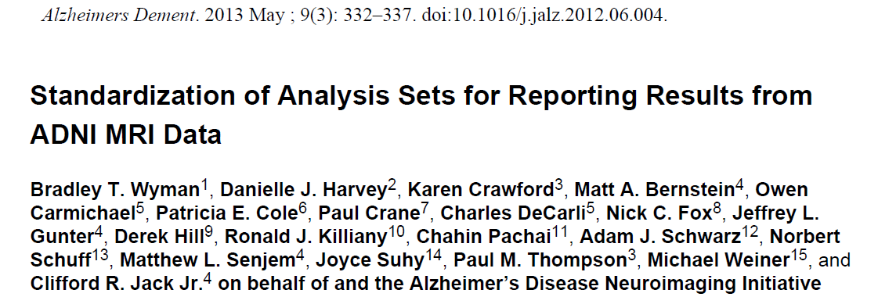
ADNI PPSB input – MRI core
ADNI2
Recommendation and adoption of standardized analysis sets for comparability of reports in the literature Alzheimers Dement. 2013 May;9(3):332-7
ADNI3 (prep)
All MRI sequences will be run at all sites; for DTI, TF-FMRI and ASL, there will be two tiers employed, basic and advanced-- sites with advanced capability sequences will employ those sequences

Slide 17
PET Endpoints Working Group
Chair | Mark Schmidt*, J&J; Richard Margolin*, CereSpir;
PET Endpoints Working Group Members * Tau PET Due Diligence Team | Adam Schwarz, Lilly; Chahin Pachai, BioClinica; Davis Ryman*, AbbVie; Derek Hill, IXICO; Enchi Liu, Janssen; Gregory Klein*, BioClinica; Jesse Cedarbaum, Biogen; John Beaver, AbbVie; Joonmi Oh, BioClinica; Kate McLeish, IXICO; Katherine Gray, IXICO; Hartmuth Kolb, J&J; Lea Marais, IXICO; Paul Maguire*, Novartis; Patricia Cole*, Takeda; Ping Chiao*, Biogen; Joyce Suhy, BioClinica Susan De Santi, Piramal
 | Johan Luthman*, Eisai Timothy McCarthy*, Pfizer; Vera Kiyasova*, Servier;

Slide 18
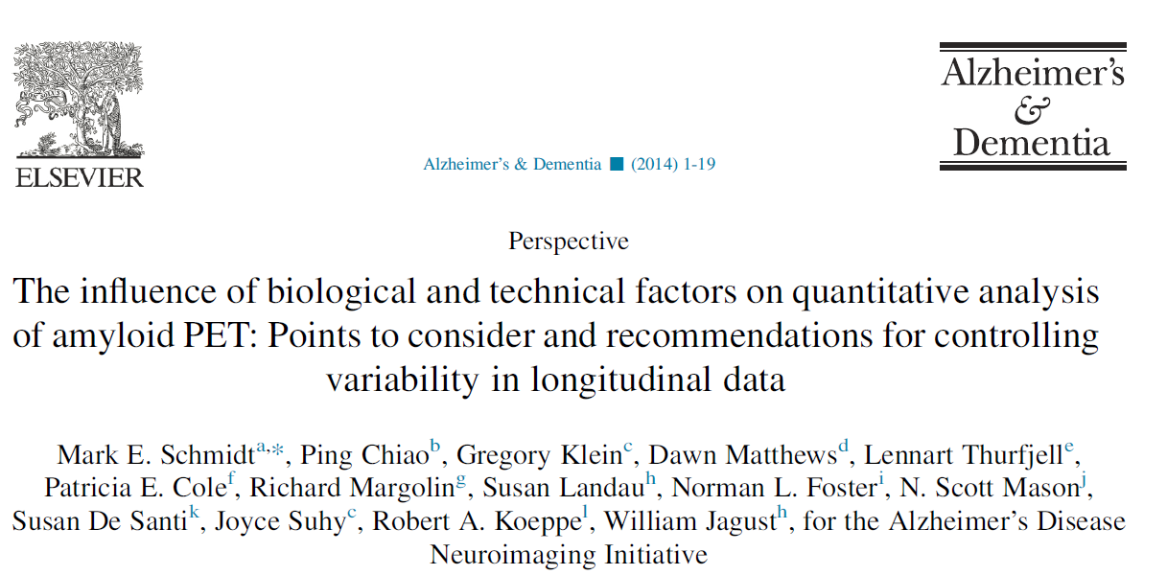
Accomplishments PET Endpoints Working Grp
Review of the PET section for the ADNI 3 grant proposal
Recommendation given to ADNI/NIA that the grant proposal include the potential for several tau PET ligands

Slide 19
PET Working Group: Goals for 2015
Work with the ADNI PET Core to support and complete the ADNI3 grant proposal section
Work with the PPSB and ADNI PET Core for inclusion of additional amyloid PET tracers into ADNI 3
Work with the PPSB and ADNI PET Core for review of tau PET ligands that can be included in ADNI 3
Due diligence process will be initiated when ADNI 3 funding is approved

Slide 20
PPSB Members – Genetics Core & Systems Biology Working Group
Chair | Nadeem Sarwar, Eisai; Leanne Munsie, Lilly
PPSB Members | Carsten Horn, Roche; David Stone, Merck; Enchi Liu, Janssen; June Kaplow, Eisai; Qingqin Li, J&J; Xiaolan Hu, BMS; Jeffrey Waring, AbbVie

Slide 21
Path from genetic signal to targeted therapeutics: key applications to drug discovery and development
Genetics Core Report: Alzheimer’s & Dementia 11 (2015) 792-814

Slide 22
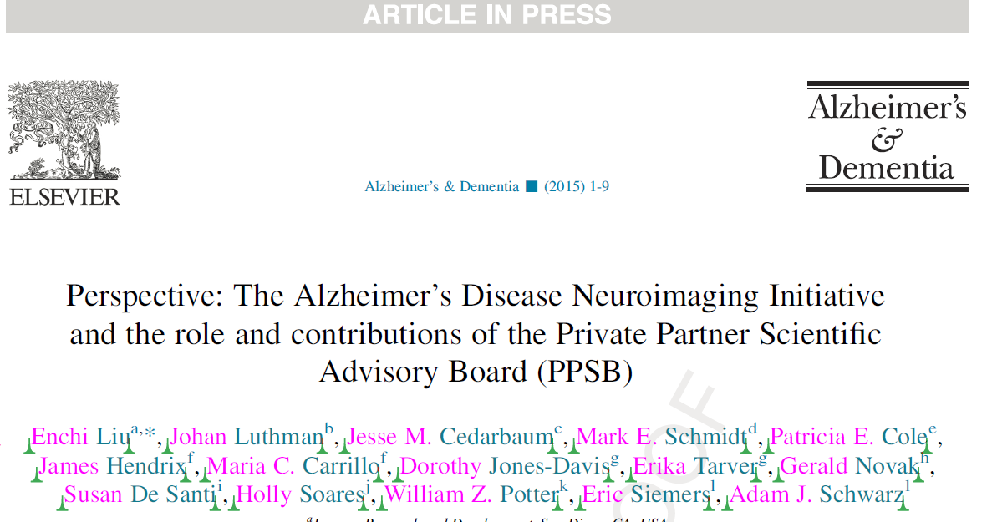
Publications

Slide 23
Contact Information
For Scientific Inquiries:
Dorothy Jones-Davis, Ph.D.
Scientific Project Manager, Neuroscience
Foundation for the NIH
301.594.2612
djones-davis@fnih.org
Rosa Canet-Aviles, Ph.D.
Scientific Program Manager, Neuroscience
Foundation for the NIH
301.402.5346
rcanet-aviles@fnih.org
For Partnership Development Inquiries:
Renée A. Bullion
Partnership Development Officer
Foundation for the NIH
301.435.4493
rbullion@fnih.org
Julie Wolf-Rodda
Director of Development
Foundation for the NIH
301.402.6027
jwolf-rodda@fnih.org
http://www.adni-info.org
http://www.adni.loni.usc.edu

Slide 24
PPSB Liaisons to ADNI Cores and Committees (1 of 2)
ADNI Core | Lead Liaison | Deputy Liaison | Extended Members
Biomarker | Holly Soares, BMS | Johannes Streffer, J&J
Biostatistics | TBD | TBD
Clinical | Veronika Logovinsky, Eisai | Nandini Raghavan, J&J
Genetics | Nadeem Sarwar, Eisai | Leanne Munsie, Eli Lilly
Notes:
24

Slide 25
PPSB Liaisons to ADNI Cores and Committees (2 of 2)
ADNI Core | Lead Liaison | Deputy Liaison | Extended Members
MRI | Adam Schwarz, Eli Lilly | Pat Cole, Takeda
Neuropathology | Enchi Liu, Janssen AI | Robert Paul, Genentech
PET | Mark Schmidt, J&J | TBD
Publications (Committee) | Lee Honigberg, Genentech | N/A
Resource Allocation (Committee) | Enchi Liu, Janssen AI | Holly Soares, BMS
Notes:
25

Slide 26
Research Allocation Review Committee (RARC)
Rima Kaddurah-Daouk - plasma metabolomics
Kaj Blennow: abeta oligomers in CSF
There was some request for urine that got turned down, I think
Anne Fagan: CSF neurogranin & neurofilament in CSF
JZ wanted to expand his alpha-synuclein studies (using CSF originally sent to U Wash for somamer assay)
request for plasma samples to validate plasma Abeta 42/40 ratio determined by specific assays as a biomarker, either as a diagnostic or to enrich for amyloid positive individuals.

