Slide 1
Arg-ADNI
Gustavo E. Sevlever (*) , Silvia Vázquez, Deborah R. Gustafson,
Salvador M. Guinjoan, Ricardo F. Allegri
and Arg-ADNI group.
Memory and Aging Center
Institute for Neurological Research (FLENI)
Buenos Aires, Argentina
WW-ADNI update: Toronto, July 2016
*speaker

Slide 2
Arg-ADNI
Staff
Management Committee
Allegri RF, Sevlever G, Guinjoan S, Gustafson D, Vazquez S.
Clinical
Stream
Cognitive Neurologists
Ricardo F. Allegri (*)
Patricio Chrem Mendez
Maria Julieta Russo
Jorge Campos
Psychiatrists
Salvador Guinjoan
Neuropsychologists
María Eugenia Martín
Florencia Clarens
Paula Harris
Neuroimaging Stream
Silvia Vazquez S (*)
Esteban Obenaus
German Falasco
Leandro Urrutia
Fernando Ventrice
Epidemiological Stream
Deb Gustafson (*)
Laboratory
Stream
Gustavo Sevlever (*) Horacio Martinetto
Ezequiel Surace
Miguel Riudavetz
Study Coordinator
Patricio Chrem Mendez
Secretary
Noelia Egido
Data Entry
Federico Nahas
(*) Stream Chair

Slide 3
Arg-ADNI
Patients’ Flowchart
Patients Invited to ADNI
Nº= 73
Patients Followed
(Baseline)
Nº= 56
Patients Followed
(1st year)
Nº= 50
Patients Followed
(30 months)
Nº= 42/46
New Patients Invited to ADNI
Nº= 6
Healthy Controls
Nº= 15
Healthy Controls
Nº= 14
Healthy Controls
Nº= 11
Patients Screened at FLENI
Nº= 60
1 Negativa
1 Negativa
Early MCI
Nº=12
Early MCI
Nº=9
Early MCI
Nº=6
1 Cancer - 1 Negativa
1 Psiquiatrica
1 Negativa
Screening Failure
Nº= 7
Dropout
Nº= 3
Late MCI
Nº= 16
Late MCI
Nº= 16
Late MCI
Nº=15
2 Claustrophobia
1 Psychiatric Disease
1 Cancer
1 Adult ADHD
2 without informant
2 removed inform.cons
1 by distance/caregiver
1 Negativa
Dementia AD
Nº=13
Dementia AD
Nº=11
Dementia AD
Nº=10
1 Institucionalizada
1 Cancer
1 Negativa
Notes:
3

Slide 4
Arg-ADNI
Results
Baseline
Follow-up
Follow-up
 | Total Nº | NPS Ass | MRI | CSF Aβ-tau | PET FDG | PET PiB | Follow-up 1 year | Follow-up 30 month
Healthy Controls | 15 | 15 | 15 | 11 | 15 | 15 | 13 | 11
Early MCI | 12 | 12 | 12 | 7 | 10 | 8 | 10 | 6
Late MCI | 16 | 16 | 16 | 14 | 16 | 15 | 16 | 15
Dementia AD | 13 | 13 | 13 | 8 | 12 | 9 | 11 | 10
TOTAL | 56 | 56 | 56 | 40 (71%) | 53 (95%) | 50 (89%) | 50 | 42

Slide 5
Baseline
n=56
Patients Followed
(Baseline)
Nº= 56
CN
n=15
MCI
N=27
AD Dementia
n=14
1 Negative to continue
1 Cancer, 1 Psiquiatric disease,
1 Cancer, 1 Institucionalized
Patients Followed
(1st year)
Nº= 50
CN
n=14
Total MCI
n=25 n=5(⅕*)
AD Dementia
n=11
Patients Followed
(30 months)
Nº= 42/46
Only 14 registered on database so far
CN
n=5 1*
Total MCI
n=6 n=1
AD Dementia
n=3
Reference *: Negative for amyloid detection

Slide 6
Arg-ADNI
Publications
Published
Creation of the Argentina-Alzheimer’s Disease Neuroimaging Initiative. Marıa Julieta Russo, Gustavo Sevlever et al. Alzheimer’s & Dementia 2014:10 S84–S87.
Concordance Between 11C-PIB-PET and Clinical Diagnosis in a Memory Clinic. American Journal of Alzheimer’s Disease & Other Dementias 2015:30(6) 599-606.
Cognitive reserve and Aβ1-42 in mild cognitive impairment (Argentina-Alzheimer’s Disease Neuroimaging Initiative). Paula Harris, Ricardo Allegri, et al. Neuropsychiatric Disease and Treatment 2015:11 2599–2604.
Predicting episodic memory performance using different biomarkers: results from Argentina. Julieta Russo, Ricardo Allegri et al. Neuropsychiatric disease and treatment. [In Press]
In development
Argentina Alzheimer’s disease neuroimaging initiative (arg-ADNI): Neuropsychology after one-year follow up. Patricio Chrem Mendez, Ricardo Allegri et al.
Functional assessment in Argentina-ADNI: comparison and diagnostic utility of the Everyday Cognition (ECog) versus Functional Assessment Questionnaire (FAQ). Julieta Russo, Ricardo Allegri et al.

Slide 7
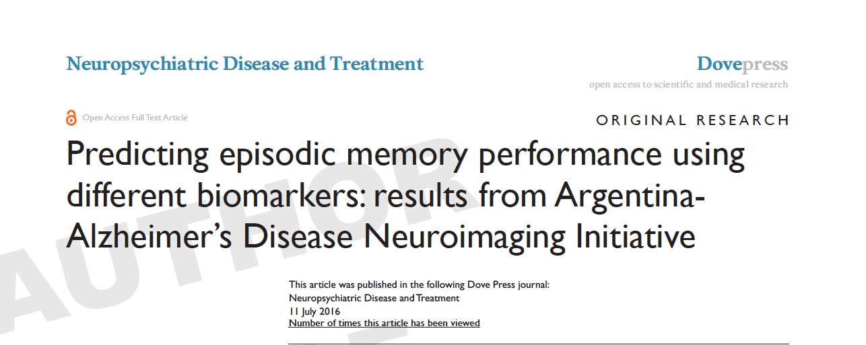
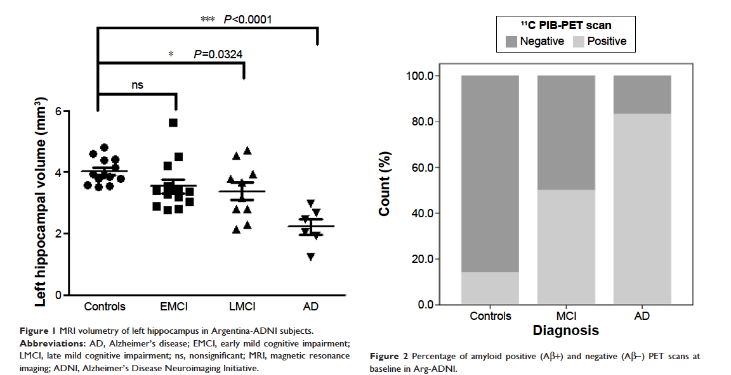

Slide 8
Arg-ADNI
New projections
Follow-up 54 months, including PET-tau AV-1451
 | Follow-up 54 months |  |  |  |  | Projected Follow-up
 | Baseline | Follow-up 54 month | NPS Ass | Alz Costs Survey | MRI | CSF Aβ-tau | PET PiB | PET-tau AV-1451
Healthy Controls | 15 | 13
Early MCI | 12 | 8
Late MCI | 16 | 15
Dementia AD | 13 | 10
TOTAL | 56 | 46

Slide 9
Arg-ADNI
Other ADNI-like studies ongoing in our Center
Dominantly Inherited Alzheimer Network Argentina (DIAN-Arg) since Dec 2015, Site 956:
3 Participants enrolled so far.
16 subjects Interested in participating in DIAN-Arg from 4 ADAD Argentinean families
National Council for Scientific and Technical Research. 3-year grant (PICT2015-2110)
Genetic and Alzheimer's disease biomarker studies in adults with Down syndrome in the Argentine population (Start-up process)
National Council for Scientific and Technical Research. 3-year grant (CONICET-PIP 0278)

Slide 10
Future Tasks
Arg-ADNI / Socioeconomic Study
PI: Julieta Russo

Slide 11
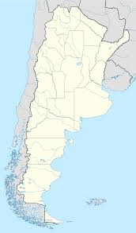
Future Tasks
Arg-ADNI 2nd Cohort (Argentine Multicenter Study)
National grant application
to study larger Argentina ADNI 2 cohort of 180pts
involving at least 8 new sites (AD Centers).
Buenos Aires
1.- FLENI
2.- Hospital Zubizarreta (GCBA)
3.- INEBA
4.- Hospital Fernandez (GCBA)
5.- Hospital Borda (GCBA)
La Plata
6.- Instituto Neuropsiquiátrico Luria
Mar del Plata
7.- CEMA
Córdoba
8.- Instituto Neuropsiquiátrico Kremer
Mendoza
9.-Univ. Mendoza

Slide 12


Arg-Center
3 year Grant
PICT 2015-2110
The Argentina DIAN center led by Dr. Ricardo Allegri and Dr. Patricio Chrem have been awarded a three year grant to support the DIAN-Argentina study by the Government Agency for Scientific Research from Argentina (CONICET).
http://www.agencia.mincyt.gob.ar/upload/PICT%202015%20TEMAS%20ABIERTOS%20TIPO%20A.pdf

Slide 13
Arg-Center
Recruitment Plan
Partners Centers from Argentina
Contact physicians that are in touch with Volga-German families (from other regions)
Community information:
Community talks at FLENI
National NGO of Alzheimer in Argentina
called ALMA (Asociación Lucha Mal de Alzheimer)

Slide 14
Arg-Center
ADAD Families
4 ADAD (PSEN1 mutations):
Family “D” M146V
4 participants, 2(+)
Family “B” M146L
7 participants, 4 (+) y 3 (-)
Family “A” M146V
2 Participants, 2(+)
Family “F” T119I
3 Participants, 1(+) 1(-) 1(in process)
Total subjects interested: 16
We expect to include 1 or 2 subjects per month.

Slide 15
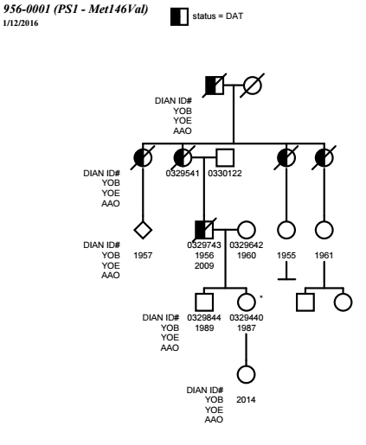
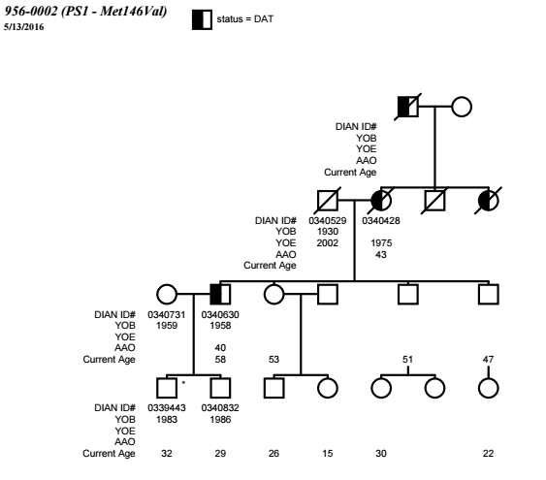
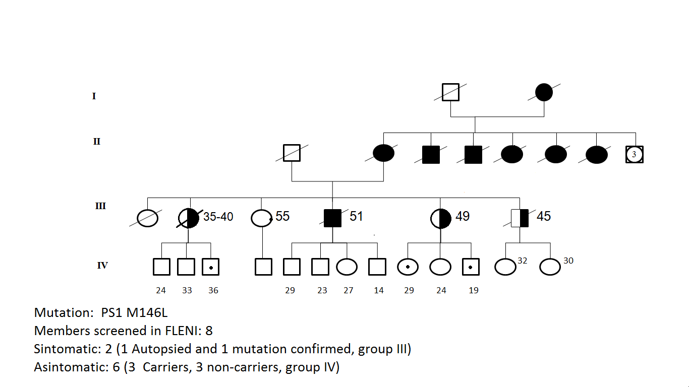
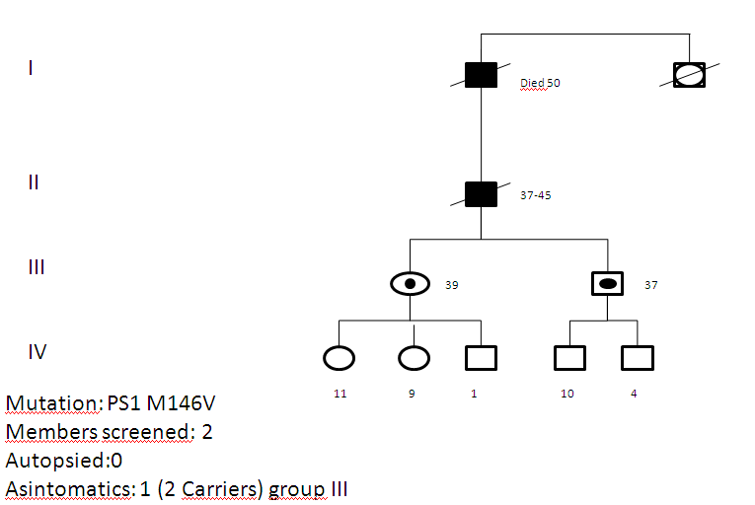
Arg-Center
ADAD Families

Slide 16
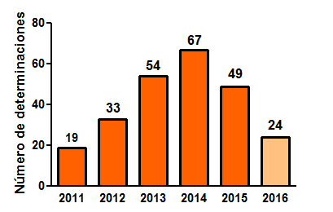
CSF biomarkers in Alzheimer Disease
Number of cases per year
Aβ 1-42; Tau; pTau (Innotest-Fujirebio)
Total: 246

Slide 17
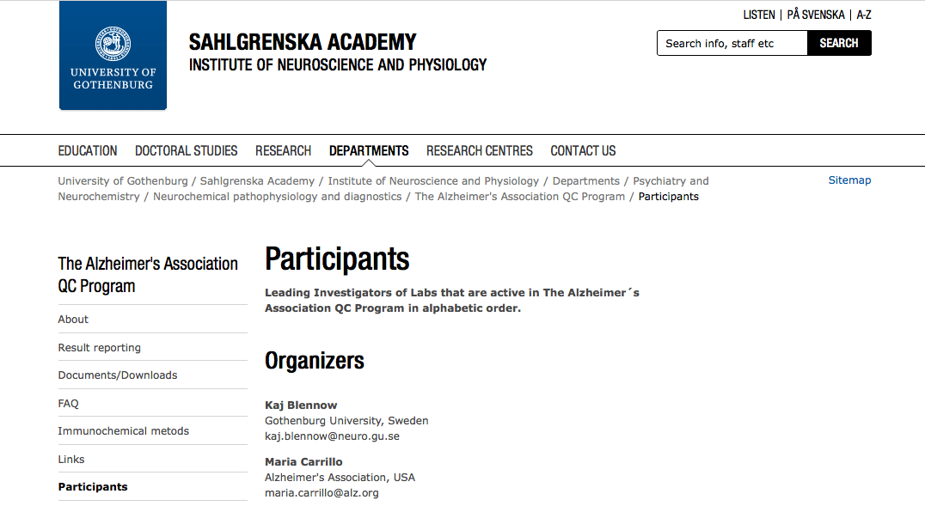
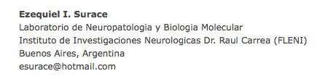

Slide 18
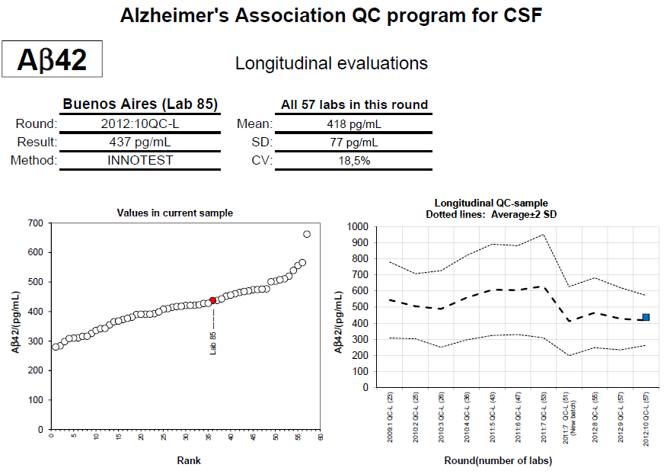
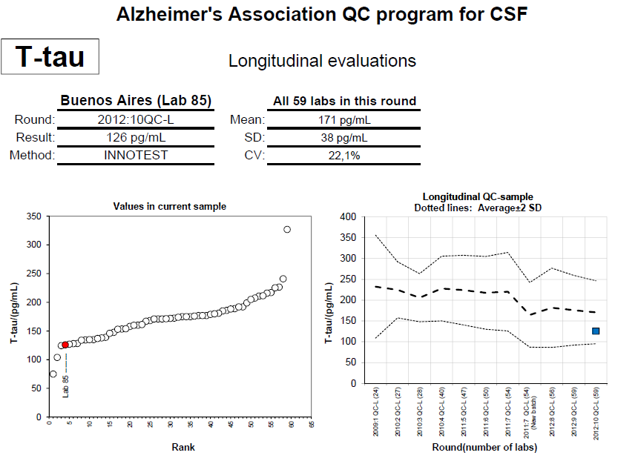
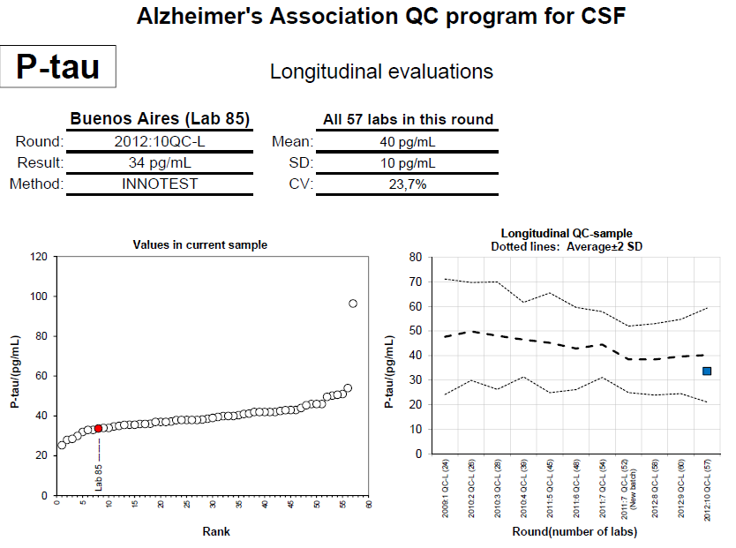

Slide 19
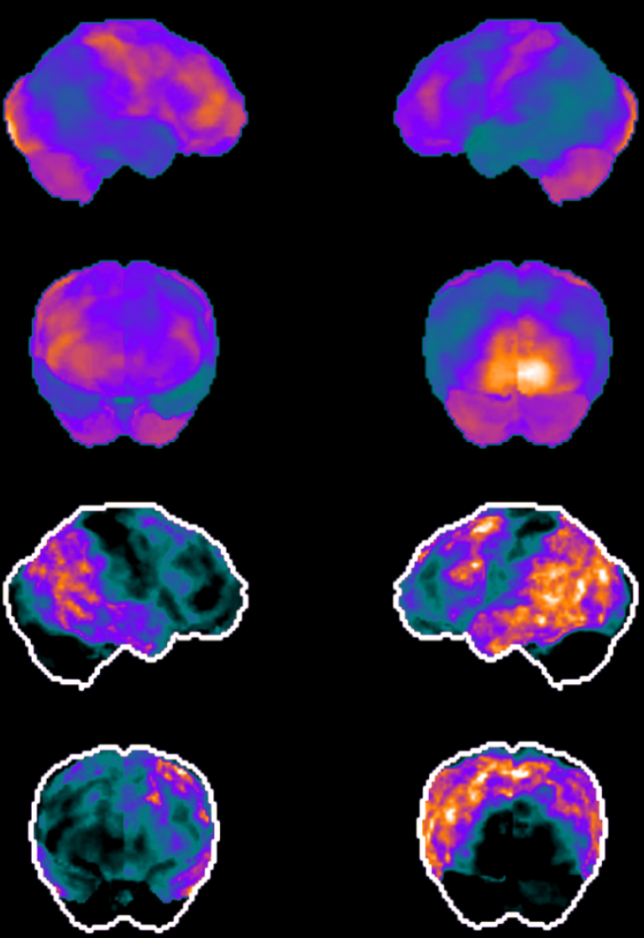
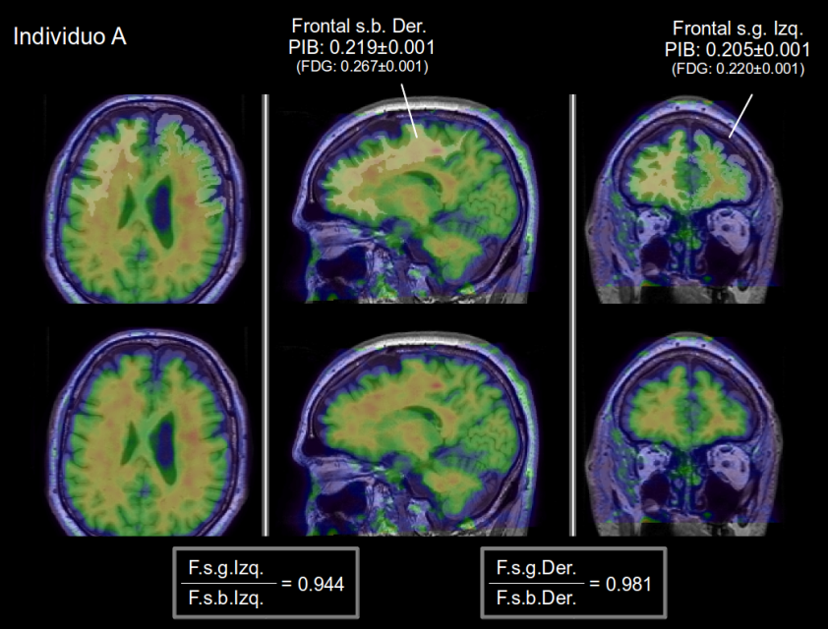
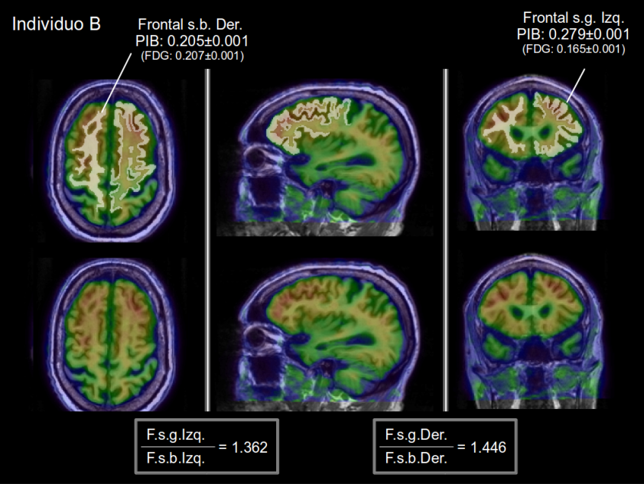
Brain ¹⁸FDG PET scan
Brain ¹¹C-PiB PET scan
Uptake Map
AD
Healthy
Hypometabolism Map
AD

Slide 20
PET Amyloid
547 patients with PIB and FDG
QC: Pittsburgh University
13 flutemetamol patients for clinical trials
QC: Bioclinica

