Slide 1


ADNI Biomarker Core
Leslie M Shaw & John Q Trojanowski
Magdalena Korecka
Michal Figurski
Teresa Waligorska
Magdalena Brylska
Leona Fields
Nirali Shah

Slide 2
ADNI3 Aims for Biomarker Core
Aim 1: Receive, aliquot, store and curate biofluid samples following established ADNI SOP’s and transfer samples to investigators approved by the RARC as described in the Administrative Core.
Continue to collect, store, curate and track all biofluid samples collected from subjects in ADNI-1, ADNI-GO, ADNI-2 and ADNI-3
Regular reconciliation and reviews with the clinical core at USC.
Provide blinded sample aliquots for studies approved by the NIA/ADNI/RARC.
Produce regular biofluid inventory reports
for ADNI biofluid collections: “CSF and plasma Inventory Reports”
for all biofluid aliquots per ADNI subject: “Aliquot Counts in the LDMS Database”
For ADNIGO&2 residual CSF aliquots: “Residual Aliquots in the LDMS Database”

Slide 3
ADNI3 Aims for Biomarker Core
Aim 2: Provide highly standardized Aβ₁₋₄₂, t-tau and p-tau₁₈₁ measurements on all ADNI subject CSF samples using the Roche automated immunoassay platform(Cobas e601) and immunoassay reagents. In addition provide immunoassay-independent measurements of Aβ species (Aβ₁₋₄₂, Aβ₁₋₄₀ and Aβ₁₋₃₈) using a validated reference 2D-UPLC/tandem mass spectrometry method in baseline and longitudinal CSF samples. Continue collaboration with other investigators to achieve harmonization of these measurements across centers and different platforms in support of their use in clinical trials.
Change: from manual RUO immunoassay to fully automated immunoassay platform for ADNI 3:
Due diligence: started Q4, 2014, in consultation with ADNI Exec Comm & NIA & PPSB/BBWG/DDWG.
Selection: in consultation with ADNI PPSB/BBWG/DDWG, chaired by Johan Luthman.
Roche Elecsys: validation for Aβ₁₋₄₂ in CSF completed.
External QC: Participation in the AlzAssn CSF QC program for Aβ₁₋₄₂
Validation of t-tau and p-tau₁₈₁: underway & scheduled for completion end of summer, 2016
Start analyses of all ADNI CSFs: FALL, 2016
Continued collaboration: with Kaj Blennow & IFCC CSF WG to produce certified reference CSF pools with assigned reference Aβ₁₋₄₂ concentration values, measured with reference 2D-UPLC/tandem mass spectrometry, to provide certified reference materials for manufacturers of Aβ₁₋₄₂ calibrators--promoting harmonization across assay platforms.
Review: pre-analytical factors for CSF collection.
Tau measurement by mass spectrometry: work initiated

Slide 4
Why automation of CSF biomarkers?
Eliminate as many manual steps as possible
Promote best possible precision
Within-lab
Between-labs
Improved lot-to-lot performance
Enable IVD test approval clinical laboratory test
Can provide both accurate and precise data
Use in treatment trials, especially international where local laboratory is essential(eg, China).

Slide 5
Method validation studies at UPenn for the Roche Elecsys immunoassay
CSF Aβ1-42:
Analytical studies
Short and long-term precision studies
Linearity
Comparison of Elecsys between UPenn and Roche
Comparison with a reference mrm/mass spectrometry method
Comparison with the RUO AlzBio3 immunoassay
Two sets of non-ADNI CSF samples utilized(250 residual CSF from routine clinic patients; 129 CSFs from the UPenn ADRC)
ROC analyses for AD vs HC in 129 CSFs from the UPenn ADRC(62 AD, 67 HC)

Slide 6
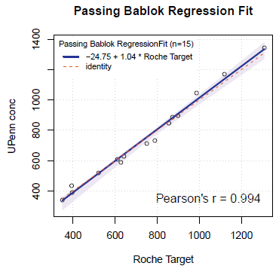
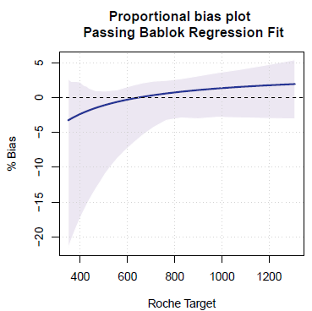
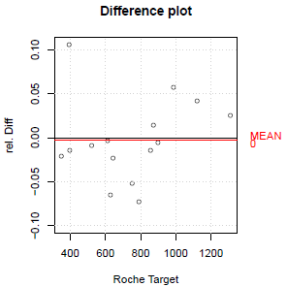
SUMMARY
UPENN/Roche comparison (both use Roche Elecsys,15 CSF pools): PB regression—Y = 1.04X - 24.8; Pearson‘s r = 0.994
Bias at cut-off <10%
Slope is within 1.0 ± 0.1
Elecsys, AlzBio3 and LC-MS Abeta(1-42) measurements were performed for 250 samples from data set A and 129 samples from data set B
Data set A and B were not pooled as AlzBio3 measurements differed between the two sample sets
Correlation between
Elecsys and AlzBio3: Spearman‘s rho 0.86(A)/0.82(B); some non-linearity
Elecsys and LC-MS: Spearman‘s rho 0.95(A)/0.96(B); Linear relationship
LC-MS and AlzBio3: Spearman‘s rho 0.87(A)/0.77(B); some non-linearity
ROC-AUC analysis within the data set B(AD vs HC): equivalent performance of all 3 methods
*This study will be presented in a poster at the Toronto AAIC meeting & included in a symposium talk.

Slide 7
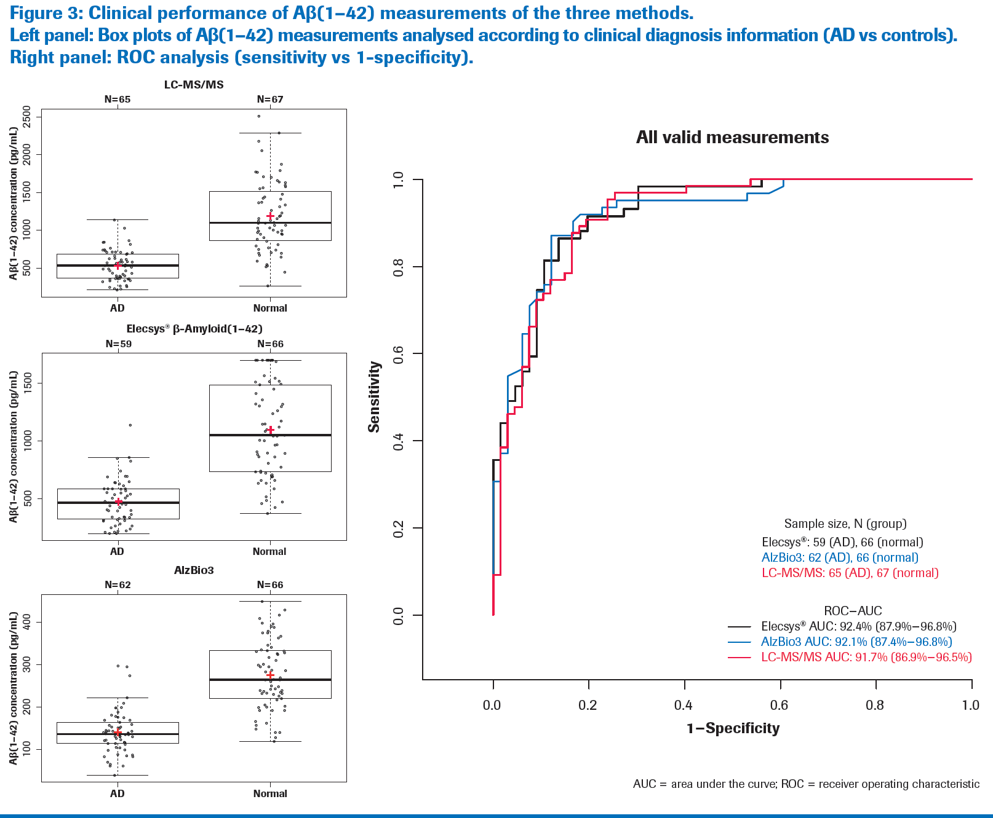

Slide 8
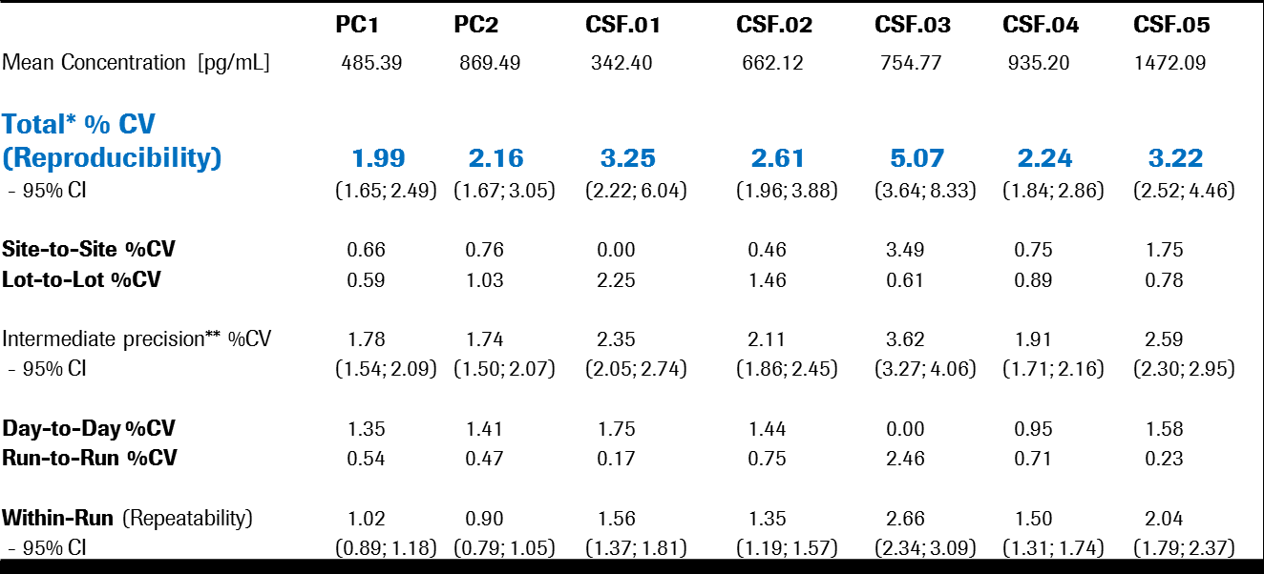
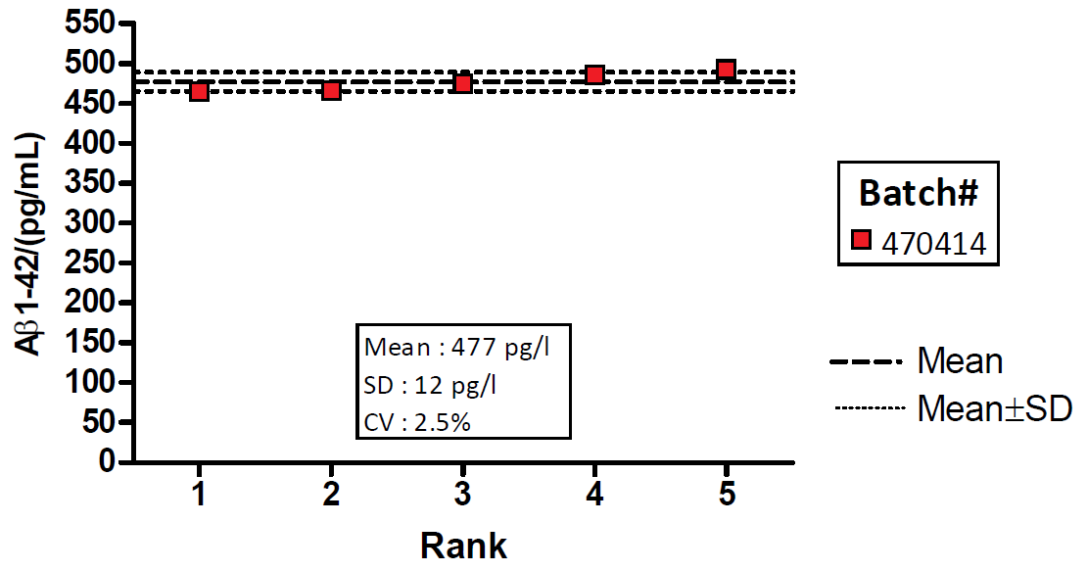
Lab to lab performance
Alz Assn CSF QC program: 5 laboratory interlab reproducility
Bittner, et al, Alz Dem, 2015.

Slide 9
Longitudinal CSFs
Rationale
Track longitudinal changes in the pathology underlying disease progression
Resources
ADNI1/GO/2 subjects who provided 1 or more CSF that have been analyzed:
90 longitudinal sets to be analyzed include 48 months CSFs for ADNIGO/2 subjects.
Challenge: continue as high a rate of longitudinal lp’s as possible
Study progress: Studies that assessed longitudinal CSF Aβ₁₋₄₂, t-tau and p-tau₁₈₁:
Biomarkers studied Beckett etal 2010; Vemuri etal 2010;Lo etal 2011
Aβ₁₋₄₂, t-tau, p-tau₁₈₁: Biomarker core Toledo etal 2013; Landau etal 2013;Mattsson etal 2015
YKL-40, Vilip-1, SNAP-25, Neurogranin:
Anne Fagan et al.
α-SYN; Ser129-α-SYN: Jing Zhang, soon
ADNI rollover subjects are very important contributors to these studies
CSF N | 1 | 2 | 3 | 4 | 5 | 6 | 7 | 8 | TOTAL
Subjects | 573 | 481 | 113 | 46 | 21 | 17 | 7 | 1 | 1259
TOTAL CSF | 573 | 962 | 339 | 184 | 105 | 102 | 49 | 8 | 2322

Slide 10
ADNI1 cognitively normal subjects with “non-pathological” Aβ₁₋₄₂ at BASELINE*
Longitudinal CSFs out to 3-4 years, n=35, all above-cutpoint Aβ₁₋₄₂ at BASELINE
Aβ₁₋₄₂: In ~2/3rds remained stable and non-pathological, but in ~1/3rd declined toward pathologic at a mean rate of 9.2 pg/mL/yr
Majority of “decliners” and “stables” were APOE ε4 negative
“stables” and “decliners” were not statistically different at BASELINE for mean cognitive & memory tests; were different for mean Aβ₁₋₄₂ : 257 vs 211pg/mL, p<0.001; comparable HV values.
Questions for ADNI 3:
which biomarker, imaging, genetic factors predict which MCI & cog normals will decline….
Which candidate biomarkers will add to predictive performance of Aβ₁₋₄₂, tau and ptau:
Neurogranin, Vilip 1, SNAP-25, YKL-40, total α-SYN, PS-129 and NFL; others?
Blood biomarkers: tau and NFL?
Longitudinal changes in these candidate biomarkers
* Subjects in the ADNI1 add-on study, sponsored by an anonymous donor, included
a total of 142 subjects with 3 or more CSFs collected longitudinally between 2005 - 2014

Slide 11
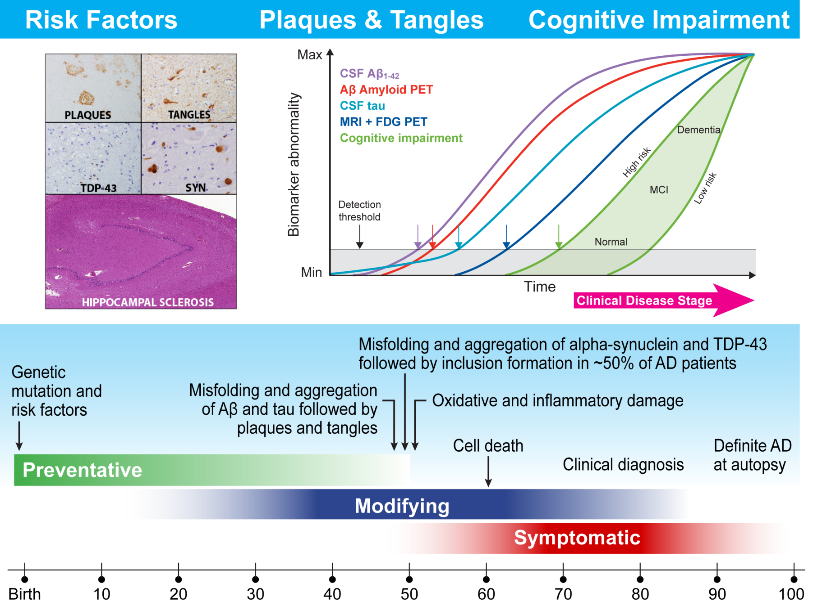
Alzheimer’s Disease: heterogeneity and biomarker timeline dynamics
Kang JH, et al, AlzDement, 2015

Slide 12
ADNI3 Aims for Biomarker Core
Aim 3: Collaboration with other investigators in the use of new tests for CSF (total and phospho-α-SYN; neurogranin; NFL; Vilip1 and TDP-43) and possibly blood biomarkers (metabolomic and lipidomic assays; Aβ₁₋₄₂ and tau proteins in neurally derived exosomes).
LOAD-disease heterogeneity a key characteristic.
It is important to take into account the heterogeneity of AD in ADNI3. Many studies emphasize this including ADNI data showing that that less than half (42%) of ADNI subjects with clinical AD/MCI had only AD plaque and tangle pathology at autopsy, while 58% had plaques and tangles in addition to TDP-43 and/or alpha-synuclein (α-syn) inclusions as well as hippocampal sclerosis in some cases (Toledo et al, ANP Commun, 1:65, 2013; Cairns etal, Neuropath 2015). These findings are echoed in a larger study of non-ADNI Penn subjects (Toledo et al, ANP, 124:23-35, 2012).
We have worked together with Jing Zhang and found that a CSF total α-SYN assay in ADNI CSF samples may enable detection of co-morbid LBs in MCI/AD subjects in ADNI1 subjects(Toledo et al, ANP, 126:683-697, 2013) and we now are continuing this by using a new total α-SYN and a phospho-α-syn immunoassay in non-ADNI patients and this could be incorporated into ADNI-3 (Wang et al, Sci Trans Med, 4:121-20, 2/15/2012).
TDP-43 biomarkers are not yet available so we work with Hugo Vanderstichele at ADx and Andreas Jeromin at Quanterex on TDP-43 ELISA based assays, but it is not yet certain if a TDP-43 immunoassay will be ready for use in ADNI-3. We also need to address the issue of co-morbid cerebro-vascular disease (CVD), but information on CVD may come from imaging rather than chemical biomarker studies.

Slide 13
New biomarkers in NIA/ADNI/RARC-approved studies
Biomarker | Fluid | # | ADNI study | Investigator
Metabolic networks | Serum | 905 | Studies in ADNIGO/2 BL samples | RKaddoura-Daouk; Duke Univ,
Aβ1-42/1-40;ELISA | plasma | 764 | ADNI 1, GO, 2 in BL & longitudinal | ISherriff; Araclon Biotech
Metabolic networks | serum | 833 | Studies in ADNI1 BL samples; data uploaded | RKaddoura-Daouk; Duke Univ,
SNAP25 & neurogranin | CSF | 612 | Longitudinal samples | AFagan; Wash University
T-& Phos-α-SYN; IA | CSF | 567 | Longitudinal samples, to be uploaded | JZhang; University of Wash
Vilip 1; YKL-40; IA | CSF | 612 | Longitudinal samples, publication planned | AFagan; Wash University
Tau; IA | plasma | 595 | BL ADNI1; publication | KBlennow; Sahlgrenska UHosp
DDE; LC/msms | plasma | 211 | AD vs controls, ADNI 1 | ALevey; Emory University
Neurogranin; NFL; IA | CSF | 416 | BL ADNI1; multiple publications | KBlennow; Sahlgrenska UHosp
AD Autoantibodies | serum | 100 | 50 BL MCI; 50 BL HC; publication | R Nagele; UMDNJ
AD Autoantibodies | serum | 118 | 36 each NC, MCI, AD BL ADNI1;publication | RMcIntyre; St Francis Hospital
Proteome/ MRM/MSMS | CSF | 306 | BL ADNI1; 221 proteins;publication;another planned | ADNI PPSB/FNIH; LHonigsberg
Proteome/RBM | plasma | 1,065 | BL & yr1; multiple publications | HSoares;Pfizer/PPSB/FNIH
Proteome/RBM | CSF | 317 | BL ADNI1; multiple publications | WPotter,etal/PPSB/FNIH
BACE & sAPP | CSF | 402 | BL ADNI1; recent publication | MSavage;merck/PPSB/FNIH
α-Synuclein;xMAP | CSF | 390 | BL ADNI1; several publications | JZhang; University of Wash

Slide 14
ADNI3 Aims for Biomarker Core
Aim 4: Collaborate in studies (a) of individual and combinations of CSF biomarkers for prediction of memory, cognitive and functional decline, (b) the effect of using individual and combinations of CSF biomarkers and associated cutpoints for reducing sample size thus improving efficiency of treatment trials, (c) study rates of change of CSF biomarkers over time to determine relationships between rates of change and future cognitive decline, (d) determine the prediction of uptake of tau ligand by CSF Aβ₁₋₄₂ below cutpoint, and (e) determine the concordance between Aβ₁₋₄₂ and amyloid-β plaque ligand uptake with the Biostatistics Core and other ADNI3 Cores as well as with other outside investigators.

