Slide 1
ADNI Clinical Core
Paul Aisen
Ron Petersen
Michael Donohue
Jennifer Salazar

Slide 2
ADNI3: Schedule of Events
Rollover and New Subjects
 | Baseline | 12 month | 24 month | 36 month | 48 month
CN | CV, MRI, Tau, AMY, LP | Phone Check | CV, MRI, Tau (+/-), AMY, LP | CV, MRI, Tau (+/-) OR Phone Check | CV, MRI, Tau, AMY, LP
MCI | CV, MRI, Tau, AMY, LP, FDG | CV, MRI | CV, MRI, Tau (+/-), AMY, LP | CV, MRI, Tau (+/-) | CV, MRI, Tau, AMY, LP
AD | CV, MRI, Tau, AMY, LP, FDG | CV, MRI, Tau | CV, MRI, Tau, AMY, LP | Phone Check (Neuropath only) | Phone Check (Neuropath only)
All rollover and new subjects have a full clinic visit, LP and PET scans in Year 1 of ADNI 3
CN: visits q2 years unless selected additional Year 3 Tau visit/scans
MCI: annual visits; some will have Year 2, 3 Tau PET
AD: annual for first 2 years
Notes:
Scenario 2.5

Slide 3
New assessments in ADNI3
MINT (instead of Boston naming)
FCI-SF
Cogstate

Slide 4
Multilingual Naming Test (MINT)
The MINT is a test of object picture naming designed to include items that are comparable across English, Spanish and other languages.
It replaces the Boston Naming Test in the Uniform Data Set of the NIA-funded AD centers because the BNT contains items that are not of the same level of difficulty for Spanish and English speakers.

Slide 5
Financial Capacity Instrument – Short Form (FCI-SF)
The FCI-SF is a brief performance measure of everyday financial skills that uses both performance and time to completion variables.
In prior research the FCI-SF performance and timing variables have discriminated between amyloid-positive and -negative controls, as well as control vs MCI vs mild AD groups.

Slide 6
The FCI-SF comprises 37 performance items which evaluate four constructs of monetary calculation, financial conceptual knowledge, use of a checkbook/register, and use of a bank statement.
The FCI-SF also includes six variables measuring time to completion (in seconds) of four FCI-SF tasks.
The FCI-SF takes 15 minutes or less to administer.

Slide 7
Cogstate pilot in ADNI2
55% of ADNI CN and MCI offered Cogstate pilot participation consented
104 Cogstate batteries completed
  59 in clinic
  45 unsupervised
Some issues:
  Web navigation and login difficulties
  Use of keyboard for test responses

Slide 8
Cogstate in ADNI3
NC and MCI
In clinic and quarterly unsupervised

Slide 9
New recruitment tools for ADNI3
Brain Health Registry
Other registries
ATRI Recruitment Core

Slide 10
Importance of timely recruitment and subject retention
Cannot be overstated

Slide 11
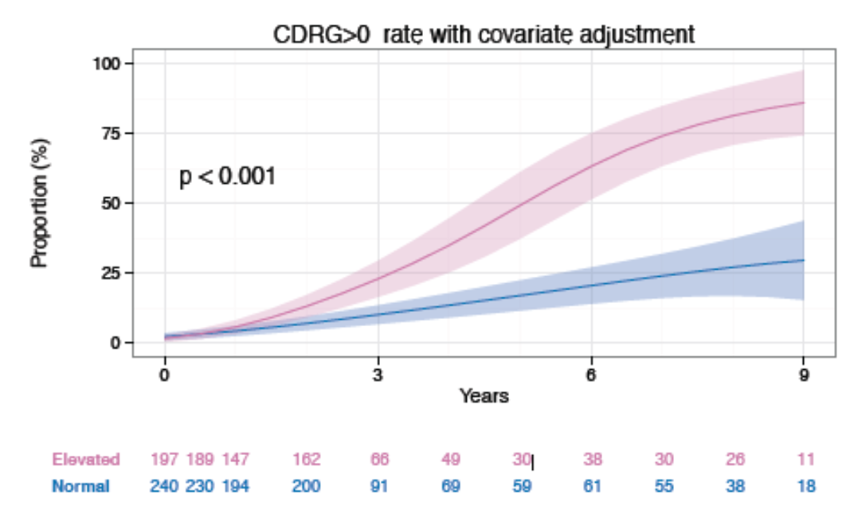
Preclinical AD progresses to CDR=0.5

