Slide 1
E-ADNI update and related activities
WW-ADNI yearly meeting
AAIC, Toronto, July 22, 2016
Jorge Jovicich, University of Trento, Italy
SUMMARY:
PharmaCOG WP5/E-ADNI
European JPND Call: Acquisition Harmonization

Slide 2
WP5 PharmaCog/ E-ADNI: Reminder
Academic Industry EU project aimed at promoting drug development through markers of AD progression
Funding Agency: European Commision (7° Program)
PI: Academic Coordinator Project Coordinator
Dr. Jill Richardson
GSK (United Kingdom)
Human Imaging working group leader (WP5): Prof. Giovanni Frisoni
Consortium: 15 academic institutions; 12 pharmaceutical companies; 5 small and medium enterprises (SMEs). 11 EU countries: Switzerland, Denmark, Germany, Italy, France, Belgium, The Netherlands, Spain, Greece, U.K. and Luxemburg.
Funds: Tot: 27.7 M€
Tot WP5: 5.1 M€
Funded activity period: 1/01/2010- 31/12/2015
Prof Régis Bordet
University of Lille (France)

Slide 3
WP5 PharmaCog/ E-ADNI: Reminder
Goal: Identify a matrix of biomarkers hologous in amnestic MCI and animal models of AD
WP5 (E-ADNI) WP6
APP, APP/PS1, Tau, APP/Tau/PS2 mouse and lemur monkeys
Serial ass.t: 3 mos x 2 yrs
Homol. cogn. tests
Homol. struct MRI
Homol. diff func MRI
Homol. EEG & ERPs
Blood & Histology
150 aMCI
Longitudinal: 6 months x 3 yrs
ADNI cogn. tests
ADNI struct 3T MRI
ADNI2 diffusion MRI, rest fMRI
EEG & ERPs
CSF & Blood

Slide 4
WP5 PharmaCog/ E-ADNI: 2015-2016 progress
Investigate enrichment criteria based on CSF
  Three high/low risk models for AD conversion
    Aβ, Aβ/t-tau and Aβ/p-tau
For each model: evaluate markers sensitivity to risk groups
  Cognitive tests
  MRI: structural, diffusion,resting-state fMRI
  EEG: resting-state, oddball task
  Blood
For each model & metric: evaluate risk group sensitivity
  At baseline (markers for AD diagnosis)
  Longitudinaly (markers for AD progression)

Slide 5
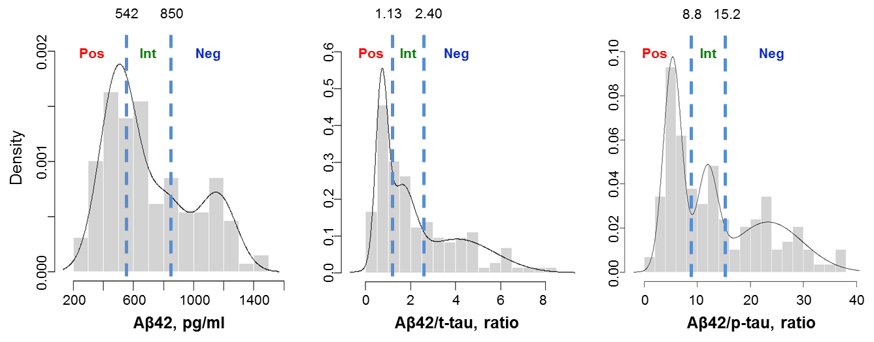
“Enrichment” based on CSF biomarkers:
Mixture models for Aβ, Aβ/t-tau and Aβ/p-tau
Histograms and corresponding overlaid density curves
Pos: high risk
Neg: low risk
Int: intermediate risk
The mixture model analysis established three main Gaussian distributions and
two cut-offs for each CSF biomarker

Slide 6
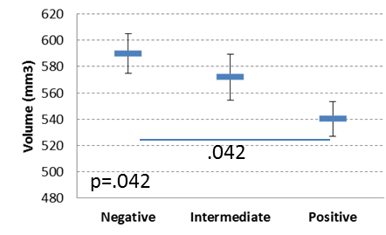
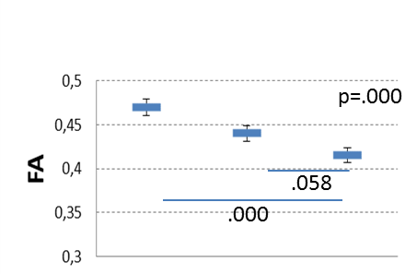
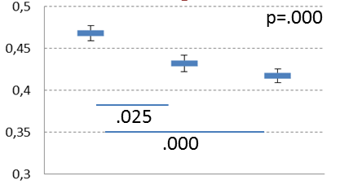
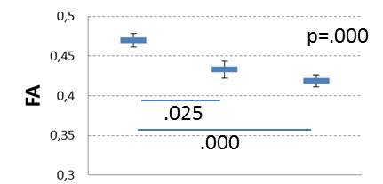
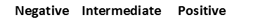
CSF and structural MRI markers at baseline
Aβ42
Aβ42/t-tau
Aβ42/p-tau
Hippoc.
Subfield
Volume:
Right CA1
n.s.
n.s.
Diffusion:
Cingulum
CSF Aβ/p-tau 3 group classification
is a better discriminators than Aβ alone and than Aβ/t-tau

Slide 7
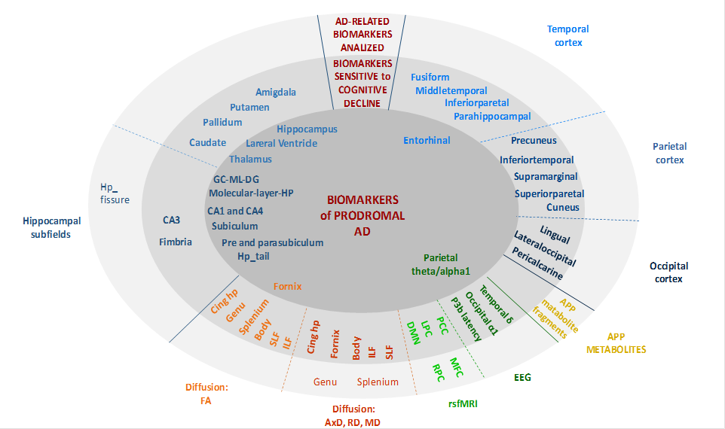
Biomarkers investigated for AD progression in WP5 aMCI patients, according to the most advanced phase of analysis

Slide 8
Pharmacog Dissemination (last 12 months outline)
AIC & AAIC
  9 Pharmacog presentations
Methodological publications
  Marchitelli et al., HBM 2016 (phys noise rsfMRI)
  Jovicich et al., Neuroimage 2016 (reprod. rsfMRI DMN)
  Marizzoni et al., HBM 2015 (reprod. hippo. subfields)
Clinical publications
  Galluzzi et al., J. Int. Med. 2016 (baseline descr. clinical, npsy, markers)
  Work in progress: Special issue (Neurob. Aging)
Data
    https://neugrid4you.eu/

Slide 9
European JPND Call: Acquisition Harmonization

Slide 10
EU JPND Harmonization Call
Call: January 8, 2016, EU Joint Programme – Neurodegenerative Disease research (http://www.neurodegenerationresearch.eu/)
  Form community-led working groups (WG)
  Propose best practice guidelines: harmonisation of neuroimaging methods
  Domains
    Acquisition harmonization
    Simplification of web access & image environments
    Innovative PET markers
    Innovative ultra-high field MRI markers
Duration: 9 months maximum for each working group
Funds: 50,000 € maximum/working group (workshop, admin)
Expected outputs
  Best practice guidelines: publish & motivate funding future JPND actions

Slide 11
SRA-NED’s Proposal
SRA-NED: Create a Strategic Research Agenda for best practice image harmonization guidelines relevant to NEuroDegenerative diseases
  Recommended for funding with other 9 proposals
SRA-NED goals:
  Develop a survey to specify current criticalities for multicentre neuroimaging acquisition protocol harmonization (MRI/PET/EEG):
    Protocol definition
    Protocol deployment
    Protocol validation
    Protocol adherence
    ...
  From the survey develop a strategic research agenda
    topics and actions deserving funding to implement best practice guidelines for neuroimaging harmonization

Slide 12
SRA-NED’s Group Structure
Coordination: PI: G. Frisoni, Co-PI J. Jovicich
Working Groups:
  MRI (#13): Method PI: J. Jovicich, Clinical PI: F. Barkhof
  PET (#11): Method PI: K.H. Wolfson, Clinical PI: B. van Berkel
  EEG (#7): Method PI: C. Mulert, Clinical PI: C. Babiloni
Advisory Group
  Key international opinion leaders (USA, AU, JP)
    C.R. Jack, W.B. Jagust, L. Prichep, C. Rowe, H. Matsuda
  International community of experts, groups and associations
  Pharma (PIs in IMI initiatives: EMIF-AD, EPAD and AETIONOMY)

Slide 13
Thanks!

