Slide 1


ADNI-3 Genetics Core Update
Andy Saykin, Indiana University
For the Genetics Core/Working Groups
Worldwide-ADNI Update Meeting
Friday, July 22, 2016
Fairmont Royal York Hotel
Toronto
asaykin@iupui.edu

Slide 2
Genetics Core Goals for ADNI-3
Overall: To identify and validate genetic markers to enhance clinical trial design and drug discovery.
Aim 1: Continue sample collection, processing, banking, curation and dissemination.
Aim 2: Continue to provide genome-wide genotyping data to the scientific community.
Aim 3: Continue to perform and facilitate bioinformatics analyses of ADNI genetics and quantitative phenotype data and test scientific hypotheses related to the goals of ADNI-3.
Aim 4: Continue to provide organization, collaboration and leadership for genomic studies of quantitative biomarker phenotypes.

Slide 3
New Aspects
Aim I: PBMC collection
Enabling iPSC and functional assays for mechanistic and drug development efforts; also adding RBC at Baseline
Aim 2: Next generation GWAS & other assays
New arrays by the time of enrollment, WGS costs decreasing, additional –omics
Aim 3: Bioinformatics analyses of quantitative phenotype data & test scientific hypotheses
Focus on trial enrichment & systems biology
Aim 4: Continue to support collaborative research
New working groups: systems biology, methylation, etc.
w/cores: Fam Hx, Neuropath. (Kim poster), Biostat., etc.

Slide 4
Major themes & hypotheses
H1: The efficiency of clinical trials can be improved by enrichment with genetic markers beyond APOE, reducing sample size, time to complete trials, and lowering costs;
H2: Systems biology modeling of multi-omics data, yielding polygenic risk scores and gene pathway- and network-based metrics, will prove more powerful than single variants in predicting disease progression and outcomes;
H3: Variation in the MAPT gene and other pathways will be associated with [18F]AV-1451 tau PET; and
H4: Genetic variation influences proteomics and metabolomics biomarker assays and controlling for genetic effects will improve the performance of –omics biomarkers in predicting disease progression and outcomes.

Slide 5
Path from genetic signal to targeted therapeutics: key applications to drug discovery and development
Core Report: Alzheimer’s & Dementia 11 (2015) 792-814

Slide 6
title
1. Strategies to decrease heterogeneity − Selecting patients with baseline measurements in a narrow range (decreased inter-patient variability) and excluding patients whose disease or symptoms improve spontaneously or whose measurements are highly variable (less intra-patient variability).
2. Prognostic enrichment strategies − choosing patients with a greater likelihood of having a disease-related endpoint event (for event-driven studies) or a substantial worsening in condition (for continuous measurement endpoints); increase absolute effect between groups.
3. Predictive enrichment strategies − choosing patients more likely to respond to the drug treatment than other patients with the condition being treated. Such selection can lead to a larger effect size (both absolute and relative) and permit use of a smaller study population.
FDA, 2012

Slide 7
IL1RAP Candidate - Longitudinal Amyloid PET
IL1RAP (interleukin-1 receptor accessory protein)
rs12053868 (P=1.38x10⁻⁹)
Ramanan et al., Brain Oct. 2015

Slide 8
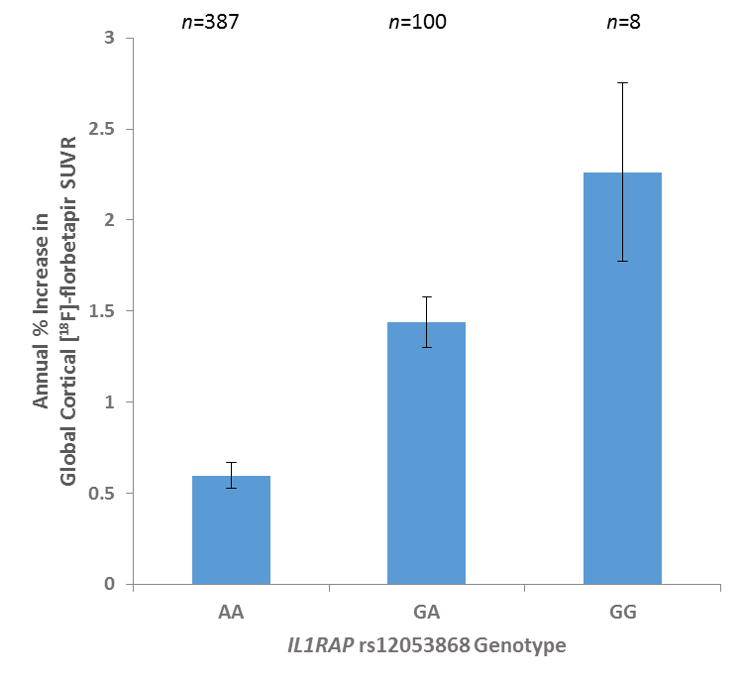
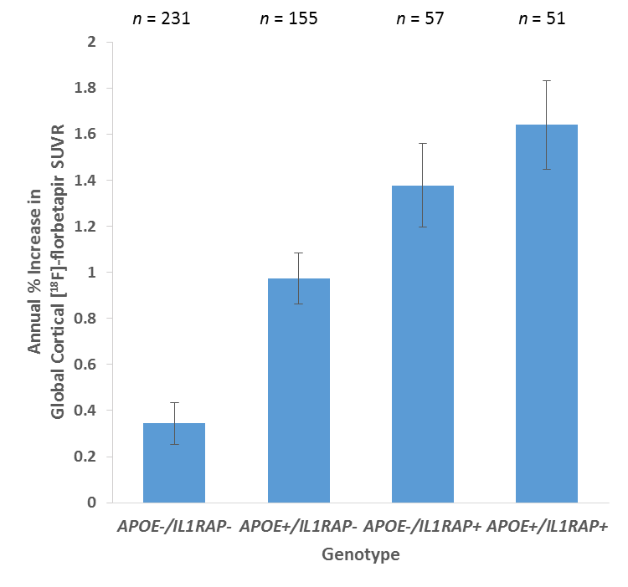
Effect of IL1RAP rs12053868
IL1RAP rs12053868-G is associated with higher rates of amyloid accumulation
IL1RAP rs12053868-G and APOE ε4 exert independent, additive effects
Cohen’s d=1.20
Equivalent OR=8.79
Cohen’s d=0.60
Equivalent OR=3.00
-IL1RAP (7.1%) + APOE ε4 (3.4%) explain 10.5% of the phenotypic variance (age and gender explain 0.9%)
-IL1RAP association remains genome-wide significant (P=5.80x10⁻⁹) with additional covariates of APOE ε4 status, baseline diagnosis, education, baseline amyloid burden and its square, and PCA eigenvectors
Ramanan et al., Brain Oct. 2015

Slide 9

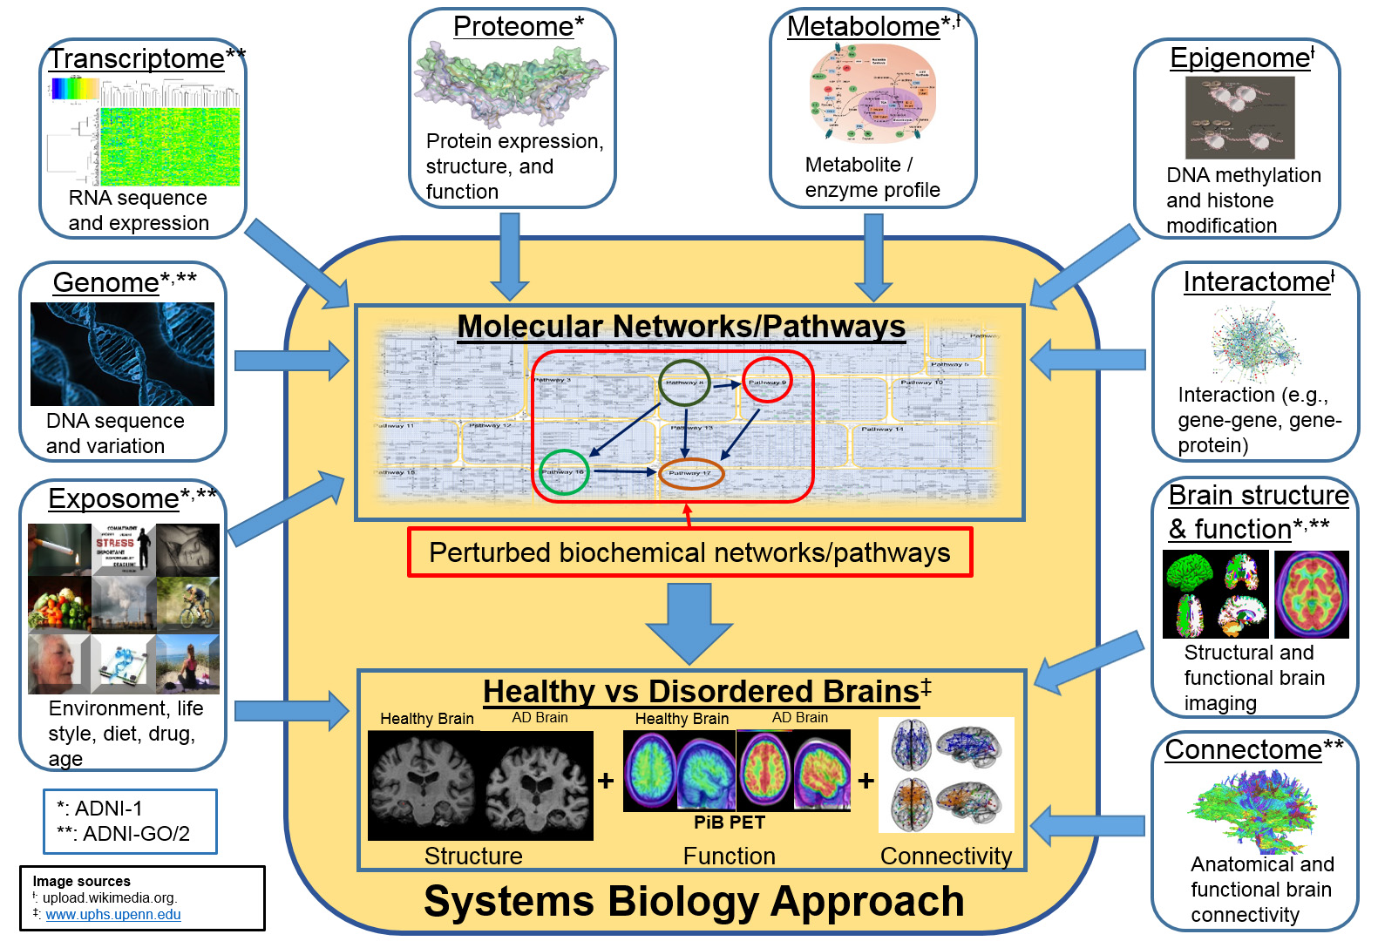

Converging –omics & Systems Biology
Genetics Core – Saykin et al Alzheimer’s & Dementia 11 (2015) 792-814
Notes:
Sources of Images:
Metabolome: http://upload.wikimedia.org/wikipedia/commons/c/c4/TumorMetabolome.jpg
Epigenome: http://upload.wikimedia.org/wikipedia/commons/a/a2/Epigenetics_of_adipose_development..jpg
Interactome: http://upload.wikimedia.org/wikipedia/commons/b/b4/The_protein_interaction_network_of_Treponema_pallidum.png
Healthy vs Disordered Brain: http://www.uphs.upenn.edu/news/News_Releases/2013/12/verma/verma_large.jpg

Slide 10
Converging –omics & Systems Biology
Genetics Core – Saykin et al Alzheimer’s & Dementia 11 (2015) 792-814
Notes:
Sources of Images:
Metabolome: http://upload.wikimedia.org/wikipedia/commons/c/c4/TumorMetabolome.jpg
Epigenome: http://upload.wikimedia.org/wikipedia/commons/a/a2/Epigenetics_of_adipose_development..jpg
Interactome: http://upload.wikimedia.org/wikipedia/commons/b/b4/The_protein_interaction_network_of_Treponema_pallidum.png
Healthy vs Disordered Brain: http://www.uphs.upenn.edu/news/News_Releases/2013/12/verma/verma_large.jpg

Slide 11
Epigenetics Sample Characteristics: Methylation and Telomere Length Assays
Study Design | Age (years; Mean, SD) | Male (N, %) | APOE ε4 positive (N,%)
Cross-sectional (All Individuals)*
Cognitively Nornal (n=221) | 76.27 (6.63) | 111 (50%) | 57 (26%)
Mild Cognitive Impairment (n=335) | 72.58 (7.82) | 188 (56%) | 153 (46%)
Alzheimer's Disease (n=93) | 77.19 (7.69) | 60 (65%) | 63 (68%)
Longitudinal design*
Cognitively Nornal (n=195) | 75.96 (6.54) | 97 (50%) | 50 (26%)
Mild Cognitive Impairment (n=283) | 72.23 (7.73) | 157 (55%) | 117 (41%)
Alzheimer's Disease (n=93) | 77.19 (7.69) | 60 (65%) | 63 (68%)
Pre-/post-conversion
MCI to AD (n=110) | 74.5 (7.89) | 62 (56%) | 71 (65%)
NL to AD (n=10) | 78.8 (4.05) | 7 (70%) | 4 (40%)
NL to MCI (n=42) | 78.71 (6.9) | 21 (50%) | 13 (31%)
* 80 cross-sectional samples were included
Selection criteria: WGS & GWAS, RNA profiling, > 2 year clinical follow-up, MRI and PET imaging data; converters, longitudinal DNA availability (except 80 cross sectional)
Updated 4/2016

Slide 12
Systems Biology Approach Pathways to Neurodegeneration
Ramanan & Saykin, Am J Neurodegener Dis 2013;2(3):145-175

Slide 13
Neurodegeneration Pathways in AD & PD
AD (Blue), PD (Red) and other (Black) genes co-regulated by the SP1 and AP-1 transcription factors
Ramanan & Saykin, Am J Neurodegener Dis 2013;2(3):145-175
Notes:
heritabil
Figure 2. Regulatory network centered on the SP1 and AP-1 transcription factors is enriched with top AD and PD genes. Meta-analytic genetic association data from public databases and supplementary manual curation was used to generate a list of 13 AD genes and 15 PD genes. Network analysis was performed using MetaCore (GeneGo, Inc.) to relate these input genes to known transcription factors and proximal targets based on published findings. A highly interconnected network including 9 AD genes (labeled in blue), 10 PD genes (labeled in red), and 13 additional genes (labeled in black) was identified. Many of the input AD and PD genes exhibit co-regulation by the SP1 and AP-1 transcription factors. Other genes of interest were also related to input AD and PD genes and represent a variety of candidate pathways in neurodegeneration.

Slide 14
Future Directions
These will require additional support before they can be fully realized, but within available resources, work will continue to develop these important areas:
A) Work with other parties to find resources for WGS, transcriptome and epigenetic profiling of ADNI’s longitudinal DNA and RNA samples;
B) Provide a forum to work on issues of return of research results to participants;
C) Work with the Clinical Core to develop new call back and family studies of ADNI participants;
D) Facilitate replication studies with other cohorts/data sets;
E) Collaborate with academic and industry partners on molecular and functional validation follow-up studies; and
F) Collaborate with the Neuropathology Core to relate differential pathological features to genetic variation.

Slide 15
Genetics Core/Working Groups
Indiana University
Imaging Genomics Lab
Andrew Saykin (Leader)
Li Shen (co-Leader)
Liana Apostolova
Sungeun Kim
Kwangsik Nho
Shannon Risacher
Vijay Ramanan
Kelly Nudelman
Emrin Horgusluoglu
National Cell Repository for AD
Tatiana Foroud (co-Leader)
Kelley Faber
PPSB Working Groups
Nadeem Sarwar*
PPSB Chairs
FNIH Team
* Genetics Core Liaison
Core Collaborators/Consultants
Steven Potkin (UCI; co-Leader)
Robert Green (BWH)
Paul Thompson (USC)
Rima Kaddurah-Daouk (Duke)**
** AD Metabolomics Consortium
Other Collaborators – RNA and other NGS Projects:
Keoni Kauwe (BYU) mtDNA
Yunlong Liu (Indiana) - mRNA
Fabio Macciardi (UC Irvine)
Systems Biology Working Group
2016

