Slide 1
MRI WW-ADNI 2016
Mayo
Cliff Jack
Bret Borowski
Matt Bernstein
Arvin Forghanian-Arani
Jeff Gunter
Dave Jones
Kejal Kantarci
Rob Reid
Denise Reyes
Matt Senjem
Kaely Thostenson
Prashanthi Vemuri
Chad Ward
Funded MRI Investigators
Charlie DeCarli – UCD
Nick Fox – UCL
Duygu Tosun – SFVA
Paul Thompson – USC
Danielle Harvey – biostats
MR company scientists
Dan Rettmann – GE Mayo
Pete Kollasch/Gunnar Kruger – Siemens
Yansong Zhao - Philips, BU

Slide 2
ADNI 3 protocol only 3T, all sequences in all subjects
3D T1 volume
3D FLAIR
SWI or equivalent
3D ASL
TF-fMRI - advanced and basic versions
Field map
dMRI - advanced and basic versions
Coronal high resolution T2

Slide 3
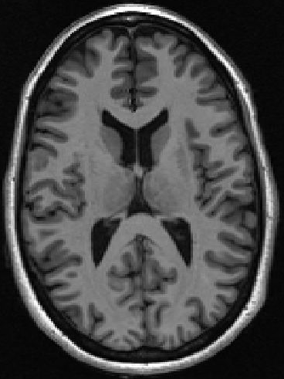
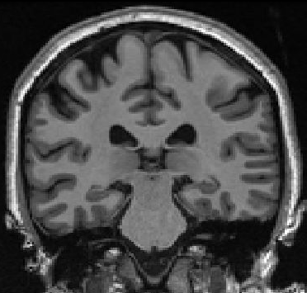
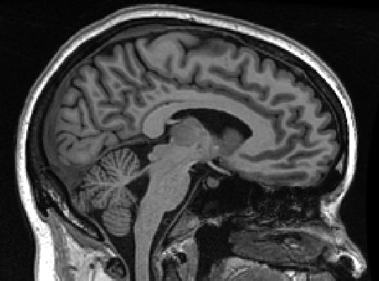
ADNI 3 MRI protocol rationale 3D T1
core for multi modality comparisons
precise longitudinal measure

Slide 4
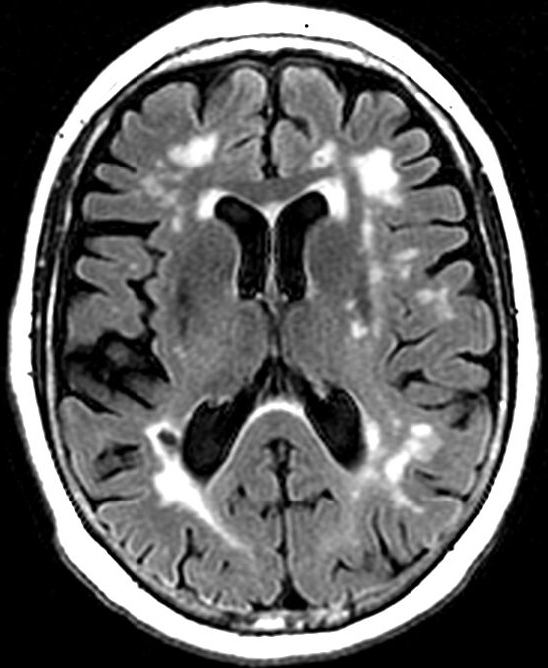
ADNI 3 MRI protocol rationale FLAIR: CV disease detection – safety standard for trials, required for standard of care local clinical reads

Slide 5
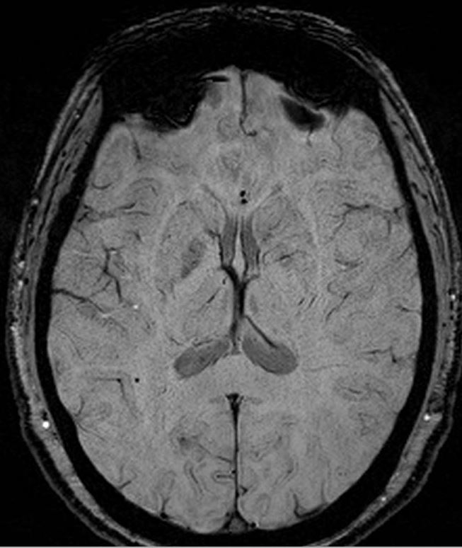
ADNI 3 MRI protocol rationale SWI: MCB detection, safety standard for trials, required for standard of care local clinical reads

Slide 6
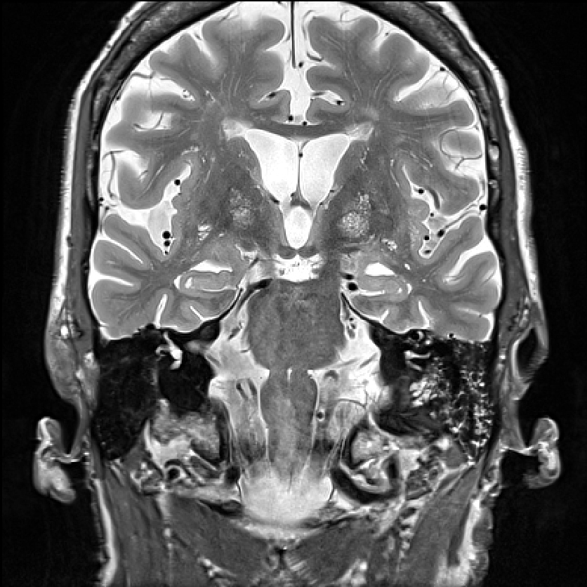
ADNI 3 MRI protocol rationale Coronal hi res T2: Hippocampal subfields

Slide 7
ADNI 3 MRI protocol rationale ASL, dMRI, TF-fMRI
Significant developments since ADNI 2
Opportunity to see if advanced methods cross the diagnostic “value” threshold in clinical trials environment
field continues to seek methods which can be used in Phase 2 which provide an early signal of treatment response
2016 advanced is 2021 routine – do not want methods to be outmoded by end of ADNI 3 grant cycle

Slide 8
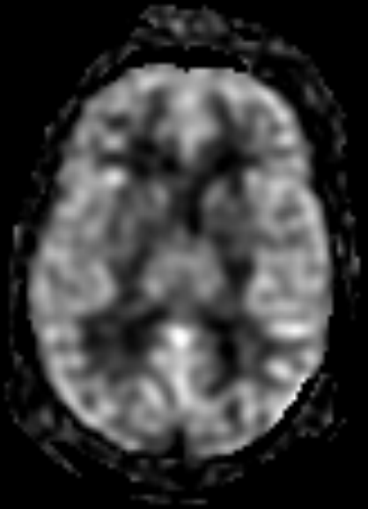
3D pCASL

Slide 9
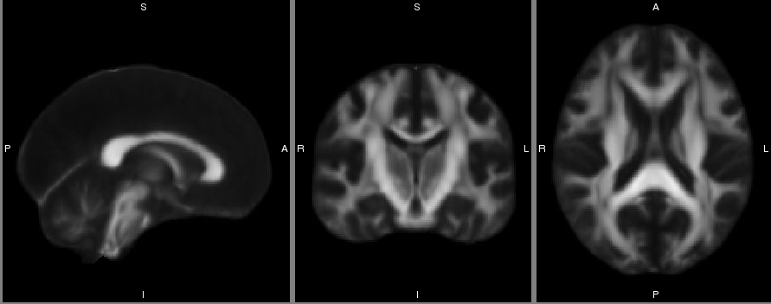
DTI – FA group map, ADNI CN and AD

Slide 10
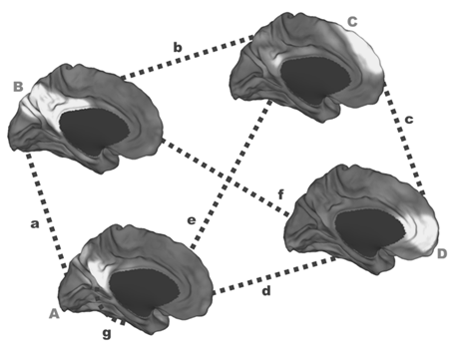
TF-fMRI
Default Mode Network subsystems - group map ADNI 2

Slide 11
MR measures – funded investigators
Structural MRI measures
BSI – UCL (Fox)
Freesurfer – SFVA (Tosun )
TBM – USC (Thompson)
TBM-Syn – Mayo (‘Jack’)
Cerebrovascuar disease – UC Davis (DeCarli)
AIRA H (MCB) – Mayo (‘Jack’)
ASL – SFVA (Tosun)
TF-fMRI – Mayo (‘Jack’)
dMRI - USC (Thompson); DeCarli; Fox
Hipp subfields – Penn (Paul Yushkevich)

Slide 12
ADNI 3 protocol - details
3D T1 volume - all platforms
MPRAGE Siemens and Philips; IR-FSPGR GE
2x accelerated
FLAIR
3D at sites with license; GE – Cube; Siemens – Space; Philips – Vista
2D if no 3D license

Slide 13
ADNI 3 protocol - details
SWI or equivalent
2D GRE if no SWI license
ASL
If have license: 3D pCASL GE and Philips; 3D pASL Siemens
If no 3D license, no ASL
Coronal high res T2 - all platforms

Slide 14
dMRI – advanced and basic
advanced, HCP-like: b=1000 & 2000 shells; or 300, 1000, 2500
Better ROI-based MD, FA measures
Enable adding NODDI, kurtosis measures
Enable tractography
Enable cortical hub to hub connectivity analyses
Basic – single shell, b=1000
Compatibility – derive equivalent of basic dMRI in every subject at no time penalty
extract b1000 shell from advanced acquisitions

Slide 15
TF-fMRI - advanced and basic
advanced, HCP-like – 10 min, sub second TR, SMS
More precise measure of time series (temporal resolution)
Less noisy node to node, ICA, graph theory measures
Directly measure physiological parameters
Time varying connectivity metrics
Basic – 10 minute, ~3 sec TR
Compatibly advanced and basic ➔ derived basic equivalent
down sample advanced time series to 1 volume per 3 sec

Slide 16
dMRI and TF-fMRI – requirements for advanced
Hardware requirement
party line: 32/64 array coil, likely Siemens 20 array coil also
Software requirement: multi band (SMS)
Siemens product VE11C - end of year
Philips product 5.3 - end of year
GE product DV 2.6 - end of year to early next year
Consequently, ADNI 3 will start with basic and sites will step up to advanced as systems are upgraded

Slide 17
Rollover subjects go to ADNI 3 protocol – i.e. no parallel ADNI 2 protocol for roll overs
3D T1 volume - consistent
SWI - break
3D FLAIR - break
ASL - break
TF-fMRI and dMRI - basic & derived somewhat consistent; advanced break
Coronal high res T2 - somewhat consistent

