Slide 1


Biomarker Core WWADNI report
Leslie M Shaw
John Q Trojanowski

Slide 2
New biomarkers in NIA/ADNI/RARC-approved studies
Biomarker | Fluid | # | ADNI study | Investigator
CMGA,NPTX2,VGF, CG2,FABP;MSMS | CSF | 645 | ADNIGO/2 longitudinal | WPotter,etal, FNIH Biomarker Consortium
NFL & Tau diag/prognosis | Plasma | 3,742 | ADNIGO/2 BL + longitudinal | HZetterberg;NMattsson;Kblennow; Sweden
sTREM2 | CSF | 1007 | ADNI1/GO/2 BL + longitudinal – shared samples | MSuares-Calvert,MEwers; DZNE, Germany
sTREM2 levels & AD; IA | CSF | 1007 | ADNI1/GO/2 BL + longitudinal | Cruchaga; Wash U
Metabolic networks | Serum | 905 | Studies in ADNIGO/2 BL samples | RKaddoura-Daouk; Duke Univ,
Aβ1-42/1-40;ELISA | plasma | 764 | ADNI 1, GO, 2 in BL & longitudinal | ISherriff; Araclon Biotech
Metabolic networks | serum | 833 | Studies in ADNI1 BL samples; data uploaded | RKaddoura-Daouk; Duke Univ,
SNAP25 & neurogranin | CSF | 612 | Longitudinal samples | AFagan; Wash University
T-& Phos-α-SYN; IA | CSF | 567 | Longitudinal samples, to be uploaded | JZhang; University of Wash
Vilip 1; YKL-40; IA | CSF | 612 | Longitudinal samples, publication planned | AFagan; Wash University
Tau; IA | plasma | 595 | BL ADNI1; publication | KBlennow; Sahlgrenska UHosp
Neurogranin; NFL; IA | CSF | 416 | BL ADNI1; multiple publications | KBlennow; Sahlgrenska UHosp
Proteome/ MRM/MSMS | CSF | 306 | BL ADNI1; 221 proteins;publication;another planned | ADNI PPSB/FNIH; LHonigsberg
Proteome/RBM | plasma | 1,065 | BL & yr1; multiple publications | HSoares;Pfizer/PPSB/FNIH
Proteome/RBM | CSF | 317 | BL ADNI1; multiple publications | WPotter,etal/PPSB/FNIH
BACE & sAPP | CSF | 402 | BL ADNI1; recent publication | MSavage;merck/PPSB/FNIH

Slide 3
PART/Ageing AD
Incidental Alpha-synuclein (Syn) And TDP-43 (TDP) Pathologies Are Rare In PART/NA, But Very Common In AD Such That Only 35% Of AD Patients In Our CNDR Brain Bank Have Pure Plaque And Tangle only AD.
+tdp 2%
+tdp+syn 2%
Trojanowski JQ

Slide 4
ADNI3 Aims for Biomarker Core
Aim 2: Provide highly standardized Aβ₁₋₄₂, t-tau and p-tau₁₈₁ measurements on all ADNI subject CSF samples using the Roche automated immunoassay platform(Cobas e601) and immunoassay reagents. In addition provide immunoassay-independent measurements of Aβ species (Aβ₁₋₄₂, Aβ₁₋₄₀ and Aβ₁₋₃₈) using a validated reference 2D-UPLC/tandem mass spectrometry method in baseline and longitudinal CSF samples. Continue collaboration with other investigators to achieve harmonization of these measurements across centers and different platforms in support of their use in clinical trials.
Change: from manual RUO immunoassay to fully automated immunoassay platform for ADNI 3:
Due diligence: started Q4, 2014, in consultation with ADNI Exec Comm & NIA & PPSB/BBWG/DDWG.
Selection: in consultation with ADNI PPSB/BBWG/DDWG, chaired by Johan Luthman.
Roche Elecsys: validation for Aβ₁₋₄₂ in CSF completed.
External QC: Participation in the AlzAssn CSF QC program for Aβ₁₋₄₂
Validation of t-tau and p-tau₁₈₁: completed FALL, 2016
Analyses of all ADNI CSFs: late FALL, 2016-early WINTER, 2017
Continued collaboration: with Kaj Blennow & AlzAssn and IFCC CSF WGs to produce certified reference CSF pools with assigned reference Aβ₁₋₄₂ concentration values, measured with reference 2D-UPLC/tandem mass spectrometry, to provide certified reference materials for validation of Aβ₁₋₄₂ calibrators--promoting harmonization across assay platforms.
Review & participate in: studies of pre-analytical factors for CSF collection.

Slide 5
Analysis of 2401 ADNI1/GO/2 CSF samples
2401 ADNI pristine CSFs, collected from 9/7/2005 to 7/25/2016 were analyzed in 36 analytical runs at UPenn from 11-17-2016 to 1-20-2017:
402 ADNI1 BASELINE; 819 ADNIGO/2 BASELINE
ADNI1: 112 HC, 192 MCI, 98 AD
ADNIGO/2: 160 HC, 96 SMC, 277 EMCI, 154 LMCI, 132 AD

Slide 6
Analyses of ADNI1/GO/2 CSF Aβ₁₋₄₂, t-tau, p-tau₁₈₁ using the Roche Elecsys fully automated immunoassay platform
Rationale for moving from RUO to full automation
Validation of Aβ₁₋₄₂ for precision, accuracy, and clinical performance
General statistics for Aβ₁₋₄₂, t-tau, p-tau₁₈₁, t-tau/Aβ₁₋₄₂, p-tau₁₈₁/Aβ₁₋₄₂ in the ADNI1/GO/2 CSF samples
Histogram distributions for Aβ₁₋₄₂, t-tau/Aβ₁₋₄₂, p-tau₁₈₁
Distributions based on FBP amyloid-β PET + or –
Cutpoint determinations
Collaborative study with BioFINDER
Concordance with FBP amyloid-β PET
Prediction of cognitive decline(CDRsob)
Summary

Slide 7
Method validation studies at UPenn: Roche Elecsys immunoassay
CSF Aβ1-42:
Analytical studies
Short and long-term precision studies
Linearity
Comparison of Elecsys between UPenn and Roche
Comparison with a reference mrm/mass spectrometry method
Comparison with the RUO AlzBio3 immunoassay
Two sets of non-ADNI CSF samples utilized(250 residual CSF from routine clinic patients; 129 CSFs from the UPenn ADRC)
ROC analyses for AD vs HC in 129 CSFs from the UPenn ADRC(62 AD, 67 HC)

Slide 9
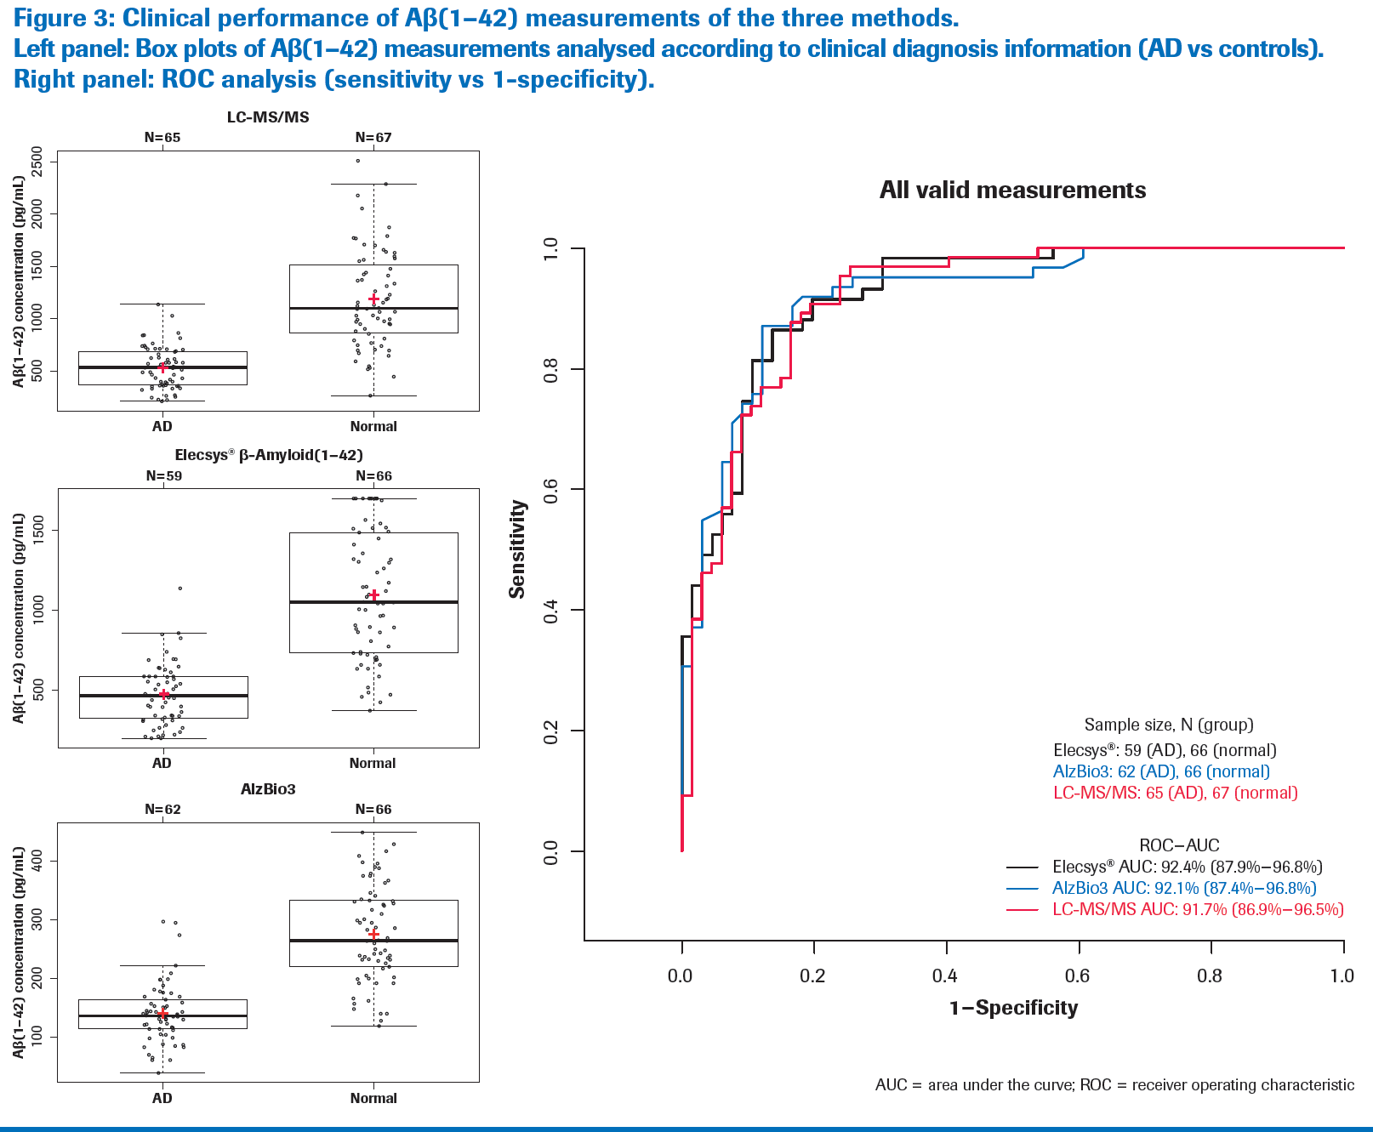

Slide 10
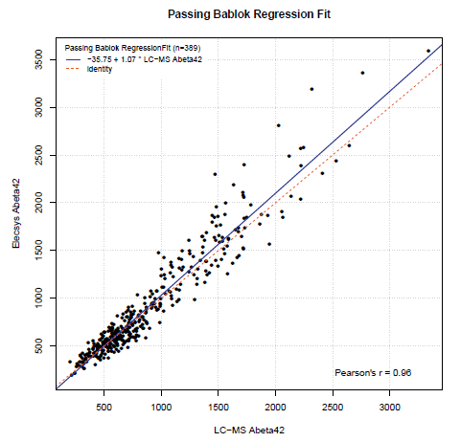
Roche Elecsys versus LC/MS for ADNI1 BASELINE CSF Aβ₁₋₄₂
Confirms finding from UPenn Method Comparison study: linear relationship and approximately 1:1

Slide 11
ADNI1 BASELINE CSF Aβ₁₋₄₂, t-tau, p-tau₁₈₁& ratios
ADNI1 | Aβ₁₋₄₂ | t-tau | p-tau₁₈₁ | t-tau/Aβ₁₋₄₂ | p-tau₁₈₁/Aβ₁₋₄₂ | % ε4+
 | (pg/mL) | (pg/mL) | (pg/mL)
AD |  |  |  |  |  | 72.6
Median | 548 | 349 | 34 | 0.62 | 0.063
N=95 mean±SD | 610±242 | 359±130 | 36±15 | 0.65±0.28 | 0.066±0.032
95% CI | 305-1125 | 154-687 | 13-73 | 0.15-1.42 | 0.012-0.14
MCI |  |  |  |  |  | 56.6
Median | 633 | 294 | 28 | 0.50 | 0.050
N=176 mean±SD | 741±338 | 312±124 | 31±14 | 0.51±0.30 | 0.052±0.033
95% CI | 292-1624 | 140-599 | 12-63 | 0.12-1.22 | 0.010-0.13
NC |  |  |  |  |  | 26.4
Median | 989 | 218 | 20 | 0.18 | 0.017
N=91 mean±SD | 1018±397 | 239±84 | 22±9 | 0.27±0.18 | 0.026±0.019
95% CI | 394-1640 | 112-444 | 11-43 | 0.11-0.73 | 0.0089-0.079

Slide 12
ADNIGO/2 CSF BASELINE Aβ₁₋₄₂, t-tau, p-tau₁₈₁ & ratios
ADNIGO/2 | Aβ₁₋₄₂ | t-tau | p-tau₁₈₁ | t-tau/Aβ₁₋₄₂ | p-tau₁₈₁/Aβ₁₋₄₂ | % ε4+
 | (pg/mL) | (pg/mL) | (pg/mL)
AD Median | 594 | 334 | 33 | 0.58 | 0.058 | 68.5
N=127 mean±SD | 649±257 | 375±155 | 37±16 | 0.64±0.32 | 0.064±0.034
95% CI | 309-1375 | 170-750 | 15-76 | 0.18-1.42 | 0.014-0.15
LMCI Median | 756 | 286 | 28 | 0.50 | 0.050 | 60.9
N=138 mean±SD | 800±285 | 308±136 | 30±15 | 0.51±0.30 | 0.052±0.033
95% CI | 340-1457 | 115-577 | 10-63 | 0.12-1.22 | 0.010-0.13
EMCI Median | 865 | 234 | 20 | 0.27 | 0.025 | 49.4
N=122 mean±SD | 943±355 | 256±122 | 22±9 | 0.33±0.26 | 0.033±0.029
95% CI | 382-1659 | 117-582 | 11-43 | 0.09-0.95 | 0.0082-0.106
SMC Median | 1111 | 218 | 19 | 0.19 | 0.017 | 43.7
N=71 mean±SD | 1079±374 | 241±94 | 22±10 | 0.25±0.16 | 0.024±0.017
95% CI | 454-1670 | 107-462 | 10-49 | 0.10-0.67 | 0.0084-0.071
NC Median | 974 | 211 | 19 | 0.21 | 0.020 | 33.0
N=109 mean±SD | 1013±379 | 238±92 | 22±9 | 0.27±0.18 | 0.0260.019
95% CI | 342-1686 | 110-469 | 10-48 | 0.09-0.69 | 0.0086-0.073

Slide 13
Aβ₁₋₄₂ all values
1248
1291
1324
1052
658
793*
562
617
Numbers inside the boxes are the respective median values for BL Aβ₁₋₄₂ in pg/mL placed above the median value horizontal line.
*p<0.005 for LMCI ADNIGO+2 vs ADNI1; p=0.11 for NL ADNIGO+2 vs ADNI1; p=0.23 for AD ADNIGO+2 vs ADNI1

Slide 14
t-tau
349
334
294
286
218
211
218
234
Numbers inside the boxes are the respective median values for BL t-tau in pg/mL placed above the median value horizontal line.
P=0.81 for NL ADNIGO+2 vs ADNI1; p=0.51 for MCI ADNIGO+2 vs ADNI1; p=0.81 for AD ADNIGO+2 vs ADNI1

Slide 15
p-tau₁₈₁
34.0
33.2
28.4
27.6
19.9
20.7
19.3
19.3
Numbers inside the boxes are the respective median values for p-tau₁₈₁ in pg/mL placed above the median value horizontal line.
*p=0.71 for ADNIGO+2 vs ADNI1; p=0.43 for MCI ADNIGO+2 vs ADNI1; p=0.88 for AD ADNIGO+2 vs ADNI1.

Slide 16
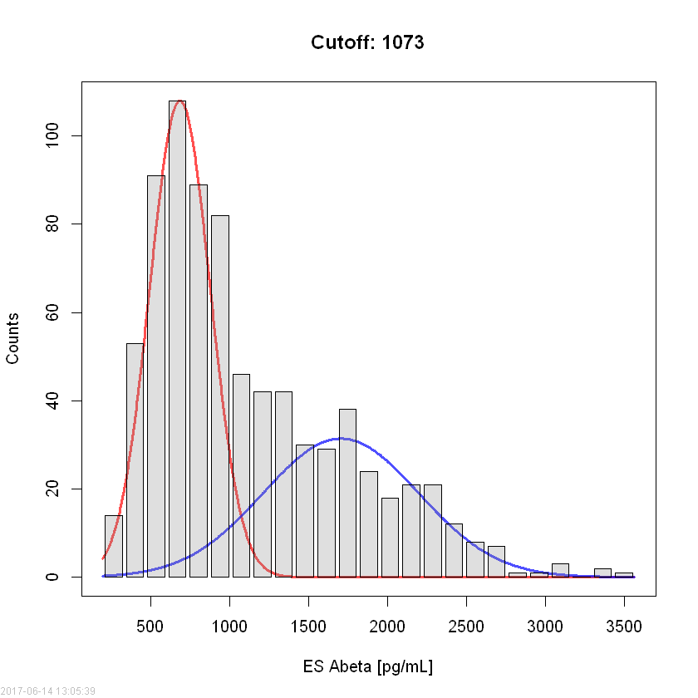
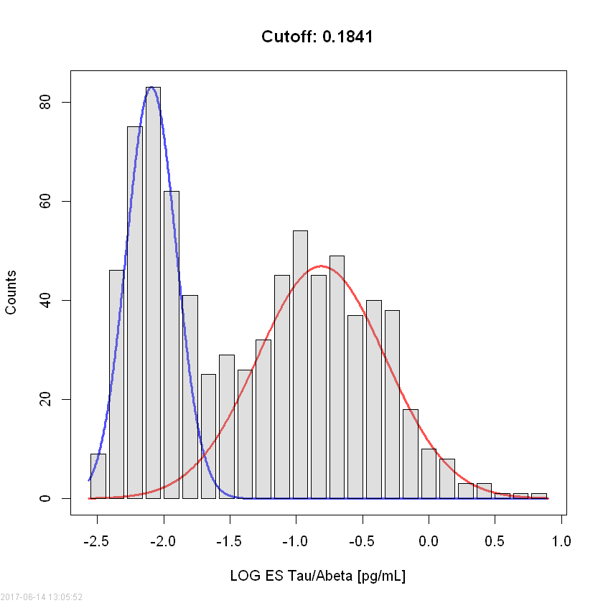
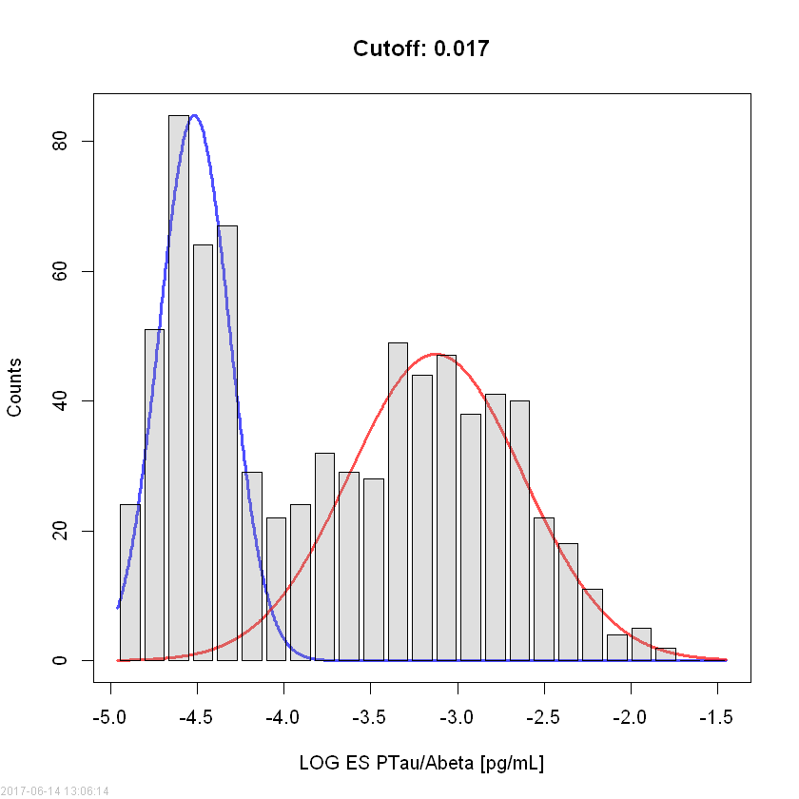
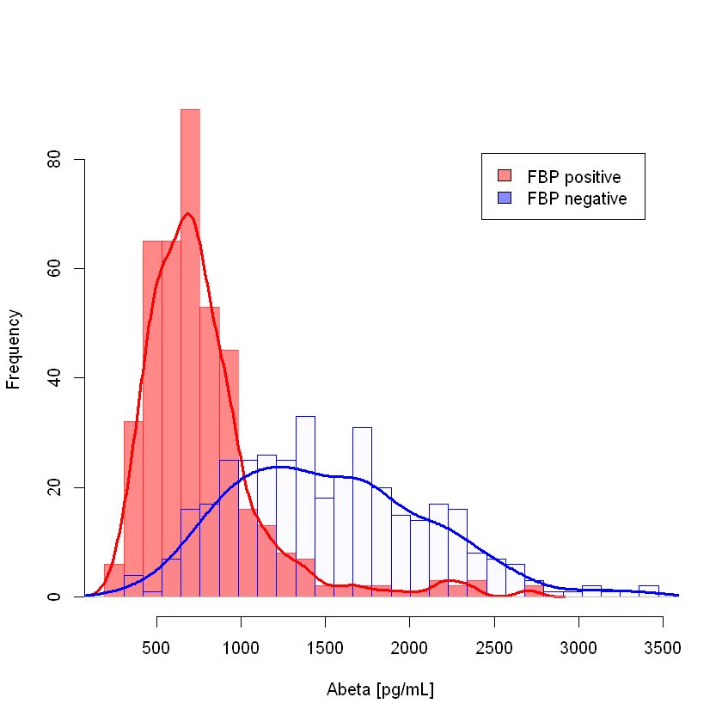
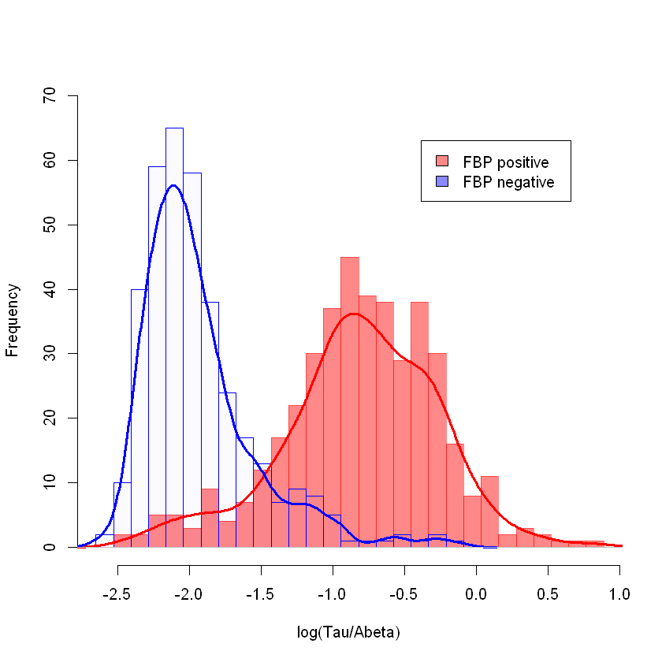
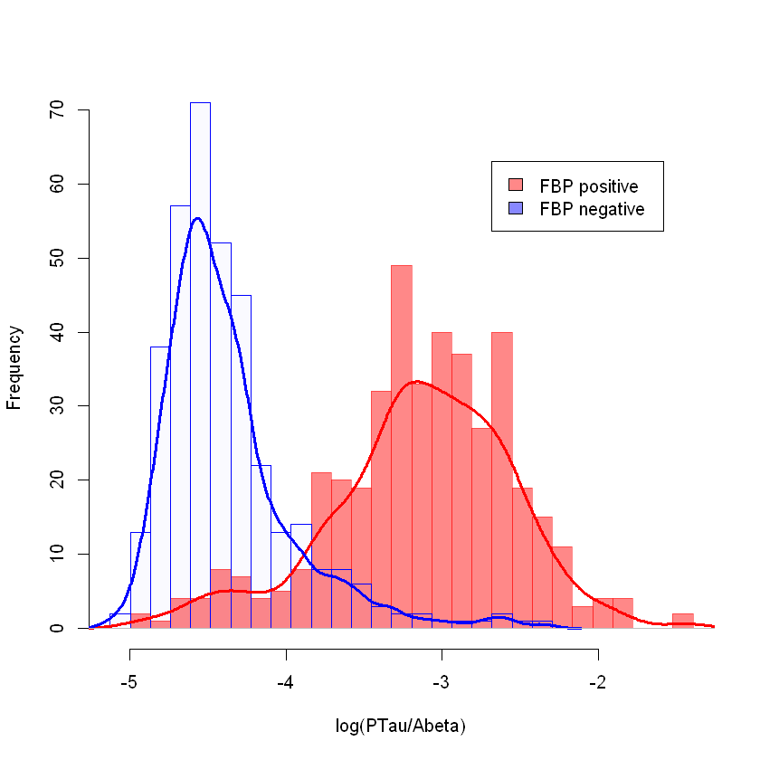
Frequency distribution plots: upper are mixture model plots,
lower are FBP+ and FBP- for ADNI NL/SMC/EMCI/LMCI/AD
Aβ₁₋₄₂
tau/Aβ₁₋₄₂
ptau₁₈₁/Aβ₁₋₄₂

Slide 17
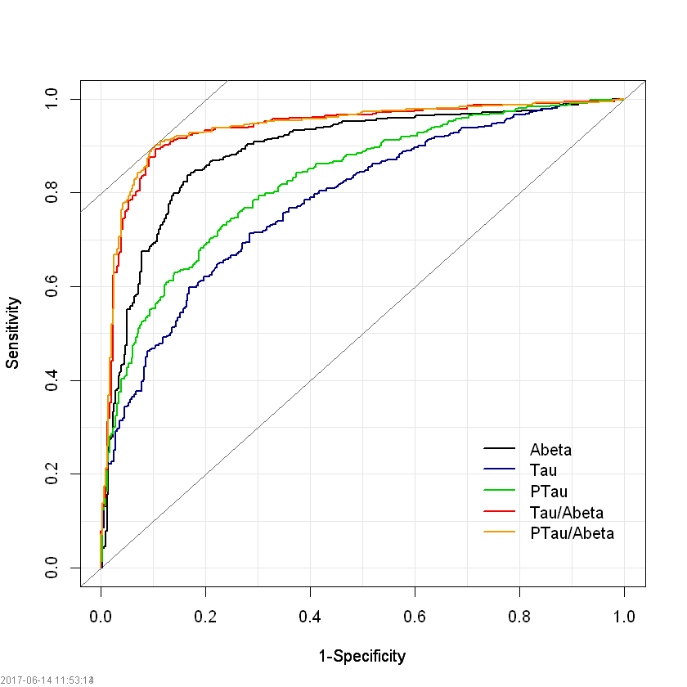
ROC Curves for NL+SMC+EMCI+LMCI+AD CSF biomarkers using FBP PET+/- as clinical endpoint*
AUC values: Sens Spec Eff
p-tau/Aβ₁₋₄₂ 0.938 89.7% 90.1% 89.9%
t-tau/Aβ₁₋₄₂ 0.935 89.3% 89.5% 89.4%
Aβ₁₋₄₂ 0.888 83.5% 83.8% 83.6%
p-tau₁₈₁ 0.825 79.9% 74.8% 77.8%
t-tau 0.781 59.9% 83.1% 70.7%
Cutpoint values:
p-tau/Aβ₁₋₄₂ 0.021
t-tau/Aβ₁₋₄₂ 0.232
Aβ₁₋₄₂ 964 pg/mL
p-tau₁₈₁ 23.2 pg/mL
t-tau 282 pg/mL
*SUVR of 1.1 used: Landau and Jagust

Slide 18
Cutpoint assessments for CSF Aβ₁₋₄₂, t-tau & p-tau₁₈₁ in ADNI
ROC with FBP PET as the endpoint:
Aβ₁₋₄₂, 964 pg/mL t-tau/Aβ₁₋₄₂, 0.23
t-tau, 282 pg/mL p-tau₁₈₁/Aβ₁₋₄₂, 0.021
p-tau₁₈₁, 23.2 pg/mL
Disease-independent mixture modeling
Aβ₁₋₄₂, 1073 pg/mL t-tau/Aβ₁₋₄₂, 0.18
t-tau, NA p-tau₁₈₁/Aβ₁₋₄₂, 0.017
p-tau₁₈₁, NA
Prediction from BioFINDER study based on pre-analytic differences
Aβ₁₋₄₂, 880 pg/mL t-tau/Aβ₁₋₄₂, 0.33
t-tau, 270 pg/mL p-tau₁₈₁/Aβ₁₋₄₂, 0.028
p-tau₁₈₁, 24 pg/mL

Slide 19
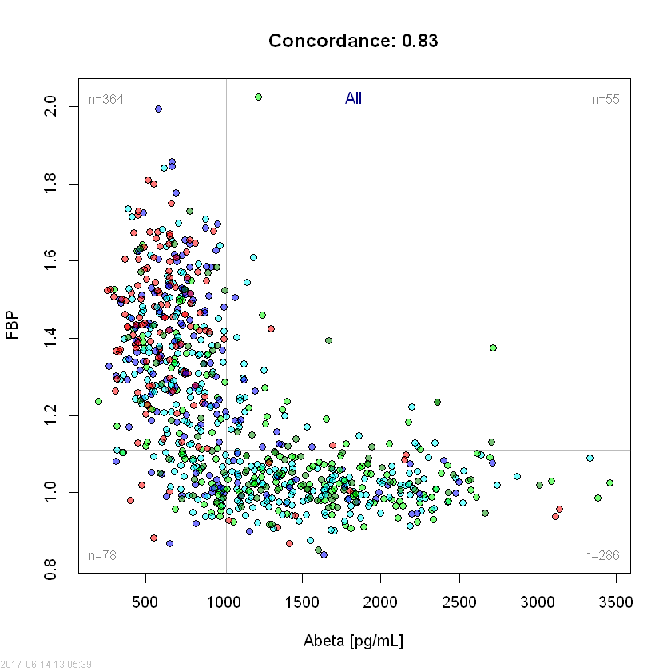
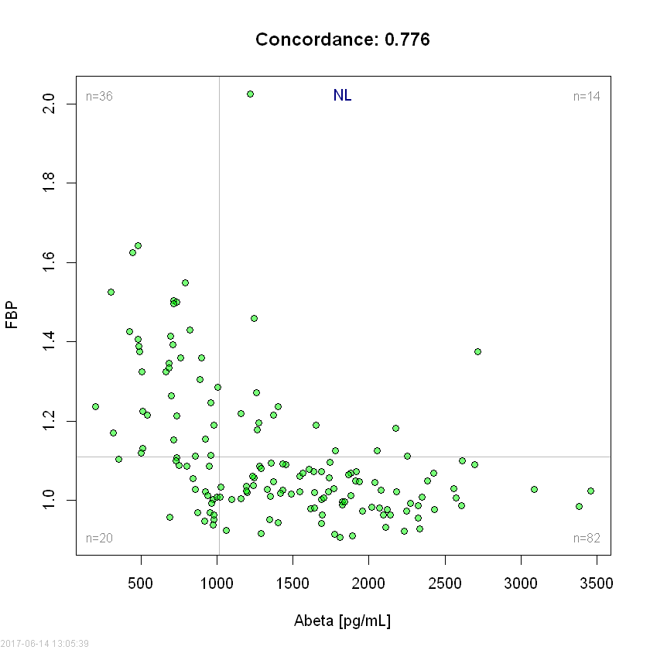
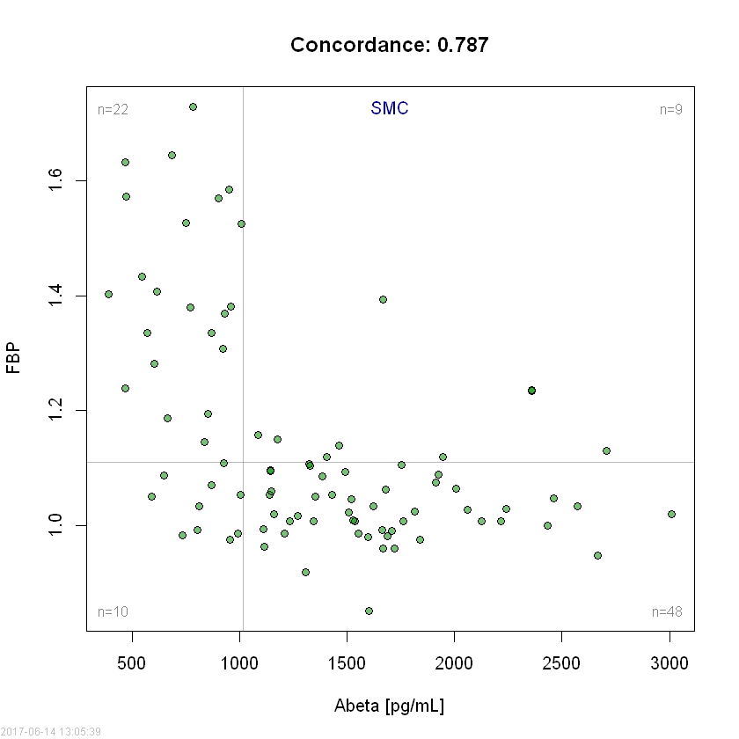
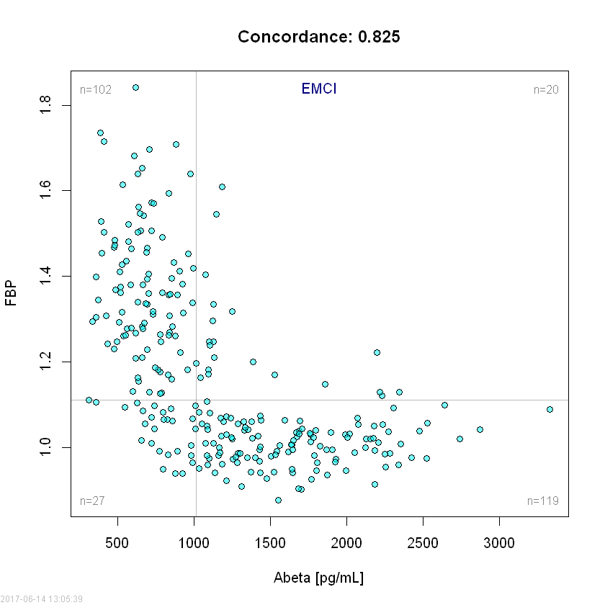
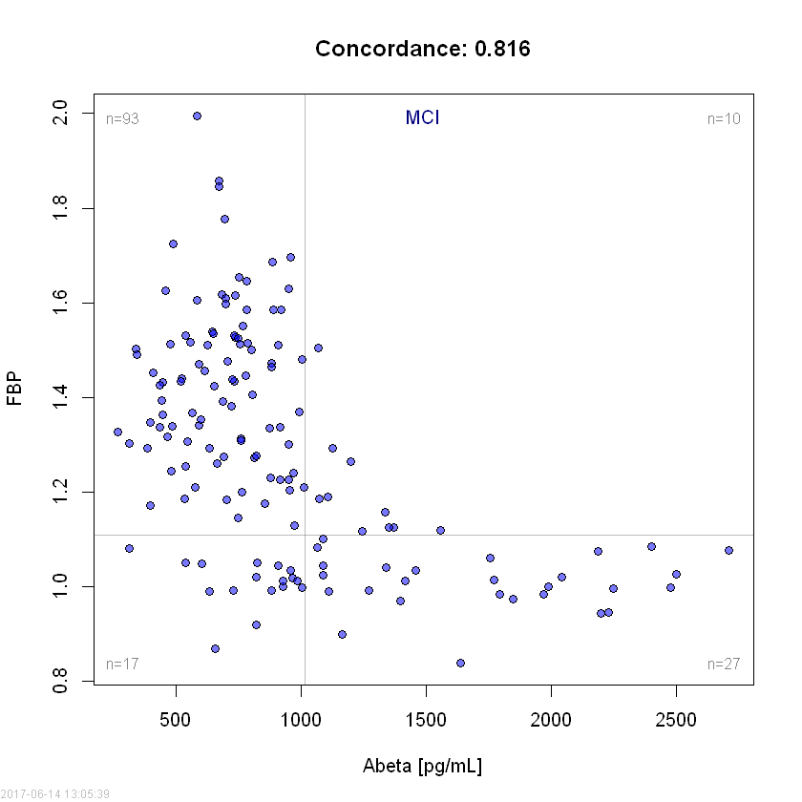
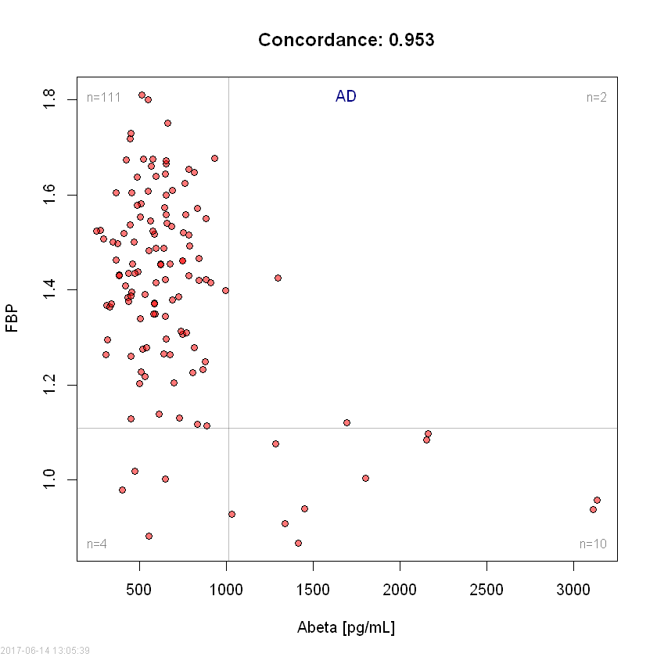
Concordance plots for FBP vs CSF Aβ₁₋₄₂ in ADNIGO/2 NL, SMC, EMCI, LMCI & AD participants at BASELINE

Slide 20
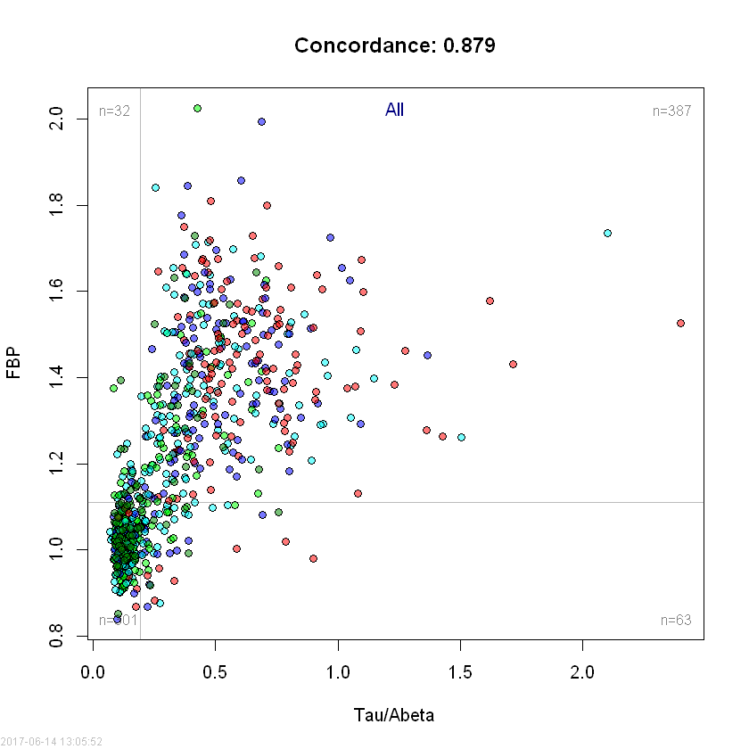
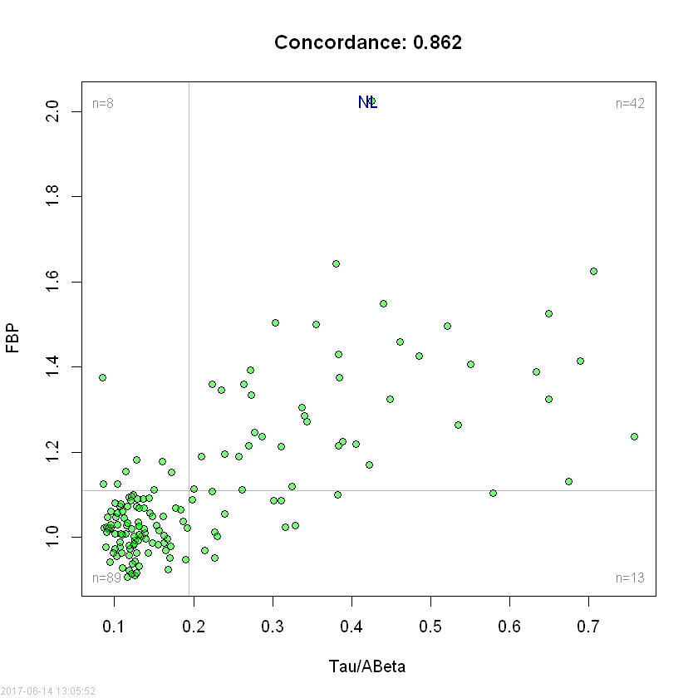
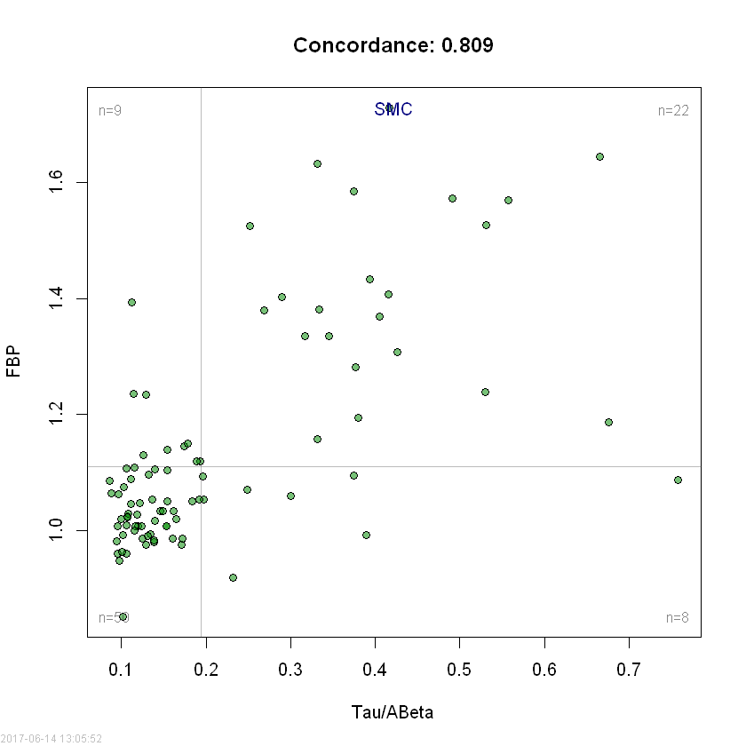
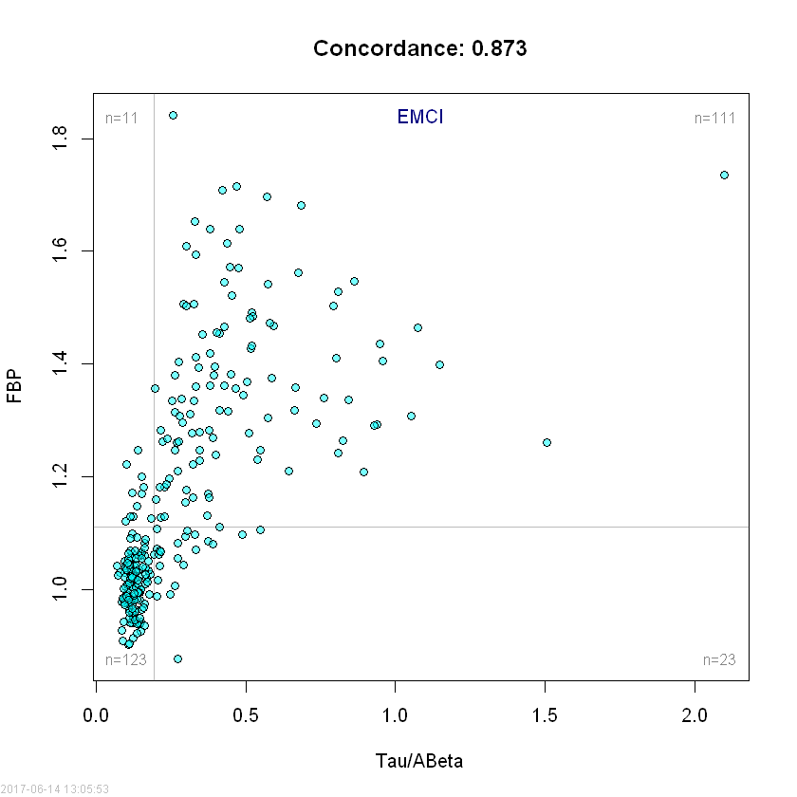
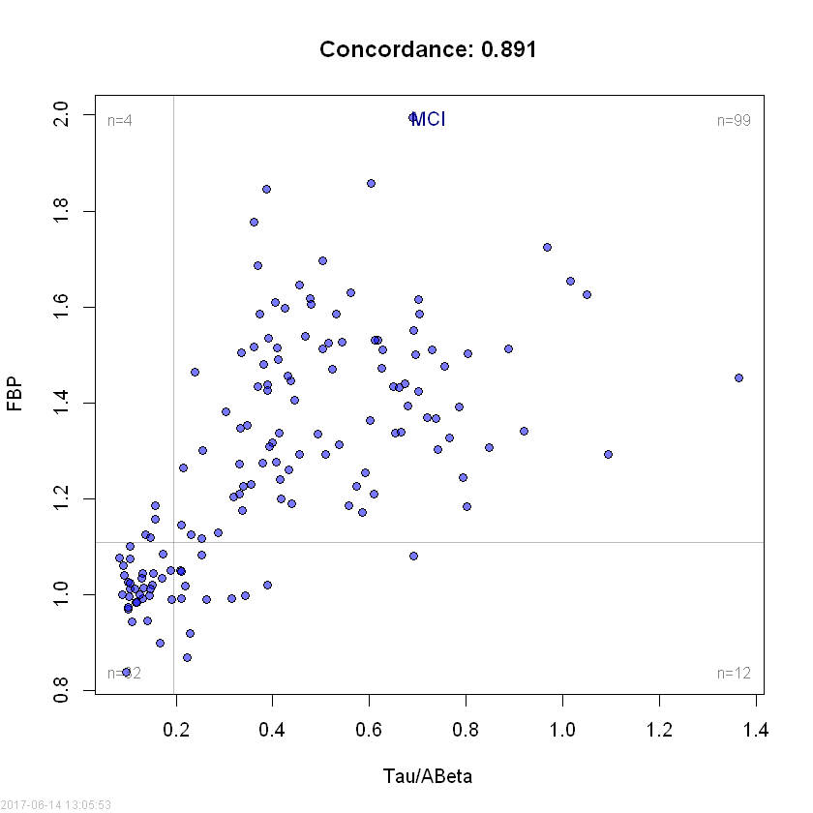
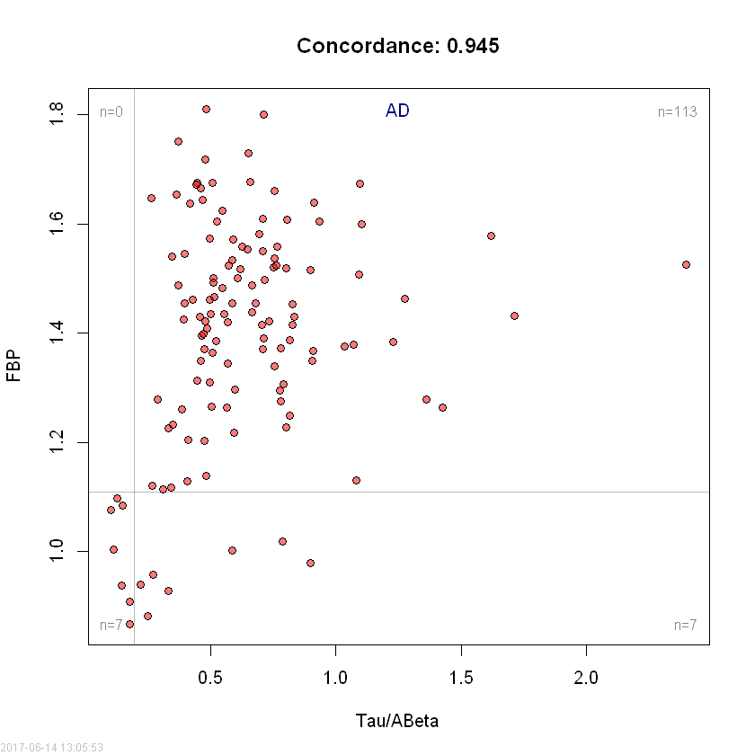
Concordance plots for FBP vs CSF tau/Aβ₁₋₄₂ in ADNIGO/2 NL, SMC, EMCI, LMCI & AD
participants at BASELINE

Slide 21
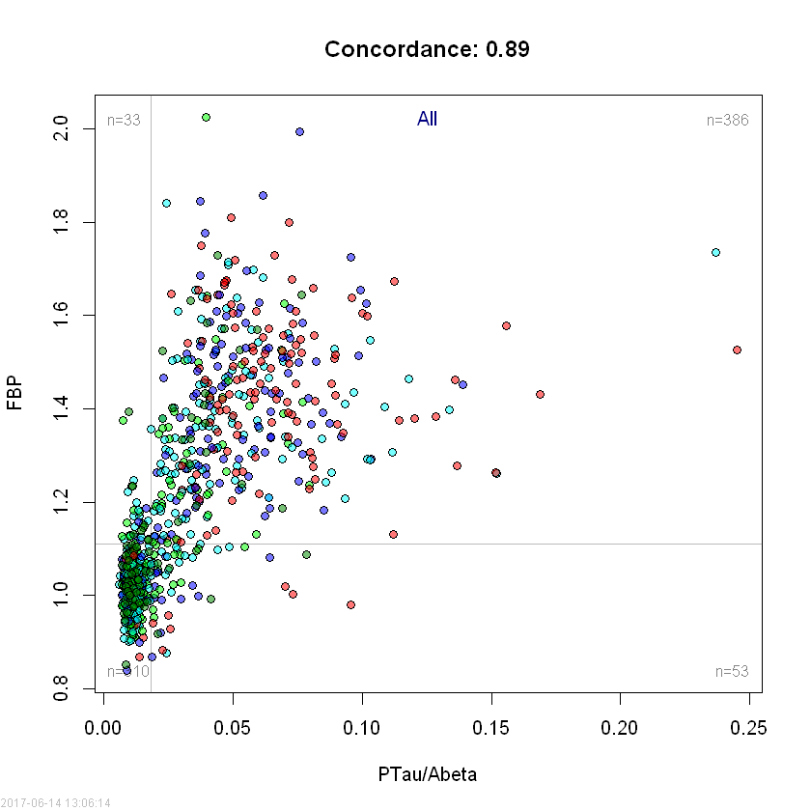

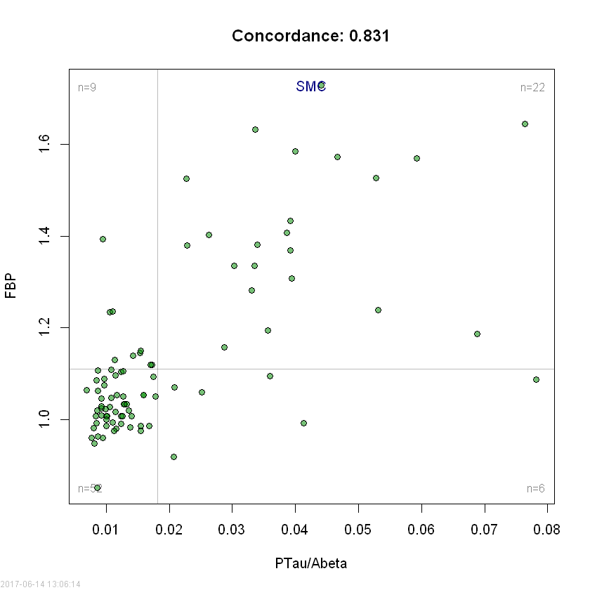

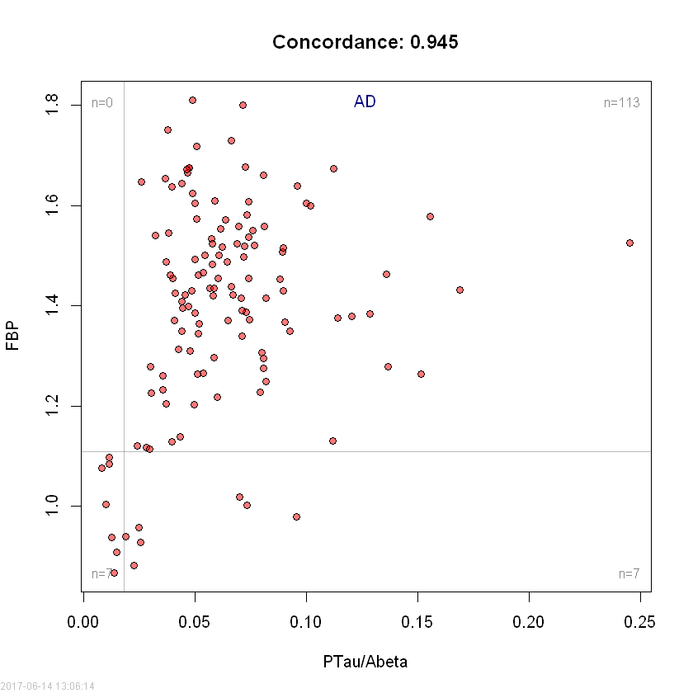
Concordance plots for FBP vs CSF ptau/Aβ₁₋₄₂ in ADNIGO/2 NL, SMC, EMCI, LMCI, AD participants at BASELINE

Slide 22
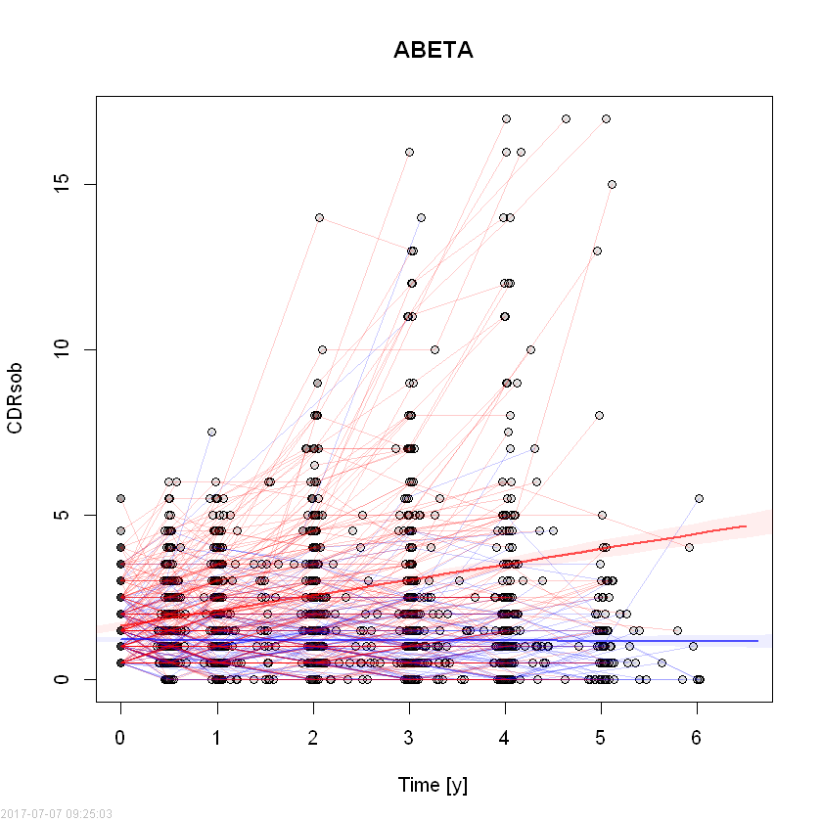
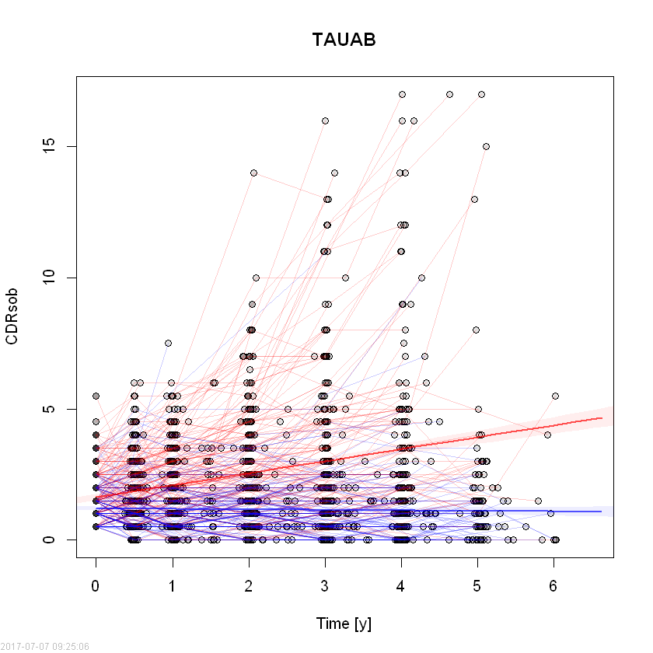
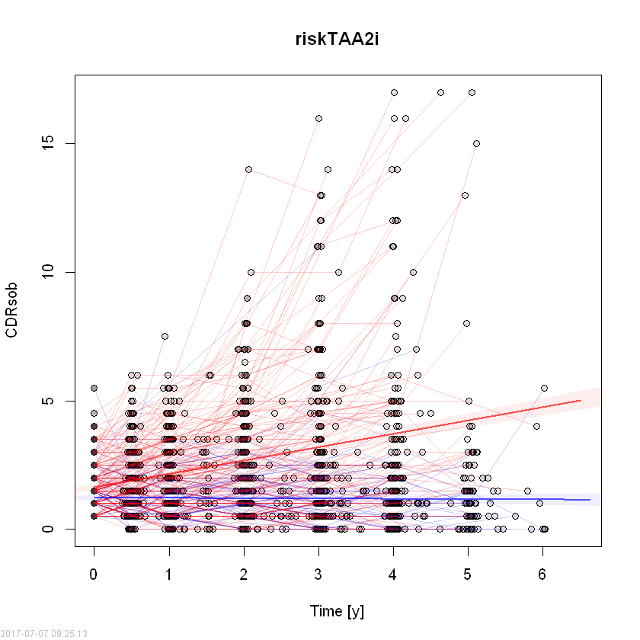
Prediction of cognitive decline(CDRsob) in ADNI1/GO/2 EMCI +MCI subjects
Aβ₁₋₄₂
t-tau/Aβ₁₋₄₂
riskTAA2i
Vertical red arrow points to regression line for CDRsob values associated with Aβ₁₋₄₂ values below cut-point value,
t-tau/Aβ₁₋₄₂ values above cut-point value, and logistic regression model(includes Aβ₁₋₄₂, t-tau and APOE ε4 allele #
as covariates) values above cut-point value.

Slide 23
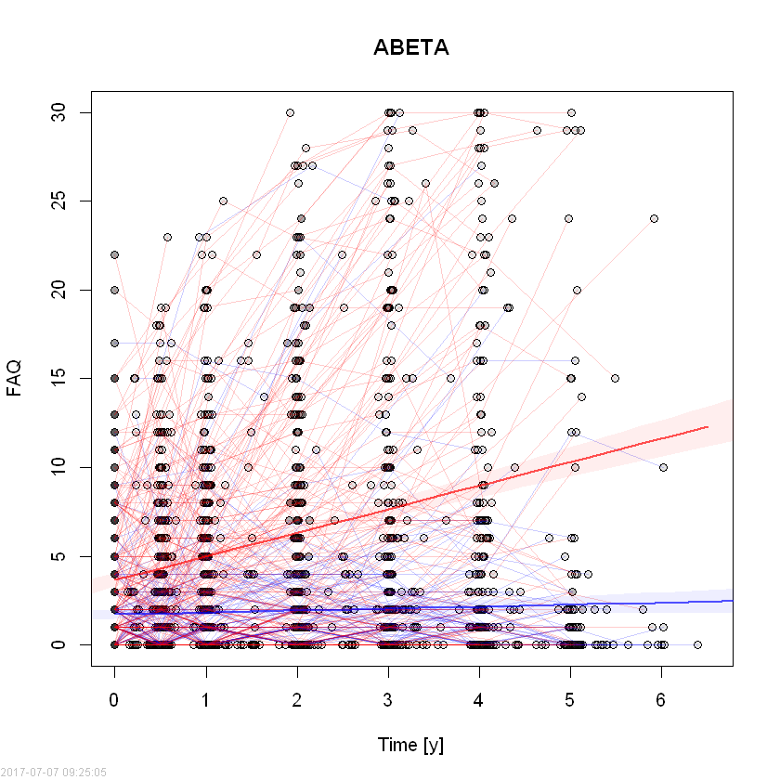
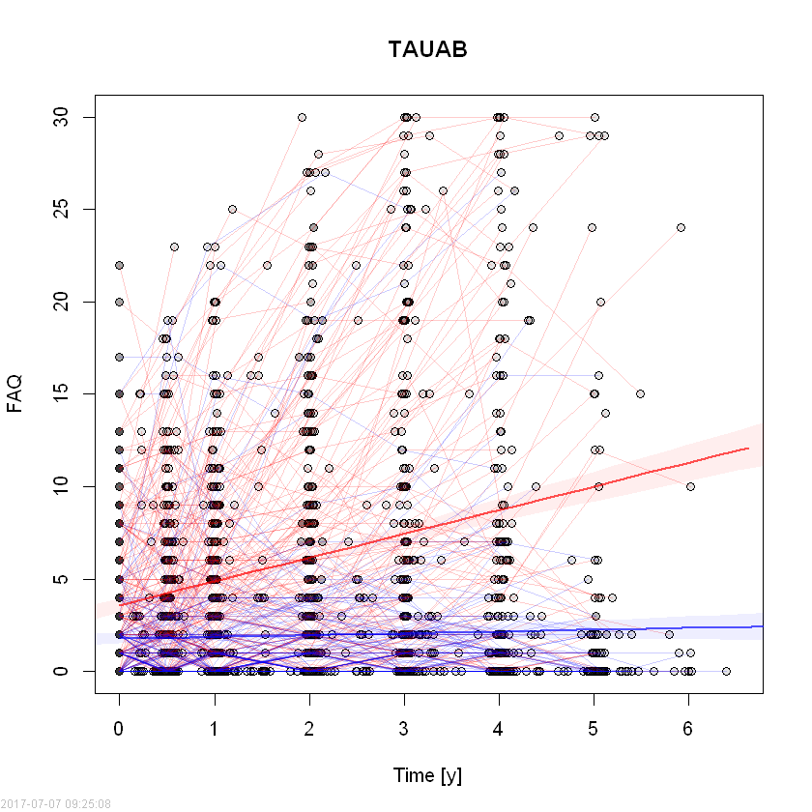

Prediction of functional decline(FAQ) in ADNI1/GO/2 EMCI +MCI subjects
Vertical red arrow points to regression line for CDRsob values associated with Aβ₁₋₄₂ values below cut-point value,
t-tau/Aβ₁₋₄₂ values above cut-point value, and logistic regression model, riskTAA2i, (includes Aβ₁₋₄₂, t-tau and APOE ε4 allele #
as covariates) values above cut-point value.

Slide 24
Summary
Roche Elecsys immunoassays for Abeta1-42, t-tau and p-tau181 completed for 2401 ADNI1/GO/2 CSFs, and uploaded on the ADNI/LONI website, March 2017
Precision and accuracy validations completed according to CLSI EP05
General stats, Frequency distributions, mixture modeling & ROC with FBP PET as endpt described
The t-tau/Aβ₁₋₄₂ and p-tau₁₈₁/Aβ₁₋₄₂ ratios outperformed Aβ₁₋₄₂ alone for clinical utilities based on:
Comparisons to FBP PET in ROC analyses
Concordance with FBP PET
Disease-independent mixture modeling
This observation is consistent with the BioFINDER study(using Roche platform/flutemetmol PET) as well as multiple other studies that used other immunoassay platforms and clinical endpoints:
Seeburger, 2015(OPTIMA study, N=227, autopsy-based diagnosis); Fagan, 2011(HASD, PIB PET based endpoint, N=103); Palmqvist, 2015(BioFINDER, Flutemetamol PET, N=366)
Mechanism possibilities: normalization of variance; tau abnormality adds to predictive performance, further studies needed
Cutpoint assessments: ROC with FBP as endpoint; disease independent mixture modeling; extrapolation from BioFINDER study based on pre-analytical differences
Prediction performance of BASELINE CSF AD biomarkers for cognitive&functional decline documentation
Continue ongoing work with ADNI and other studies toward goal of defining universal cutpoints for Aβ₁₋₄₂, t-tau and p-tau₁₈₁ including use of autopsy-based cases and age-matched controls.
Continue to work with colleagues on pre-analytical and other factors to help minimize and control these sources of variability
Implement in ADNI3
Collaboration on multimodal studies that include CSF, imaging, genetic, clinical parameters

Slide 25
ACKNOWLEDGEMENTS
Biomarker Research Lab
Magdalena Korecka
Michal Figurski
Magdalena Brylska
Teresa Waligorska
Leona Fields
Jacob Alexander
Ju Hee Kang
CNDR/ADRC
John Trojanowski
Virginia M-Y Lee
Steve Arnold
Murray Grossman
Jon Toledo
Alice Chen-Plotkin
*Deceased
William Hu
Anne Fagan
Hugo Vanderstichele
Kaj Blennow
Henrik Zetterberg
Chris Clark*
Manu Vandijck
John Lawson
Udo Eichenlaub
Tobias Bittner
The Roche team
*Deceased
Robert Dean
Holly Soares
Adam Simon
Eric Siemers
Piotr Lewczuk
William Potter
Rand Jenkins
Erin Chambers
Supported by the NIH/NIA & families
of our patients
MJ Fox Fdn for PD research
ADNI investigators include: (complete listing available at www.loni.usc.edu\ADNI\ Collaboration\ADNI_Manuscript_Citations.pdf

