Slide 1
BIOSTATISTICS Core ADNI 2 Summary & ADNI3 Plans
Laurel Beckett, Danielle Harvey, Michael Donohue
with help from Daniel Tancredi, Naomi Saito, and Teresa Filshtein
University of California, Davis and University of Southern California (MD)
14 July 2017

Slide 2
ADNI2 Results: Highlights
The Biostatistics Core integrates data from all Cores to address implications for clinical trial design:
Comparing candidate biomarkers for potential for inclusion/exclusion, stratification, adjustment
Predictors of disease progression (to MCI or to AD)
Predictors of cognitive and functional decline
Comparing candidate biomarkers as outcome measures of change
Signal-to-noise ratio of change over 1-2 years
Correlation of change in biomarker with cognitive or functional change
Characterizing sequence of change, especially in preclinical and early stages
Identifying important subgroups in MCI

Slide 3
Predictors of progression from MCI to AD within 24 months
Marker | Effect Size
FDG-R-UCB | 1.19
AV45-R-UCB | 1.06
Entr thickness | 1.00
Hpc vol | 0.93
CSF pTau | 0.92
CSF abeta | 0.91
CSF tau | 0.87
Entr vol | 0.71
Ventricles vol | 0.38
Whole brain vol | 0.30
W mat hyp | 0.22
Measures with highest effect size for predicting progression are at top
Effect size: how many SD separate the means for those that progress and those that do not
Measures sharing colored bar are not significantly different after multiple comparisons

Slide 4
Predictors of change in ADAS-Cog in MCI (n=328)
Marker | Correlation | p-value
FDG-R-UCB | -0.32 | <0.01
Entr thickness | -0.25 | <0.01
AV45-R-UCB | 0.22 | <0.01
CSF pTau | 0.19 | <0.01
CSF tau | 0.18 | <0.01
CSF abeta | -0.15 | <0.01
Hpc vol | -0.14 | <0.01
Ventricles vol | 0.12 | 0.02
Entr vol | -0.09 | 0.12
Whole brain vol | 0.003 | 0.96
Many baseline markers correlated with increase in ADAS-Cog
The same top 3 as for progression to AD
Measures sharing colored bar are not different after multiple comparisons

Slide 5
Promising biomarkers for prediction in MCI
Three different brain markers have at least a 1-SD difference between the baseline means for those that progress and those that do not and also correlate (|r| ≥ 0.2) with ADAS-Cog change
FDG-PET summary measure (UC Berkeley)
AV45 cortical summary measure (UC Berkeley)
Entorhinal cortex thickness (UCSF, FreeSurfer)
These markers, singly or in combination, could be used to improve clinical trial design by:
Inclusion of people more likely to progress
Exclusion of people more likely to stay stable, or
Stratifying by risk group

Slide 6
Assessing biomarkers in NC is harder
Prediction of short-term progression to MCI is much weaker than MCI to AD
Short-term change in ADAS-Cog is smaller and more variable, so harder to predict
Instead, will see what does change

Slide 7
Signal-to-noise properties of 1-year change in NC
Marker | n/group
CSF Abeta rate | 13546
WMHYP rate | 7382
AV45 rate | 6873
Entr volume rate | 3810
TOTAL13 rate | 3223
Hippocampal vol rate | 3173
CDR-sb rate | 2880
MMSE rate | 1582
CSF Tau rate | 1548
CSF PTau rate | 1389
Entr thickness rate | 1130
Whole brain vol rate | 947
TBM rate | 516
Ventricles vol rate | 397
Sample size required for 1-yr trial in NC to detect 25% reduction in change
Best precision (smallest sample size) at bottom
Measures sharing colored bar are not significantly different after multiple comparisons

Slide 8
Validating change in markers: correlation with ADAS-Cog change in NC (n=206)
Increase in AV45 correlated with increase in ADAS-Cog
No other association is significant
Measures sharing colored bar are not significantly different after multiple comparisons
Marker | Correlation | p-value
AV45-R-UCB | 0.14 | 0.049
Entr thickness | -0.12 | 0.09
Entr vol | -0.12 | 0.10
CSF abeta | -0.08 | 0.25
CSF ptau | 0.08 | 0.28
Hpc vol | -0.07 | 0.33
CSF tau | -0.06 | 0.41
FDG-R-UCB | 0.05 | 0.46
Ventricles vol | -0.05 | 0.51
Whole brain vol | -0.03 | 0.64

Slide 9
Promising markers for prediction in NC
Less consistent than in MCI
Some imaging measures have promising signal-to-noise ratios
Ventricular volume (FreeSurfer, UCSF)
TBM (Mayo)
Not as correlated with change in ADAS-Cog
Change in AV45 summary measure most correlated with change in ADAS-Cog
Best marker to use in NC depends on goal

Slide 10
What about sequences of change in markers in NC and MCI?
Clustering methods developed by Teresa Filshtein
Utilizes longitudinal sequence of multiple markers to group “similar” people
Applied to 339 participants (106 NC and 233 MCI) from ADNI-GO/ADNI-2
Based on 3 markers
Hippocampal Occupancy (HOC; derived from UCSF FreeSurfer)
AV45 SUVR Summary Measure (UC Berkeley)
FDG-PET Summary Measure (UC Berkeley)
Each measurement type transformed via weighted empirical distribution to get pseudo-centiloid measures (on 0 to 1 scale; 0=normal, 1=fully realized dementia)

Slide 11
Determining number of clusters
Calinski and Harabasz criterion – identified two syndromes
Clinical relevance
Adapted a technique from Mike Donohue’s approach for estimating trajectories within a single well-defined syndrome.
Technique identified 3 subgroups (essentially split one of the C-H groups)

Slide 12
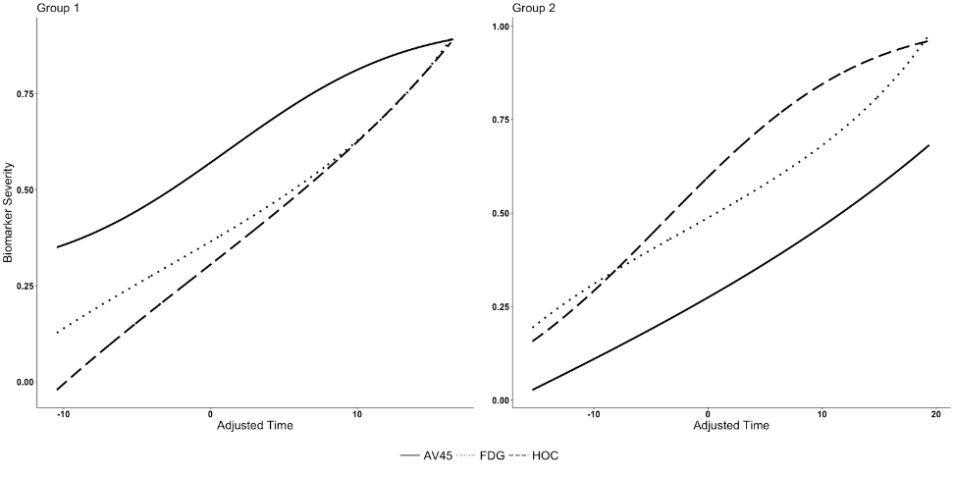
Calinski-Harabasz grouping
Two syndromes
Left side: amyloid 1st, then FDG, then HOC (54% of sample)
Right side: FDG and HOC first, then amyloid (46% of sample)

Slide 13
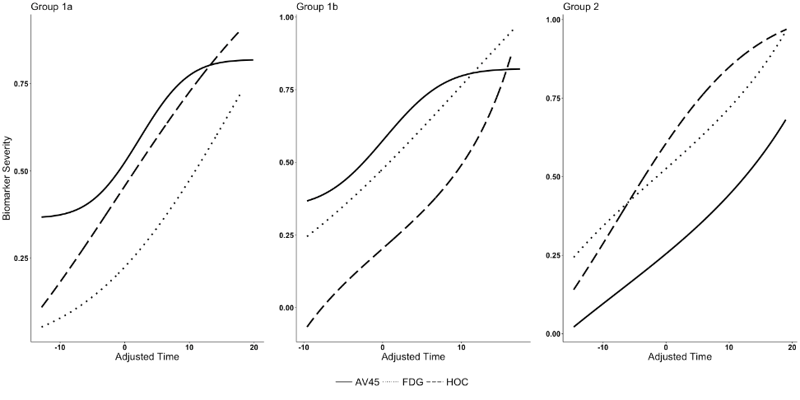
Clinical relevance grouping
Left side: amyloid first, then HOC, then FDG (31% of sample)
Center: amyloid and FDG first, then HOC (29% of sample)
Right side: FDG and HOC first, then amyloid (40% of sample)

Slide 14
What about subgroups in MCI ?
Interested in subgroup of MCI that remains stable
Considered MCI (at baseline) from ADNI-1, GO, 2 (includes EMCI)
Computed person-specific slopes in ADAS-Cog
Split according to slow changer (slope < 1) or not
Further evaluated change in CDR Sum of Boxes (stable=1st and last score equal)

Slide 15
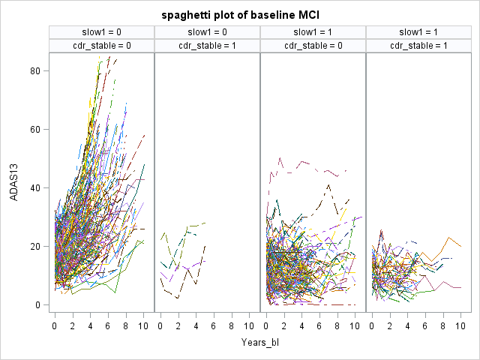
Spaghetti plots of ADAS-Cog
Which markers differ between those that remain stable and those that change? Something informative/protective in those that remain stable?

Slide 16
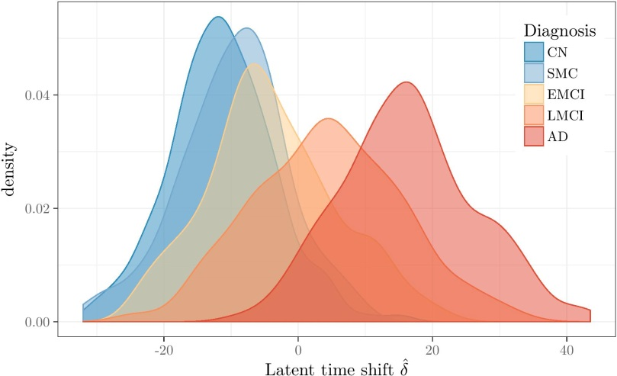
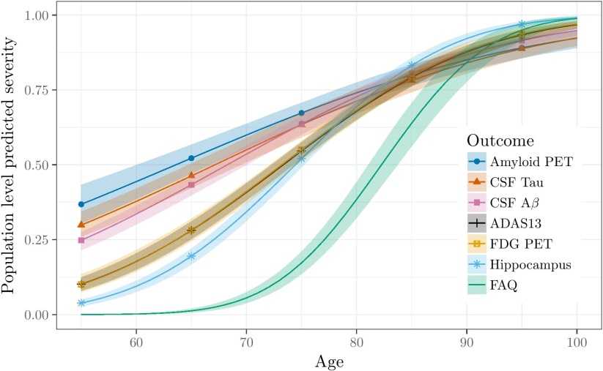
Bayesian Latent Time Joint Mixed-Models
Population-level predicted order
Subject-level predicted order (APOE𝝴4+)
Submitted to Stat Meth Med Res. Preprint: https://arxiv.org/abs/1703.10266

Slide 17
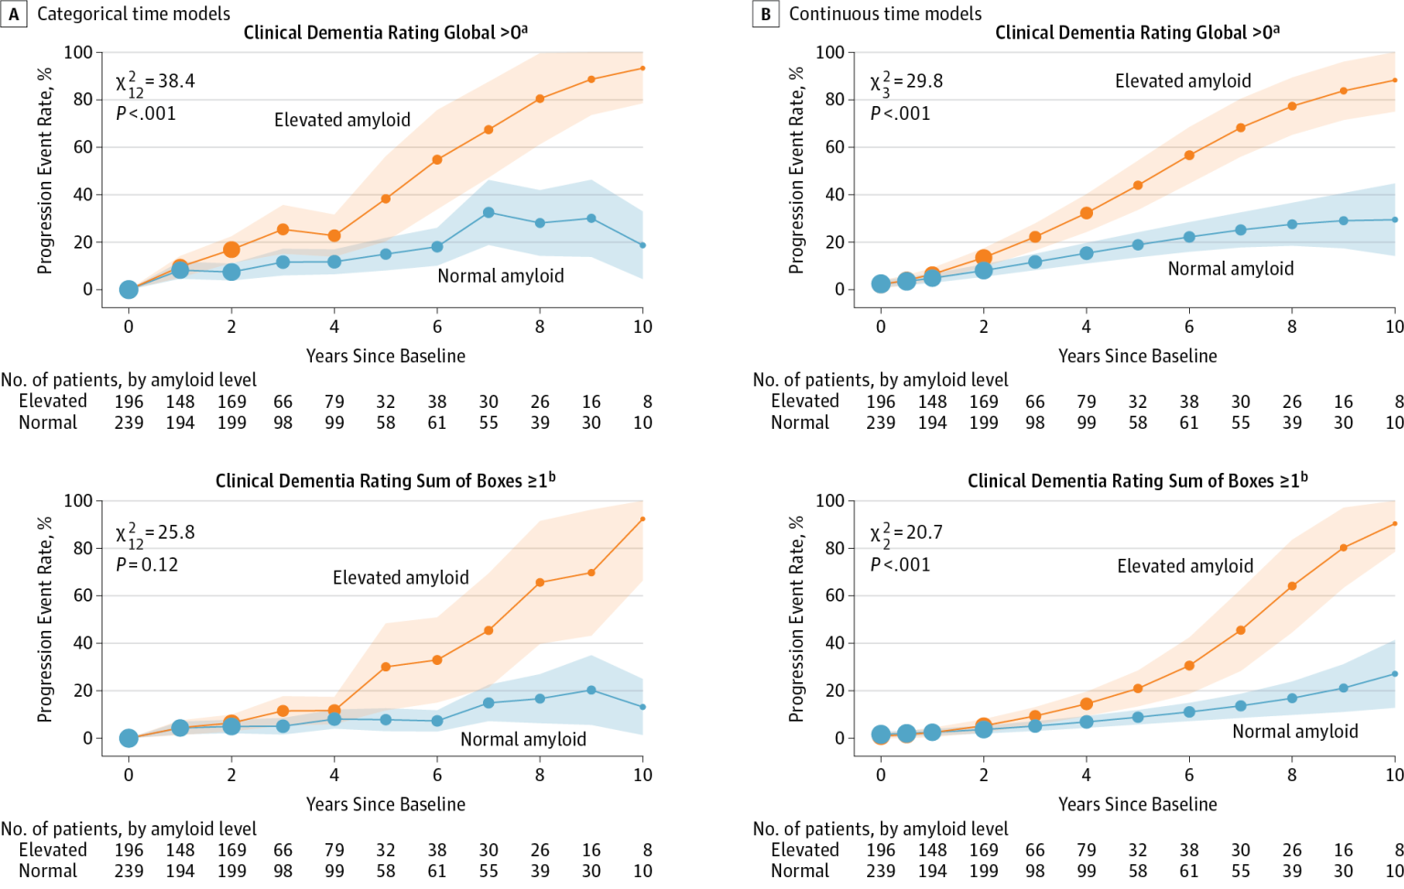
Preclinical progression
JAMA. 2017;317(22):2305-2316. doi:10.1001/jama.2017.6669

Slide 18
ADNI3: toward better clinical trials
We will assess new candidate markers (including from tau imaging), looking for markers with:
Sensitivity to change in early disease (at baseline, over time)
Good signal-to-noise properties
Correlated with relevant clinical change
Plausibility as surrogate marker and intervention target
Also consider new clinical outcome measures (such as CogState) and how they might help in early disease
Sensitivity to early change
Good signal-to-noise properties

Slide 19
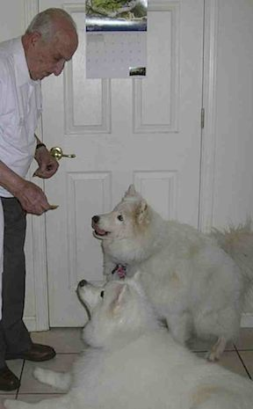
Thank you for your attention!

