Slide 1
ADNI3 CLINICAL CORE
Paul Aisen
Ron Petersen
Mike Donohue
Jennifer Salazar
Yuli Cabrera
Lindsey Hergesheimer

Slide 2
ADNI3 Cohorts
CN
MCI
Mild AD

Slide 3

CN Eligibility Criteria
Age initially 65-90, but may adjust to match other cohorts
With or without subjective memory complaints
CDR=0
MMSE 24-30
Logical Memory
  >=9 for 16+ years of education
  >=5 for 8-15 years of education
  >=3 for 0-7 years of education
No cholinesterase inhibitors or memantine

Slide 4
MCI Eligibility Criteria
Age 55-90
Subjective memory concern by participant, study partner or clinician
CDR=0.5
MMSE 24-30
Logical Memory
  <=11 for 16+ years of education
  <=9 for 8-15 years of education
  <=6 for 0-7 years of education
Stable cholinesterase inhibitors and memantine allowed

Slide 5
Mild AD Eligibility Criteria
Age 55-90
Subjective memory concern by participant, study partner or clinician
CDR=0.5 or 1
MMSE 20-26
Logical Memory
  <=8 for 16+ years of education
  <=4 for 8-15 years of education
  <=2 for 0-7 years of education
Diagnosis of probable AD
Stable cholinesterase inhibitors and memantine allowed

Slide 6
ADNI3: Schedule of Events
Rollover and New Subjects
 | Baseline | 12 month | 24 month | 36 month | 48 month
CN | CV, MRI, Tau, AMY, LP | Phone Check OR CV, MRI, Tau (+/-) | CV, MRI, Tau (+/-), AMY, LP | Phone Check | CV, MRI, Tau, AMY, LP
MCI | CV, MRI, Tau, AMY, LP, FDG | CV, MRI, Tau (+/-) | CV, MRI, AMY, LP, Tau (+/-) | CV, MRI, | CV, MRI, Tau, AMY, LP
AD | CV, MRI, Tau, AMY, LP, FDG | CV, MRI, Tau | CV, MRI, Tau, AMY, LP | Phone Check (Neuropath only) | Phone Check (Neuropath only)
All rollover and new subjects have a full clinic visit, LP and PET scans during their Initial visit of ADNI 3
CN: visits q2 years unless selected additional Year 3 Tau visit/scans
MCI: annual visits; some will have Year 2, 3 Tau PET
AD: annual for first 2 years
Notes:
Scenario 2.5

Slide 7
New components of ADNI3
MINT (instead of Boston naming)
Cogstate
FCI-SF
BHR

Slide 8
Multilingual Naming Test (MINT)
The MINT is a test of object picture naming designed to include items that are comparable across English, Spanish and other languages.
It replaces the Boston Naming Test in the Uniform Data Set of the NIA-funded AD centers because the BNT contains items that are not of the same level of difficulty for Spanish and English speakers.

Slide 9
ADNI2 Cogstate Pilot: Preliminary analysis (from Bruce Albala)
Approximately 80% of participants who completed an in-clinic baseline assessment (N=98) also completed a follow-up at-home assessment (N=78).
Based on qualitative feedback, participants most often encountered difficulties in relation to accessing the website. A small proportion of participants also had difficulty remembering to use the D and K buttons.
Assessments take ~15 minutes in-clinic or at-home
Similar results in-clinic and at-home on all 4 tests
Performance on the CBB was worse among patients with MCI when compared with cognitively normal controls.
Participants who were amyloid positive (but not diagnosed with MCI) performed worse on the One Card Learning test when compared with participants who were amyloid negative (but not diagnosed with MCI).

Slide 10
Cogstate in ADNI3
CN and MCI
Administered via Cogstate web site
In clinic and quarterly unsupervised

Slide 11
Financial Capacity Instrument – Short Form (FCI-SF, Dan Marson)
The FCI-SF is a brief performance measure of everyday financial skills, comprised of 37 performance items which evaluate four constructs of monetary calculation, financial conceptual knowledge, use of a checkbook/register, and use of a bank statement.
The FCI-SF also includes six variables measuring time to completion (in seconds) of four FCI-SF tasks.
The FCI-SF takes 15 minutes or less to administer.
FCI-SF performance and timing results discriminate between amyloid-positive and -negative controls, as well as control vs MCI vs mild AD groups.

Slide 12


BHR in ADNI3
Recruitment
  ADNI3.org
All ADNI3 CN and MCI participants invited to join BHR

Slide 13
ADNI3 Start-up Progress

Slide 14
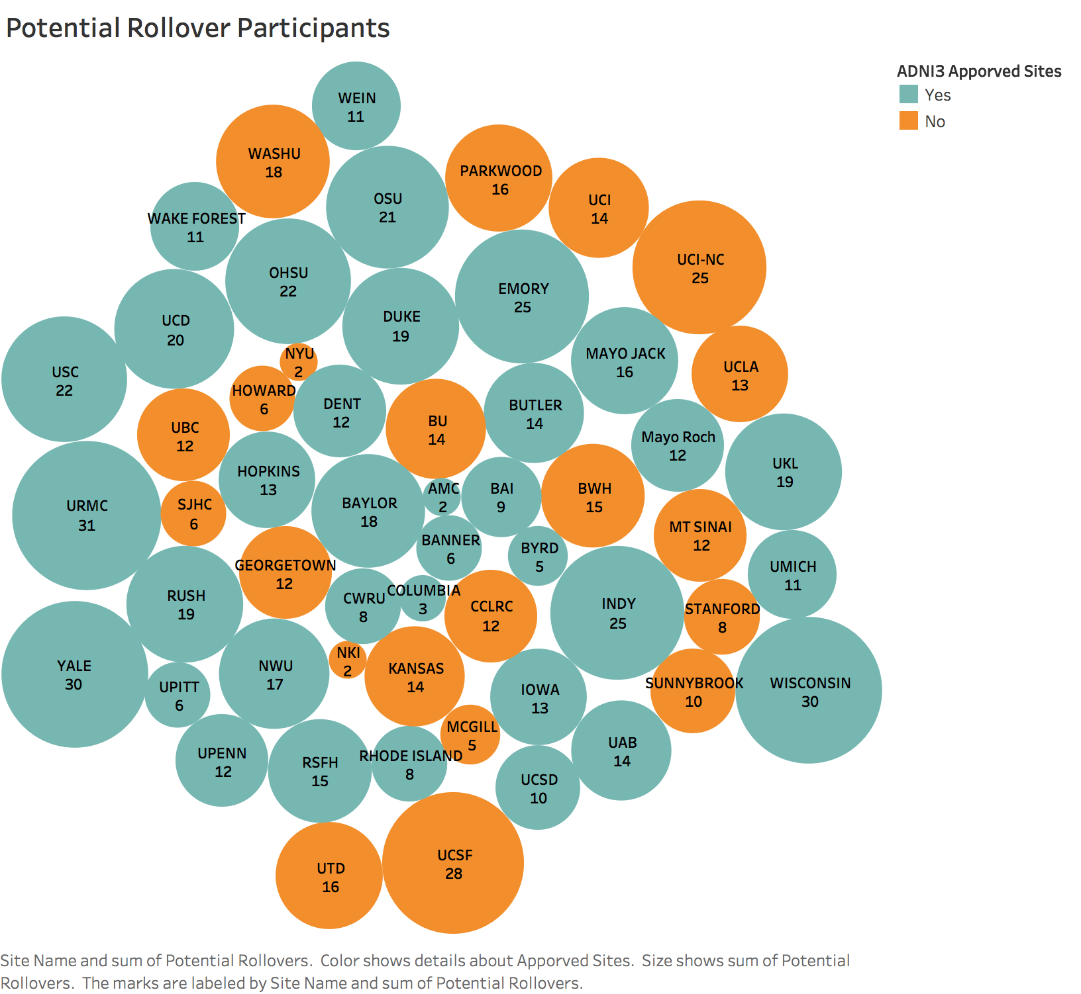
Orange Sites are not yet Approved (36/59 approved)
Notes:
Sites were surveyed at the end of ADNI2

Slide 15
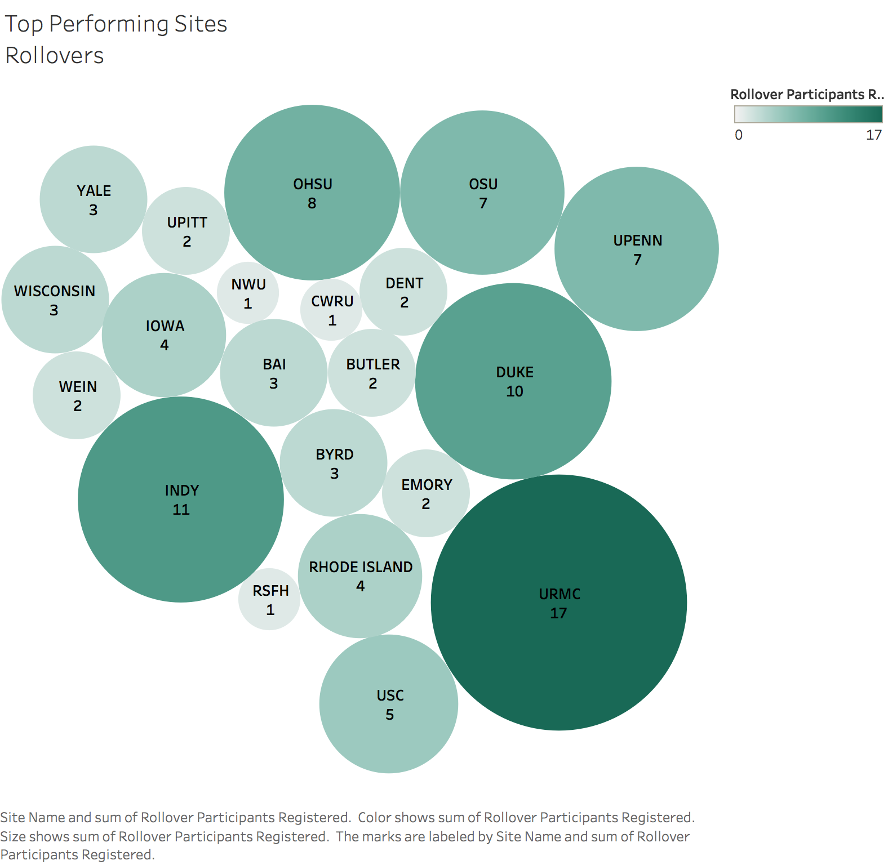
Total Rollover Participants Registered: 98
Notes:
Total Rollover participants Registered: 98

Slide 16
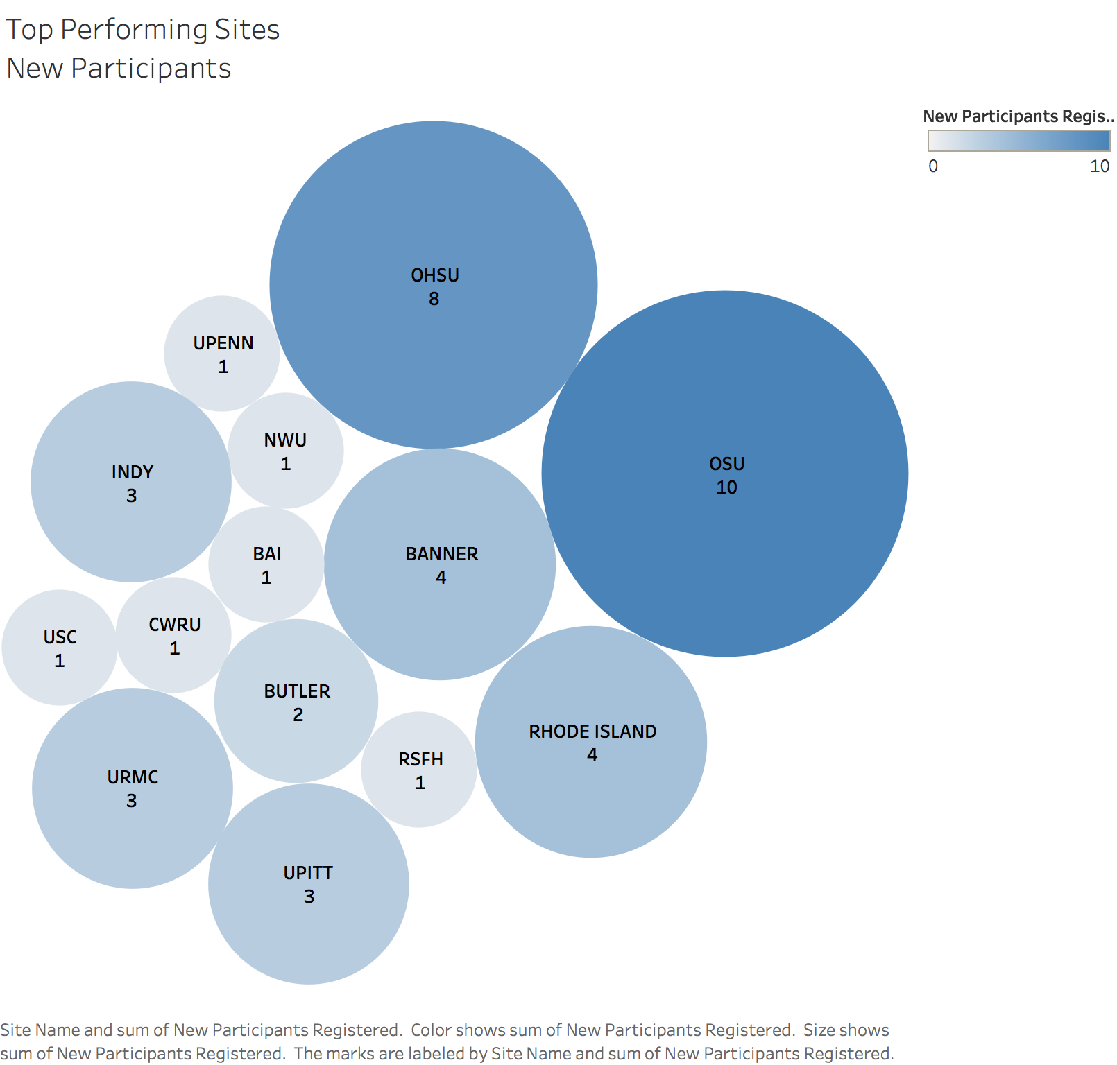
Total New Participants Registered: 43
Notes:
Total New Participants Registered: 43
(Does not display number of Screen Fails or actual enrolled)

Slide 17
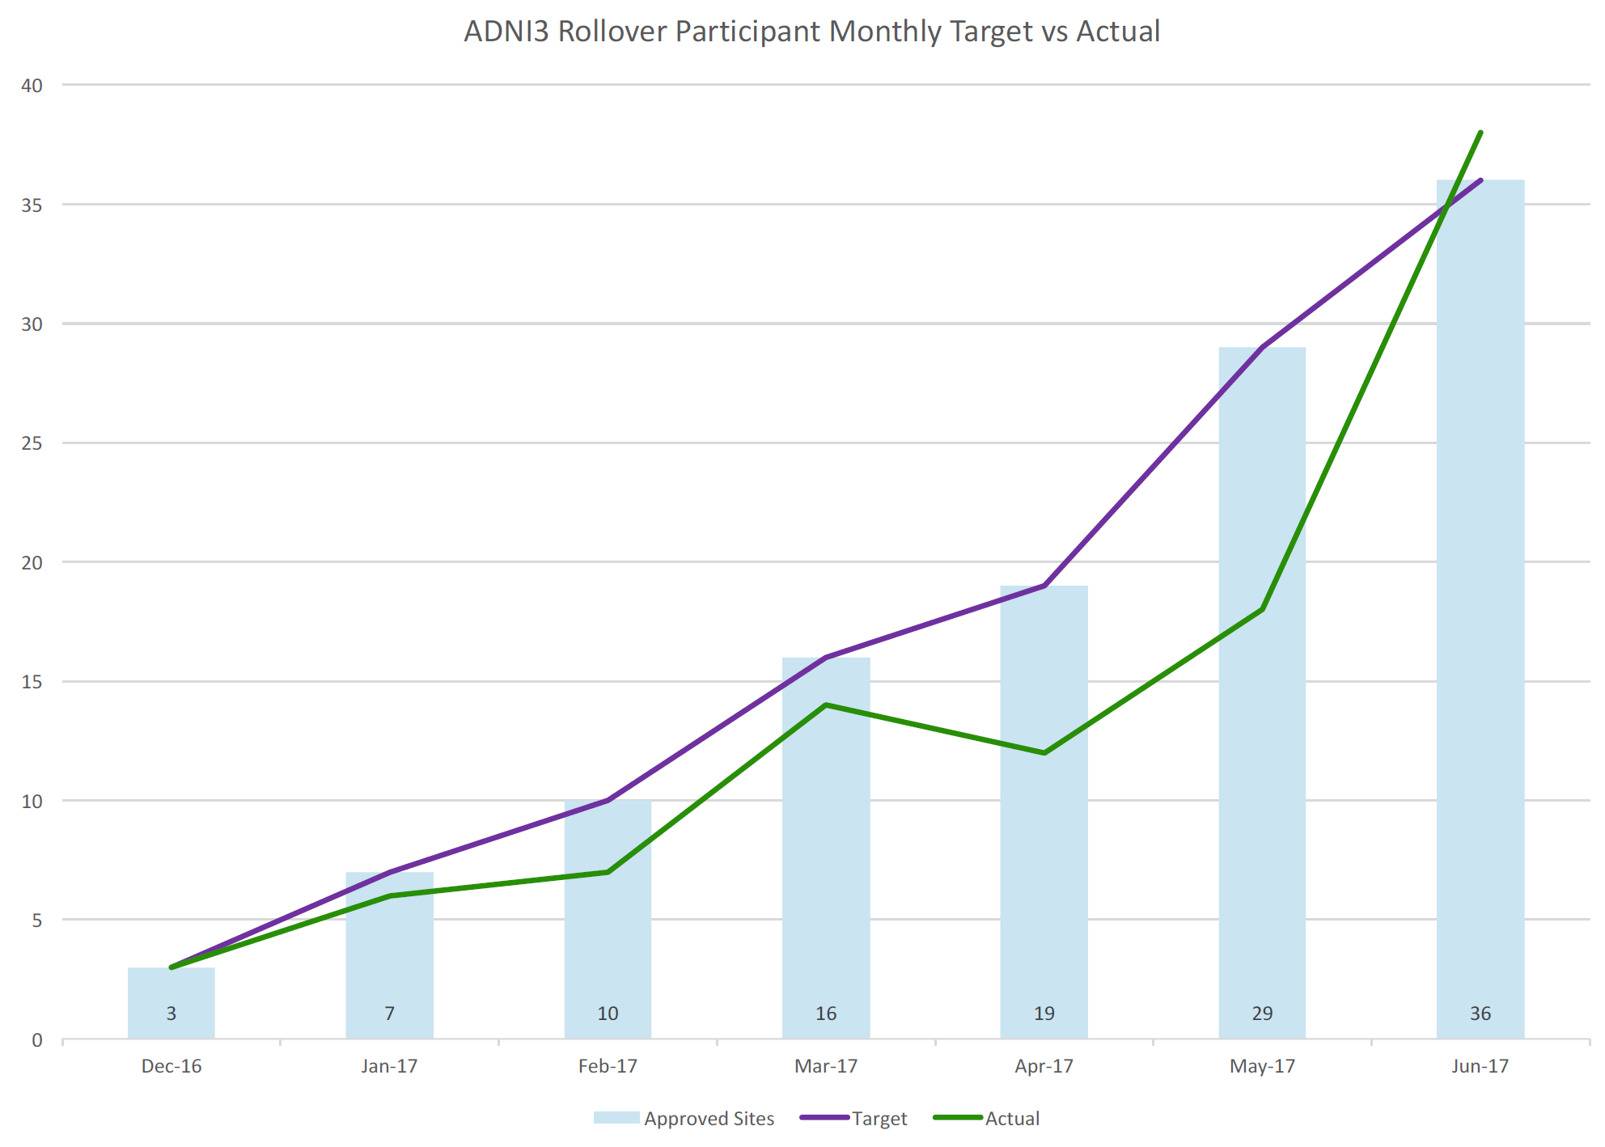

Slide 18
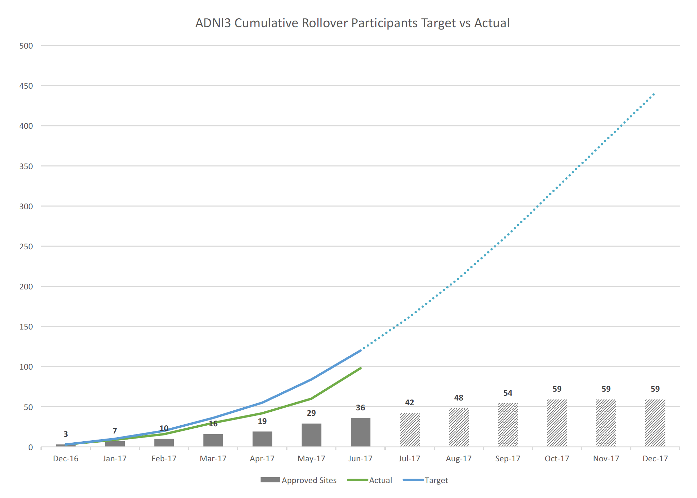

Slide 19
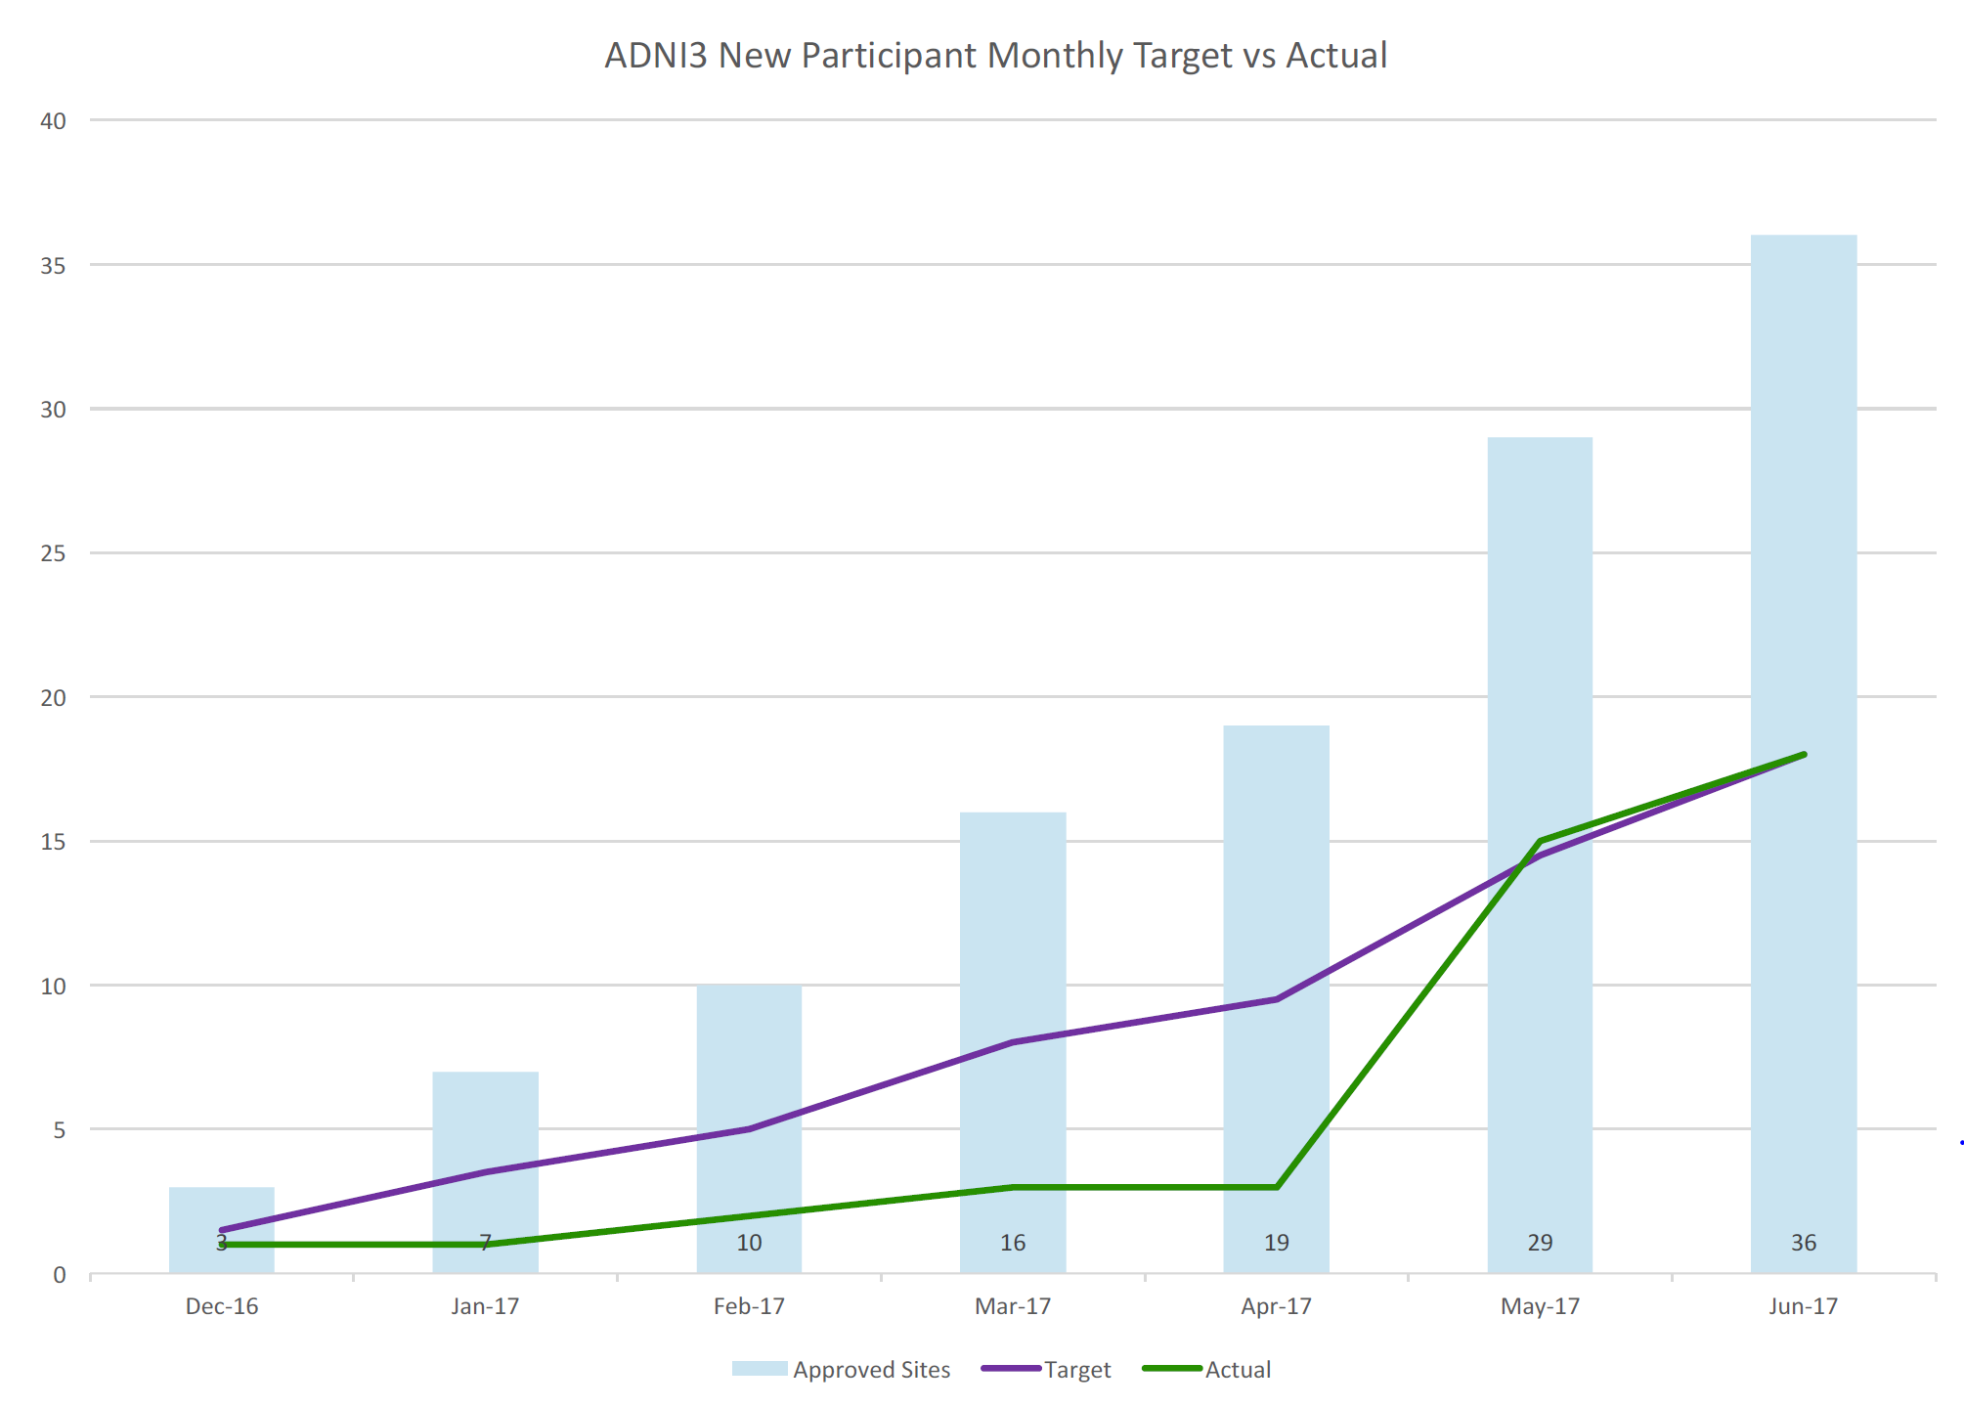

Slide 20
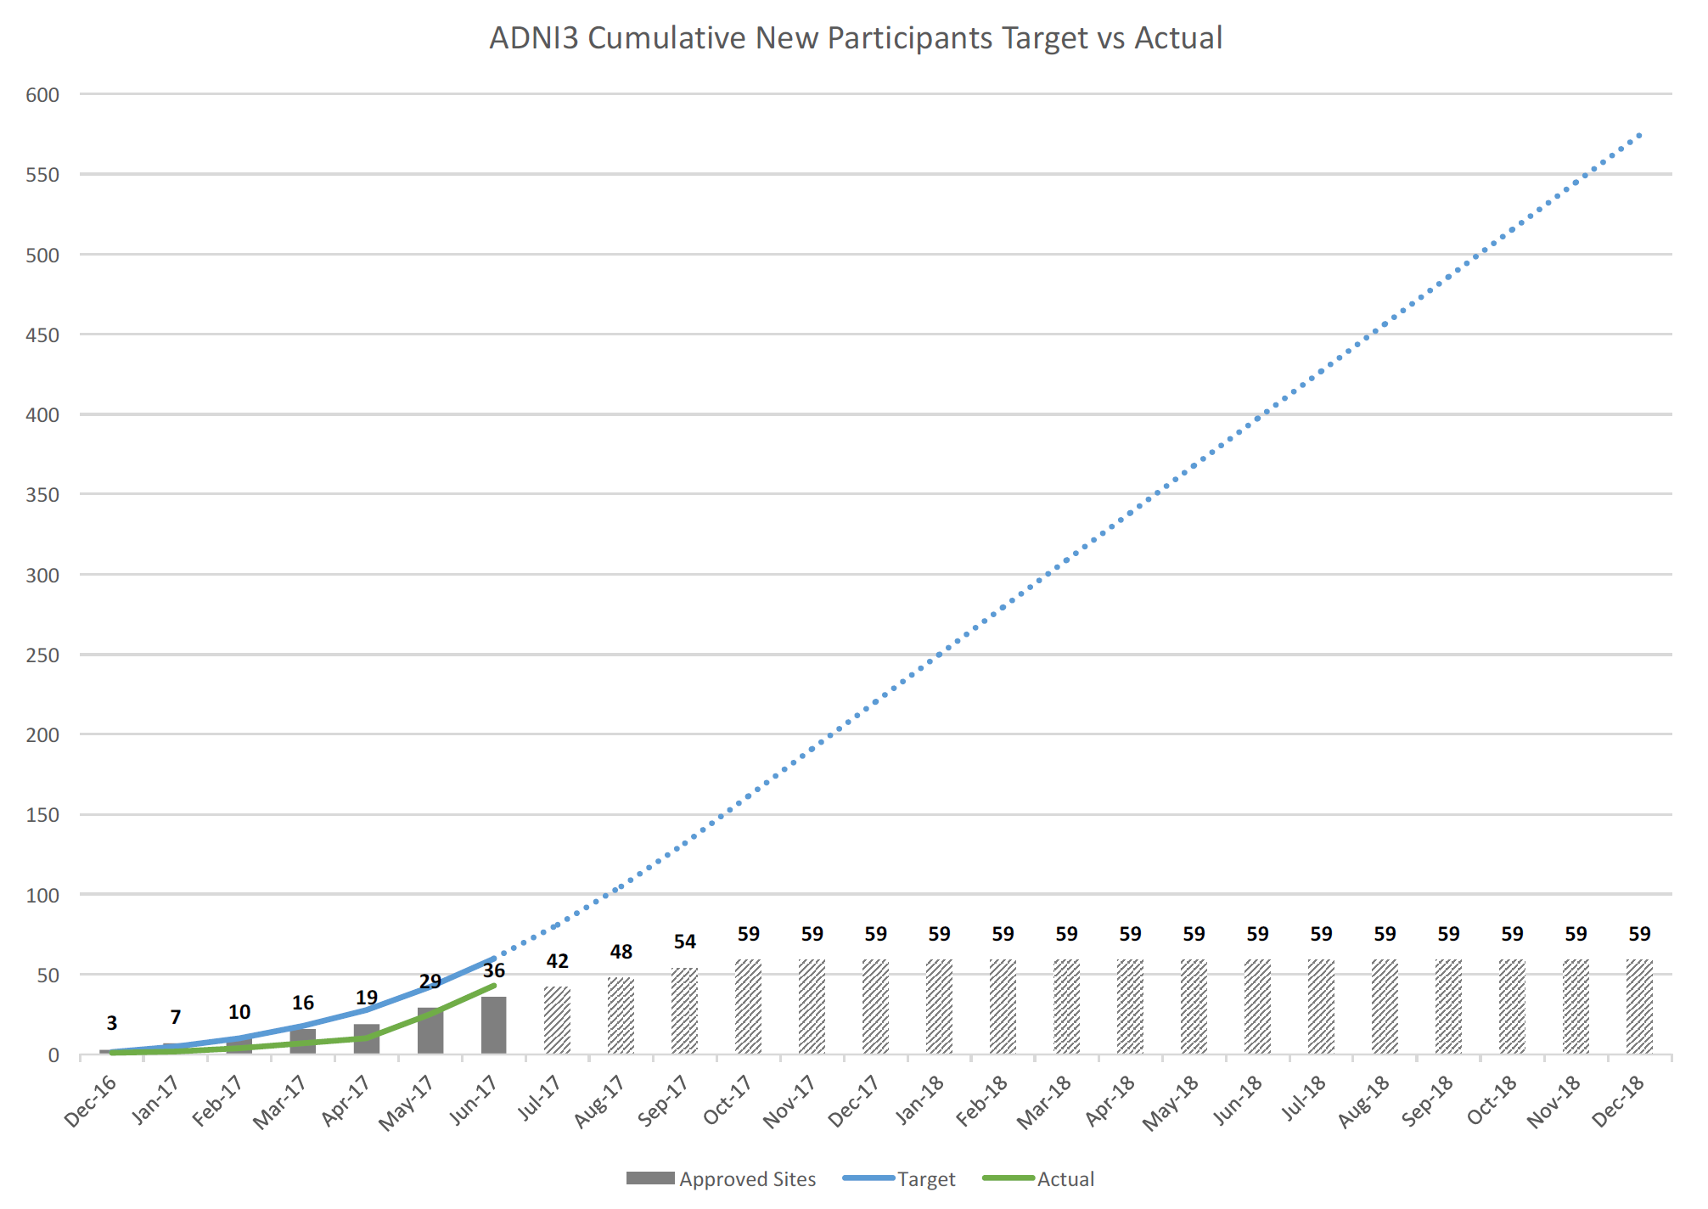

Slide 21
ADNI3 Clinical Core
Co-DIRECTORS:
Paul Aisen
Ron Petersen
PROJECT & DATA MANAGEMENT:
Devon Gessert
Jennifer Salazar
Yuliana Cabrera
Sarah Walter
Lindsey Hergesheimer
BIOSTATISTICS:
Mike Donohue
Rema Raman
Chung-Kai Sun
MEDICAL SAFETY:
Mike Rafii
Tiffany Chow
REGULATORY AFFAIRS:
Elizabeth Shaffer
Brittney Sloan
RECRUITMENT:
Shelley Moore
Charissa Barger
INFORMATICS:
Gus Jimenez
ADMINISTRATION:
Debbie Tobias
Jeremy Pizzola

