Slide 1
Alzheimer’s Disease Neuroimaging Initiative 3 (ADNI 3)
Michael W. Weiner

Slide 2
SUMMARY OF THIS PAST YEAR
ADNI 3 was funded by NIA and PPSB
ADNI 2 being completed, sites transition to ADNI 3
ADNI 3 started up
  Most sites fully qualified, all sites qualified by Oct 1
  Enrollment at projected rate for completion Fall 2018

Slide 3
WHAT HAPPENED IN PAST YEAR?
Negative Phase 3 studies by Lilly and Merck
  One possible explanation is “too late”
Greater appreciation that cognitive decline/dementia in the elderly may be “more than AD”
  Many autopsy studies (ADNI) showed mixed patholgy
Emerging tau PET data shows
  Rate of tau accumulation slows with age
  Comparison of ADNI and UCSF tau PET

Slide 4
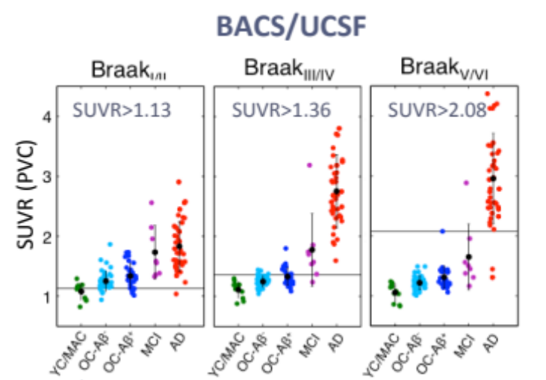
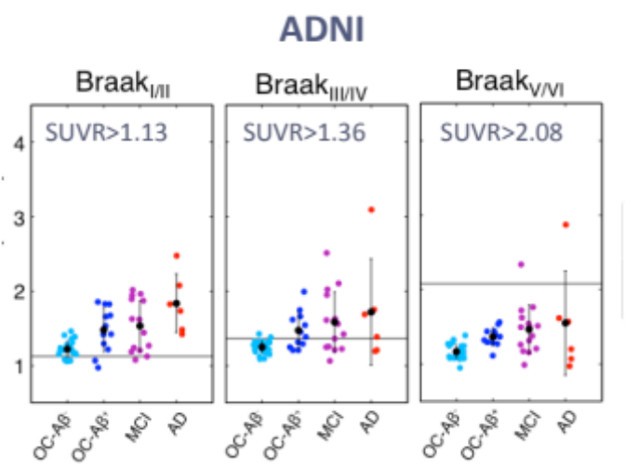
YC/MAC
Young controls/middle aged controls
Mean Age = 39
OC
Old controls (Aβ+ and Aβ-)
Mean age = 78
MCI Mean age = 70
AD Mean age=63
AD
Old controls (Aβ+ and Aβ-)
Berkeley/UCSF
Higher cortical uptake in younger UCSF AD patients
OC
Mean age = 73
MCI
Mean age = 80
AD
Mean age = 80
ADNI

Slide 5
IMPLICATIONS
We are still in the early days of tau PET.
These finding emphasize the importance of ADNI. The only large observational study using tau PET, in which data and biosamples are widely shared
Is it possible that lack of anti AB treatment effects in LOAD are due to mixed pathology?

Slide 6
HIGHLIGHTS FROM DOD ADNI
INCIDENCE OF MCI
(Total 174 participants)
Healthy Controls 3%
PTSD subjects 15%
TBI subjects 10%
PTSD+TBI subjects 21%

Slide 7
DOD ADNI: Imaging and CSF Results
 | Control | TBI | PTSD | TBI &PTSD
Hippocampal volume (% of ICV) | 52 0.51 (0.06) | 16 0.52 (0.05) | 37 0.53 (0.06) | 15 0.51 (0.08)
WMH | 58 5.6 (5.5) | 19 5.0 (5.3) | 53 4.3 (3.7) | 25 4.5 (5.0)
AV45 (Berkeley) | 55 1.07 (0.14) | 24 1.08 (0.18) | 56 1.02 (0.08) | 29 1.08 (0.16)
CSF A-beta | 27 218.7 (53.9) | 10 222.7 (56.7) | 24 237.6 (29.6) | 7 229.5 (41.2)
CSF Tau | 26 54.7 (27.0) | 10 45.8 (9.4) | 24 46.4 (16.8) | 7 44.4 (13.7)
CSF pTau | 27 32.1 (22.1) | 10 26.0 (6.7) | 24 27.7 (13.6) | 6 36.1 (20.6)
MS A-beta 42 | 37 1091.8 (412.7) | 15 1148.9 (487.0) | 43 1412.9 (517.4) | 20 1305.6 (533.3)
MS A-beta 40 | 37 7326.5 (2469.1) | 15 7404.3 (1695.9) | 43 8039.9 (2890.7) | 20 7721.9 (2306.8)
MS A-beta 38 | 37 1627.9 (532.8) | 15 1726.5 (396.1) | 43 1801.6 (633.6) | 20 1712.1 (531.9)
Sample size and mean (standard deviation) is presented, due to differences in processed scans/samples across labs. Control refers to those with neither TBI nor PTSD. Hippocampal volume is generated using FreeSurfer from the Weiner lab. WMH is white matter hyperintensities from the DeCarli lab. AV45 (Berkeley) is the summary SUVR measure from the Jagust/Landau lab.

Slide 8
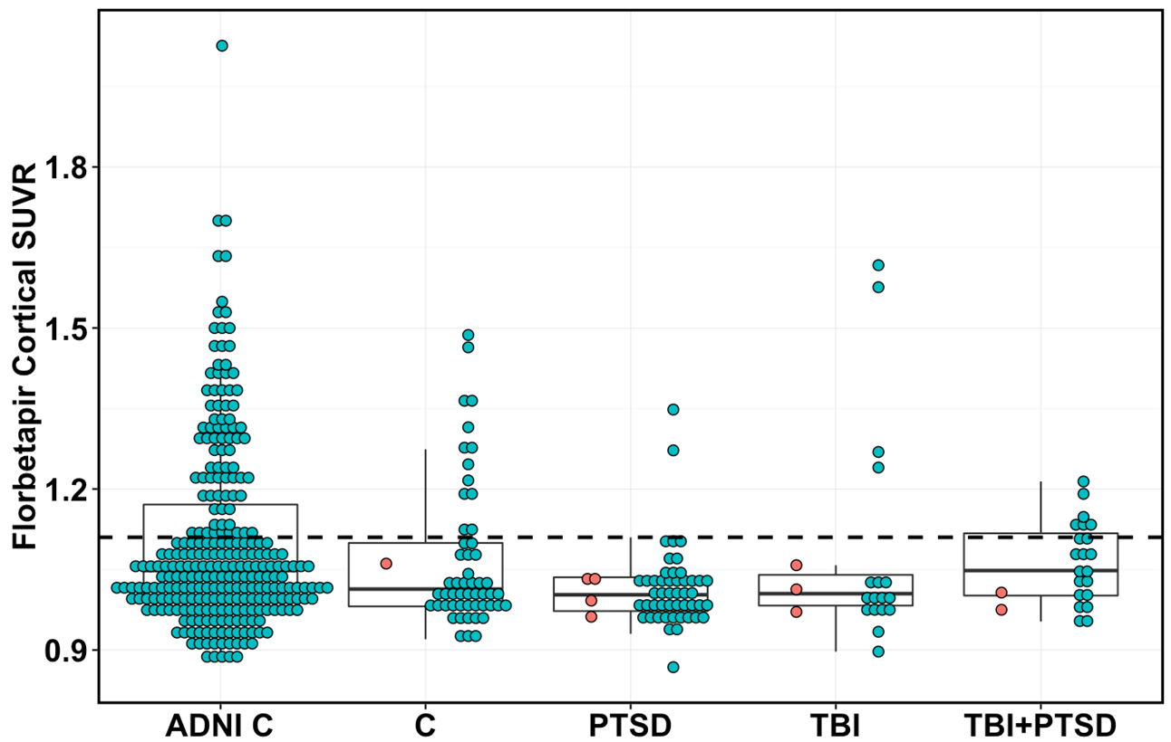
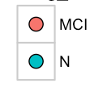
MCI
Normal
80/266 AV45+
(30%)
13/54 AV45+
(24%)
3/52 AV45+
(6%)
4/20 AV45+
(20%)
6/23 AV45+
(26%)
266
75.6
26%
54
70.6
28%
52
67.7
27%
20
67.5
37%
23
68.1
38%
N
Age
% ApoE4+
Total N
149

Slide 9
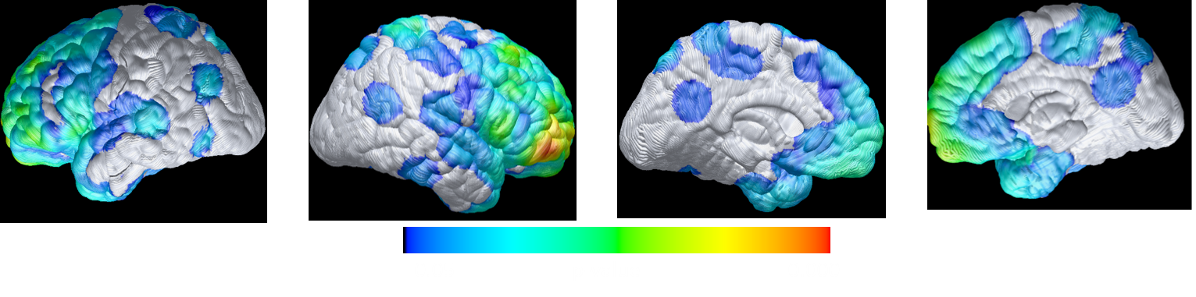
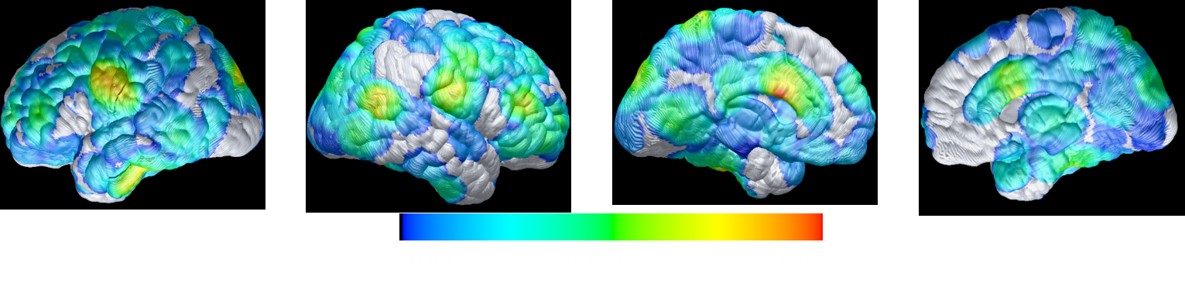
Lower Florbetapir SUVRs in cognitively impaired PTSD Subjects (n=43) than in controls (n=47) , p=0.05 uncorrected (Kewei Chen, Eric Reiman, Banner Inst)
1
Lower Florbetapir SUVRs in in CU PTSD Subjects with SSRI Use (n=16) than in CU PTSD Subjects without SSRI Use (n=27) p=0.05 uncorrected
1
All analyses were w/ Age, Education, APOE status and MMSE corrected, but findings remained w/o.
Monte Carlo simulation (N=1000) showed that # of voxels in the displayed direction is significantly greater than # of voxels in the opposite direction (p<0.001).

Slide 10
ACCOMPLISHMENTS OF ADNI
Validation of “amyloid phenotyping”
Longitudinal study of CN and MCI for many years
Large scale longitudinal tau PET
Improved CSF analysis: leading to clinical use
Over 1200 publications from ADNI
Data widely used for design of AD clinical trials

