Slide 1
MRI WW ADNI 2017
Funded MRI Investigators
Charlie DeCarli – UCD
Nick Fox – UCL
Duygu Tosun – SFVA
Paul Thompson – USC
Paul Yuskevich - Penn
Danielle Harvey – biostats
MR company scientists
Dan Rettmann (Mayo) – GE
Pete Kollasch (Mayo)/Gunnar Kruger (MGH) – Siemens
Yansong Zhao (BU) - Philips
Mayo
Cliff Jack
Bret Borowski
Matt Bernstein
Arvin Forghanian-Arani
Jeff Gunter
Dave Jones
Kejal Kantarci
Rob Reid
Denise Reyes
Matt Senjem
Kaely Thostenson
Prashanthi Vemuri
Chad Ward

Slide 2
ADNI 3 protocol all 3T, all 8 sequences in all subjects (where possible)
3D T1 volume
3D FLAIR
T2* GRE
ASL – 3 possible sequences depending on model
TF-fMRI - advanced and basic versions
Field map
dMRI - advanced and basic versions
Coronal high resolution T2

Slide 3
3D T1: Change from ADNI 2 to 3
ADNI 2
Unaccelerated and 2x accelerated
all platforms
ADNI 3
2x accelerated
All platforms
Slight resolution improvement – 1mm cubed

Slide 4
FLAIR: Change from ADNI 2 to 3
ADNI 2
all platforms
2D FLAIR
1x1x5 mm
ADNI 3
all platforms
3D FLAIR
1x1x2 mm

Slide 5
T2*GRE: Change from ADNI 2 to 3
None
All platforms
Hi res coronal: Change from ADNI 2 to 3
ADNI 2
One vendor
ADNI 3
Minor tune up to parameters
all platforms

Slide 6
ASL: Change from ADNI 2 to 3
ADNI 2
One vendor – Siemens 2D PASL
ADNI 3
all platforms (but must have license)
3D pCASL : GE >15 & Philips 5.3
3D PASL : Siemens VD & VE
2D PASL: Siemens VB, Philips 3X and 5.1
Upgrade schedule
Siemens 3D pCASL ?

Slide 7
dMRI : change from ADNI 2 to 3
ADNI 2 - single vendor, single b=1000 shell
ADNI 3 – all platforms, advanced or basic
basic – single b=1000 shell
advanced, HCP-like: b=500, 1000, 2000; 3X SMS, 6/8 PF
Better FA/MD
Enable NODDI, tractography, cortical hub to hub connectivity , multi tissue compartments
Custom gradient direction set – posted LONI
Compatibility – derive equivalent of basic single b=1000 shell in every subject at no time penalty

Slide 8
TF-fMRI: change from ADNI 2 to 3
ADNI 2 – single vendor, ~ 3 sec TR
ADNI 3 – all platforms, advanced or basic
basic – 10 minute, ~3 sec TR
advanced, HCP-like – 10 min, 600msTR, 8x SMS
More precise measure of time series (temporal resolution)
Less noisy node to node, ICA, graph theory measures
Time varying connectivity metrics
Compatibly advanced and basic ➔ derived basic equivalent

Slide 9
dMRI and TF-fMRI – requirements for advanced
32 or 64 channel head coil
multi band (SMS)
Siemens product VE11C plus SMS license
Philips 5.3 – initial roll out
GE DV 26 – 2017 only dMRI; fMRI SMS?
Consequently, almost all ADNI 3 have started with basic and sites will step up to advanced as systems are upgraded

Slide 10
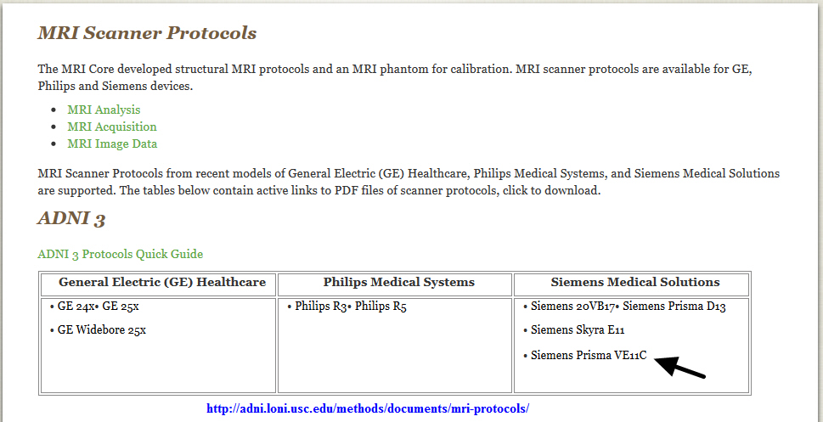
Link to ADNI 3 protocol PDFs: http://adni.loni.usc.edu/methods/documents/mri-protocols/

Slide 11
ADNI-3 MRI Protocols Posters
General overview – Jeff Gunter PhD
AIC: IC-P-137 Saturday, 12:15-13:30
(Poster #18496)
AAIC: P4-242 Wednesday, 12:00-13:00
(Poster # 16551)
Posted to http://adni.loni.usc.edu/methods/documents/mri-protocols/
Diffusion MRI – Rob Reid PhD
AAIC: P3-09 Tuesday, 12:00-13:00
(Poster # 327)

