Slide 1
Arg-ADNI
ADNI annual meeting
AAIC 2017
Presenter: Dr. Patricio Chrem
On Behalf of:
Dr. Prof Ricardo Allegri (PI)
Dr. Gustavo Sevlever
July 14th, 2017

Slide 2
Arg-ADNI
Patients’ Flowchart
2012
2017
Patients Invited to ADNI
Nº= 73
Patients Followed
(Baseline)
Nº= 56
Patients Followed
(1st year)
Nº= 50
Patients Followed
(30 months)
Nº= 43
New Patients Invited to ADNI
Nº= 6
Healthy Controls
Nº= 15
Healthy Controls
Nº= 14
Healthy Controls
Nº= 12
Patients Screened at FLENI
Nº= 60
1 Negativa
1 Negativa
Early MCI
Nº=12
Early MCI
Nº=9
Early MCI
Nº=6
1 Cancer - 1 Negativa
1 Psiquiatrica
1 Negativa
Screening Failure
Nº= 7
Dropout
Nº= 4
Late MCI
Nº= 16
Late MCI
Nº= 16
Late MCI
Nº=15
2 Claustrophobia
1 Psychiatric Disease
1 Cancer
1 Adult ADHD
2 without informant
2 removed inform.cons
1 by distance/caregiver
1 has died (cancer)
1 Negativa
Dementia AD
Nº=13
Dementia AD
Nº=11
Dementia AD
Nº=10
1 Institucionalizada
1 Cancer
1 Negativa
Notes:
2

Slide 3
Arg-ADNI
Drop-out rates
2012
2017
Patients Followed
(Baseline)
Nº= 56
Patients Followed
(1st year)
Nº= 50
Patients Followed
(30 months)
Nº= 43
Drop-out rate 10.7%
Nº= 6
Drop-out rate 14%
Nº= 7

Slide 4
Arg-ADNI
Drop-out circumstances
AD group:
Ocurrence of comorbidities (concomitant diseases)
Moved to nursing-home
HC group:
Loss of interest

Slide 5
Arg-ADNI
News
 | Follow-up 60 months |  |  |  |  | Projected Follow-up
 | Baseline | Follow-up 60 month | NPS Ass | Alz Costs Survey | MRI | CSF Aβ-tau (Optional) | PET PiB | PET-tau AV-1451
Healthy Controls | 15 | 12
Early MCI | 12 | 6
Late MCI | 16 | 15
Dementia AD | 13 | 10
TOTAL | 56 | 43

Slide 6
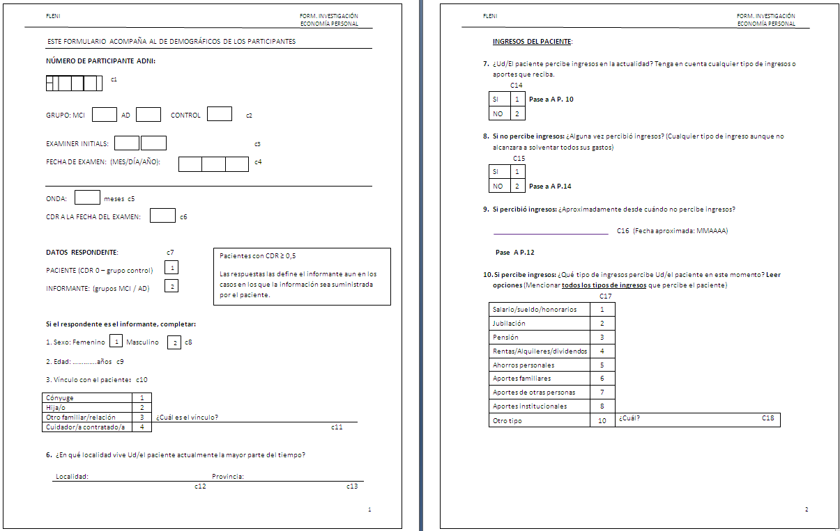
Arg-ADNI
Alz Cost Survey
Objective: to calculate the economical impact of AD into the participant´s family group.
Magariños and cols.

Slide 7
Arg-ADNI
AV-1451
FLENI has received the precursors for manufacturing the TAU-tracer from AVID.
Also has got authorization from AVID for its use in Arg-ADNI protocol.
We are in the process of fulfilling with all pharmaceutical regulatory instances to start trials in humans.
We hope to have the first Tau-PET scan done by August

Slide 8
Arg-ADNI
Results
Baseline
Follow-up
Follow-up
 | Total Nº | NPS Ass | MRI | CSF Aβ-tau | PET FDG | PET PiB | Follow-up 1 year | Follow-up 30 month | Follow-up 60 month
Healthy Controls | 15 | 15 | 15 | 11 | 15 | 15 | 13 | 12 | 3
Early MCI | 12 | 12 | 12 | 7 | 10 | 8 | 10 | 6 | 2
Late MCI | 16 | 16 | 16 | 14 | 16 | 15 | 16 | 15 | 1
Dementia AD | 13 | 13 | 13 | 8 | 12 | 9 | 11 | 10 | 1
TOTAL | 56 | 56 | 56 | 40 (71%) | 53 (95%) | 50 (89%) | 50 | 43 | 7

Slide 9
Arg-ADNI
Future directions
Make the cohort bigger
Inclusion of the Tau-PET scan
Funding:
Arg-ADNI was all funded by FLENI´s Foundation
Our task during 2017: to apply for international grants

Slide 10
Arg-ADNI
Publications
Recent publications
Adding Recognition Discriminability Index to the Delayed Recall Is Useful to Predict Conversion from Mild Cognitive Impairment to Alzheimer's Disease in the Alzheimer's Disease Neuroimaging Initiative. Russo, MJ; Campos, J; Vázquez, S; Sevlever, G; Allegri, RF; Alzheimer's Disease Neuroimaging Initiative. Front Aging Neurosci, 2017 vol. 9 pp. 46
Usefulness of Discriminability and Response Bias Indices for the Evaluation of Recognition Memory in Mild Cognitive Impairment and Alzheimer Disease. Russo MJ, Cohen G, Campos J, Martin ME, Clarens MF, Sabe L, Barcelo E, Allegri RF. Dement Geriatr Cogn Disord. 2017;43(1-2):1-14.
Predicting episodic memory performance using different biomarkers: results from Argentina-Alzheimer's Disease Neuroimaging Initiative. Russo MJ, Cohen G, Chrem Mendez P, Campos J, Nahas FE, Surace EI, Vazquez S, Gustafson D, Guinjoan S, Allegri RF, Sevlever G. Neuropsychiatr Dis Treat. 2016 Sep 13;12:2199-2206.
In development
Argentina Alzheimer’s disease neuroimaging initiative (arg-ADNI): Neuropsychology after one-year follow up. Patricio Chrem Mendez, Ricardo Allegri et al.
Functional assessment in Argentina-ADNI: comparison and diagnostic utility of the Everyday Cognition (ECog) versus Functional Assessment Questionnaire (FAQ). Julieta Russo, Ricardo Allegri et al.

Slide 11
Arg-ADNI
Other ADNI-like studies ongoing in our Center
Dominantly Inherited Alzheimer Network Argentina (DIAN-Arg) since Dec 2015, Site 956:
7 Participants enrolled so far.
16 subjects Interested in participating in DIAN-Arg from 4 ADAD Argentinean families
National Council for Scientific and Technical Research. 3-year grant (PICT2015-2110)
Start-up process of DIAN_TU next generation by 2018
Genetic and Alzheimer's disease biomarker studies in adults with Down syndrome in Argentine population (Start-up process)
National Council for Scientific and Technical Research. 3-year grant (CONICET-PIP 0278)
Validation of UDS Battery for FTD in Spanish in conjunction with the UPenn FTD Center.
FLENI held a PPA symposium during 2016 with the presence of Dr. M. Mesulam and S. Weintraub.

