Slide 1








.
The Australian Imaging Biomarkers and Lifestyle
Study of Ageing
Commenced late 2006

Slide 2
AIBL cohort : Number of assessments
 | 0m | 18m | 36m | 54m | 72m | 90m | 108m | 126m
CN | 1476 | 1034 | 776 | 684 | 523 | 419 | 376 | 219
MCI | 394 | 174 | 107 | 79 | 59 | 34 | 28 | 19
AD | 427 | 286 | 219 | 127 | 68 | 44 | 30 | 6
Other | 17 | 7 | 10 | 12 | 8 | 6 | 3 | 2
Total | 2314 | 1501 | 1112 | 902 | 658 | 503 | 437 | 246
Cumulative Withdrawn |  | 468 | 681 | 838 | 986 | 1066 | 1129 | 1153
% Follow up complete |  | 81% | 68% | 61% | 49% | 40% | 37% | 21%

Slide 3
Progress
Baseline assessment in 2314 subjects with MRI and amyloid PET in 75% but 95% of recruits since 2013.
10.5 year review cycle almost complete.
Amyloid PET and MRI at 0, 18, 38 months then every 3 years
Tau PET – 120 THK5351, 110 AV1451, 25 MK6240 baseline. 80 repeat scans - all AV1451.
CSF in 250 subjects but not serial.
All amyloid scans are now F-18 NAV4694
All tau scans are now F-18 MK6240

Slide 4
Progress
Adding amyloid scan classification to AIBL data on GAAIN.
All amyloid PET results now available in Centiloids.

Slide 5
Conversion Equations
Florbetaben CL = 153.4*SUVr_{sm} – 155
PiB CL = 93.7*SUVr_{sm} – 94.6
NAV4694 CL = 85.3*SUVr_{sm} – 88
Florbetapir CL = 175.4*SUVr_{sm} – 182.3
Flutemetamol CL = 121.4*SUVr_{sm} – 121.2
sm = Standard Centiloid Method using SPM8 and ROI from centiloid site on GAAIN

Slide 6
Current Focus
Blood biomarkers. Collaboration with multiple external parties. Good results from Japanese collaboration (Nakamura A, et al. High performance plasma amyloid-β biomarkers for Alzheimer’s disease. Nature 2018 doi:10.1038/nature25456).
Pooling of data with other large cohorts (academic and commercial initiatives)
Supporting clinical drug trials in preclinical and prodromal AD
Evaluating tau tracers
Genetic (e4, BDNF, aquaporin 4, CLU, KIBRA, polygenic risk scores, etc) and lifestyle (diet, exercise, sleep) analysis
Retinal scans (multispectral; curcumin)
CapAIBL – Automated analysis package for MRI volumes, amyloid and tau PET.
ADNeT, the Australian Dementia Network.

Slide 7
CapAIBL
http://milxcloud.csiro.au
PET only quantification of Amyloid PET images (¹¹C-PiB, ¹⁸F-Florbetapir, ¹⁸F-FDG, ¹⁸F-Florbetaben, ¹⁸F-Flutemetamol and ¹⁸F-NAV4694)
Centiloid quantification for ¹¹C-PiB, ¹⁸F-Florbetaben and ¹⁸F-NAV4694
PDF reports emailed at the end of processing
20 minutes per scan
Supports Dicom upload

Slide 8
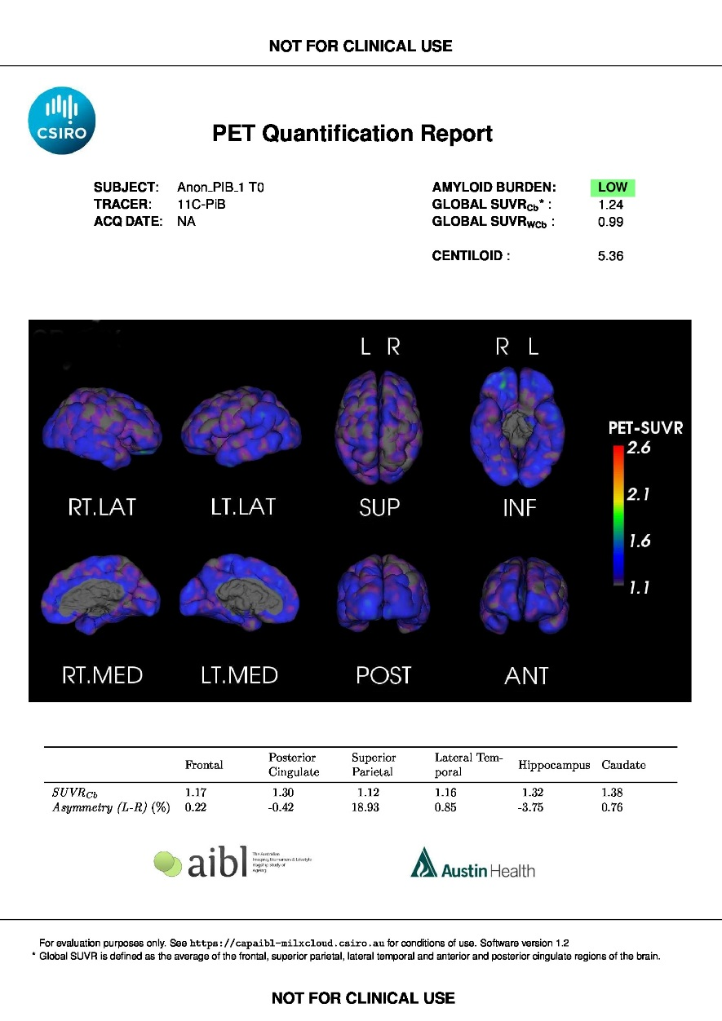
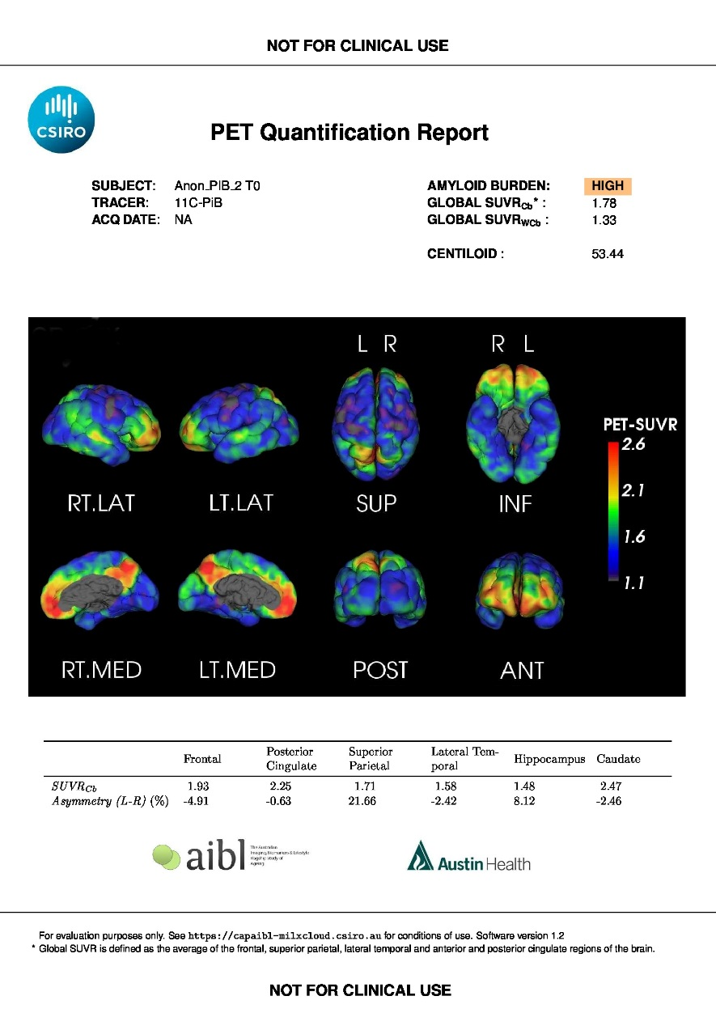
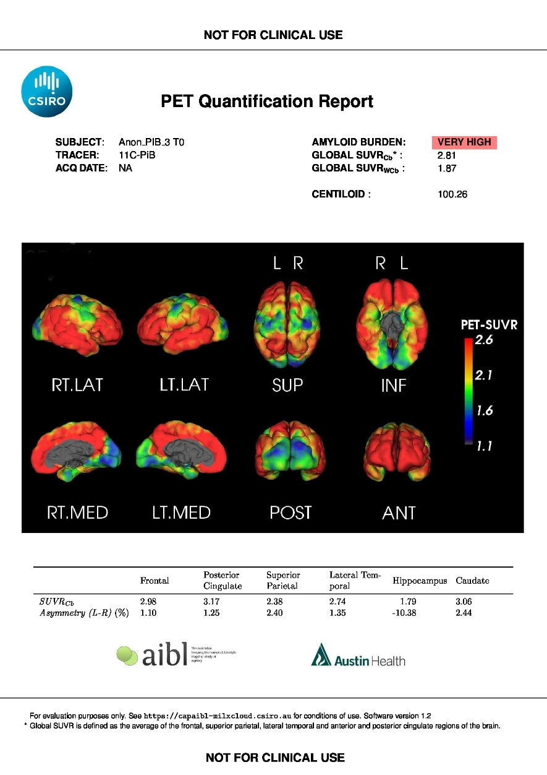
CapAIBL
http://milxcloud.csiro.au

Slide 9
The Australian Dementia Network
$20 million funding over 5 years from July 1, 2018.
Clinical Quality Registry for newly diagnosed dementia or MCI
Memory Clinics – expand, standardize and support
Clinical Trial sites – expand and support
Longitudinal (n=4,000) and Trial ready (n=500) cohorts – blood, MRI, cognition, amyloid and tau PET every 18 months +/- CSF

Slide 10
Problems for AIBL
Funding – will merge with ADNeT
Retaining amyloid positive participants for longitudinal study – most going into drug trials.

Slide 11
Expression of interest for collaboration or more in-depth data access should go to:
Christopher Fowler - AIBL Co-ordinator
christopher.fowler@florey.edu.au

Slide 12










Acknowledgements
AIBL would like to thank the study participants and their families
AIBL Study team
David Ames
Jenalle Baker
Mary Barnes
Kevin Barnham
Shayne Bellingham
Sabine Bird
Julia Bomke
Pierrick Bourgeat
Sveltana Bozinovski (nee Pejoska)
Belinda Brown
Rachel Buckley
Samantha Burnham
Ashley Bush
Lesley Cheng
Steven Collins
Ian Cooke
Elizabeth Cyarto
David Darby
James Doecke
Vincent Dore
Denise El-Sheikh
Michael Fenech
Shane Fernandez
Binosha Fernando
Christopher Fowler
Maxime Francois
Jurgen Fripp
Shaun Frost
Sam Gardener
Simon Gibson
Veer Gupta
David Hanson
Karra Harrington
Andy Hill
Eugene Hone
Maryam Hor
Gareth Jones
Adrian Kamer
Yogi Kanagasingam
Fiona Lamb
Nicola Lautenschlager
Simon Laws
Wayne Leifert
Hugo Leroux
Qiao-Xin Li
Yen Ying Lim
Florence Lim
Lucy Lim
Linda Lockett
Andrea Louey
Kathy Lucas
Lance Macaulay
Lucy Mackintosh
Ralph Martins
Georgia Martins
Paul Maruff
Colin Masters
Simon McBride
Alissandra Mcilroy
Steve Pedrini
Kayla Perez
Kelly Pertile
Tenielle Porter
Stephanie Rainey-Smith
Carolina Restrepo
Malcolm Riley
Blaine Roberts
Jo Robertson
Mark Rodrigues
Christopher Rowe
Rebecca Rumble
Tim Ryan
Olivier Salvado
Ian Saunders
Greg Savage
KaiKai Shen
Brendan Silbert
Harmid Sohrabi
Kevin Taddei
Tania Taddei
Sherilyn Tan
Christine Thai
Philip Thomas
Brett Trounson
Victor Villemagne
Irene Volitakis
Michael Vovos
Larry Ward
Andrew Watt
Mike Weinborn
Rob Williams
Bill Wilson
Michael Woodward
Paul Yates
Ping Zhang
Collaborators
AIBL is a large collaborative study and a complete list of contributors can be found at www.aibl.csiro.au

