Slide 1


ADNI Biomarker Core update
Leslie M Shaw and John Q Trojanowski
WW ADNI meeting
Chicago, July 20, 2018

Slide 2
Summary of ADNI CSF, plasma and serum samples received
as of July 18, 2019
 | CSF | Ser + Pla | TOTAL
ADNI 1 Primary Biofluids Collected | 1118 | 9756 | 10874
ADNI 1 Aliquots in Bank | 24934 | 132581 | 157515
ADNI GO/2 Primary Biofluids Collected | 1318 | 7816 | 9134
ADNI GO/ 2 Aliquots in Bank | 35315 | 114919 | 150234
ADNI 3 Primary Biofluids Collected - Rollover Participants | 118 | 667 | 785
ADNI 3 Primary Biofluids Collected - New Enrollees | 162 | 402 | 568
Total Primary Biofluids Collected | 2716 | 18641 | 21357
ADNI aliquots in Bank | 60249 | 247500 | 307749

Slide 3
Biofluid Samples Sent to Investigators for RARC Approved Studies
Shipment Date | Principal Investigator | Project | Specimen Type | Specimen Number | Data Upload to ADNI/LONI
July 2018 | Robert Nagele, UMDNJ {Autoantibody Array} | Autoantibodies for AD detection | Serum | 406 ADNI1/GO/2 Baseline + longitudinal Samples, 10 replicates | Anticipated Completion Date: 3rd Q 2018
March 2018 | William Hu, Emory University {Immunoassays} | Cytokines/Chemokines | CSF | 388 ADNIGO/2 Baseline + longitudinal Samples, 10 replicates | Anticipated Completion Date: 4th Q 2018
January 2018 | FNIH BC/Caprion Proteome Inc., Washington DC/Montreal, Quebec, Canada {LC/MSMS} | CMGA, NPTX2, VGF, CG2, FABP | CSF | 730 ADNI1/GO/2 CSF Longitudinal Samples, 20 replicates | Anticipated Completion Date: 1st Q 2019
November 2017 | Randall Bateman, Washington University School of Medicine {LC/MSMS} | Aβ42/Aβ40 in FBP+ / FBP- | Plasma | 200 ADNI GO/2 Baseline Plasma Samples, 20 replicates | Anticipated Completion Date: 3rdQ 2018
September 2017 | Carlos Cruchaga, Wash U, and Marc Suarez-Calvert, DZNE, Germany {Immunoassays} | sTREM2 & Progranulin | CSF | 1859 ADNI1/GO/2 longitudinal samples | Date uploaded: 2/23/2018
August 2017 | Henrik Zetterberg, Kaj Blennow, Molndal, Sweden {sensitive immunoassay} | NFL & Tau diagnosis/prognosis | Plasma | 3762 ADNI 1, GO, 2 longitudinal aliquot samples 20 replicates | Anticipated Completion Date: 3rd Q 2018
May 2017 | Jing Zhang, Harborview Medical Center, University of Washington School of Medicine | α-Syn, Tau, ABeta for AD Diagnosis | Plasma | 310 ADNI 1/GO/2 samples 10 replicates | Anticipated Completion Date: end of 3rd Q 2018

Slide 4
ADNI3 Aims for Biomarker Core
Aim 2: Provide highly standardized Aβ₁₋₄₂, t-tau and p-tau₁₈₁ measurements on all ADNI subject CSF samples using the Roche automated immunoassay platform(Cobas e601) and immunoassay reagents. In addition provide immunoassay-independent measurements of Aβ species (Aβ₁₋₄₂, Aβ₁₋₄₀ and Aβ₁₋₃₈) using a validated reference 2D-UPLC/tandem mass spectrometry method in baseline and longitudinal CSF samples. Continue collaboration with other investigators to achieve harmonization of these measurements across centers and different platforms in support of their use in clinical trials.
Change: from manual RUO immunoassay to fully automated immunoassay platform for ADNI 3:
Due diligence: started Q4, 2014, in consultation with ADNI Exec Comm & NIA & PPSB/BBWG/DDWG.
Selection: in consultation with ADNI by Johan LPPSB/BBWG/DDWG, chaired by Johan Luthman.
Roche Elecsys: validation for Aβ₁₋₄₂ in CSF completed.
External QC: Participation in the AlzAssn CSF QC program for Aβ₁₋₄₂
Validation of t-tau and p-tau₁₈₁: completed FALL, 2016
Analyses of all ADNI CSFs: late FALL, 2016-early WINTER, 2017
All ADNIGO/2 CSFs by validated LC/MSMS for Aβ42, Aβ40, Αβ38: uploaded 2018
Continued collaboration: with the GBSC/ AlzAssn and IFCC CSF WGs to produce certified reference CSF pools with assigned reference Aβ₁₋₄₂ concentration values, measured with reference 2D-UPLC/tandem mass spectrometry, to provide certified reference materials for validation of Aβ₁₋₄₂ calibrators--promoting harmonization across assay platforms. Completed late 2017, discussion/planning for harmonization across platforms by an Alz Assn pre-analytical consortium.
Review & participate in: studies of pre-analytical factors for CSF collection.

Slide 5
Analyses of ADNI1/GO/2 CSF Aβ₁₋₄₂, t-tau, p-tau₁₈₁ using the Roche Elecsys fully automated immunoassay platform
At our previous ADNI meetings the following were described.
Rationale for moving from RUO to full automation
Validation of Aβ₁₋₄₂ for precision, accuracy, and clinical performance
General statistics for Aβ₁₋₄₂, t-tau, p-tau₁₈₁, t-tau/Aβ₁₋₄₂, p-tau₁₈₁/Aβ₁₋₄₂ in the ADNI1/GO/2 CSF samples
Histogram distributions for Aβ₁₋₄₂, t-tau/Aβ₁₋₄₂, p-tau₁₈₁
Distributions based on FBP amyloid-β PET + or –
Precision performance with an abnormal CSF pool; lot P09 comparison with lot P07
Cut-point determinations
Collaborative study with BioFINDER:
Concordance with FBP (ADNI), flutemetamol (BioFINDER) amyloid-β PET,
Prediction of cognitive decline(eg, CDRsob)
Prediction of progression to dementia
Assessments of the contribution of CSF t-tau and p-tau₁₈₁ to the clinical utility of CSF Aβ₁₋₄₂ using A|T & add (N)
Analyses of all DIAN samples and a re-analysis of a sub-set of ADNI CSFs as part of the joint study with DIAN-study includes Aβ40 – statistical analyses underway
1st Batch analysis of ADNI3 CSFs(New & Rollover participants): planned for October 2018

Slide 6
Analyses of ADNI1/GO/2 CSF Aβ₁₋₄₂, Aβ₁₋₄₀, Aβ₁₋₃₈ using validated LC/MSMS
1,445 CSF samples: all ADNIGO/2 BASELINE and at least 2 longitudinal ADNI CSFs including some ADNI1 carryovers
Completed analyses in 615 DIAN CSFs as part of the collaborative study between ADNI and DIAN
Have begun to characterize the ADNI CSF data including the comparison of Aβ42/Aβ40 ratio compared to Aβ42 alone for:
Concordance with FBP amyloid-β PET: 89%(ratio) vs 83% (Aβ42), Korecka etal
Prediction of cognitive decline
Prediction of progression to AD dementia in MCI participants
In the A|T paradigm for predictive performance

Slide 7
Analysis of 2401 ADNI1/GO/2 CSF samples
2401 (1221 BASELINE + 1180 longitudinal) ADNI pristine CSFs, collected from 9/7/2005 to 7/25/2016 were analyzed in 36 analytical runs on the Roche Elecsys platform at UPenn from 11-17-2016 to 1-20-2017:
ADNI Phase | HC | SMC | EMCI | LMCI | AD | Total
 | 1221 BASELINE ADNI CSFs
ADNI 1 | 112 | -- | -- | 192 | 98 | 402
ADNIGO/2 | 160 | 96 | 277 | 154 | 132 | 819

Slide 8
Analyses of ADNI1/GO/2 CSF Aβ₁₋₄₂, t-tau, p-tau₁₈₁ using the Roche Elecsys fully automated immunoassay platform
In order to further address the question of what does CSF p-tau₁₈₁ add to the clinical utilities of CSF Aβ₁₋₄₂ we describe the following analyses for the ADNIGO/2 EMCI+MCI participants:
Stratify into 4 sub-groups using Aβ₄₂ and p-tau₁₈₁
Amyloid plaque burden +/- represented by Aβ₄₂+ or – : [Aβ+ or Aβ-]
Tau pathology +/- represented by p-tau₁₈₁+ or - : [p-tau+ or p-tau-]
As a pilot study, do the same thing except substitute Aβ42/Aβ40 ratio + or - for Aβ+ or Aβ- respectively using newly completed LC/MSMS analysis data
Use the cut-points described previously to determine + or – status for each biomarker.
Test the hypothesis that having both Aβ+ & ptau+ [ie, Aβ+|ptau+] is associated with much greater rates of cognitive, functional and memory decline as compared to having only one of the two pathologic states [ie, Aβ+|ptau- or Aβ−|ptau+].
Test the hypothesis that the least cognitive decline is associated with both classes of CSF biomarker being negative.
Test this also for risk for progression from a diagnosis of MCI to a diagnosis of AD dementia.
Move on to A|T|(N) : N (examples-HV, FDG PET, others possible (NIA-AA Framework)

Slide 9
Cox proportional-hazards analyses: comparisons across CSF t-tau(+ or-) combined with Aβ42 (+ or -) ± FDG PET
A|T|(N): NIA-AA Framework,
Jack etal
FDG PET cutpoint: 1.21 SUVR,
Landau & Jagust

Slide 10
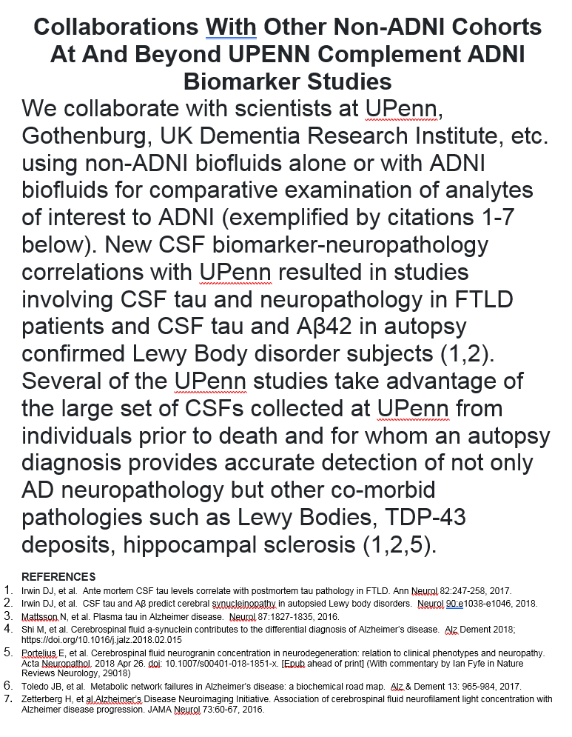

Slide 11
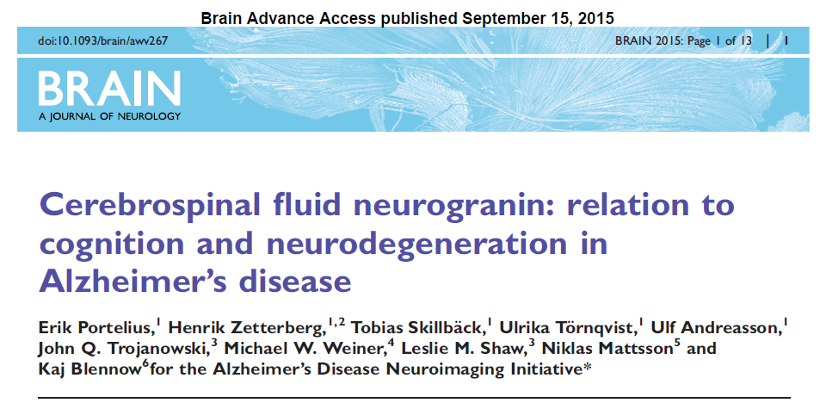
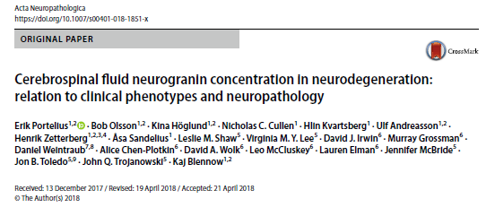
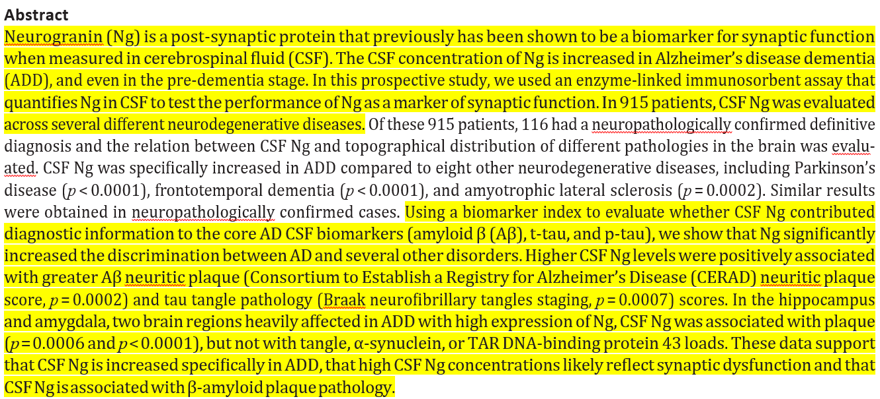

Slide 12
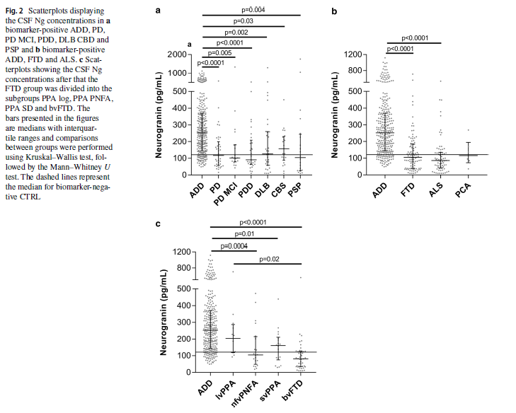
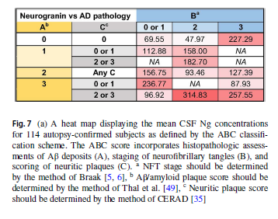

Slide 13
ACKNOWLEDGEMENTS
Biomarker Research Lab
Magdalena Korecka
Michal Figurski
Magdalena Brylska
Teresa Waligorska
Leona Fields
Jacob Alexander
Ju Hee Kang
CNDR/ADRC
John Trojanowski
Virginia M-Y Lee
Steve Arnold
David Irwin
Murray Grossman
Jon Toledo
Alice Chen-Plotkin
William Hu
Anne Fagan
Kaj Blennow
Henrik Zetterberg
Douglas Galasko
Chris Clark*
Hugo Vanderstichele
Manu Vandijck
John Lawson
Udo Eichenlaub
Tobias Bittner
The Roche team
*Deceased
Robert Dean
Holly Soares
Adam Simon
Eric Siemers
Piotr Lewczuk
William Potter
Rand Jenkins
Erin Chambers
Supported by the NIH/NIA & families
of our patients
MJ Fox Fdn for PD research
ADNI investigators include: (complete listing available at www.loni.usc.edu\ADNI\ Collaboration\ADNI_Manuscript_Citations.pdf

