Slide 1
Initial Looks at ADNI3 and Analysis Update
Laurel Beckett, Danielle Harvey, and Naomi Saito, UC Davis Michael Donohue, USC
University of California, Davis labeckett@ucdavis.edu
20 July 2018
Biostatistics Core for WW-ADNI, 2018

Slide 2
Disclosures
Work presented here was funded in part by: U19AG024904 (Weiner) - ADNI parent grant
P30AG010129 (DeCarli) - UC Davis Alzheimer’s Disease Center
Biostatistics Core for WW-ADNI, 2018

Slide 3
Biostatistics Core goals:
Integrate data from all Cores to study implications for clinical trial design:
Compare candidate biomarkers and clinical measures for potential at baseline for inclusion/ exclusion, stratification, adjustment.
Compare candidate biomarkers and clinical measures for potential as outcome measures of change in clinical trials.
Assess relationship of changes among biomarkers and clinical measures.
Characterize sequence of changes, especially in preclinical and early stages.
Identify important subgroups in MCI.
Biostatistics Core for WW-ADNI, 2018

Slide 4
What’s new from the Biostatistics Core
ADNI3 is still mostly cross-sectional data, so we can’t look at prognosis yet.
Looking at new measures: e.g. Financial Capacity Instrument. Multiple amyloid measures: how do they compare?
Continuing to wrap up analysis of earlier ADNI phases.
Biostatistics Core for WW-ADNI, 2018

Slide 5
A new measurement: Financial Capacity Instrument
Financial Capacity Instrument (FCI), 37 items, covering 5 domains: Mental calculation (2 items)
Financial conceptual knowledge (4 items) Single checkbook/ register task (10 items) Multiple checkbook/ register task (14 items) Bank statement task (7 items)
We have taken a preliminary look at the FCI on the first 384 participants (245 CN, 114 MCI, 25 AD).
Biostatistics Core for WW-ADNI, 2018

Slide 6
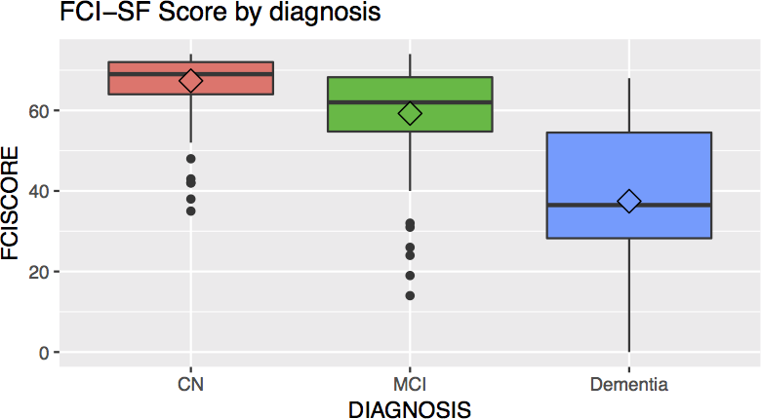
FCI results: Total score by diagnosis group
Shows expected pattern with AD much worse. MCI appears closer to NC.
Biostatistics Core for WW-ADNI, 2018

Slide 7
Are MCI closer to AD than to NC in some domains than others?
We did ANOVA, then scaled all distances from NC to AD as 1.0.
Domain | NC to MCI | MCI to AD
Mental calc | 0.25 | 0.75
Financial knowledge | 0.29 | 0.71
Single checkbook | 0.28 | 0.72
Multiple checkbook | 0.25 | 0.75
Bank Statement | 0.31 | 0.69
Overall, MCI scores are about 25-30% of the way to the AD group.
Biostatistics Core for WW-ADNI, 2018

Slide 8
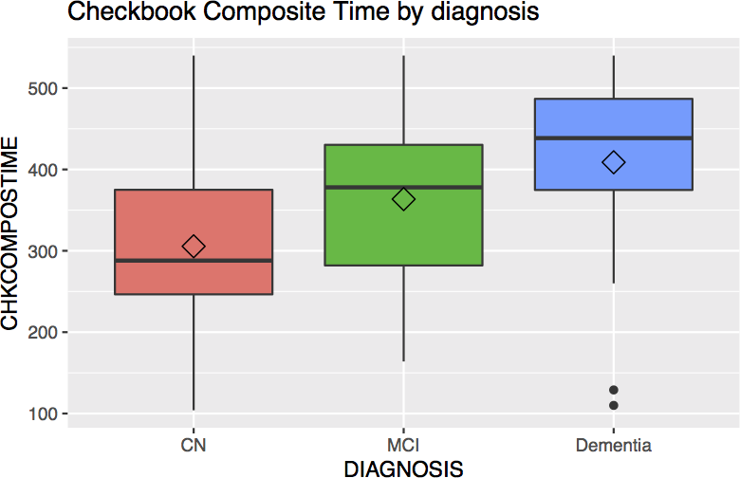
Timed performance on financial tasks
MCI about 56% of the way toward the AD group on time. They can still do some tasks but slower.
Biostatistics Core for WW-ADNI, 2018

Slide 9
Ranking of performance across domains: Mallows model
A first look at whether individuals vary in which domains have more problems.
We converted each domain score to a percent of maximum possible.
We ranked the percent scores within each individual from best to worst (ties scored as mean of possible ranks.)
We fitted a simple Mallows model to estimate most common ranking and how commonly variations occurred.
Biostatistics Core for WW-ADNI, 2018

Slide 10
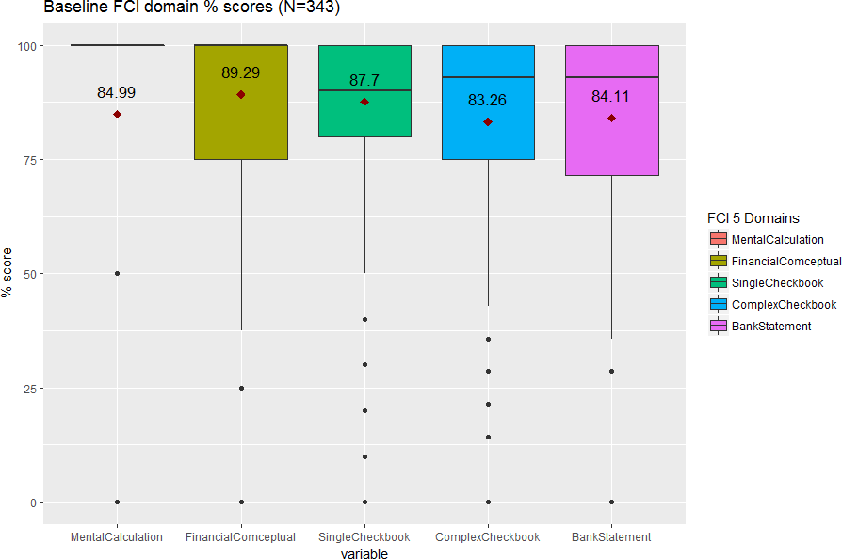
Percent of maximum score by domain
The overall picture looks pretty similar across domains! Looking at rankings within individual may tell us more.
Biostatistics Core for WW-ADNI, 2018

Slide 11
Basic Mallows model results for FCI (very preliminary!)
The most common sequence, best performance to worst, was:
Mental calculation
Financial conceptual knowledge Single checkbook/ register task Bank statement task
Multiple checkbook/ register task
Every pairwise adjacent switch dropped the proportion of participants with that ranking about 25%.
Biostatistics Core for WW-ADNI, 2018

Slide 12
Amyloid measures: AlzBio3, Roche, Florbetapir
We are interested in the relationship among current measures of amyloid status:
AlzBio3: immunoassay of CSF amyloidβ₁₋₄₂, U Penn Elecsys: Immunoassay of CSF amyloidβ₁₋₄₂, Roche Florbetapir: [¹⁸F]florbetapir PET uptake summary measure.
Some longitudinal data are just becoming available, but we focus here on cross-sectional.
Biostatistics Core for WW-ADNI, 2018

Slide 13
Data analysis:
Roche and Florbetapir values were first log-transformed.
We switched the direction of Florbetapir measure so that all 3 would have lower values corresponding to worse.
All 3 measures were normalized after this to have mean 0, standard deviation 1.
Biostatistics Core for WW-ADNI, 2018

Slide 14
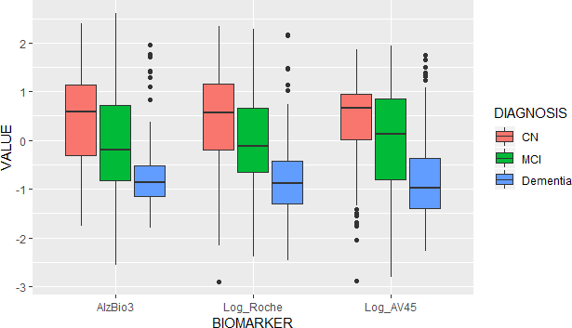
Clinical diagnosis group differences (cross-sectional)
All 3 measures have a few AD with normal amyloid. Florbetapir has a few CN with bad amyloid.
Biostatistics Core for WW-ADNI, 2018

Slide 15
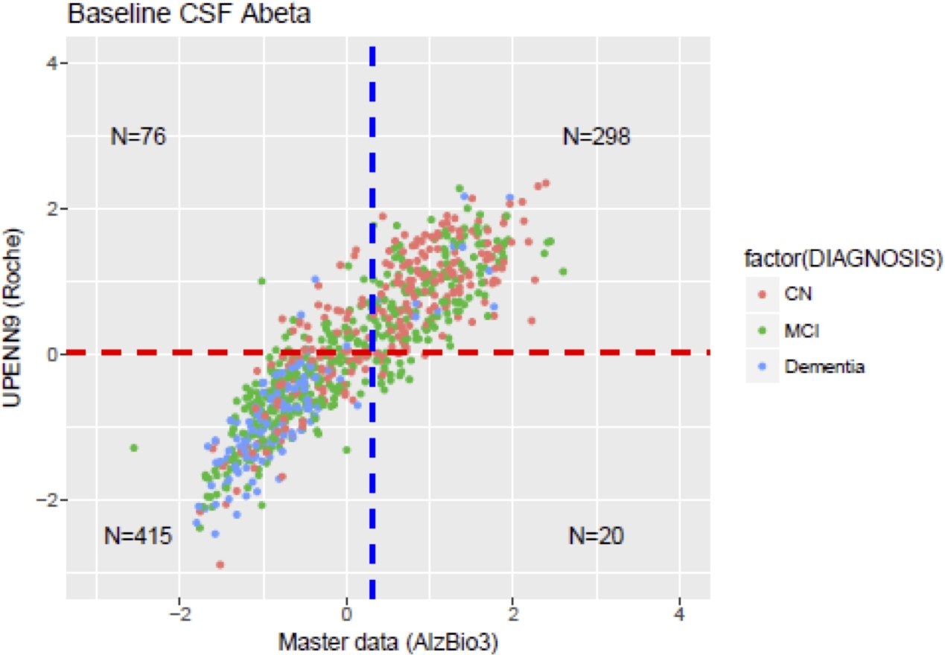
CSF measure relationship (cross-sectional)
Original cutpoints transformed to 0-1 scale.
Biostatistics Core for WW-ADNI, 2018
15 / 22

Slide 16
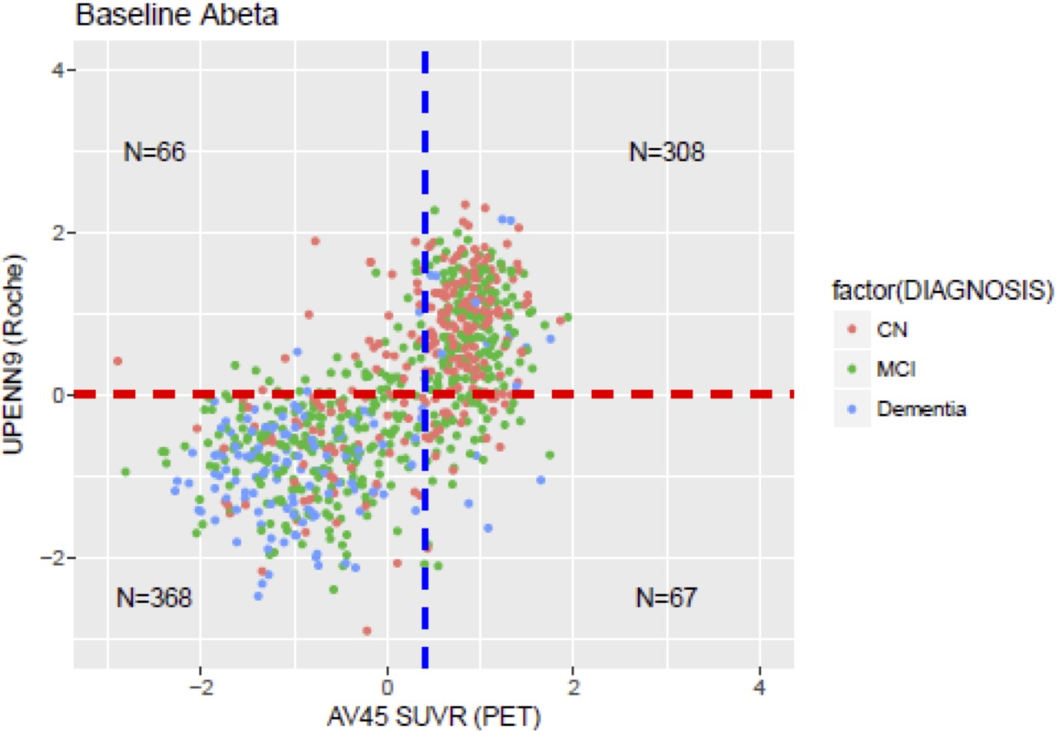
CSF - PET imaging relationship (cross-sectional)
Cutpoints again transformed to 0-1 scale. Maybe nonlinear?
Biostatistics Core for WW-ADNI, 2018

Slide 17
Other activities: finishing analyses of ADNI2 data
Example: “Added value" of baseline imaging and fluid biomarkers to predicting cognitive decline just with baseline cognitive and clinical measures in MCI.
Results similar to ADNI1.
FDG PET adds substantial value to predict greatest rates of decline.
New: AV45 amyloid PET adds comparable predictive value. CSF biomarkers add value, not quite as much as PET. Volumetric predictors add minimal value.
Biostatistics Core for WW-ADNI, 2018

Slide 18
Other activities: Collaborations
Joint work with Takeshi Iwatsubo and Japan-ADNI, comparison with ADNI: to appear in Alzheimer’s and Dementia.
Collaboration with John Morris and DIAN team: comparison of DIAN disease onset and progression with ADNI.
Selection of ADNI participants for comparison study
Alignment of time scales to allow comparison despite 30+ year age difference.
More from John Morris a little later.
Biostatistics Core for WW-ADNI, 2018

Slide 19
Other activities: ATRI biostatistics team
Submitted ADNI3 predictions to the tadpole.grand-challenge.org Manuscript in preparation – joint mixed effect models + random forests
Submitted to Alzheimer’s and Dementia: Diagnosis, Assessment and Disease Monitoring pi4cs.org/qt-pad-challenge modeling challenge
Risk Based Monitoring tool development
Biostatistics Core for WW-ADNI, 2018

Slide 20
ADNI3 updates to Biostatistics Core website
The Core interacts with many biostatisticians and other quantitative researchers from academia and industry who are interested in using ADNI data. We have developed updates to our portion of the website to help investigators navigate the database, cope with changes in data acquisition, and work with data files. Sections include:
Frequently used ADNI data tables, Common issues working with ADNI tables, Installing ADNIMERGE packages, Biostatistics Core news.
Biostatistics Core for WW-ADNI, 2018

Slide 21
Contributors and Collaborators
Thank you to our many students and collaborators! Jingxuan Yang, graduate student, Biostatistics.
Mike Donohue, PhD (USC); Danielle Harvey, PhD, Naomi Saito, MS, and Yueju Li, MS (UC Davis): the ADNI Biostatistics Core team
Mike Weiner and all the ADNI investigators and participants
Biostatistics Core for WW-ADNI, 2018

Slide 22

Thank you!
More adventures to come!
Questions?
Biostatistics Core for WW-ADNI, 2018

