Slide 1

Update of China-ADNI
Kuncheng Li, MD. PhD.
Dept. of Radiology, Xuanwu Hospital,
Capital Medical University Beijing:100053,
Email: cjr.likuncheng@vip.163.com
WW-ADNI 2018, Chicago, U.S.
Notes:
Dear Chair, colleagues, goodmorning! I am Kuncheng Li, from Beijing. on behalf of China-ADNI to report our progress.

Slide 2
Outline
General information of China-ADNI
Progress of the China-ADNI
Notes:
The report have two parts. Part one is to introduce general information of China-ADNI.

Slide 3
China-ADNI
Scientist advisory board
Administration committee
PI: Prof. Kuncheng Li, CMU
CO-PI: Prof. Jun Wang, BJU
CO-PI: Prof. Hongzheng Wang, BUMC
Clinical core
Liyan Qiao
MRI core
Kuncheng Li
PET core
Fang Li
Patholoy core
Cuidi Wang
Biomarker and Genetics Core
Jun Wang/Yan Zhang
Biostatistics and Informatics core
Li Wang
DATA Post process
Core
Yong Fang
Notes:
Although officially joined WW-ADNI only 7 years of history, but we have made the gradual progress. China-ADNI have a scientist advisory board, clinical, MRI, PET, pathology, biomarker and genetics, biostatistics and informatics, and data post process core. PI is me, kuncheng Li, and Jun Wang, Hongzhen Wang are co-PI. After more than four years running, the workflow among different core became more smoothly.

Slide 4
Initial plan of China-ADNI
800-1000 subjects (80 sites)
Normal | Early MCI | Late MCI | Mild AD
200-250 | 200-250 | 200-250 | 200-250
Notes:
The initial plan of China-ADNI is to collect 800-1000 subject that includes volunteer as normal control, early and late MCI, mild AD four groups.

Slide 5
Research plan
Neuropsychological battery
Biomarkers:
Blood: ApoE gene polymorphism, Amyloid
40, 42, and tau
CSF: Amyloid 40,42 and tau
MRI: Multimodal
PET: ¹⁸F-FDG
¹⁸F-AV-45
Notes:
This is research plan: We have to collect the data of neuropsychological battery, APOE gene polymorphism, Amyloid 40,42 and tau in blood and amyloid 40,42, and tau in CSF. Imaging examination including multimodal MRI，¹⁸F-FDG PET, and AV45 amyloid imaging.

Slide 6
Outline
General information of China-ADNI
Progress of the China-ADNI
Notes:
The second parts of the report is the progress of the China-ADNI over the past year.

Slide 7
Enrolled Subjects
62 new subjects enrolled in the past 1 year
Normal | MCI | AD
12 | 21 | 29
Notes:
we have collected 62 new subject in the past 12 months, so total of 146 cases in China-ADNI.

Slide 8
Neuropsychological battery
Screening: MMSE, LM-I, LM-II, GDS, CDR，Hachinski
  Baseline: ADAS-Cog，CWRT，MoCA, BNT, Rey AVLT(30’
  Delay), Category fluency, Trial making test A&B,NPI, FAQ
  6 month: MMSE, CDR, MoCA, ADAS-Cog，E-cog,BNT, Rey
  AVLT(30’ Delay), Category fluency, Trial making test A&B,
  NPI, FAQ
  12 month,24 month 36 month: MMSE, LM-I, LM-II,DR,ADAS-
  Cog, E-cog, Rey AVLT(30’ Delay), MoCA,Category fluency
  Trial making test A&B,BNT, NPI , FAQ
Notes:
Neuropsychological tests completely follow WW-ADNI‘s plan. Including screening, baseline, and follow-up test.

Slide 9
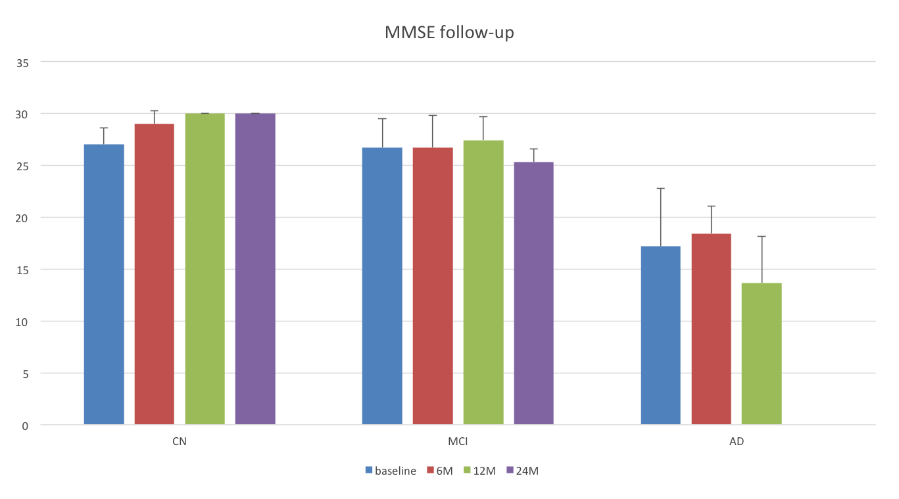
MMSE examination follow-up
Notes:
The average MMSE score of normal volunteers after 2 years follow-up was almost of full score. The average MMSE score of MCI slight increase after one year, then decrease at two years later. The changing trend of AD is the same as that of MCI

Slide 10
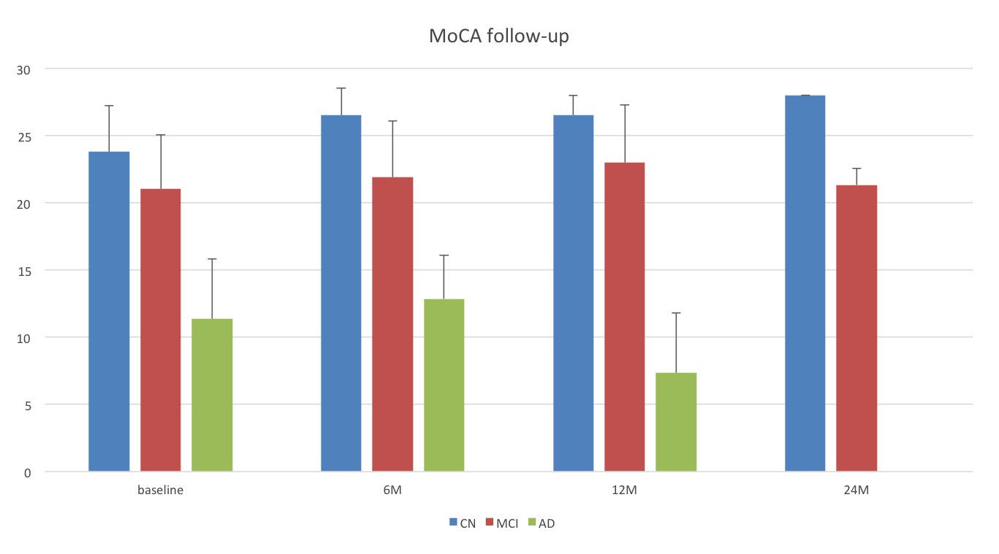
MoCA examination follow-up
Notes:
The average MoCA score are no significantly change in NC, and MCI during the two years follow-up, however, decreased. in AD. AD group only have a years follow-up.

Slide 11
MRI Study
Standard protocol for MRI scanning
Quality control among different sites
Improve the post-processing methods
Notes:
We have performed standard protocol for MRI scanning according to the WW-ADNI guideline, and implement quality control among different sites, and improve the post-processing methods.

Slide 12
Scanning protocol of MRI
3D T₁ volume
Diffusion tensor imaging
Resting state fMRI
Arterial spin labelling
Susceptibility weighted imaging
Notes:
Scanning protocol of MRI is including 3D-T1 volume, DTI, rs-fMRI, ASL perfusion and SWI of brain.

Slide 13
Local-to-remote cortical connectivity in aMCI
a novel rs-fMRI connectome index, regional functional
homogeneity on the 2-dimensional cortical surface,
to detect full-cortex vertex-wise changes of the local
rs-fMRI connectivity
seed based functional connectivity to explore the
remote rs-fMRI connectivity
Zhang et al. Neurobiology of Aging,2017,56:138-149
Notes:
We perform cortical connectivity analysis, including local and remote rs-fMRI connectivity.

Slide 14
Local-to-remote cortical connectivity in aMCI
Significantly lower local connectivity in default mode network and higher local connectivity in the somatomotor network observed in aMCI.
Abnormal remote connectivity was primarily detectable within the default mode network as decreased however, increased in the somatomotor and attention networks.
Abnormalities in the remote default mode network connectivity were significantly associated with episodic memory performance in patients.
Notes:
We found that significantly lower local connectivity in default mode network and higher local connectivity in the somatomotor network observed in aMCI.Abnormal remote connectivity relevant to local connectivity was primarily detectable within the default mode network as decreased however, increased in the somatomotor and attention networks.
Abnormalities in the remote default network connectivity were significantly associated with episodic memory performance in patients.

Slide 15
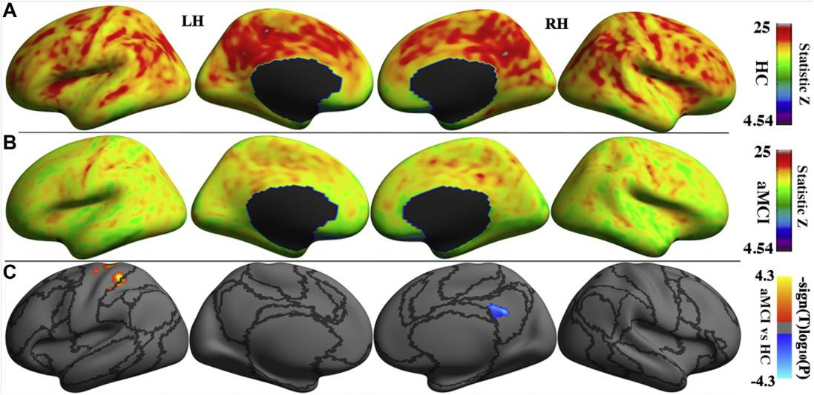
Reduced local synchronization in aMCI was located in the default mode network (right posterior cingulate cortex), and the increased local synchronization mainly occurred in the somatomotor network (left precentral sulcus and postcentral sulcus.
Notes:
Reduced local synchronization in aMCI was located in the default mode network (right posterior cingulate cortex), and the increased local synchronization mainly occurred in the somatomotor network (left precentral sulcus, and postcentral sulcus).

Slide 16
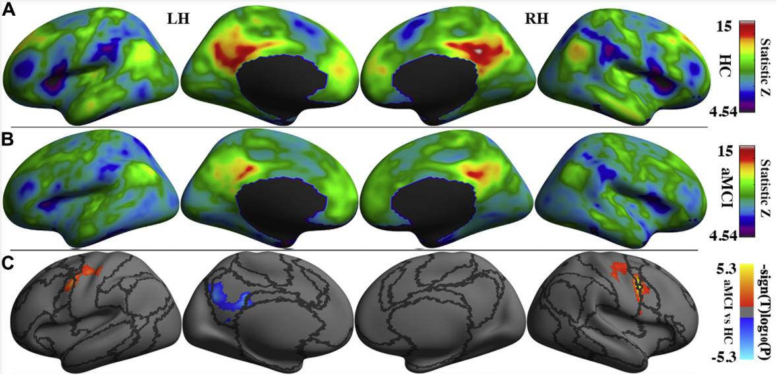
aMCI patients showed decreased remote seed-based functional connectivity between the right posterior cingulate cortex and left posterior cingulate cortex/precuneus and enhanced seed-based remote functional connectivity between right posterior cingulate cortex the bilateral central sulcus and right precentral gyrus.
Notes:
aMCI patients showed decreased remote seed-based functional connectivity between the right PCC and left PCC/precuneus and enhanced seed-based remote functional connectivity between right posterior cingulate cortex, the bilateral central sulcus and right precentral gyrus

Slide 17
3D-ASL evaluation of AD
Decreased rCBF was observed in a series of
cerebral cortex, including bilateral HP, PCC,
fronto-temporal cortex, especially in the right PCC
Abnormal perfusion in AD may be an significant
biomarker in the early diagnosis
Notes:
The 3D-ASL was used for evaluation of AD, we found that decreased rCBF in a series of cerebral cortex, including bilateral HP, PCC,fronto-temporal cortex, especially in the right PCC. Abnormal perfusion in AD may be an significant biomarker in the early diagnosis.

Slide 18
Epidemiological Investigation in Underdeveloped Area (Liupanshui)
501(M 275, F 226), 51~82 years (61.4±7.2)
illiteracy 286 (57.1%)
primary school education 175 (34.9%)
junior high school 40 (8.0%)
senior high school and above 0
Notes:
We have a epidemiological investigation in backward and poor areas in Liupanshui, 501 middle and old aged people were investigated, average age 61.4±7.2 years，among them illiteracy people was 57.1%,primary school education was 34.9%,junior high school was 8.0%,and no person educational level was higher than senior high school.

Slide 19
Incidence rate of cognition impairment in different gender
gender | No. | Cognition impairment patients
M | 275 | 39（13.1%）﹡
F | 226 | 79（35.0%）
Total | 501 | 118（23.6%）
Incidence rate of cognition impairment in different age level
age（year） | No. | Cognition impairment patients
50~ | 222 | 49（22.1%）﹡
60~ | 214 | 51（23.8%）﹡
70~ | 54 | 13（24.1%）﹡
80~ | 11 | 5（45.5%）
Notes:
There were 23.6% people with cognition impairment and more women than men. The people under 80 years old suffered from cognitive impairment is 22.1%～24.0%, and those over 80 years old is up to 45.5%

Slide 20
Incidence rate of cognition impairment in different degree of education
Degree of education | No. | Cognition impairment patients
illiteracy | 286 | 94（32.9%）
primary School | 175 | 22（12.6%）﹡
junior high school | 40 | 2(5.0%)﹡
Incidence rate of cognition impairment in different annual family income
Annual family income (ten thousands yuan) | No. | Cognition impairment patients
<1 | 59 | 29（49.12）
<3 | 215 | 53（24.7%）﹡
<5 | 174 | 33（19.0%）﹡
<10 | 52 | 3（5.8%）﹡
>10 | 1 | 0（0%）﹡
Notes:
The lower level of education, the higher the proportion with cognitive impairment, The lower annual household income, the higher the proportion with cognitive impairment suffered.

Slide 21
Traditional Chinese Medicine in AD
Four-gate acupuncture could slow down the
progress of perfusion deficit in AD and MCI
by ASL perfusion MRI
Traditional Chinese Tuina could improve the
quality of life of AD patients
Notes:
We try to apply traditional Chinese medicine to treat AD also, and found that four-gate acupuncture could slow down the progress of perfusion deficit in AD by ASL perfusion MRI.
Traditional Chinese Tuina could improve the quality of life of AD patients

Slide 22
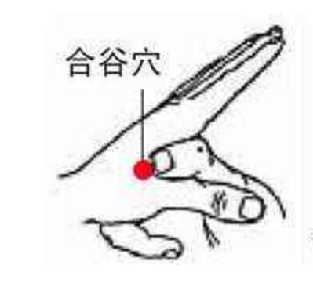
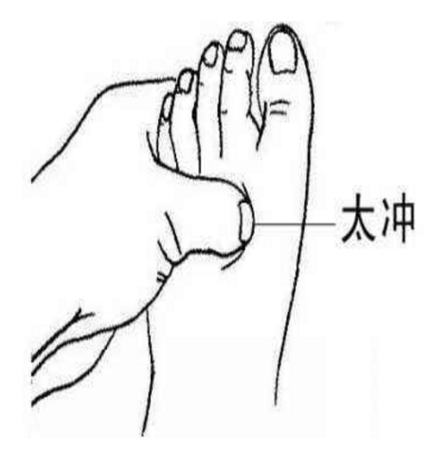
Baseline of perfusion of AD and NC
group | Gender(M/F) | age | Education years | MMSE | MoCA
AD | 3/7 | 70.7±8.0 | 10.4±3.1 | 17.4±2.6 | 14.3±3.8
NC | 2/8 | 64.5±4.9 | 9.8±3.3 | 29.0±1.1 | 26.1±1.4
t value | 2.087 | -0.493 | 0.422 | -12.933 | -9.171
P value | 0.628 | 0.051 | 0.422 | 0.000* | 0.000*
Four-gate acupoint :
hegu and taichong
Notes:
Please look at the location map of Siguan point: this is Hegu, that is Taichong. The table was results comparison between NC and AD group.

Slide 23
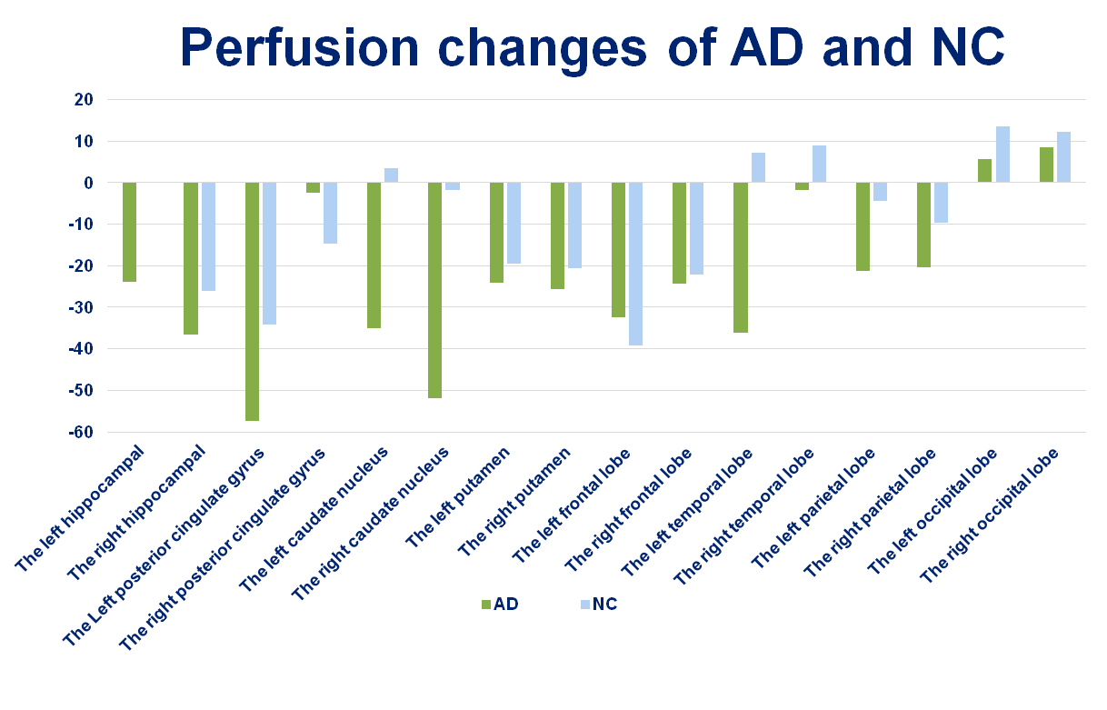
Compared to NC, decreased rCBF was observed in AD in bilateral HP, PCC, and fronto-temporal cortex, especially in the right PCC. Whereas no significant difference was observed in the perfusion changes between AD and NC after the acupuncture on the four-gate acupoint for six months.
Notes:
Compared to NC, decreased rCBF was observed in AD in bilateral HP, PCC, and fronto-temporal cortex, especially in the right PCC. Whereas no significant difference was observed in the perfusion changes between AD and NC after the acupuncture on the four-gate acupoint for six months.

Slide 24
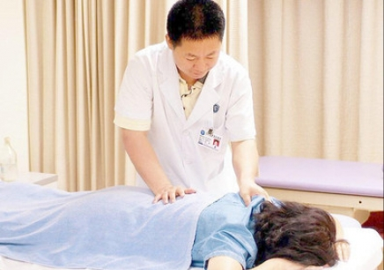

Treatment of AD by Traditional Chinese Tuina
Notes:
We try to treat the patients with AD by Traditional Chinese Tuina like this.

Slide 25
Treatment of AD by Traditional Chinese Tuina
The purpose of the study is to improve the quality of
life and reduce social and family burden.
83 AD patients were enrolled and divided into mild,
moderate and severe groups.
During Six months, each patient was treated no less
than 5,300 times, and each process is managed,
monitored and recorded during the treatment.
Notes:
The purpose is to improve the quality of life and reduce social and family burden. Total 83 AD patients were enrolled and divided into mild, moderate and severe groups.During six months,each patient was treated no less than 5,300 times, and each process is managed, monitored and recorded during the treatment.

Slide 26
Preliminary results
Age group | No. of patients | MMSE Score increased |  | MMSE Score decreased |  | MMSE Score Un changed
50-60 | 5 | 5 | 100% | 0 | 0 | 0 | 0
60-70 | 13 | 10 | 76.9% | 3 | 23.1% | 0 | 0
70-80 | 23 | 18 | 78.3% | 3 | 13.0% | 2 | 8.7%
80-90 | 25 | 20 | 80% | 2 | 8% | 3 | 15%
90-95 | 5 | 3 | 60% | 1 | 20% | 1 | 20%
total | 71 | 56 | 78.9% | 9 | 12.7% | 6 | 8.5%
Notes: 71 effective data according to statistics of MMSE score.
Notes:
This is preliminary results. Please look at the table, we can see the that MMSE score increases in most AD patients, The decrease of MMSE score only a few patients, only 6 patients MMSE score unchanged after Tuina treatment.

Slide 27
Preliminary results
the mental state and the cognitive
ability of time and location improved
the flexibility of action increased
the insomnia improved
Notes:
After treatment of AD by traditional Chinese Tuina, the mental state, and cognitive abilityof time and location of the AD patients was improved, the flexibility of action Increased, and the insomnia were improved also.

Slide 28
Acknowledgements
all the colleague of China-ADNI
the support from WW-ADNI
Notes:
Finally, I express my gratitude to all the colleague of China-ADNI, and many thanks to the support from WW-ADNI. So far we could catch pace up with WW-ADNI, and we can do more in future.

