Slide 1
ADNI Clinical Core
Ron Petersen & Paul Aisen
July 20, 2018

Slide 2
ADNI3 Cohorts
CN
MCI
Mild AD

Slide 3

CN Eligibility Criteria
Age initially 65-90, but may adjust to match other cohorts
With or without subjective memory complaints
CDR=0
MMSE 24-30
Logical Memory
>=9 for 16+ years of education
>=5 for 8-15 years of education
>=3 for 0-7 years of education
No cholinesterase inhibitors or memantine

Slide 4
MCI Eligibility Criteria
Age 55-90
Subjective memory concern by participant, study partner or clinician
CDR=0.5
MMSE 24-30
Logical Memory
<=11 for 16+ years of education
<=9 for 8-15 years of education
<=6 for 0-7 years of education
Stable cholinesterase inhibitors and memantine allowed

Slide 5
Mild AD Eligibility Criteria
Age 55-90
Subjective memory concern by participant, study partner or clinician
CDR=0.5 or 1
MMSE 20-26
Logical Memory
<=8 for 16+ years of education
<=4 for 8-15 years of education
<=2 for 0-7 years of education
Diagnosis of probable AD
Stable cholinesterase inhibitors and memantine allowed

Slide 6
ADNI3: Schedule of Events
Rollover and New Subjects
 | Baseline | 12 month | 24 month | 36 month | 48 month
CN | CV, MRI, Tau, AMY, LP | Phone Check OR CV, MRI, Tau (+/-) | CV, MRI, Tau (+/-), AMY, LP | Phone Check | CV, MRI, Tau, AMY, LP
MCI | CV, MRI, Tau, AMY, LP, FDG | CV, MRI, Tau (+/-) | CV, MRI, AMY, LP, Tau (+/-) | CV, MRI, | CV, MRI, Tau, AMY, LP
AD | CV, MRI, Tau, AMY, LP, FDG | CV, MRI, Tau | CV, MRI, Tau, AMY, LP | Phone Check (Neuropath only) | Phone Check (Neuropath only)
All rollover and new subjects have a full clinic visit, LP and PET scans during their Initial visit of ADNI 3
CN: visits q2 years unless selected additional Year 3 Tau visit/scans
MCI: annual visits; some will have Year 2, 3 Tau PET
AD: annual for first 2 years
Notes:
Scenario 2.5

Slide 7
New components of ADNI3
MINT (instead of Boston naming)
Cogstate
FCI-SF
BHR

Slide 8
The ADNI Study
Informing the design of therapeutic trials by looking at clinical, imaging, biomarker, and genetic characteristics across NL, MCI, and AD cohorts
 | ADNI1 | ADNIGO | ADNI2 | ADNI3*
Duration | 2004-2009 | 2009-2011 | 2011-2016 | 2016-2021
Sample Size | 800 | 200 | 1180 | 615
Cohorts | NL, MCI, AD | EMCI | NL, SMC, EMCI, LMCI, AD | NL, MCI, AD
*ADNI3 enrollment began 2016

Slide 9
ADNI3 Updates
Total Sites approved: 57/59
Total Enrollment*: 615
Rollover Participants: 375
New Participants: 240
Screen-fails: 125
*Enrollment is measured by the number of Registry eCRFs at Baseline and Initial visit and does not include screening visits
Notes:
Screen-fails are mostly non-minority participants. Reasons include not meeting inclusion criteria: logical memory, CDR and willing to undergo repeated imaging scans. Also not meeting the Exclusion criteria for Contraindications for MRI, significant systemic illness or unstable medical conditions and clinical significant abnormalities in B12 or TFTs that might interfere with the study (note: B12 may change so participants can re-screen in a few months).

Slide 10
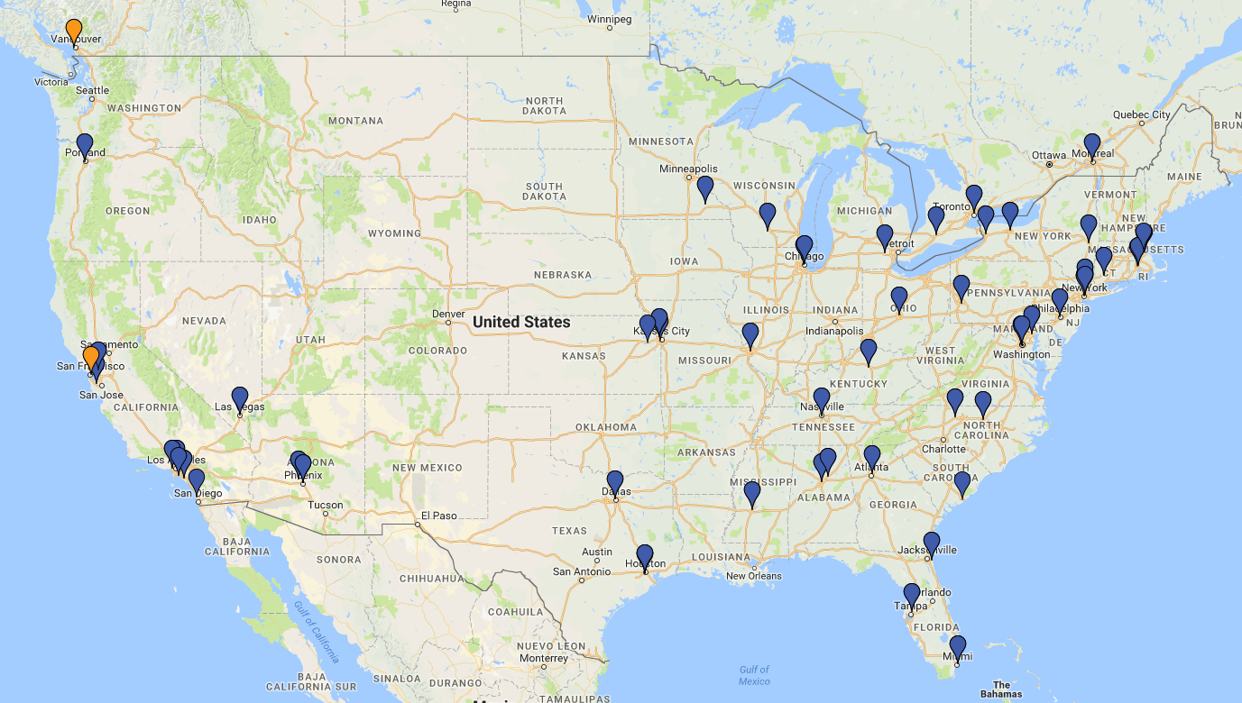

Slide 11
ADNI3 Overall Participants
Notes:
Column of Participants that have missing diagnosis were removed; 88 participants. Sites still working on entering data for these.

Slide 12
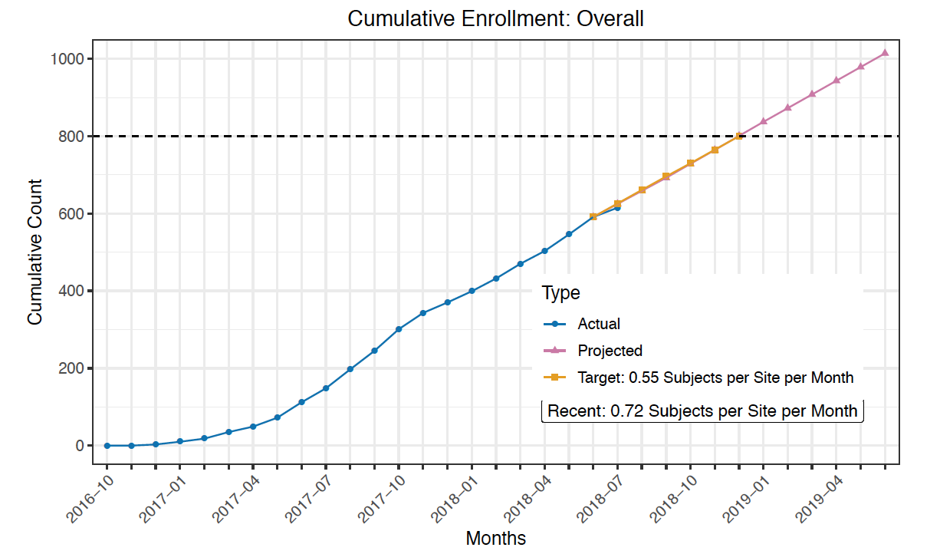
Target for Overall Participants

Slide 13
Enrollment challenges
Minority enrollment only 10%
Very slow enrollment of MCI and AD cohort
Plans:
Supplemental recruitment funds to all sites
Additional pilot site activity awards
Focus on diversity efforts, tracking efficacy of tactics
Central and local media outreach
New participant transportation initiative

Slide 14
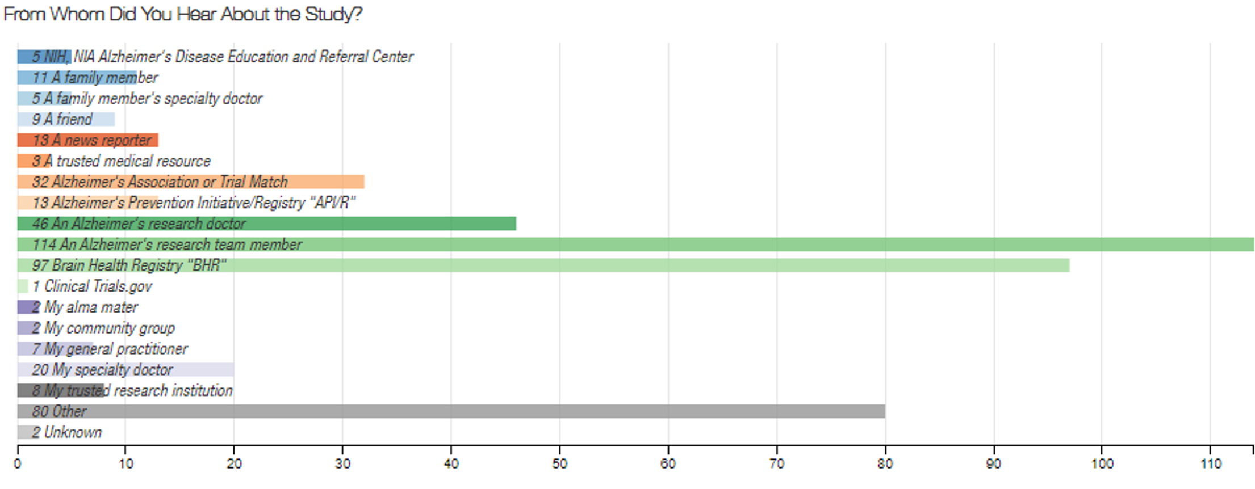
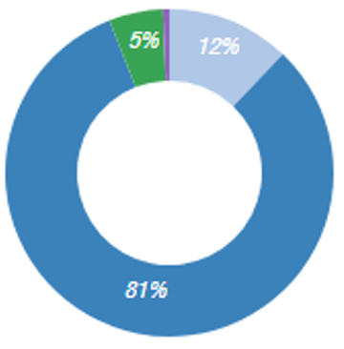
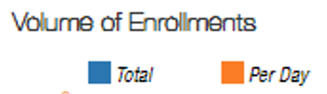
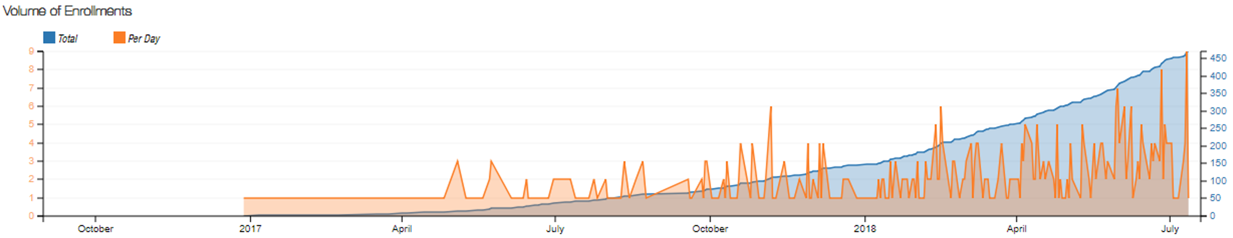
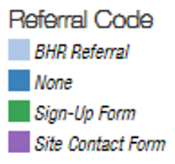
Tracking ADNI3 Enrollment

Slide 15
ADNI3 Clinical Core
Co-DIRECTORS:
Paul Aisen
Ron Petersen
PROJECT & DATA MANAGEMENT:
Devon Gessert
Jennifer Salazar
Yuliana Cabrera
Sarah Walter
Lindsey Hergesheimer
BIOSTATISTICS:
Mike Donohue
Rema Raman
Chung-Kai Sun
MEdical Safety:
Mike Rafii
Tiffany Chow
REGULATORY AFFAIRS:
Elizabeth Shaffer
Brittney Sloan
RECRUITMENT:
Shelley Moore
Charissa Barger
INFORMATICS:
Gus Jimenez
ADMINISTRATION:
Debbie Tobias
Jeremy Pizzola

