Slide 1



AAIC 2018 Biomarker Rates of Change in Autosomal Dominant Versus “Sporadic” Alzheimer Disease
John C. Morris, MD
On behalf of MW Weiner, L Beckett, T Benzinger, D Coble, AM Fagan, BA Gordon, P Massoumzadeh, L McCue, N Saito, L Shaw, C Xiong, VD Buckles,
and all Dominantly Inherited Alzheimer Network (DIAN) and Alzheimer Disease Neuroimaging Initiative (ADNI) Investigators

Slide 2
Disclosures
The DIAN-ADNI Comparison Study is funded by:
Alzheimer’s Association
Anonymous Foundation
National Institute on Aging
Alzheimer Disease Neuroimaging Initiative, U19 AG024904
Dominantly Inherited Alzheimer Network, UF1 AG032438
Roche Diagnostics (Elecsys)
JCM has no pertinent disclosures

Slide 3
Autosomal Dominant AD (ADAD) & “Sporadic” Late Onset AD (LOAD)
Both ADAD and LOAD have altered Aβ₄₂ homeostasis:
LOAD is characterized by underclearance of Aβ₄₂ (Patterson et al., Ann Neurol, 2015)
ADAD mutations result in relative Aβ₄₂ overproduction (St. George-Hyslop, Biol Psychiatry, 2000; Potter et al., Sci Trans Med, 2013)
If ADAD and LOAD share the same pathophysiology, will their clinical and pathological phenotypes be similar and will they respond similarly to mechanism-based therapies?
ADNI (since 2004) and DIAN (since 2008) are multi-center, international studies using multimodal biomarkers to study “sporadic” late-onset AD (ADNI) and autosomal dominant AD (DIAN)

Slide 4
ADAD Compared to LOAD
Measure | ADAD | LOAD
Clinical presentation | Amnestic predominant | Amnestic predominant
Cognitive deterioration | Memory, frontal/executive, generalized cognitive decline | Memory, frontal/executive, generalized cognitive decline
Pathology – Identity and sequence | Amyloid plaques & tau tangles > Lewy bodies | Amyloid plaques & tau tangles > Lewy bodies > TDP-43 > Other
MRI | Hippocampal and whole brain atrophy | Hippocampal & whole brain atrophy
PIB PET | Cortex plus basal ganglia | Cortex
FDG PET | Parieto-occipital hypometabolism | Parieto-occipital hypometabolism
CSF Aβ42 | Decreased by 50% | Decreased by 50%
CSF tau | Increased by 2-fold | Increased by 2-fold
Symptom onset | Mid-life or “Early onset” | Late-life or “Late onset”
Disease duration | ~ 9.7 years | ~ 8-10 years
Some mutations produce additional symptoms including seizures, spastic paraparesis and extrapyramidal signs.

Slide 5
Analytic Challenges
Age
When cohort age ranges do not overlap, “adjusting for age” can be done within each cohort but not between the two cohorts
In response, the cohorts were anchored on dementia progression using CDR-SumBox (SB) ≥1 to permit cognitive test results to serve as outcome measures; participants were aligned on CDR-SB=1 to compare rates of change before and after this anchor point
Neuropathological Heterogeneity
AD rarely occurs in isolation in ADNI’s older adults¹ (e.g., TDP43, vasculopathy/infarcts, synucleinopathy, hippocampal sclerosis) whereas DIAN cases (with the exception of synucleinopathy) have pure AD²
Mutation-dependent pathology in DIAN (e.g., PSEN1 mutations before codon 200 of APP have greater amyloid burden than mutations after codon 200³)
PSEN mutations affect many other proteins that are γ secretase substrates⁴
¹Boyle PA et al, Ann Neurol; 2018; 83:74-83 ³Mann DM et al, Am J Pathol 2001; 158:2165-75
²Cairns NJ et al, Neuropathol 2015; 35:390-400 ⁴Roher AE et al, J Alz Dis 2016; ;50:645-58

Slide 6
Analytic Challenges – Cont’d
Variable methods confound comparisons
Different amyloid PET tracers, different imaging pipelines
DIAN uses PiB, ADNI uses AV45 (some PiB in the past)
Solution: Reprocess imaging data with conversion equation (Centiloid)
CSF analytic variability (lot to lot and plate to plate); Aβ₄₂ assay drift¹
Solution: Reprocess CSF with Roche Elecsys automated platform for CSF analytes (Aβ₄₂, Aβ₄₀, tau, p-tau)
Shaw (ADNI Biomarker Core) and Fagan (DIAN Biomarker Core) designed additional analyses to obtain mass spectrometry measures of Aβ isoforms and important methodological comparisons (AlzBio3)
¹Schindler SE et al., Alzheimers Dement. 2017;S1552-5260(17):32516-5

Slide 7
Anchoring Cohorts at CDR-SB≥1
ADNI - Age at symptomatic onset unavailable for the ADNI cohort unless progression occurred from CDR-SB=0 to CDR-SB ≥1. Otherwise, age of onset is estimated (See below)
DIAN – Age at onset is available for all by observation, extrapolation, or estimation (See below)
 | ADNI (n=559) Any clinical group (CN-MCI-AD) at baseline Baseline amyloid PET At least a 1-point increase in the CDR-SB with follow-up in CN/MCI | DIAN (n=291) All mutation carriers, symptomatic and asymptomatic 224 PSEN1, 45 APP, 22 PSEN2
Baseline CDR-SB ≤ 1 | Age when actual CDR-SB ≥ 1 | Age when actual CDR-SB ≥ 1
Baseline CDR-SB > 1 | Age extrapolated using the estimated rate of change in CDR-SB from a mixed effect model | Age extrapolated using the estimated rate of change in CDR-SB from a mixed effect model
CDR-SB remained < 1 | Not Applicable – all CN/MCI had to have CDR-SB change by 1 | Estimated mutation-specific age of onset (or parental age of onset)

Slide 8
Cohort Baseline Description
 | DIAN Mutation Carriers N= 291 |  | ADNI Participants N=559
 | Asymptomatic CDR=0 N=184 (63%) | Symptomatic CDR>0 N=107 (37%) | Asymptomatic CDR=0 N=72 (13%) | Symptomatic CDR>0 N=487 (87%) | DIAN vs ADNI CDR=0 p | DIAN vs ADNI CDR>0 p
Age, Years, Mean (SD) | 33.4 (8.7) | 46.0 (10.0) | 75.2 (5.6) | 73.6 (7.6) | <.0001 | <.0001
Sex (% Women) | 57.6 | 51.4 | 51.4 | 39.4 | 0.3647 | 0.0232
Race (% Caucasian) | 88.0 | 92.5 | 93.1 | 95.5 | 0.2465 | 0.2108
Education, Years, Mean (SD) | 14.8 (2.9) | 13.4 (3.1) | 16.1 (2.8) | 15.9 (2.8) | 0.0006 | <.0001
MMSE, Mean (SD) | 29.1 (1.2) | 22.5 (6.9) | 29.1 (1.0) | 26.1 (2.8) | 0.9721 | <.0001
APOE4+ 1 E4 2 E4 | 52 (28.3%) | 28 (26.2%) | 22 (30.6%) | 215 (44.2%) | 0.7299 | 0.0005
 | 2 (1.1%) | 6 (5.6%) | 1 (1.4%) | 75 (15.4%) | 0.9407 | 0.0017
Clinical f/u, Years, Mean (SD) | 3.4 (1.5) | 2.5 (1.5) | 5.8 (3.2) | 3.5 (2.5) | <.0001 | 0.0012

Slide 9
Variables Available for Comparison
Reprocessed Biomarker | DIAN | ADNI
CSF reprocessed by ADNI Biomarker Core (Roche Elecsys)
Aβ1-42 | Yes | Yes
Aβ1-40 | Yes | Yes
Tau | Yes | Yes
pTau181 | Yes | Yes
Imaging reprocessed by DIAN Imaging Core
MRI Hippocampal volume Cortical thickness in precuneus | Yes | Yes
Amyloid PET Cortical mean Centiloid units | PiB | AV45 (initially PiB)
Common Cognitive Assessments
Animal Fluency | Logical Memory Immediate
Boston Naming | Logical Memory Delayed
Digit Span Forward | Trailmaking A
Digit Span Backward | Trailmaking B
Letter Fluency - F | WAIS Digit Symbol
Vegetable Fluency | MMSE
Global Composite (All tests)

Slide 10
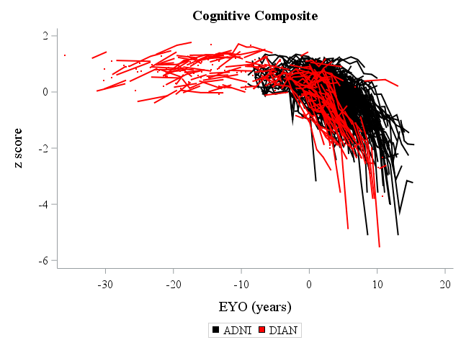
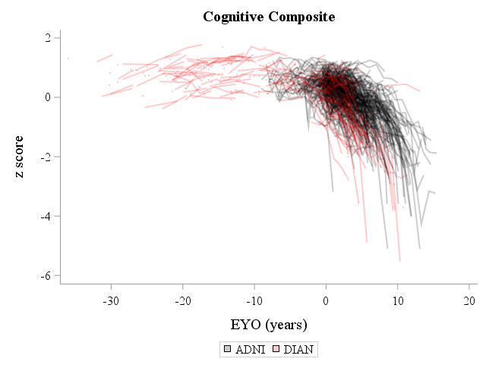
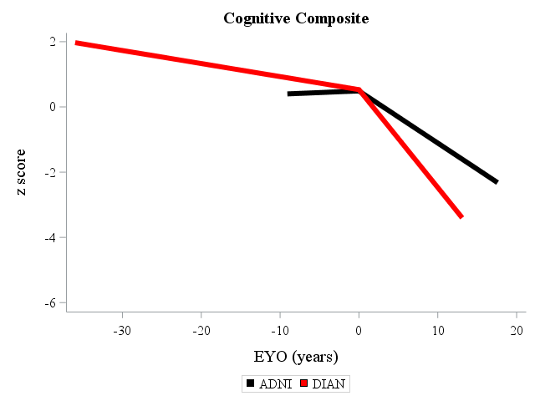
Cognitive Composite Score
Unadjusted comparisons (adjusting for sex, education, race, and APOE4 did not notably change results)

Slide 11
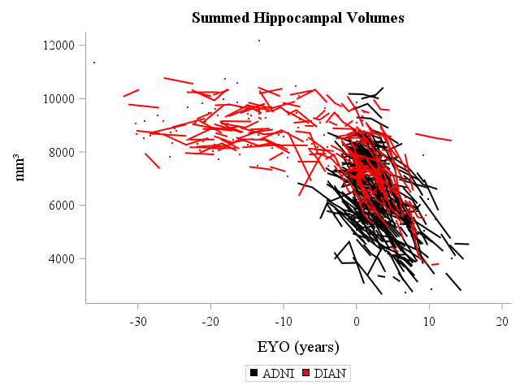
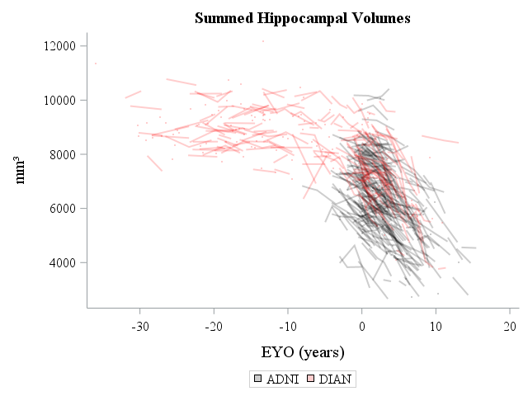
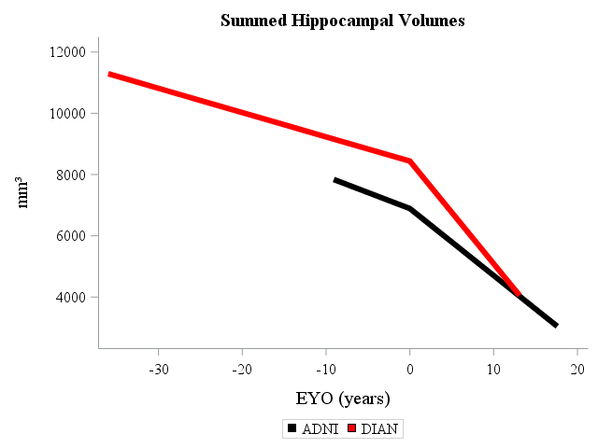
Hippocampal Volume (Summed)

Slide 12
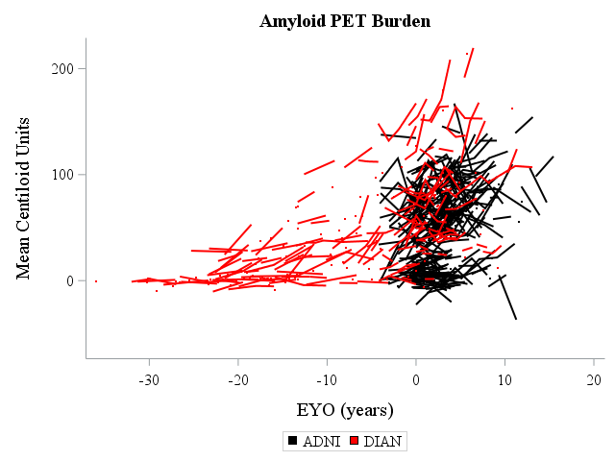
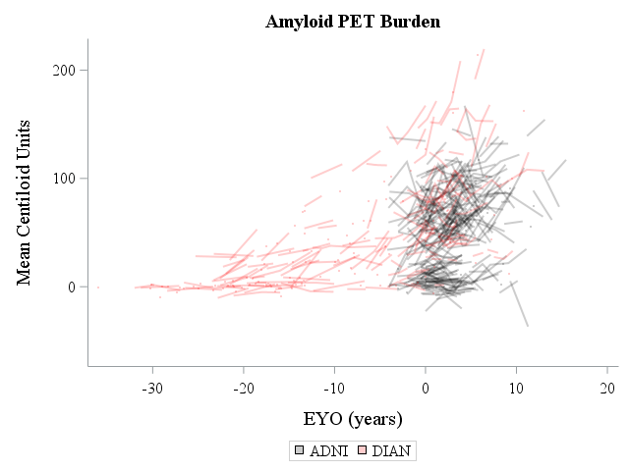
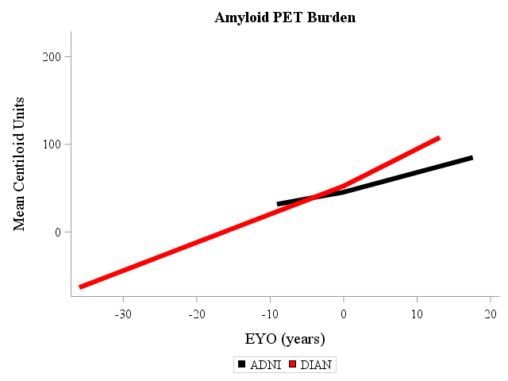
Cortical Mean Amyloid – Centiloid Units

Slide 13
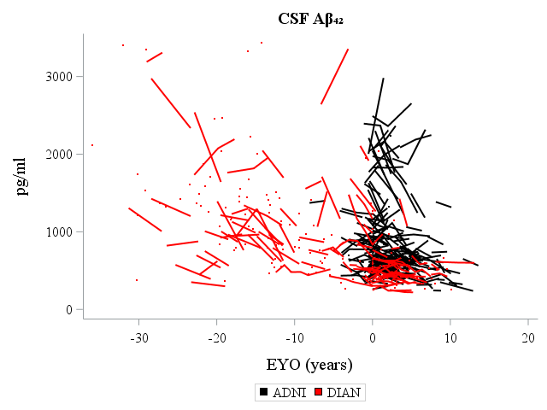
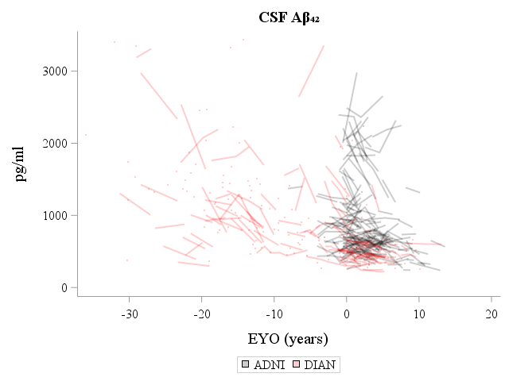
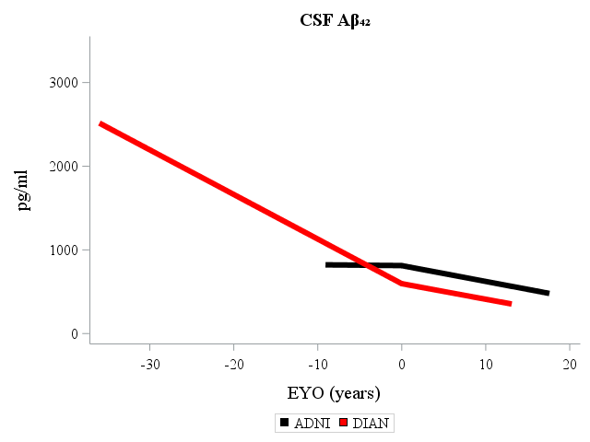
CSF Aβ₄₂ log

Slide 14
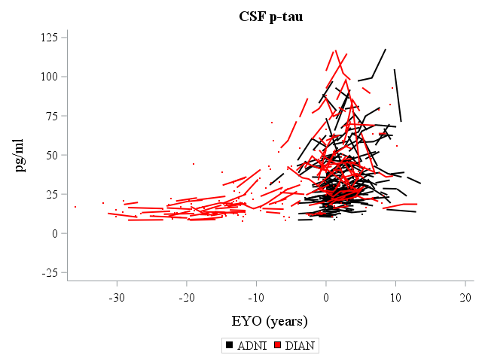
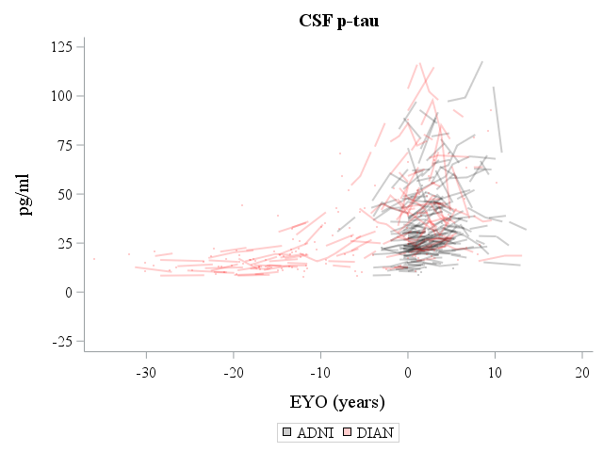
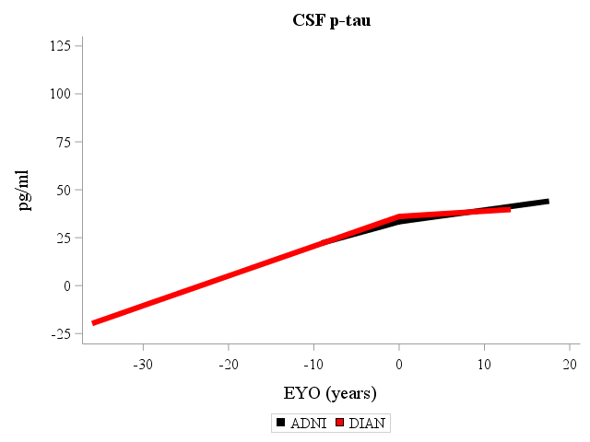
CSF p-tau

Slide 15
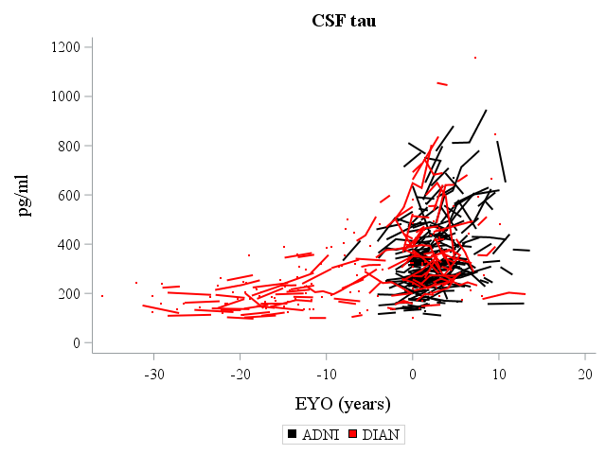
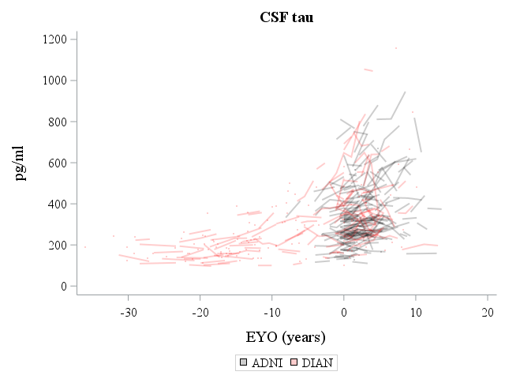
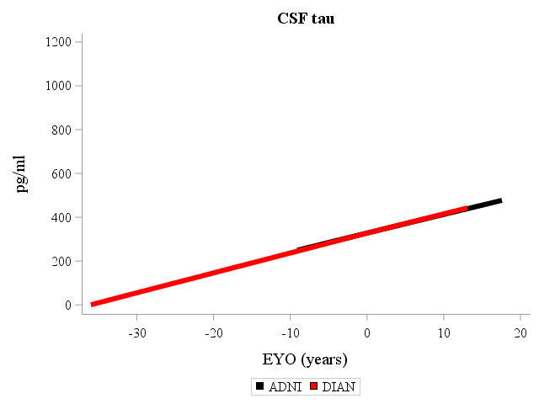
CSF tau

Slide 16
Conclusions
Differences between ADAD and LOAD
LOAD may be modified by age, APOE4 effects, and other pathologies
ADAD may be modified by individual mutation effects on Aβ, other substrates
The course of symptomatic ADAD appears to be more aggressive than LOAD
However, both share a long asymptomatic period and have identical AD endophenotypes (supported by ADNI’s independent analyses):
At symptomatic onset (often marked by inflection points):
Increasing amyloidosis (amyloid PET; CSF Aβ₄₂)
Increasing tauopathy (CSF t-tau, p-tau)
Progressive hippocampal atrophy
Progressive cognitive decline
Cautious optimism that lessons from ADAD will translate to LOAD

