Slide 1




European Prevention Alzheimer’s Dementia
José Luis Molinuevo

Slide 2

Why EPAD?
Scientific Knowledge Gap
- AD mechanism?
- Slow data sharing
Limited Translatability of existing Disease Models
Lack of validated, non-invasive biomarkers
Inefficient Trial System
Long duration
Slow recruitment & high screen failure rates
Lack of suitable outcome measures & regulatory acceptance
EPAD aims to develop an infrastructure that efficiently enables the undertaking of adaptive, multi-arm Proof of Concept studies for early and accurate decisions on the ongoing development of drug candidates or drug combinations for the prevention of AD dementia

Slide 3

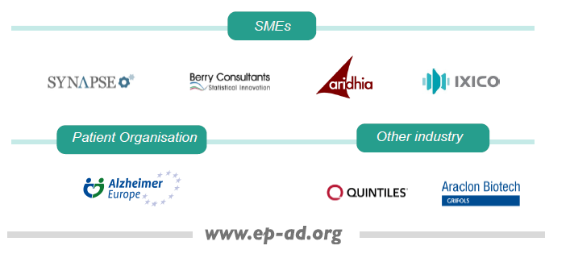



The EPAD Consortium

Slide 4
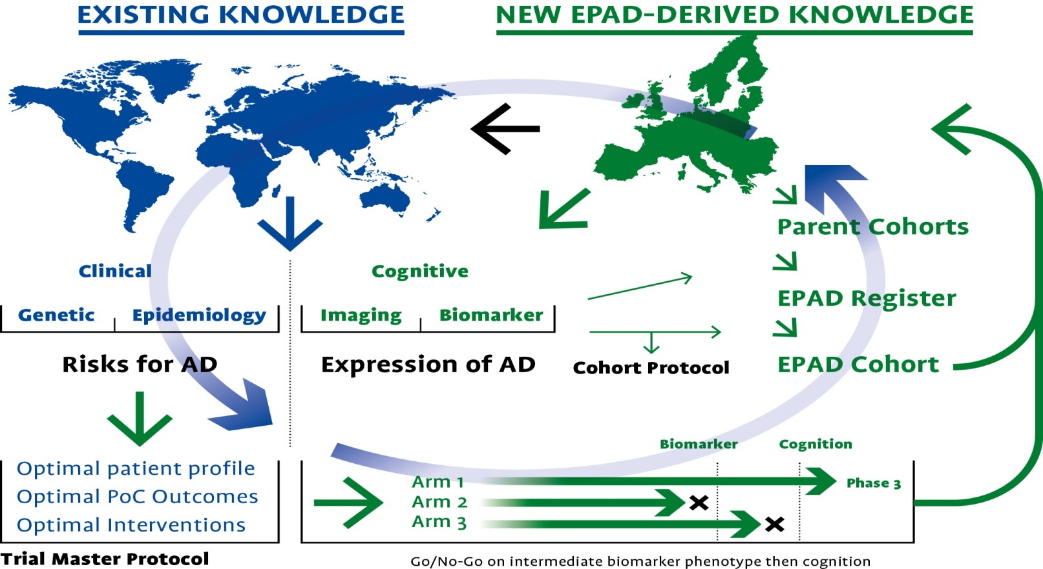
EPAD Structure
WP2
WP3/8
WP1
The EPAD Delivery Cluster
WP4/8
WP4/8
WP2/4
WP 5-8: Supporting Work Packages

Slide 5
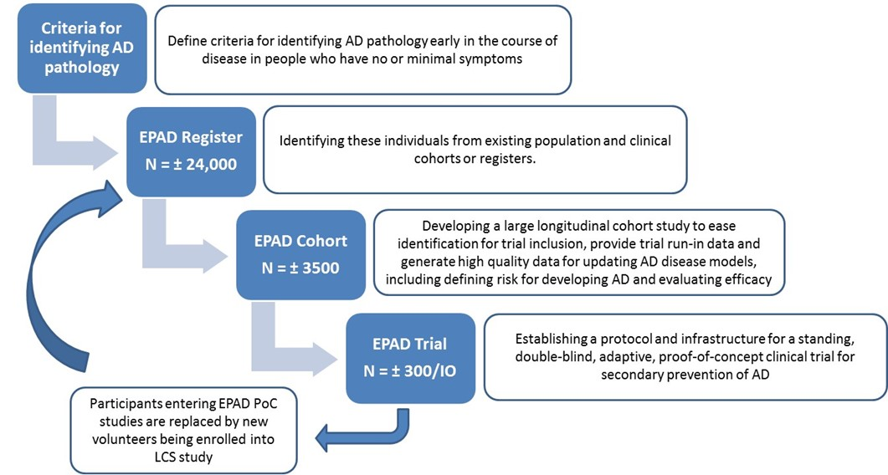
The EPAD Approach

Slide 6
EPAD flow: the trial “machine”
LOW probability, based on risk factors, disease evidence, symptoms
LCS
6000 subjects
Parent cohorts
Virtual register
Subjects identified by fingerprinting
Proof of concept study
Single sponsor
Multiple treatme-nt arms
Placebo arm
Shared across studies
Study arm 3
500 subjects
Adaptive design
Alzheimer’s probability spectrum
Study arm 1
500 subjects
Study arm 2
500 subjects
Continuous LCS recruitment
HIGH probability, based on risk factors, disease evidence, symptoms
Adapted from ALZ Forum. Coming to a Center Near You: GAP and EPAD to Revamp Alzheimer’s Trials. 2016. Available at: http://www.alzforum.org/news/conference-coverage/coming-center-near-you-gap-and-epad-revamp-alzheimers-trials (accessed January 2017). EPAD, European Prevention of Alzheimer’s Dementia Consortium; LCS, longitudinal cohort study

Slide 7
LCS: the heart

Slide 8
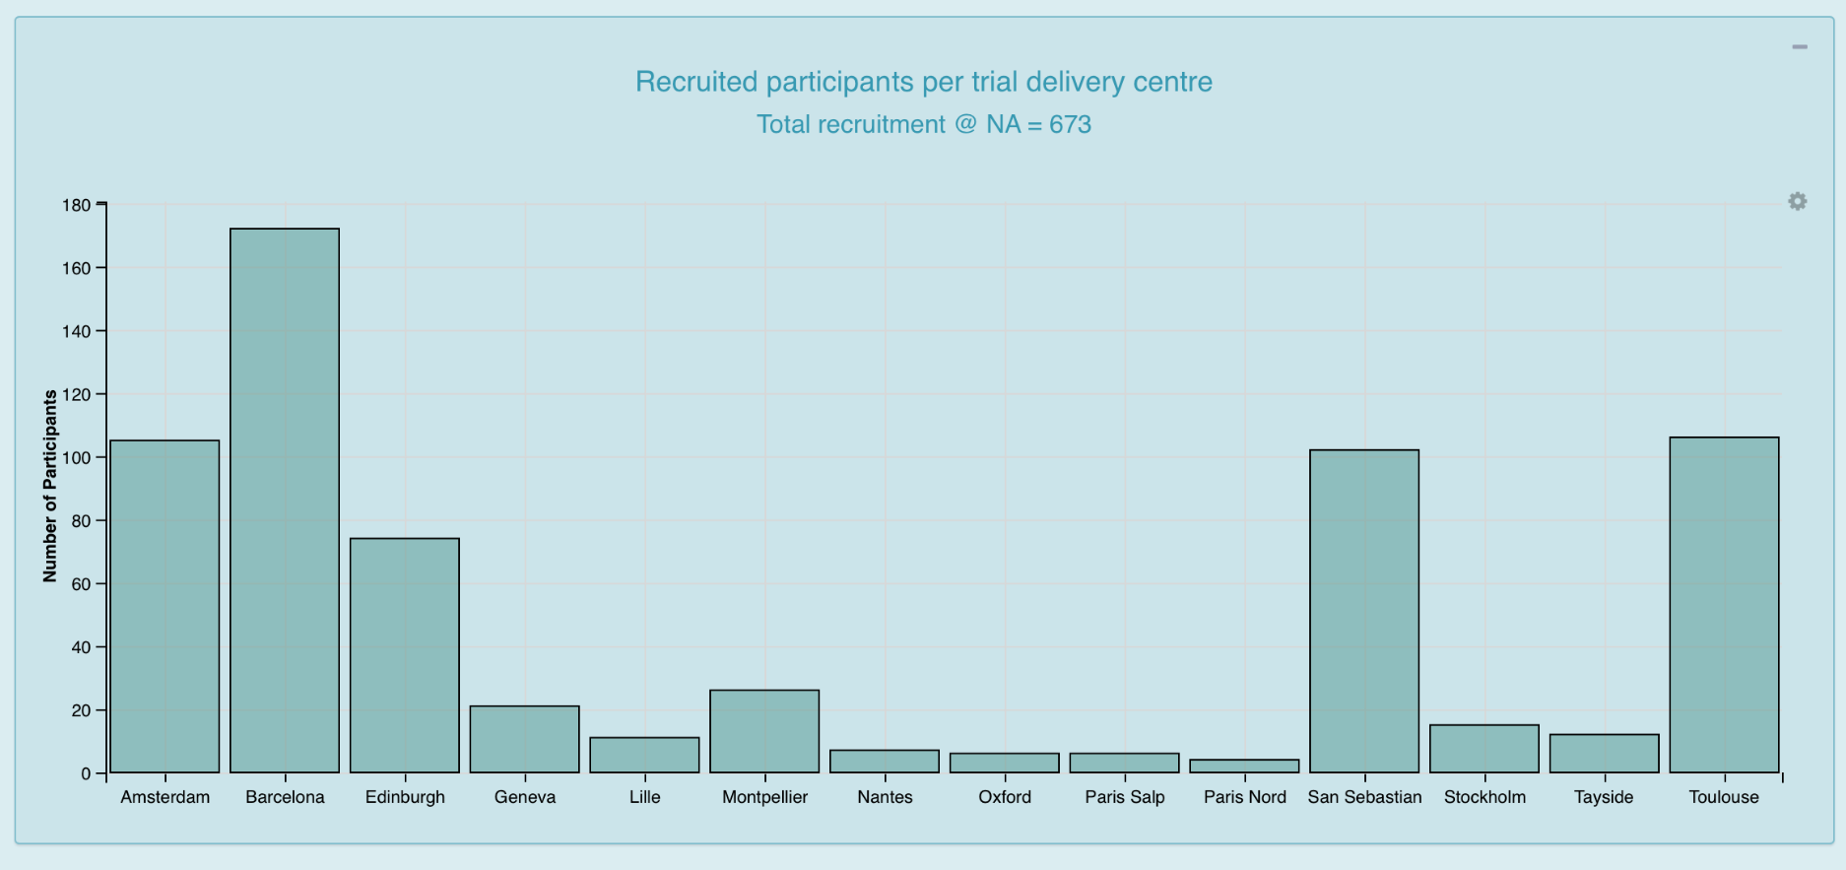
Cohort structure – How many and where?

Slide 9
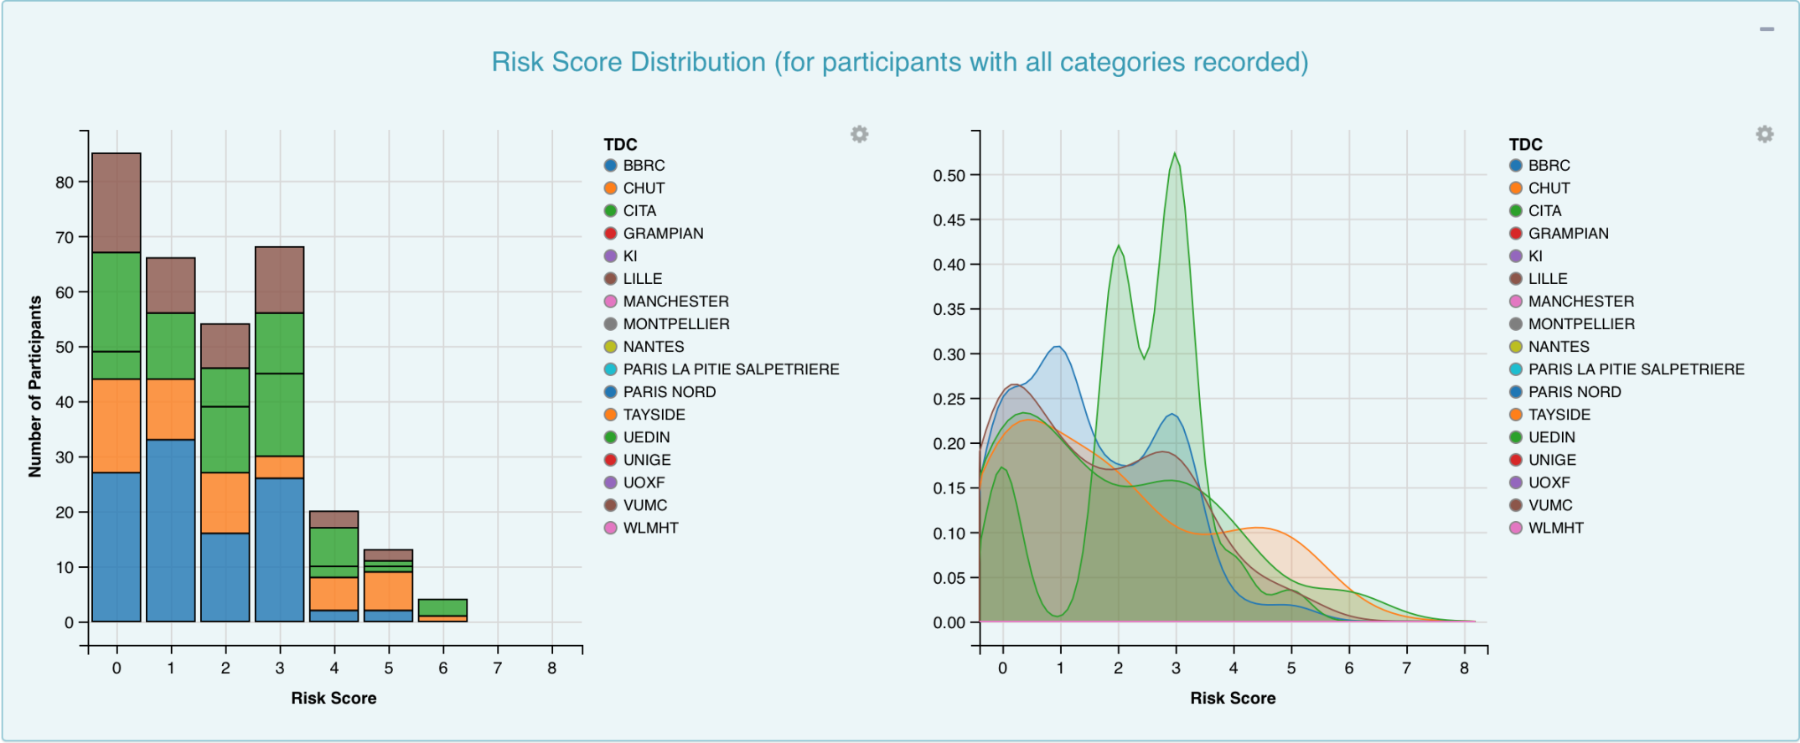
Cohort structure – Probability Spectrum

Slide 10
LCS Cohort Structure and Readiness
CDR=0
N=314
CDR=0.5
N=43
Data as of May 18th 2018

Slide 11

Proof of Concept Trial
The POC will run in prodromal and preclinical subjects
The LCS provides eligible subjects to the POC trial
anticipated Screen Failure Rate of only 10%
Need to replenish the LCS again, assuming a real world Screen Failure Rate to get 1 eligible subject
LCS
SF: 10%
SF_{preclinical}: 90 %
POC
SF_{prodromal}: 66 %

Slide 12
PoC Adaptive design - Protocol
Longitudinal Cohort Study
Proof-of-Concept Trial
3
1
Active Treatment
Appendix A
1
Equal Randomization
Placebo
1
Appendix B
1
Appendix C

Slide 13
The EPAD proof of concept trial
Baseline
Biomarker (target engagement) and biomarker proof of concept
Cognitive proof of concept
Biomarker
Biomarkers
Negative
Stop
Positive
Cognitive
Cognitive
Negative
Stop
Positive
Phas3
Allows early decisions on progression to longer term clinical outcomes by impact on pre-defined and target-specific intermediary phenotype
Molinuevo JL. EPAD update. Worldwide-ADNI Update Meeting, Friday July 17, 2015, Washington DC. Available at: https://www.alz.org/research/funding/partnerships/2015_meeting/session2/2-MolinuevoEPADupdate_Acknowledgment.pptx (accessed January 2017). EPAD, European Prevention of Alzheimer’s Dementia Consortium

Slide 14

Master POC Protocol
Study population
Maximum treatment duration – 4 years
Randomization 3:1
Minimum frequency of on-site visits
Primary and secondary endpoints assessed every 6 months
Minimum criteria for futility or success
Stats Analyses incl. interim analyses
Operational CRO Platform

Slide 15
Main Achievements
First version of the EPAD register established: >25000 non-demented research participants over 50 years old
EPAD Longitudinal Cohort Study (LCS) up and running in 12 TDCs and more than 500 Research Participants enrolled, to be increased to 20/30 TDCs with >1000 enrolled by Q2 2018
EMA Scientific Advice on LCS and Proof-of-Concept (PoC)
PoC Framework established, ready to start FPI by Q3-Q4 2018

Slide 16









EPAD Collaborating to prevent AD
Deep and Frequent Phenotyping Study
Target identification & development
Trial ready cohorts & data
Clinical Trials

Slide 17
Contribution to:
RESEARCH
INDUSTRY
Largest data repository in existence for disease- and risk modelling
Extensive collection of biological samples
Platform to test novel biomarkers
Excellent pre-trial characterization of research participants to inform selection and reduce screen failure (aim <20%)
Access to drug-ready infrastructure
Rapid decision making faster, cheaper, and more efficient studies
PATIENTS
SOCIETY
Faster access to innovative interventions
Engagement in design of clinical studies
Prediction of risk of developing dementia due to AD combined with personalized measures to reduce risk
Development of disease modifying therapies
Continued investment in Alzheimer research in Europe, allowing
EU institutions taking the lead in development of new AD interventions

Slide 18




Acknowledgement
The research leading to these results has received support from “la Caixa” Banking Foundation (Alfa Project), and the Innovative Medicines Initiative Joint Undertaking under grant agreement n° 115736, resources of which are composed of financial contribution from the European Union's Seventh Framework Programme (FP7/2007-2013) and EFPIA companies’ in kind contribution.
ALFA PROJECT:
EPAD:

Slide 19

THANK YOU!!

