Slide 1
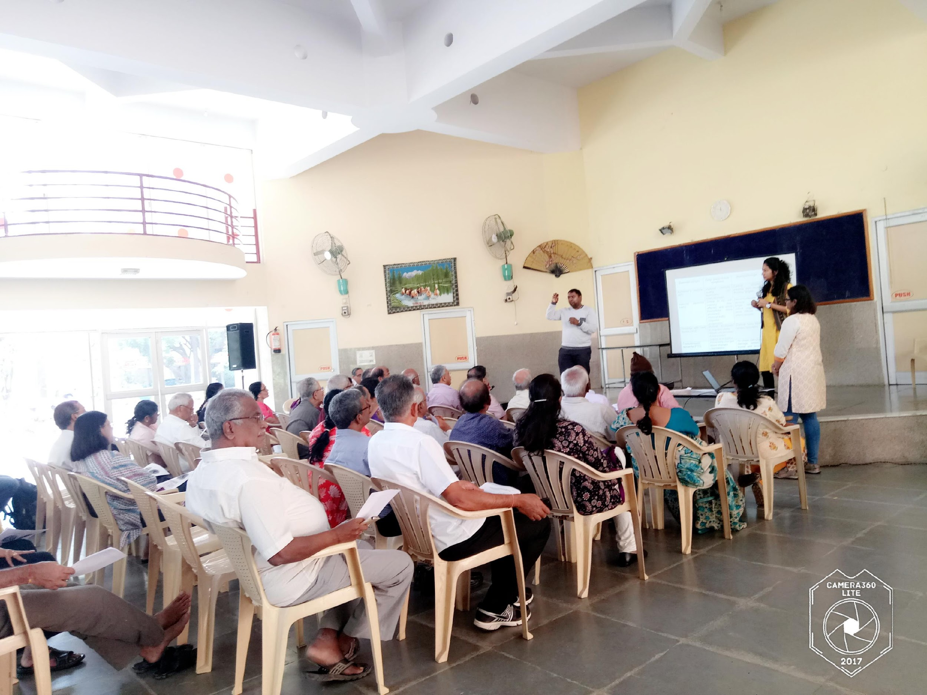
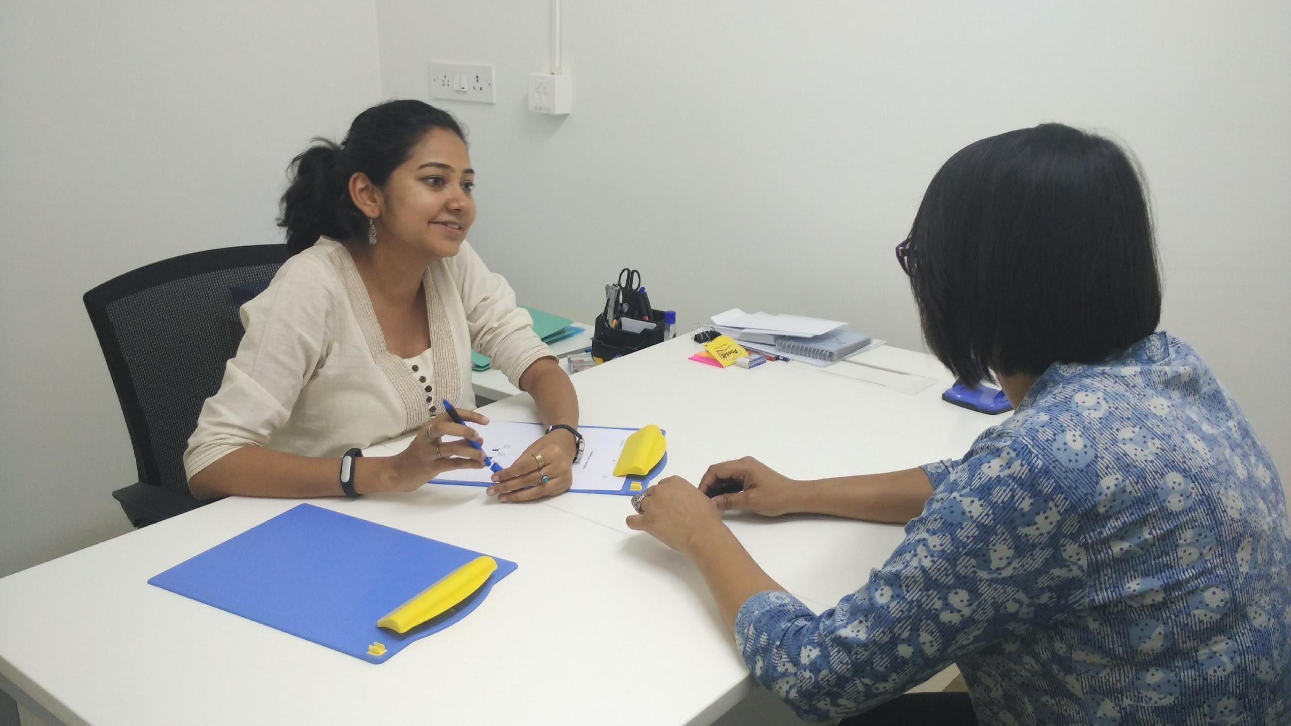
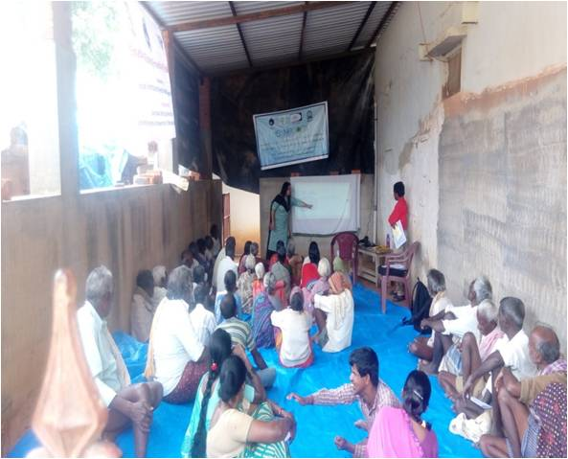
INDIA - ADNI
Dr Naren Rao
Indian Institute of Science
National Institute of Mental Health and Neurosciences

Slide 2
Tata Longitudinal study of Aging
Funded by Tata trust, a private philanthropy
A longitudinal study assessing cognitive change in Urban population
Age for inclusion >50 years
Baseline visit and annual follow up (follow up changed to Once in 2 years)

Slide 3
Schedule of events
Telephonic screening
Genotyping
Clinical assessment
Assessments
Carotid Doppler
Cognitive assessment
PET
(18F-FDG)
Blood investigation
MRI

Slide 4
Current status
Baseline | Cognitive and Clinical examination | MRI | PET
Baseline | 226 | 124 | 44
Follow up (year 1) | 48 | 32
Follow up visit (Year 2) | 11 | 5 | 2

Slide 5
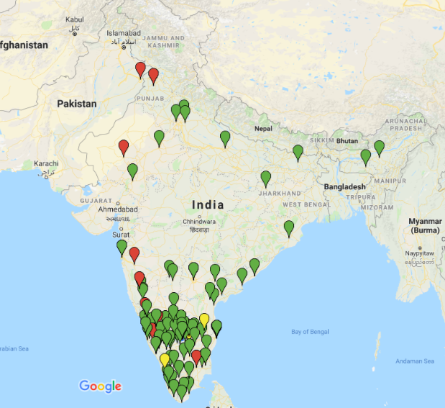
Place of origin

Slide 6
Medical comorbidities

Slide 7
Medical comorbidities

Slide 8
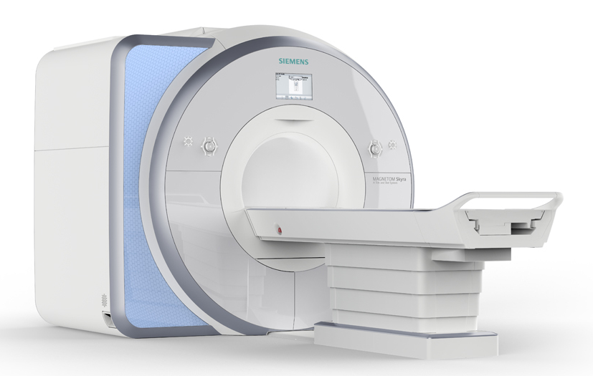
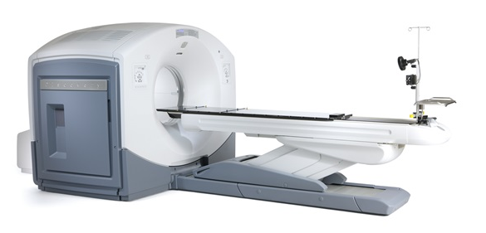
ADNI 2 PROTOCOL
MRI – Siemens Skyra
PET/CT – GE discovery
Siemens PRISMA purchase is in progress – will be shifted to ADNI 3 protocol

Slide 9
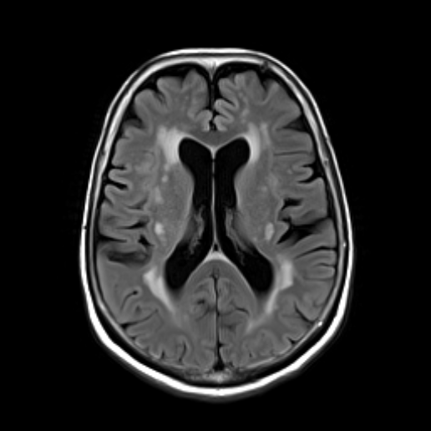
WHITE MATTER HYPERINTENSITY

Slide 10

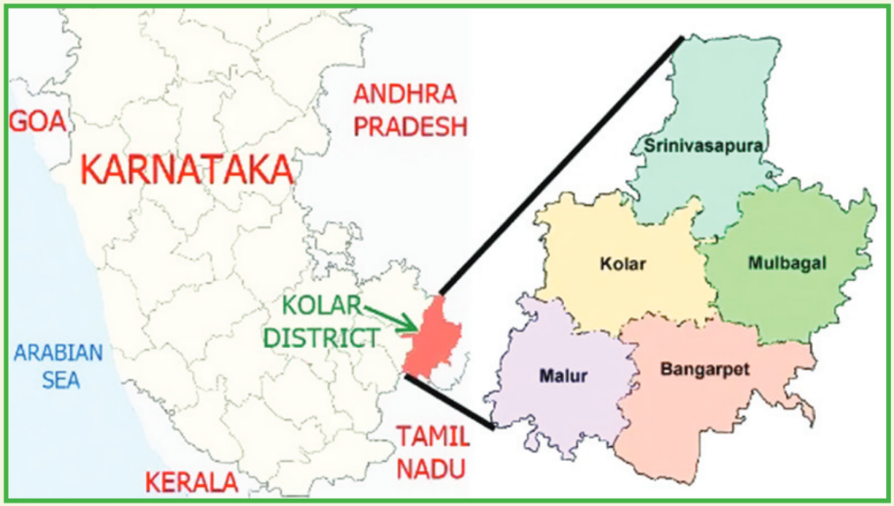





Srinivaspura Aging, Neuro Senescence and COGnition (SANSCOG) Study
Bengaluru
Sri Devaraj Urs Academy of Higher Education and Research
Notes:
GC: Added IISc logo as many of them are part of the study and will be in the meeting.

Slide 11


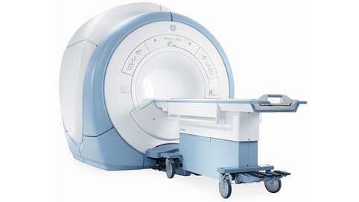
Rural cohort of >45 years (n=10,000; MRI -1,000)
30 min
Screening & Informed Consent
Sociodemographic & Brief clinical Assessment
Home visit
2-3 weeks
3 hrs
Detailed cognitive Assessment
Detailed clinical assessment
Biochemistry & Genetics
Eye fundus photograph
Carotid doppler
2-3 weeks
Study site
2 hrs
MRI (ADNI 3 protocol)
PET
Wrist actigraphy
MRI/PET

Slide 12
Study components
Recruitment of
subjects
Clinical assessments
Cognitive assessments
(COGNITO adapted to India)
Magentic resonance imaging
(MRI)
Positron emission tomography (PET) – tau & amyloid
Biochemical measures
Carotid doppler
Activity monitoring with wearable devices
Genetics – whole genome sequencing/ GWAS and storage

Slide 13
Progress so far (n=370)

Slide 14
ADNI 3 PROTOCOL
MRI -– Philips Ingenia
PET/MRI – Siemens Biograph – simultaneous PET-MRI
Siemens PRISMA purchase is in progress – will be used in addition to Ingenia

Slide 15
UNIQUENESS
Rural and Urban population cohorts
Different environmental and socio-cultural factors
Younger population (above 45 years)
Higher proportion vascular risk factors and nutritional deficiency
Considerable proportion of Illiterate population (Education level = 0); Cognitive tests and instruments have been modified and validated

Slide 16
AT AAIC, 2018
P2-449 Relation between Corpus Callosum Volume and Brain Glucose Metabolism in Middle Aged Individuals
Ranjini Garani Ramesh, Simran Purokayastha, Mahendra Javali, Kumar Kallur, Naren Rao
Poster #26610
Date: Monday, July 23,
Location: McCormick Place, Hall - F1
Notes:
update

Slide 17
AT AAIC, 2018
P3-385 Corpus Callosum Volume and Executive Function: A Potential Early Marker of Cognitive Decline
Simran Purokayastha¹, Ranjini Garani Ramesh¹, Mahendra Javali² , Kumar Kallur³ and Naren Prahalada Rao^{1,4}
Poster #26606
Date: Tuesday, July 24
Location: McCormick Place, Hall - F1
Notes:
Update FDG

Slide 18
AT AAIC, 2018
P2-107 The epsilon4 Allele Frequency of Apoe and Its Association with Mild Cognitive Impairment/Alzheimer’s Disease Status in South Indians
Ganesh Chauhan, Naren Prahalada Rao, Suvarna Alladi, Diji Kuriakose, Ranjini Garani Ramesh, Simran Purokayastha, Mahendra Javali and Vijayalakshmi Ravindranath
Poster #26422
Date: Monday, July 23
Location: McCormick Place, Hall - F1

Slide 19
THANK YOU

