Slide 1
MRI ADNI 2018
Mayo
Cliff Jack
Bret Borowski
Matt Bernstein
Arvin Forghanian-Arani
Jeff Gunter
Dave Jones
Kejal Kantarci
Rob Reid
Denise Reyes
Matt Senjem
Kaely Thostenson
Prashanthi Vemuri
Chad Ward
Funded MRI Investigators
Charlie DeCarli – UCD
Nick Fox – UCL
Duygu Tosun – SFVA
Paul Thompson – USC
Paul Yuskevich - Penn
Danielle Harvey – biostats
MR company scientists
Dan Rettmann (Mayo) – GE
Pete Kollasch (Mayo)/Gunnar Kruger (MGH) – Siemens
Yansong Zhao (BU) - Philips

Slide 2
Some of the goals for ADNI 3 – determine effect of technical changes on quantitative metrics
vendor changes
model/hardware changes within a vendor line
operating system changes
protocol changes
ADNI 2 vs ADNI 3: does better technology translate into better diagnostic performance?
Better technology in ADNI 3 vs ADNI 2

Slide 3
ADNI 3 protocol compared to ADNI 2 no change; small change; major change
3D T1 volume
3D FLAIR
T2* GRE
ASL – (Siemens to all) 2D in ADNI 2, 2D/3D mix in ADNI 3
TF-fMRI – (Philips to all) advanced (17) and basic versions
Field map
dMRI – (GE to all) advanced (17) and basic versions
Coronal high resolution T2

Slide 4
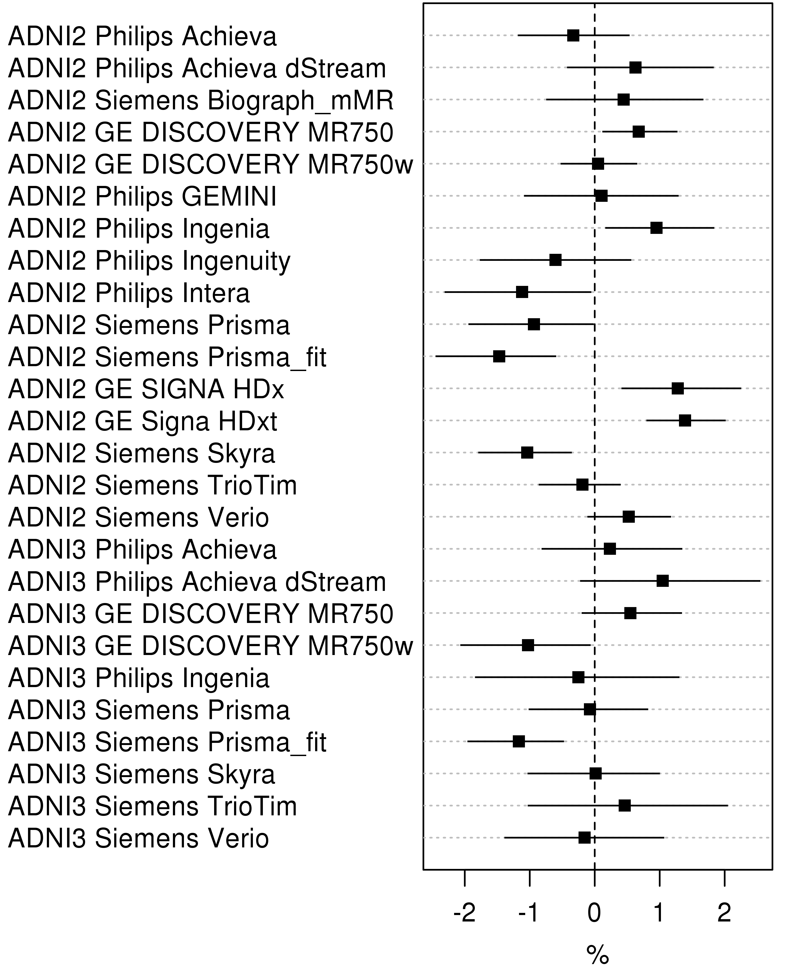
TBM-SyN by manufacturer, model, and ADNI cycle – M Senjem
No effect of protocol change
Significant effect of vendor change
A linear mixed model was fit with age, diagnosis, and random intercepts for subject and model-manufacturer-phase. The difference between any two estimates represents the effect of changing from one model to another (or from ADNI-2 to ADNI-3).

Slide 5
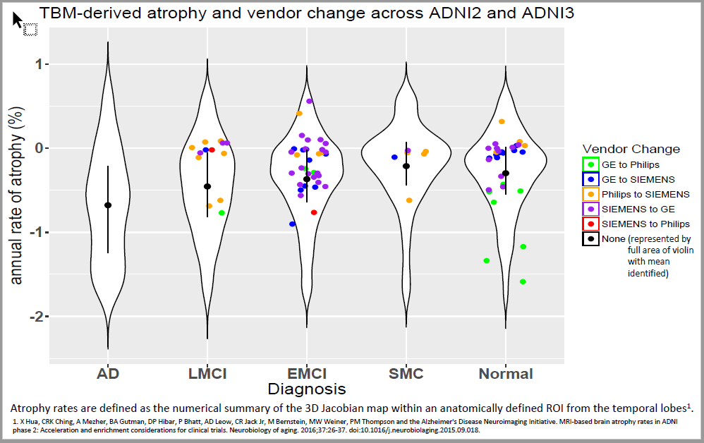
Paul Thompson et al USC
Vendor effect

Slide 6
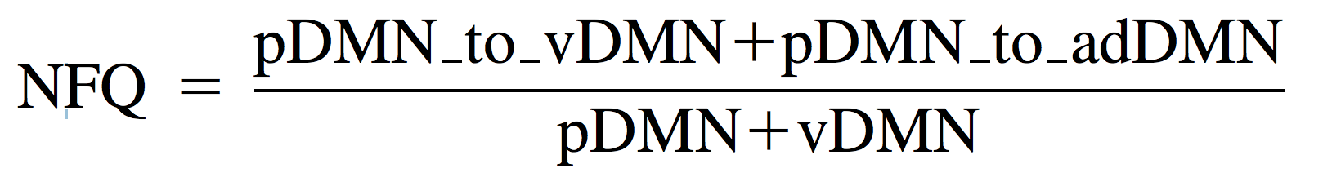
fMRI: Network Failure Quotient (NFQ) Jeff Gunter & Dave Jones - Mayo
Straight forward pre-processing:
Slice time and motion correction
Motion and nuissance regressed, bandpass filtered
GM inherited from T1 segmentation
Dual regression using DMN regions to get region time courses

Slide 7
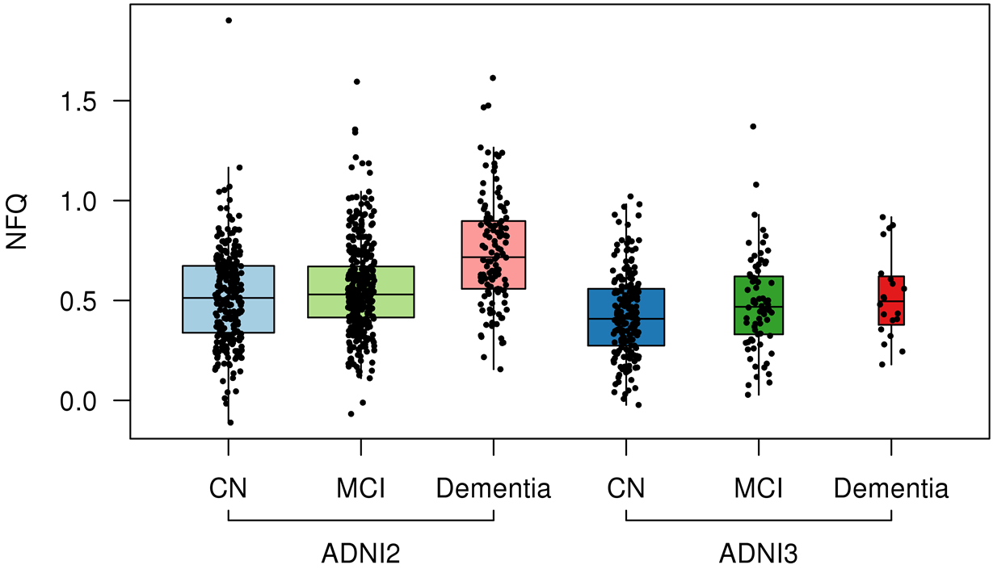
NFQ by diagnosis and ADNI cycle
Box plots and data points by diagnosis stratified by ADNI 2 versus ADNI 3. Repeated measurements across individuals are shown.

Slide 8
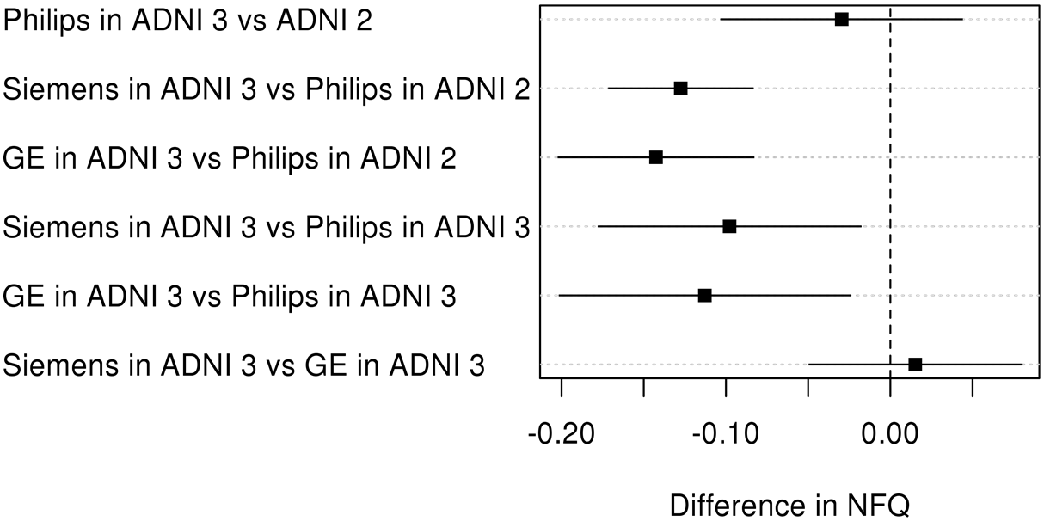
Differences in NFQ by manufacturer and ADNI cycle
Estimated differences by manufacturer for ADNI 2 and ADNI 3 based on a linear mixed model adjusted for age and diagnosis with a random subject-specific intercept.

Slide 9
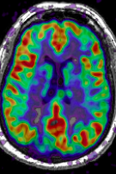
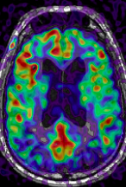
3D PASL vs 2D PASL – diagnostic efficacy ADNI 3 vs 2
Group separation relative to normals at baseline - effect size (Cohen's d)
 | 3D PASL |  |  | 2D PASL
 | SMC | EMCI | LMCI | SMC | EMCI | LMCI | AD
Left inferior parietal | - | -0.62 | - | - | - | - | -0.36
Right inferior parietal | - | - | - | - | - | - | -0.62
Left precuneus | - | -0.64 | -0.68 | - | - | - | -
Left hippocampus | - | -0.50 |  | - | - | - | -0.47
Left inferior temporal | - | - | - | - | - | - | -0.44
Right inferior temporal | 0.62 | - | - | - | - | - | -0.33
3D PCASL
Normal, F 58.9
Normal, M 78.4
Notes:
Determine relative diagnostic value (at this point, group-wise discrimination is probably all that’s possible if that) of advanced vs basic diffusion MR; advanced vs basic fMRI; 2D ASL vs 3D ASL.

Slide 10
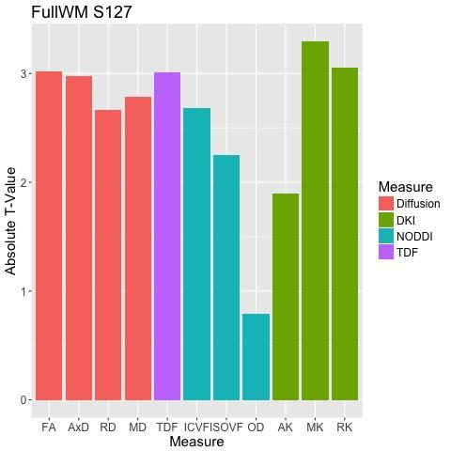
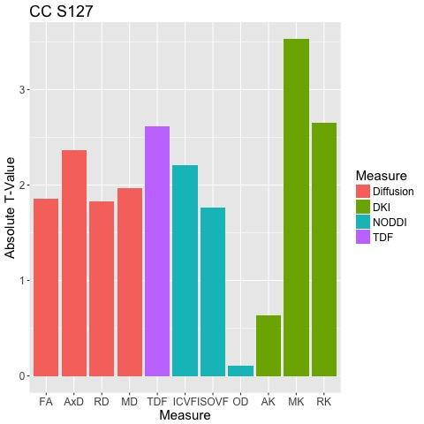
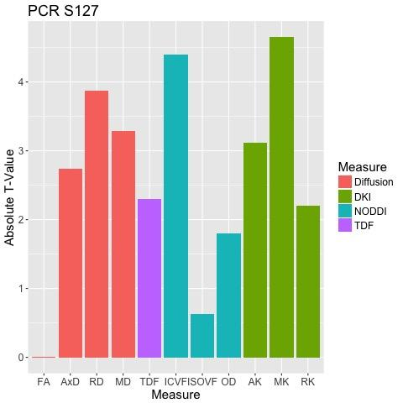
ADNI3: Initial Multishell dMRI Analysis- P Thompson
DKI and NODDI vs. DTI/TDF Associations with Age in Controls (N=14)
* P<0.05
+ Positive Association
- Negative Association
More complex/newer measures better performance
Full WM
CC
PCR
*
*
*
*
*
*
*
*
*
*
*
*
*
*
*
*
*
*
-
+
+
+
+
-
+
+
-
-
-
-
+
+
+
+
-
+
+
-
-
-
-
+
+
+
+
-
+
-
-
-
-
These are preliminary findings in N=14, and will be extended as more scans are acquired
DTI: 61 volumes (b=0+1000) NODDI, DKI: 127 volumes (b=0,500,1000,2000)

Slide 11
Conclusions
ADNI MR data more heterogeneous with time
Assessing effects of specific vendor, scanner model, and sequence changes over time a work in progress
Likely that some types of change will result in longitudinal inconsistencies – will vary by sequence and processing method
Future work
Identifying which changes do and which don’t matter
Make this information available to ADNI users
Identify possible fixes
Diagnostic improvements in ADNI 3 vs ADNI 2

