Slide 1

EUROPEAN ADNI/PharmaCOG
Selection of AD-related biomarkers for compound
measure computation
AD-related biomarkers considered
Biomarkers sensitive to cognitive decline
Biomarkers of prodromal AD (R²<.833,
time x csf status interaction, p<.05)
Abbreviations:
DMN= Default Mode Network; ILF/SLF=Inferior/Superior Lateral Fasciculi; LPC/RPC= Left/Right Parietal Cortex;
MFC= Medial Frontal Cortex;
PCC= Posterior Cingulate Cortex;

Slide 2
Best individual biomarker VS
Best compound measure
Sample size required to detect 30% slowing of atrophy
x1.3
α= 0,05
Power= 0,80
339
Right Lateral Ventricle
x1.7
259
Best Compound Measure
x1.6
Vol. of L lateral ventricle
Vol. of R lateral ventricle
Vol. of L hippocampal tail
Vol. of R hippocampal molecular layer
146
107
88
68

Slide 3
Journal of Alzheimer’s Disease
E-ADNI (PHARMACOG WP5) Special issue
 | Variables of Interest | Preliminary Titles | 1st author *equally contributing authors | Last author
1 | Structural markers (3T MRI: T1, DTI, FLAIR) | Predicting and monitoring short term disease progression in aMCI patients with prodromal AD: structural brain biomarkers | Marizzoni M | Frisoni GB
2 | Functional markers (3T MRI: rsfMRI; EEG: rsEEG, auditory oddball ERP) | Predicting and monitoring short term disease progression in aMCI patients with prodromal AD: functional brain biomarkers | Jovicich J*, Babiloni C* | Frisoni GB
3 | Peripheral markers (blood biomarkers: Abeta and innate immunity-related molecules) | Predicting and monitoring short term disease progression in aMCI patients with prodromal AD: blood biomarkers | Albani D | Frisoni GB
4 | CSF, 3T MRI, EEG/ERP, peripheral biomarkers | Biomarker matrices to diagnose and track short term disease progression in aMCI patients with prodromal AD | Marizzoni M | Frisoni GB
Deadline: July 2017

Slide 4
Dissemination
Journal | Title | Status | Author
Neurobiology of Aging | Relationship between cognitive function, hippocampal volume and CSF biomarkers Association between CSF biomarkers, hippocampal volume and cognitive function in patients with amnestic mild cognitive impairment (MCI). | Published May 2017 | Nathan et al.
Human Brain Mapping | Reproducibility of multicentre DTI Free water elimination improves test-retest reproducibility of diffusion tensor imaging indices in the brain: A longitudinal multisite study of healthy elderly subjects. | Published Jan 2017 | Albi et al.
Human Brain Mapping | Reproducibility of multicentre rs-fMRI Test-retest reliability of the default mode network in a multi-centric fMRI study of healthy elderly: Effects of data-driven physiological noise correction techniques. | Published Jun 2016 | Marchitelli et al.
J Intern Med. | Description of clinical, npsy, and biomarker features at baseline Clinical and biomarker profiling of prodromal Alzheimer's disease in workpackage 5 of the Innovative Medicines Initiative PharmaCog project: a 'European ADNI study'. | Published Jun 2016 | Galluzzi et al.
NeuroImage | Reproducibility of multicentre rs-fMRI Longitudinal reproducibility of default-mode network connectivity in healthy elderly participants: a multicentric resting-state fMRI study | Published Jan 2016 | Jovicich et al.
Notes:
4

Slide 5
Dissemination
Journal | Title | Status | Author
Human Brain Mapping | Reproducibility of multicentre automated hippo subfields segmentation Longitudinal reproducibility of automatically segmented hippocampal subfields: a multi-site European 3T study on healthy elderly | Published Sep 2015 | Marizzoni et al.
Neurobiology of Aging | Structural markers of progression in murine models Striatum and entorhinal cortex common neuropathological targets in Alzheimer's disease mouse models | Published Feb 2015 | Micotti et al.
NeuroImage | Reproducibility of multicentre DTI Multisite Longitudinal Reliability of Tract-Based Spatial Statistics in Diffusion Tensor Imaging of Healthy Elderly Subjects | Published Nov 2014 | Jovicich et al.
NeuroImage | Reproducibility of multicentre structural MRI Brain morphometry reproducibility in multi-center 3T MRI studies: A comparison of cross-sectional and longitudinal segmentations | Published Dec 2013 | Jovicich et al.
Drug Discovery Today: Therapeutic Strategies | PharmaCog concept of parallel clinical-preclinical validation of markers of progression A new paradigm for testing AD drugs – neuroimaging biomarkers as surrogate outcomes homologous in animals and humans | Published Oct 2014 | Marizzoni et al.
Journal of Alzheimer’s Disease | Review of disease tracking markers for AD Disease tracking markers for Alzheimer's disease at the prodromal (MCI) stage | Published Aug 2011 | Drago et al.
Notes:
5

Slide 6
EUROPEAN ADNI: EPAD
Aim: to create a platform for faster and better assessment of drugs for the prevention of Alzheimer’s disease (AD), in people with very early or no symptoms at all
3 Major components of EPAD
Cohorts/Registry (PCs)
Longitudinal
Cohort Study
Proof of Concept (PoC) Study
EPAD
Registry
N=24,000
EPAD
LCS
N=6,000
EPAD
PoC
N=1,500
Adaptative
trial
Active cohorts with non-demented participants >50 years
Willingness to have participants enrolled in EPAD LCS and PoC

Slide 7
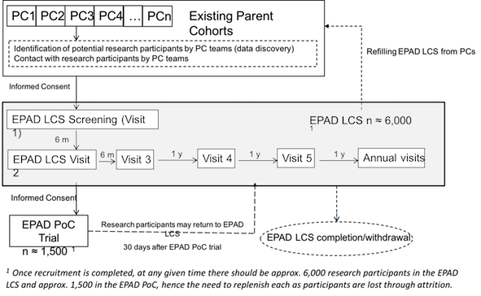
European Prevention of Alzheimer’s Dementia Longitudinal Cohort Study (LCS)
Prospective Multicentre pan European Longitudinal Cohort Study (LCS)
From EPAD registry to EPAD LCS

Slide 8
European Prevention of Alzheimer’s Dementia Longitudinal Cohort Study (LCS)
Biosampling
Clinical
a) Blood Sample
b) Saliva Sample
c) Urine Sample
d) Cerebrospinal Fluid Sample
a) Physical examination
b) Medical History
c) ENE Cognitive Battery: RBANS, Dot Counting (NIH Examiner), Flanker (NIH Examiner/Toolbox), Nameface pairs, Four Montains Task, Virtual Reality Supermarket Trolley
d) Geriatric Depression Scale
e) State Trait Anxiety Inventory
f) Pittsburgh Sleep Quality Index
g) Amsterdam Instrumental Activities of Daily Living Questionnaire
h) Clinical dementia Rating Scale
j) Mini-Mental Health Status Examination
Neuroimaging
a) structural MRI
b) fMRI
Lifestyle
a) Socio-demographics
b) Family History of Alzheimer's Dementia
c) Lifestyle factors
Flexible algorithm → deliver accurate disease models to estimate an individual’s overall probability of developing AD

Slide 9
European Prevention of Alzheimer’s Dementia Longitudinal Cohort Study (LCS)
July 2016
May 2017
December 2019
1st wave: Edinburgh, Toulouse, Amsterdam, Barcelona
Sponsor: University of Edinburgh
FPI: end of summer 2016
So far, around 100 patients (10-12 participants per month) have been recruited
N=200 TDC
N=700 Swit/Italy
N=6000 Europe
2nd wave:
Brescia, Paris, Oxford, Lille, Cologne are about to start recruiting

Slide 10
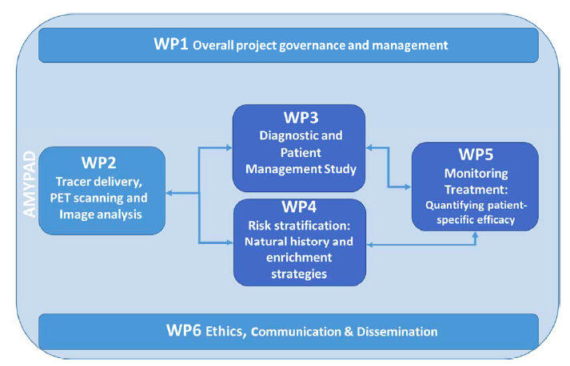
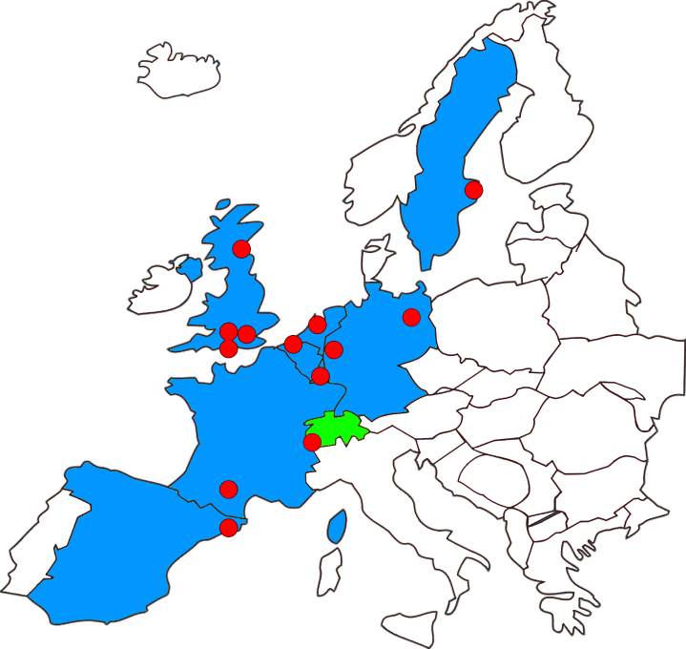
EUROPEAN ADNI: AMYPAD
Determine clinical utility of Amyloid PET
Diagnostic value – patient management
Risk stratification – EPAD long cohort (LCS)
Monitoring treatment – clinical trials
AMYPAD Consortium
8 academic centers, 3 pharma companies, 2 SMEs and 1 patient organization spread across Europe

Slide 11
WP3: Diagnostic Study Study Diagram
First consultation
History, Neuropsycological assessment locally adopted
Intended dx work up
MRI scan or CT if not already available
T0 - V0 (Screening ) and Baseline
Screening: Informed Consent, Diagnosis (syndromic), inclusion/exclusion criteria
Baseline: Cognition, Anxiety, Depression, Coping skills, Quality of life, Dx confidence, Likelihood that symptoms are due to AD pathology
ARM 1
ARM 2
ARM 3
Stratification in SCD Plus (N=300), MCI (N=300) , Dementia where AD is differential diagnosis (N=300)
Randomisation
Additional exams
Dx disclosure
Only Amyloid PET
Any test, no Amyloid PET
Any test
Amy PET if chosen
Etiologic diagnosis & Management Plan
Extension of dx work up
Optional: FDG PET, CSF, DaTscan, EEG, others.....
DIAGNOSTIC STUDY
CLINICAL ROUTINE
T1 (12 weeks from baseline) : data inclusion in eCRF
Etiologic diagnosis & Management Plan
ARM 3 : Amyloid PET if chosen
T2 –V1 (6 months from baseline): data inclusion in eCRF
Cognition, Anxiety, Depression, Coping skills, Quality of life, Dx confidence, Likelihood that symptoms are due to AD pathology
ARM 2: Amyloid PET
8 Months + - 8 weeks
Refinement of Dx
Refinement of etiologic diagnosis & management plan
T3 –V2 (13 months from baseline): data inclusion in eCRF
Cognition, Anxiety, Depression, Coping skills, Quality of life, Dx confidence, Likelihood that symptoms are due to AD pathology
the difference between early (Arm 1) versus late (Arm 2) utilisation of amyloid PET imaging in the proportion of patients who at 12 weeks (T1) have an etiological diagnosis and confidence ≥ 90%.
Notes:
Primary Objectives: the difference between early (Arm 1) versus late (Arm 2) utilisation of amyloid PET imaging in the proportion of patients who at 12 weeks (T1) have an etiological diagnosis and confidence ≥ 90%.

Slide 12
WP3: Diagnostic Study
Timeline to FPI
Approved Draft of the Protocol
Informed Consent
April 2017
Generation of core clinical document
May-June 2017
Generation of Country specific documents for EC/RA submission in 8 different centres
Germany
(Cologne)
Netherlands
(Amsterdam)
France
(Toulouse)
Spain
(Barcelona)
UK
(London, Edinburgh)
Sweden
(Stockholm)
Switzerland
(Geneva
SPONSOR)
FPI
Estimated October 2017

Slide 13
WP4: Prognostic and Natural History Study
Study Diagram

Slide 14
WP4: Prognostic Study
Timeline to FPI
Approved Draft of the Protocol
May 2017
Generation of core clinical document
May-June 2017
Generation of Country specific documents for EC/RA submission in 8 different centres
Germany
(Cologne)
Netherlands
(Amsterdam)
France
(Toulouse)
Spain
(Barcelona)
Sweden
(Stockholm)
Switzerland
(Geneva)
UK
(Edinburgh:
SPONSOR)
UK
(London)
FPI
Estimated October 2017

