Slide 1





Canadian ADNI’s
Sandra E. Black, O.C, O.Ont., MD, FRCP(C), FRSC, FAAN, FANA
Brill Professor of Neurology, Department of Medicine
Sunnybrook Health Sciences Centre, U of Toronto
Executive Director, Toronto Dementia Research Alliance
University of Toronto
Update on the amyloid imaging project in periventricular white matter disease on behalf of the
Medical Imaging Network of Canada MITNEC-C6 project group
WWADNI Telecon Nov13/15

Slide 2
Disclosure of Potential
Conflict of Interest
Clinical Trial Contract Research:
Pfizer, Novartis, Roche, Lundbeck, Lilly-Avid, GE Healthcare,
Ad hoc Consultant: GE Healthcare,
Lilly-Avid, Novartis
No stock or equity interests

Slide 3
Medical Imaging Trials NEtwork of Canada (MITNEC) CIHR-funded network
A national medical imaging clinical trials network established to provide a clinical platform for imaging research in Canada to move innovations in imaging to facilitate the uptake of research outcomes into clinical practice and improved patient care.
Theme A – Imaging Trials in Oncology
Theme B – Imaging Trials in Cardiology
Theme C – Imaging Trials in Neurology
http://www.mitnec.org/

Slide 4
Rationale
Small vessel disease often coexists with Alzheimer’s disease (AD) and contributes to cognitive decline and progression to dementia.
Elders with extensive periventricular White matter Hyperintensities (pvWMH) may represent an at-risk group for amyloid deposition and could help us better understand the additive/interactive relationships of these common pathologies and could be a target for intervention
Progression to dementia could be averted in at-risk groups through aggressive vascular risk factor management and potentially anti-amyloid agents

Slide 5
Aims
To determine in patients with significant WMH, stratified by apoliprotein E e4 status:
  The baseline prevalence and degree of uptake of amyloid on PET in relation to baseline clinical and multimodal brain imaging measures
  if baseline white matter disease volume predicts increased amyloid uptake at 2 years
To evaluate changes, if any, in amyloid uptake in correlation with the changes in clinical and structural and functional brain measures over 2 years

Slide 6
Research Design
150 patients (75 from stroke prevention clinics, 75 from memory clinics)
250 NC , 400 MCI, and 150 AD from ADNI-GO and ADNI-2 studies will serve as control groups
Study Procedures at baseline and one year
    3T-MRI (3DT1/PD/T2/FLAIR/GrEcho/DTI/rsFMRI/(ASL)
    FDG-PET, Florbetapir PET
    Brief neuropsychological Testing
    Blood sampling at baseline for APOE e4, other genomics and metabolomics

Slide 7
Inclusion Criteria
Age ≥ 60 years
WMD score on CT or MRI of 3 on the Fazekas scale, but no cortical infarcts or subcortical >1cm
Memory clinic patients will meet criteria for amnestic or multi-domain MCI and mild early AD (MMSE ≥ 20) using the same criteria as in the ADNI project
TIA patients from stroke prevention clinics may have MMSE scores between 20 – 30

Slide 8
Neuropsychology Protocol
Mini Mental Status Exam (MMSE)
Montreal Cognitive Assessment (MoCA)
Phonemic and Semantic Fluency
Trails A & B
Symbol Digit Modalities Test
The Centre for Epidemiologic Studies Depression scale (CES-D)
  ANART (American National Adult Reading Test)
  TUG (Timed up and Go)
  FAQ (Functional Assessment Questionnaire)

Slide 9
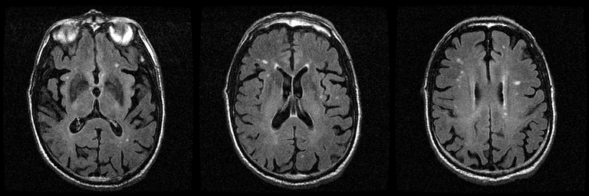
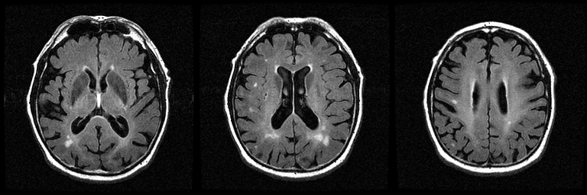
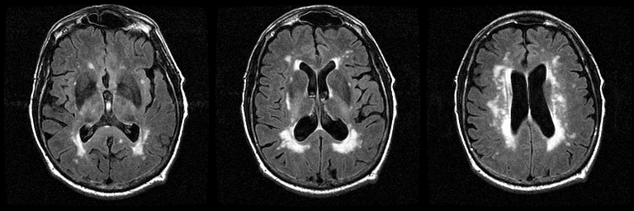
Example of Fazekas Scores
Fazekas 1
Fazekas 2
Fazekas 3

Slide 10
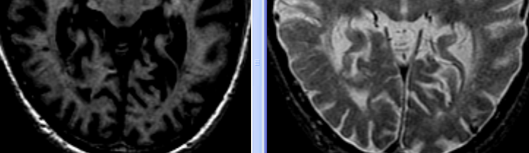
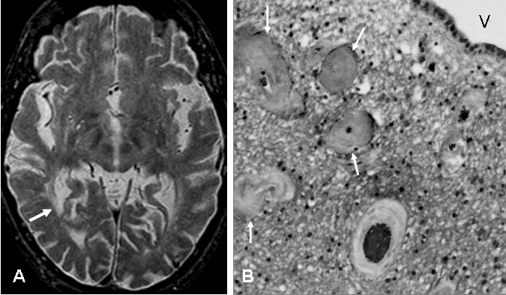
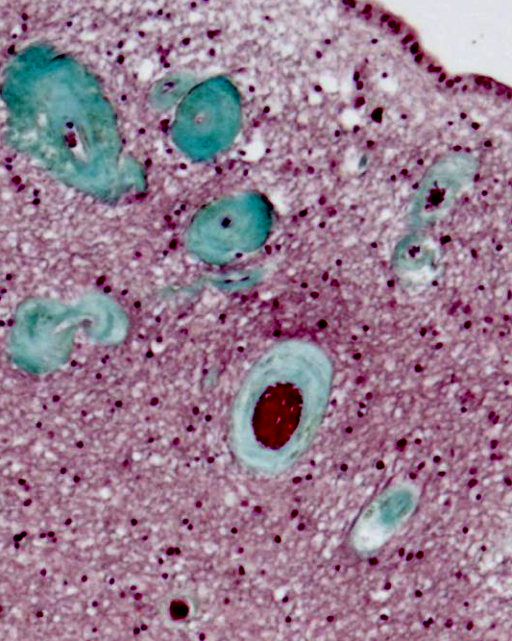
Periventricular White
Matter Hyperintensities:
A Venous Insufficiency
Syndrome?
V
Stenosis of large
and medium venules
are the pathological
correlate of PvWMH
A
B
Courtesy of FQ Gao

Slide 11
Subjects and procedures
  Study protocol
    3T-MRI (structural, DTI, TF-MRI), FDG-PET, 18 florbetapir PET, Neuropsychological Testing, Blood Sampling (Apoe E e4) at baseline and at 24 months
    Analysis pipelines designed to derive total supratentorial intracranial volume, tissue segmentation including grey, white, lesion subtypes (lacunar, deep and periventricular hyperintensities), with adapted free surfer application

Slide 12
Research Team – Recruitment Sites
Alberta
University of Alberta – Edmonton
Brian Buck
Richard Camicioli
University of Calgary
Eric Smith
British Columbia
University of British Columbia
Robin Hsiung
Nova Scotia
Dalhousie University
Steven Burrell
Sultan Darvesh
Ontario
McMaster University
Demetrios Sahlas
University of Ottawa
Dar Dowlatshahi
University of Toronto
Sandra Black
Sunnybrook HSC
Leanne Casaboun Toronto Western
University of Western Ontario
Michael Borrie
Jennifer Mandzia
Quebec
CHUQ
Robert Laforce
CHUS
Christian Bocti
McGill University
Howard Chertkow
Alex Thiel
  Exec Com
  Sandra Black
  Richard Frayne
  Frank Prato
  Eric Smith
  Stephen Strother
  John Valliant
  Jean-Claude Tardiff

Slide 13
MITNEC C6 Progress
Two thirds of sites initiated
All initiated sites are actively recruiting
83% of sites have fully executed contracts
Aim to recruit 100 by March 2016
Two Health Canada approved sites producing the Florbetapir ligand – Isologic in Lachine Quebec, St Joseph’s In Western University in

Slide 14
Ontario Brain Institute:
Ontario Neurodegenerative Research Initiative
PRIMARY OBJECTIVE
To develop a pan-Ontario research consortium that will integrate a wide range of experimental, clinical, imaging and epidemiological expertise to investigate neurodegenerative and vascular cognitive impairment in the aging population
SECONDARY OBJECTIVE
Degenerative cognitive impairment can be caused by a heterogeneous group of disorders that can be explained, characterized and predicted using an integrated multimodality approach
To understand the contribution of small vessel disease changes to disease presentation/cognition in aging and neurodegenerative diseases.
Courtesy Mike Strong

Slide 15
ONDRI Study Design
Scientific director: Michael Strong
3-year observational cohort study
12-18 month enrolment, followed by 2- 3 years of follow-up
Six hundred (600) subjects: AD/MCI (150), ALS (90), FTD (60) PD (150), and VCI (150)
Enrolled from 12 centres throughout Ontario
All patients undergo rigorous evaluations at baseline, including neuropsychological assessment, gait and ocular assessments, genomics and neuroimaging
These will be repeated on an annual basis, with telephone follow-up every 6 months

Slide 16
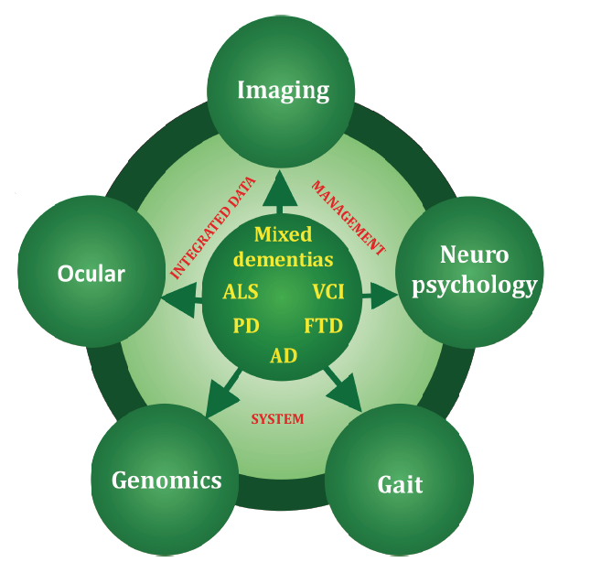
ONDRI Assessment Platforms

Slide 17
Canadian Consortium for Neurodegeneration in Aging
Scientific Director: Howard Chertkow
CROSS-CUTTING
PROGRAMS
Theme 1:
PREVENTION
1. Genetics of NDD
2. Inflammation & Growth Factors
3. Protein Misfolding
4. Synapses & Metabolomics
5. Lipids & Lipid Metabolism
6. Nutrition, Lifestyle, &
Prevention of AD
Theme 2:
TREATMENT
7. Vascular Aspects of NDD
8. Lewy Body Dementia
9. Biomarkers
10. Cognitive Intervention and
Brain Plasticity
11.Prevention and Treatment of Neuropsychiatric Symptoms
12. Mobility, Exercise, and Cognition
13. Frontotemporal Dementia
1600 patients over 3 years
Theme 3:
QUALITY OF LIFE
14. How Multi-Morbidity
Modifies the Risk of Dementia
and the Patterns of Disease
Expression
15. Gerontechnology & Dementia
16. Driving & Dementia
17. Interventions at the Sensory
and Cognitive Interface
18. Effectiveness of Caregiver
Intervention
19. Integrating Dementia Patient
Care into the Health Care System
20. Issues in dementia care for
rural and indigenous populations
TRAINING &
CAPACITY
BUILDING
KNOWLEDGE
TRANSFER
ELSI
WOMEN
& DEMENTIA
Eight Platforms to Support the Teams
1. Clinical Cohorts
2. The Normative Comparison Group
3. Imaging/Database/Information Technology
4. Blood, Saliva & CSF Biosamples
5. DNA Sequencing
6. Brain Banking
7. Transgenic Colonies
8. Academic Clinical Trials
Courtesy Howard Chertkow

