Slide 1
European Prevention of Alzheimer’s Dementia (EPAD) Goal
The European Prevention of Alzheimer's Dementia (EPAD) project aims to develop an infrastructure that efficiently enables the undertaking of adaptive, multi-arm Proof of Concept studies for early and accurate decisions on the ongoing development of drug candidates or drug combinations for the prevention of AD dementia.

Slide 2



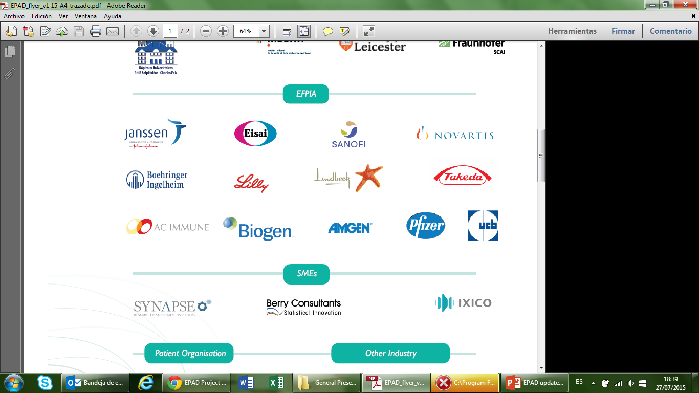
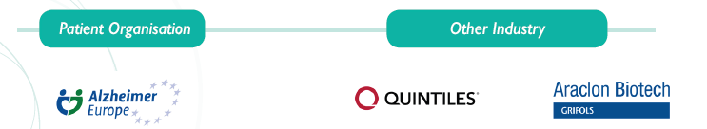

EPAD Consortium
Co-ordination: Serge Van Der Geyten
Co-coordination: Craig Richie
Slides from Craig Ritchie
Notes:
Talking points:
EPAD is a community of 35 diverse partners, including patient organizations, academic institutes, Biotech and other SMEs, CROs and pharmaceutical companies. All are essential to make EPAD a success.

Slide 3
EPAD funnel

Slide 4
Selection of Research Participants
Access data in Parent Cohorts
Run Participant Discovery Software (EMIF)
Generate list to Parent Cohort Owner who invite potential participants to attend local EPAD TDC.
Parent Cohort Engagement ongoing

Slide 5
Finding and filtering for EPAD LCS
EPAD LCS is the gateway into the EPAD Project for the Research Participants
We need to make sure that the LCS population is fit for purpose
We do this by looking for data that defines the most suitable people from the parent cohorts for EPAD

Slide 6
The EPAD Longitudinal Cohort Study
Loss to Follow Up
Enter Other Clinical Trial
Enter EPAD Trial
?
Maintained at N=6,000
Data
Data
Data
EPAD Cohort Baseline
Clinical
Biomarker
Imaging
1st Follow Up
2nd Follow Up
Replenishment from Virtual EPAD Register
6

Slide 7
The EPAD LCS Protocol
Annual assessments
6/12 Cognition Assessment
EPAD Neuropsychological Evaluation (ENE)*
Neuroimaging*
100% will give CSF Sample for Aβ/Tau (Gothenburg)
Blood, urine and saliva for genomics (blood) and storage for exploratory biomarkers (Edinburgh)
Safety labs done locally at the TDCs
Clinical and other risk factors

Slide 8
EPAD Neuropsychological Examination (ENE)
Cognition (in order of administration)
RBANS (Primary)
Verbal Episodic Memory: List Learning & Story Memory
Visual Episodic Memory: Figure Recall
Visuospatial/Constructional: Figure Copy & Line Orientation
Language: Picture Naming
Attention/Executive Functioning: Semantic Fluency, Digit Span, Coding
Four Mountains Task - (allocentric space; Exploratory) Dot counting - (working memory; Secondary) Flanker - (choice reaction time and set-shifting; Secondary) Name/Face pairs - (paired associate learning; Secondary) Supermarket Trolley Virtual Reality - (egocentric space; Exploratory)

Slide 9
EPAD Neuroimaging Battery (ENB)
Neuroimaging outcomes
Structural MRI
Cortical thickness, deep GM volumes
Fractional anisotropy (FA) of temporal lobe, diffusion kurtosis (multi b-value DTI), network alterations
Functional MRI
Global & parietal CBF
Changes within the default-mode network (DMN) & relation with hippocampal activity (rsfMRI)
Bolus arrival time (multi-delay ASL)
Network analysis (rsfMRI)
PET Amyloid Imaging
To be confirmed in IMI2

Slide 10
Conclusions
April 1st expect First Research Participant to be Recruited into EPAD LCS.
Success of project predicated on close academic collaboration with Parent Cohorts across Europe and engagement with public on the vision of EPAD.
Forming a key part of the developing global network of aligning projects:
GAP, CPAD, JPAD and APAD

