Slide 1
PharmaCog WP5 / E-ADNI

Slide 2
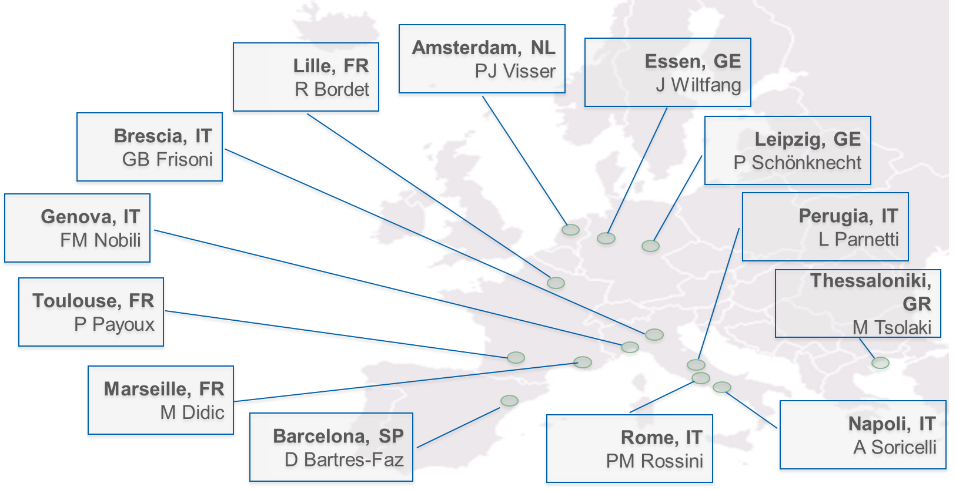
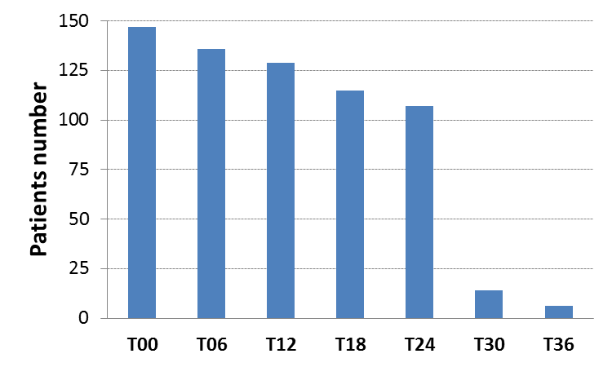
PharmaCog WP5 / E-ADNI
Clinical sites
Enrollment and follow-ups
PATIENTS EXPECTED
Maximum
Minimum

Slide 3
Peer-reviewed Publications
Journal | Title | Status | Author
Journal of Internal Medicine | Clinical and biomarker profiling of prodromal Alzheimer’s disease in IMI Pharmacog’s WP5: a “European ADNI study” | Submitted | Galluzzi et al.
Human Brain Mapping | Test-Retest Reliability of the Default Mode Network in a Multicentric fMRI Elderly Study: Effects of Data-Driven Physiological Noise Correction Techniques | Submitted | Marchitelli et al
Human Brain Mapping | Longitudinal reproducibility of automatically segmented hippocampal subfields: a multi-site European 3T study on healthy elderly | Published in Sept 2015 | Marizzoni et al.
NeuroImage | Longitudinal reproducibility of default-mode network connectivity in healthy elderly participants: a multicentric resting-state fMRI study | Published in July 2015 | Jovicich et al.
NeuroImage | Multisite Longitudinal Reliability of Tract-Based Spatial Statistics in Diffusion Tensor Imaging of Healthy Elderly Subjects | Published in Nov 2014 | Jovicich et al.
Drug Discovery Today: Therapeutic Strategies | A new paradigm for testing AD drugs – neuroimaging biomarkers as surrogate outcomes homologous in animals and humans | Published in Oct 2014 | Marizzoni et al.
NeuroImage | Brain morphometry reproducibility in multi-center 3T MRI studies: A comparison of cross-sectional and longitudinal segmentations | Published in Dec 2013 | Jovicich et al.
Journal of Alzheimer’s Disease | Disease tracking markers for Alzheimer's disease at the prodromal (MCI) stage | Published in Aug 2011 | Drago et al.

Slide 4
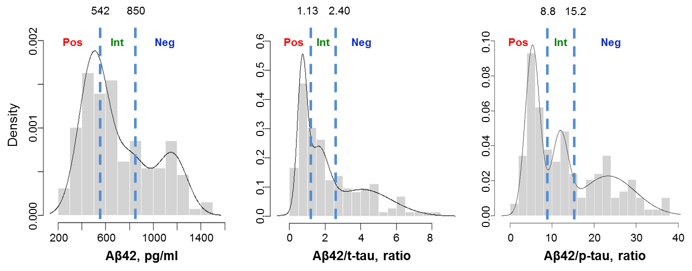
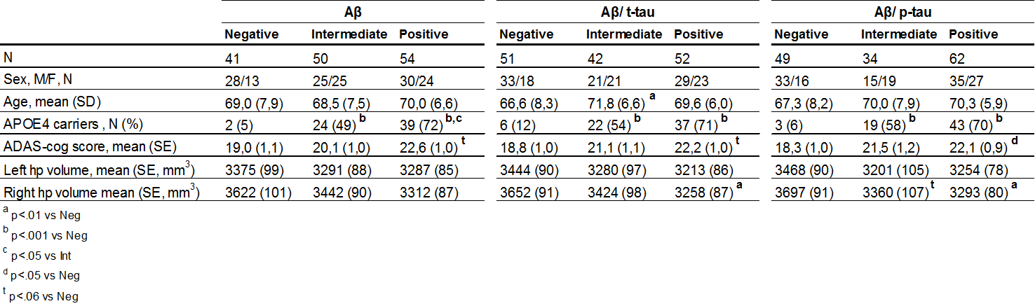
Baseline CSF Aβ, Aβ/t-tau and Aβ/p-tau distributions to classify PharmaCog MCI patients
Notes:
Histograms and corresponding overlaid density curves estimated by mixture models for Aβ, Aβ/t-tau and Aβ/p-tau. Dotted lines represent the cut-offs established by the mixture model analysis.

Slide 5
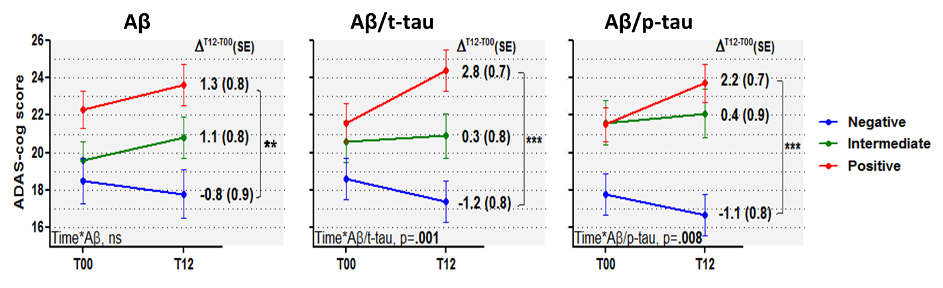
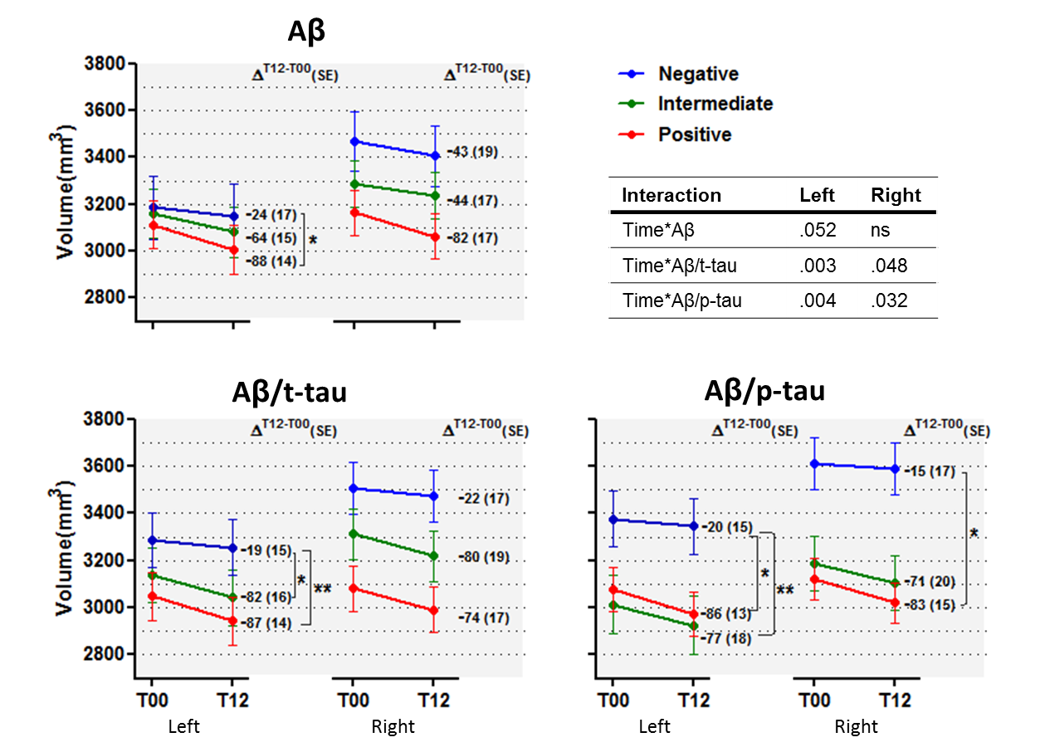
Cognitive and hippocampal volume changes
Notes:
Changes in global cognition in MCI patients classified as Negative, Intermediate or Positive concordantly with the mixture modelling cut-offs. The absolute difference at one year was also reported on the right of each line. Error bars indicate the standard error on the mean as estimated by the general linear model corrected for age and education. **p< .01, ***p<.001 at Bonferroni post hoc test.
Hippocampal volume changes in MCI patients classified as Negative, Intermediate or Positive concordantly with the mixture modelling cut-offs. The absolute difference at one year was also reported on the right of each line. Error bars indicate the standard error on the mean as estimated by the general linear model corrected for age and TIV. *p< .05, **p< .01 at Bonferroni post hoc test.

Slide 6
Peer-reviewed Publications
Series of papers in preparation
The IMI PharmaCog WP5/European ADNI study: status and progression of prodromal AD as revealed by a matrix of clinical, neuropsychological, and biological markers
Introduction
Cross-sectional papers
Longitudinal papers
22 papers divided into
Special issue of peer-reviewed journal

