Slide 1
Programming ‘JavaScript’ {
forbeginners.html
workshop.css
[Document Object Model]
< DOM represents the document as nodes and objects >
}
Programming Language

Slide 2
Table Of ‘Contents’ {
01
02
03
forbeginners.html
workshop.css
Theory Lesson
< Introduction to the DOM > < DOM Structure >
< DOM API > < Documnet Interface >
< Element Interface > < NodeList Interface >
< Event Handling with the DOM >
Features of the Topic
< Practical overview of the DOM with examples >
Practical Exercise
< Complete exercises in project >
}
Programming Language

Slide 3
Introduction {
forbeginners.html
workshop.css
‘The DOM is a programming interface for web documents that provides a structured representation of the document as a tree-like structure of nodes and objects.’
<p The DOM is used to manipulate HTML and XML documents with JavaScript to create dynamic and interactive web pages. >
The DOM allows developers to access and manipulate any part of a web document, including HTML elements, text, and attributes.
</p>
}
Programming Language

Slide 4
DOM Structure {
forbeginners.html
workshop.css
document
body
head
The DOM is structured as a tree-like structure of nodes, with each node representing an element, attribute, or piece of text in the document.
Obj..
Node
Obj..
Node
The top-level node in the tree is the document object, which represents the entire HTML or XML document.
The structure of the DOM can be navigated and manipulated using the various DOM API methods and properties.
}
Programming Language

Slide 5
DOM API {
< /1 >
< /2 >
forbeginners.html
workshop.css
< The DOM API is a set of methods and properties that can be used to manipulate the DOM structure and content. >
Some of the most common methods include: getElementById(), getElementsByTagName(), and appendChild().
These methods can be used to find specific elements or collections of elements, add or remove elements from the DOM, and modify the attributes and content of elements.
}
Programming Language

Slide 6
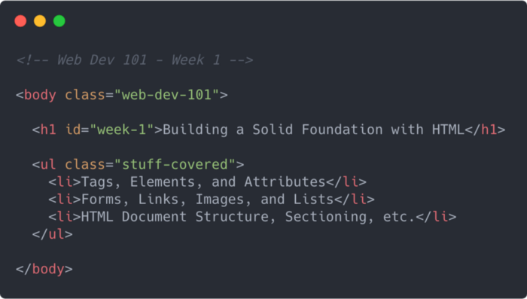
Document Interface {
forbeginners.html
workshop.css
< The document object represents the entire HTML or XML document and provides a wide range of methods and properties that can be used to manipulate it. >
< Some of the most common methods include createElement(), getElementById(), and getElementsByClassName(). >
< These methods can be used to create new elements, find existing elements by ID or class, and modify the attributes and content of elements. >
}
Programming Language

Slide 7
Element Interface < /1 > {
forbeginners.html
workshop.css
< The ‘Element’ interface represents individual HTML or XML elements and provides a wide range of methods and properties that can be used to manipulate them. >
< Some of the most common properties include innerHTML, textContent, and classList. >
< These properties can be used to get or set the content and attributes of elements, and to manipulate their CSS classes and styles. >
}
Programming Language

Slide 8
NodeList ‘Interface’ {
forbeginners.html
workshop.css
NodeList
< Interface represents collections of nodes, such as lists of elements returned by methods like getElementsByTagName() or querySelectorAll(). >
Methods
< Some of the most common methods include item(), forEach(), and length. >
< These methods can be used to iterate over collections of elements, access individual elements by index, and get the number of elements in a collection. >
}
Programming Language

Slide 9
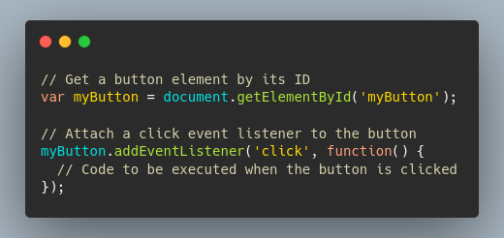
Event Handling with the ‘DOM’ {
forbeginners.html
workshop.css
Interactions
The DOM provides a wide range of methods and properties that can be used to handle user interactions with web pages, such as clicks, key presses, and mouse movements.
Listeners
The addEventListener() method can be used to attach event listeners to specific elements in the DOM, allowing developers to execute JavaScript code in response to user interactions.
}
Programming Language

Slide 10

lessonFinished() { return ‘Thank You!’
}

