Slide 1
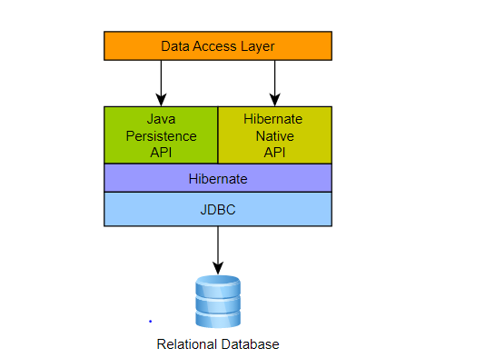
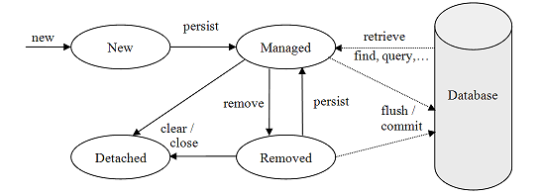

Slide 2
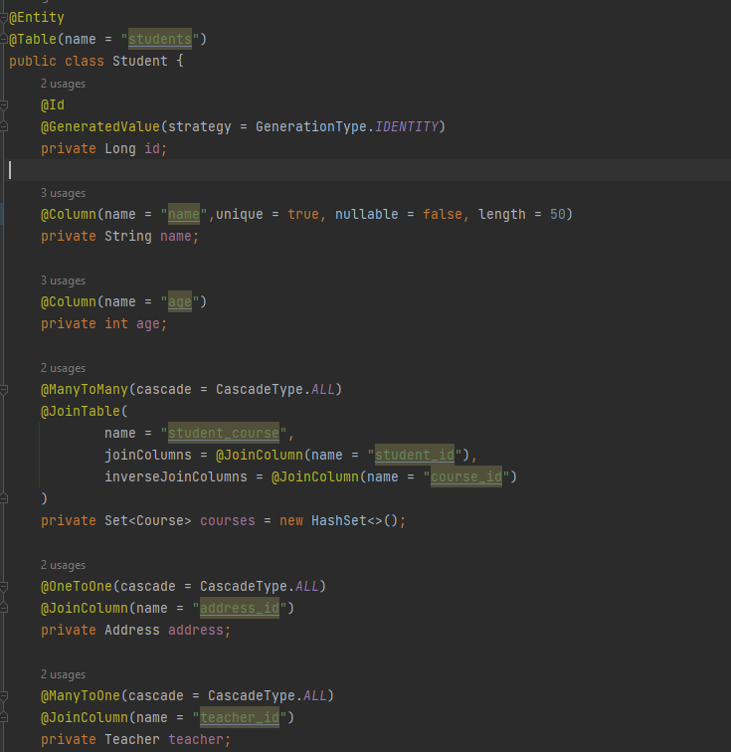

a

Slide 3
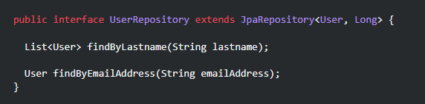
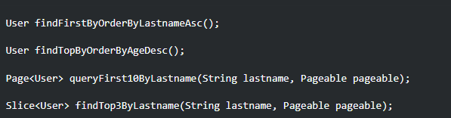
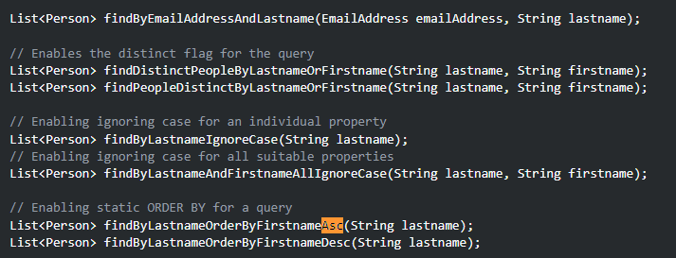
REPOSıtory
Pageable firstPageWithTwoElements = PageRequest.of(0, 2);
Sort.by("name")
PageRequest.of(0, 3, Sort.by("price").descending());
a

Slide 4
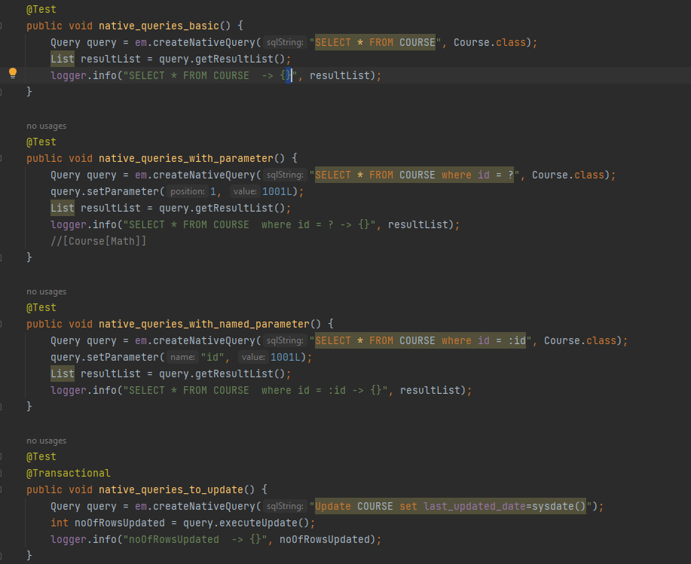

Natıve query
a

Slide 5
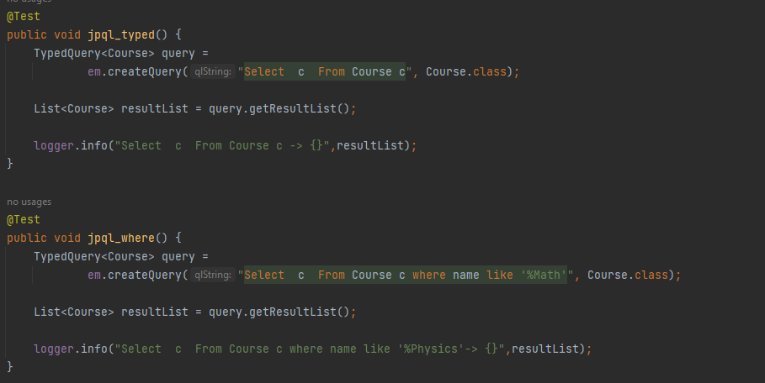
JPQL Query
a

Slide 6
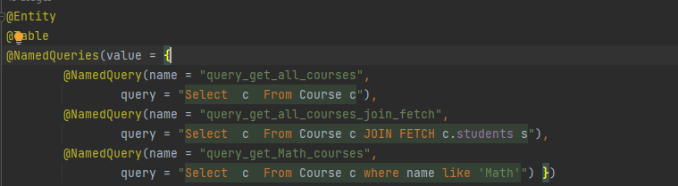

Named query
TypedQuery<Employee> query = entityManager.createNamedQuery("findEmployeesByLastName", Employee.class);
query.setParameter("lastName", lastName);
return query.getResultList();
a

Slide 7
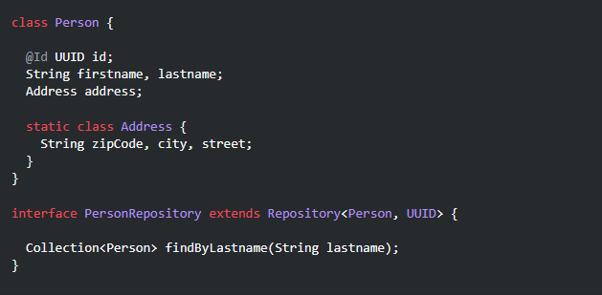
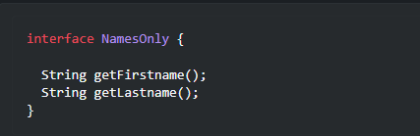
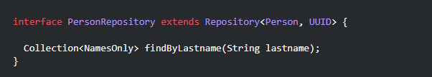
Projectıon
a

Slide 8
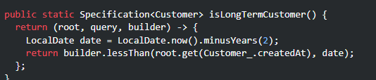
spesıfıcatıon

Slide 9
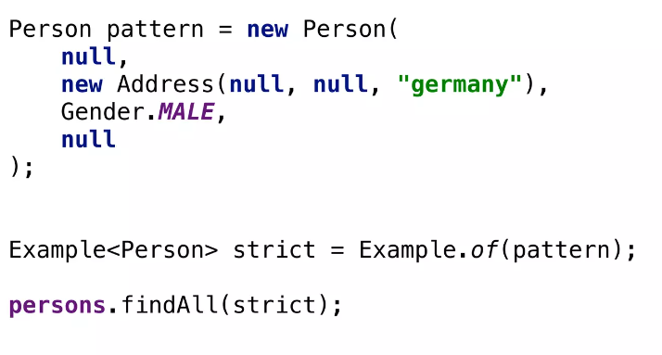
Query by example

Slide 10

Query dsl

