Slide 1
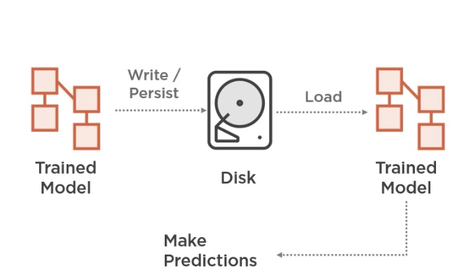

Slide 2
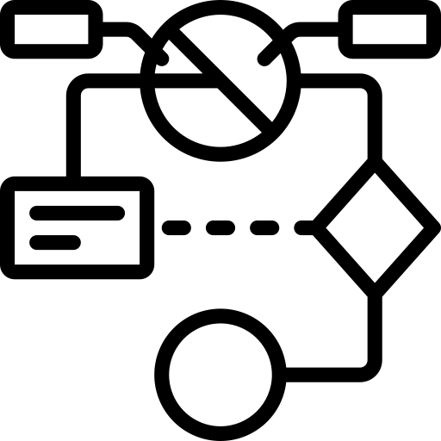


Write/
Persist
Load
Trained Model
Disk
Trained Model
Predictions

