Slide 1
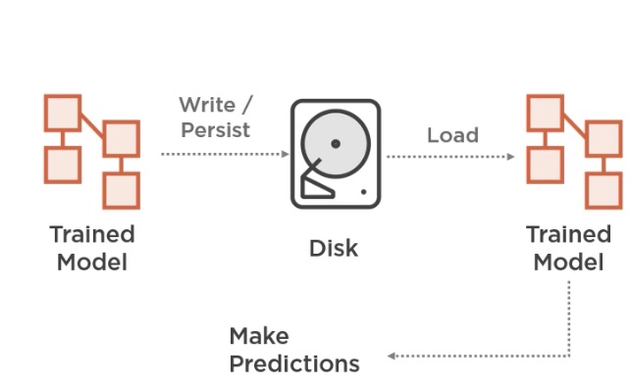

Slide 2
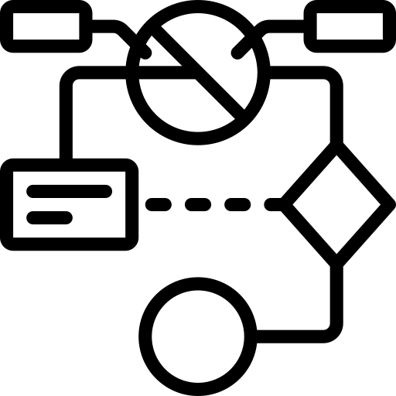


Write/
Persist
Load
Trained Model
Disk
Trained Model
Predictions

Slide 3
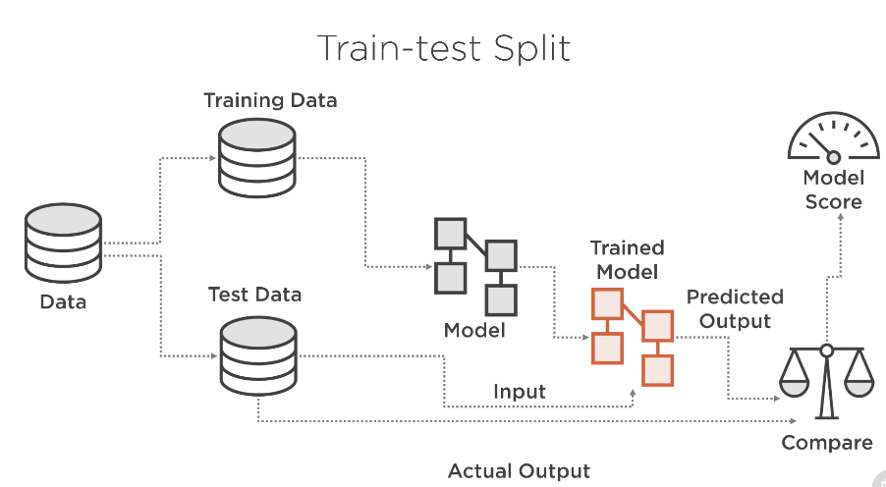

Slide 4





Model Persistence
Training Data
Trained Model
Model Performance
Data
Data Processing
Outlier Detection
Feature Engineering
Prediction
Testing Data
Analysis of Results

