Slide 1

SignalR
Emrah Okic
IB150132
Real-Time Communication

Slide 2
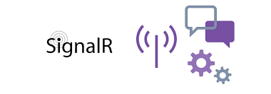

What is signalR?

Slide 3
TRANSPORT PROTOCOL
WebSockets
ServerSentEvents
LongPolling

Slide 4
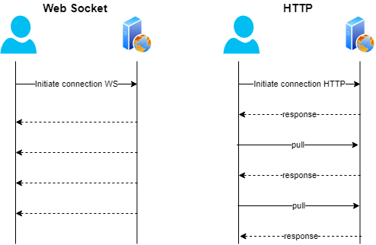

What are Websockets?

Slide 5
EASE OF IMPLEMENTATION
SERVER:
CLIENT:
Configuring SignalR
Configuring Endpoint
Creating SignalR hub class
Overriding function onConnect
Import SignalR Client

Slide 6
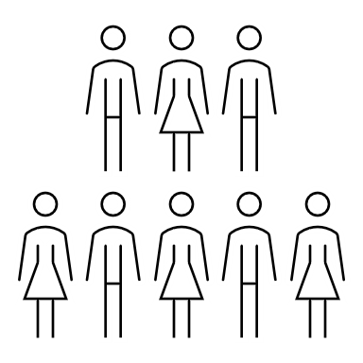
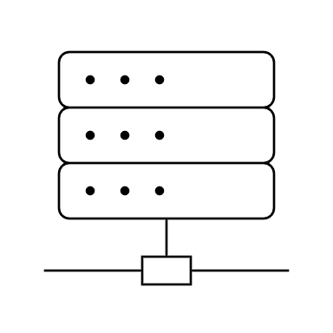


CLIENT TARGETING WITH SIGNALR
Group “A”
Group “B”
HUB
Person 3
Person 1
connection.invoke(“functionName")
Clients.Caller(“eventName", "Hi");
Person 2
connection.on(“eventName",function(){});

Slide 7
CLIENT TARGETINGWITH SIGNALR
Group “A”
Group “B”
HUB
Person 3
Person 1
Person 2
Clients.Client(person.ConnectionID).SendAsync("eventName","Hi");

Slide 8
CLIENT TARGETINGWITH SIGNALR
Group “A”
Group “B”
HUB
Person 3
Person 1
Person 2
Clients.Group.(“B”).SendAsync("eventName", "Hi");

Slide 9
CLIENT TARGETINGWITH SIGNALR
Group “A”
Group “B”
HUB
Person 3
Person 1
Person 2
Clients.Groups(new List<String> { "A", "B" }).SendAsync("eventName", "Hi");

Slide 10
CLIENT TARGETINGWITH SIGNALR
Group “A”
Group “B”
HUB
Person 3
Person 1
Clients.All.SendAsync("eventName", "Hi");
Person 2

Slide 11
CLIENT TARGETINGWITH SIGNALR
Group “A”
Group “B”
HUB
Person 3
Person 1
Clients.Others.SendAsync("eventName", "Hi");
Person 2

Slide 12

DeMO
https://github.com/emrahokic/SignalR_Demo

Slide 13
WHY SIGNALR?
Multi language support (Hub protocol specification)
Ease of implementation
Scalability

Slide 14


Slide 15
Thank You For Your Attention

