Slide 1
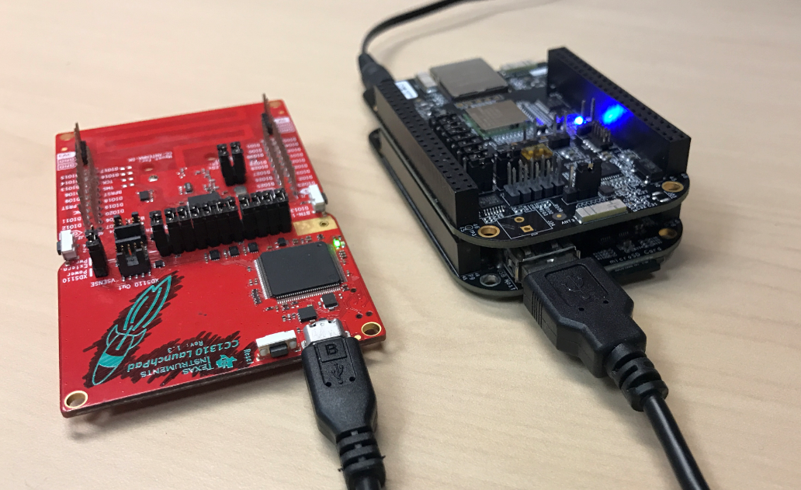
Power Supply
BBB Wi-Fi Cape
CC1310LP running MAC CoProcessor
BBB + Pre-programmed SD card
USB connecting LP and BBB

Slide 2
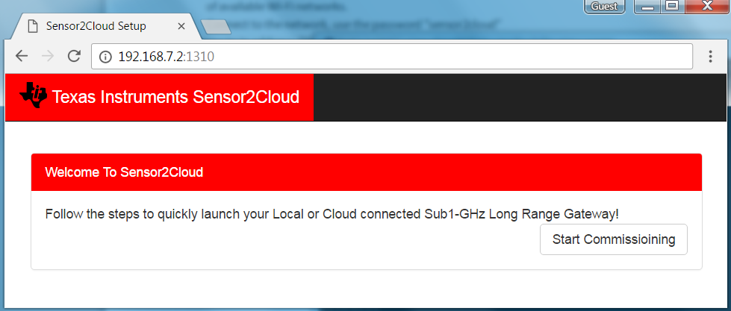

Slide 3
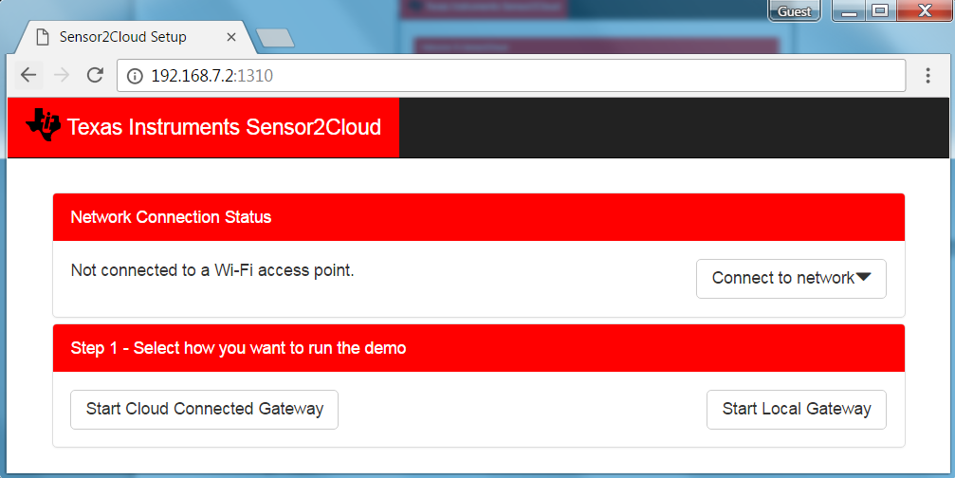
Select to run a cloud connected gateway
Select to run the gateway without internet connection or local gateway

Slide 4
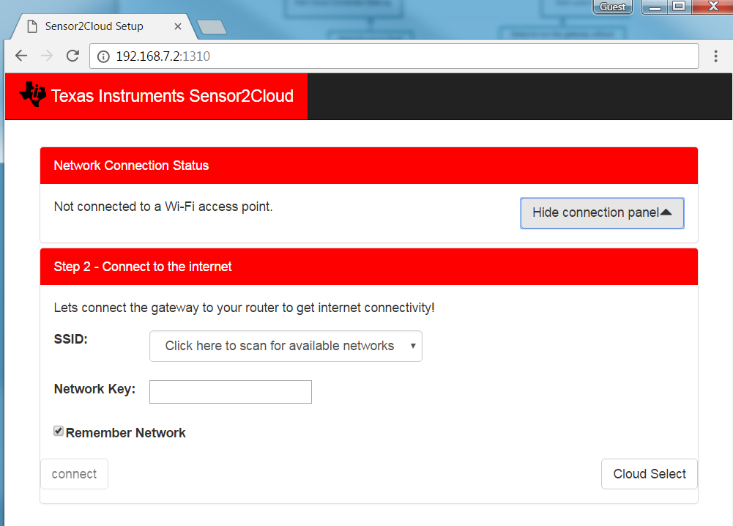
Click here wait for 10 seconds for list of available networks to show-up. Select the desired network and enter password

